Slide 1

Lecture 02 Creating Graphical User Interface Part 1
Java GUI and the swing package
References:
Textbook, chapter 10, 11
Java-Tutorials/tutorial-2015/uiswing/index.html

Slide 2
Why should we study this lecture?
Objectives
Do you want to create GUI applications (graphic user interface)?
How do GUI applications execute?
What do Java APIs support for developing GUI App?

Slide 3
Review
Knowledge used in this lecture:
Event: Some thing happens.
Event in applications: In almost cases, when IO devices complete a task, an event is thrown → When user presses a key or clicks mouse, events are thrown.
Event handler: Code executes when the appropriate event is thrown.
How does application know an event?
When an IO device completes a task, a signal (called as interrupt) from the device will be sent to CPU and operating system (OS) knows it. OS collects states of keyboard, mouse position, mouse keys,…, called as event object then OS passes the event object to the application.

Slide 4
Contents
Two Kinds of Applications
Java Model for Event Management
About Java Foundation Classes (JFC)
A Strategy for Designing the GUI
Using Ordinary Swing Components
A Demonstration

Slide 5
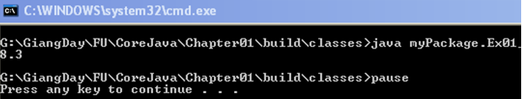
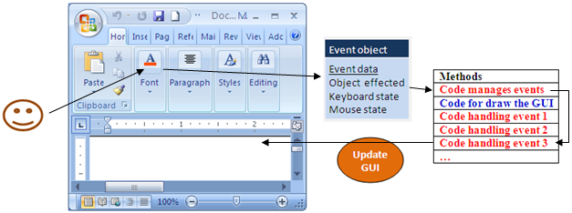
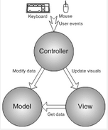
1- Two Kinds of Apps
Console App.
Compute-centric Apps
Event-based App.
User-centric Apps(GUI)
Model-View Controller Architecture for GUI component.
Model: Object contains data.
View: Object users can see it on the screen
Controller: Object manages events
[www.songho.ca]

Slide 6
2-Java model for event management
Application
Component C1
Specific Event Object E1
Component
Keyboard state
Mouse state
View
Model
-data
-Reference to listener object
(from OS)
Run time Environment (JVM)
Event Component Listener code
E1 C1 L1 1234
E2 C2 L2 5678
……..
Register Table
Delegates
Update
GUI
Controller
Listener L1
Event handler 1
Event handler 2

Slide 7


Some Common Events
Object | Event | Interface | Method (Event handler)
JButton | ActionEvent | ActionListener | actionPerformed()
JCheckBox | ActionEvent ItemEvent | ActionListener ItemListener | actionPerformed() itemStateChanged()
JRadioButton | ActionEvent ItemEvent | ActionListener ItemListener | actionPerformed() itemStateChanged()
JTextField JTextArea | ActionEvent FocusEvent | ActionListener FocusListener | actionPerformed() focusGained(), focusLost()
JPasswordField | ActionEvent | ActionListener | actionPerformed()
More Details about events will be introduced in the next session.

Slide 8
3- About Java Foundation Classes
This trail concentrates on the Swing components. We help you choose the appropriate components for your GUI, tell you how to use them, and give you the background
JFC encompass a group of features for building graphical user interfaces (GUIs) and adding rich graphics functionality and interactivity to Java applications. It is defined as containing the features shown in the table below:
Feature | Description
Swing GUI Components | Includes everything from buttons to split panes to tables. Many components are capable of sorting, printing, and drag and drop, to name a few of the supported features.
Pluggable Look-and-Feel Support | Allowing a choice of look and feel. For example, the same program can use either the Java or the Windows look and feel. Additionally, the Java platform supports the GTK+ look and feel, which makes hundreds of existing look and feels available to Swing programs. Many more look-and-feel packages are available from various sources.
Accessibility API | Enables assistive technologies, such as screen readers and Braille displays, to get information from the user interface.
Java 2D API | Enables developers to easily incorporate high-quality 2D graphics, text, and images in applications and applets. Java 2D includes extensive APIs for generating and sending high-quality output to printing devices.
Internationalization | Allows developers to build applications that can interact with users worldwide in their own languages and cultural conventions. With the input method framework developers can build applications that accept text in languages that use thousands of different characters, such as Japanese, Chinese, or Korean.

Slide 9
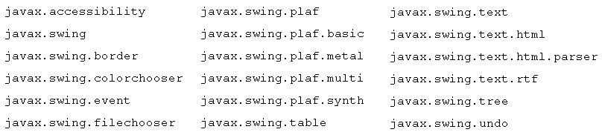
JFC…
This trail concentrates on the Swing components. We help you choose the appropriate components for your GUI, tell you how to use them, and give you the background
Which Swing Packages Should I Use?
The Swing API is powerful, flexible — and immense. The Swing API has 18 public packages:

Slide 10

4- A Strategy for Designing the GUI
Requirements
Input data
Implement event handlers
Output Data
Operations
Identify needed components.
Isolate regions and behaviors.
Sketch (phác hoạ) the GUI.
Choose Layout managers.

Slide 11
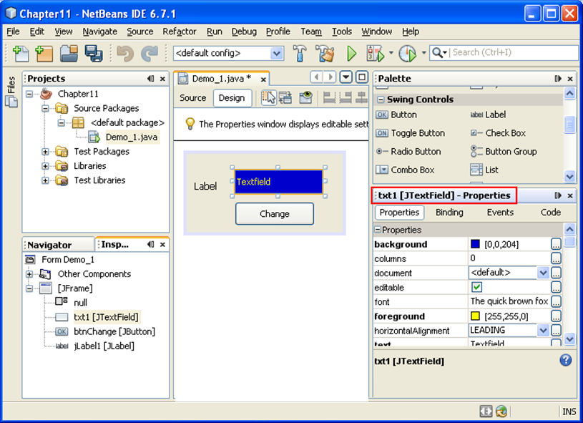
5- Ordinary Swing Component
Component Properties:
Name, size, location, background color, foreground color, font, enable, editable
Set/get

Slide 12
Ordinary Swing Components
javax.swing package contains APIs for developing GUI Apps Refer to Java documentation for more details of this package.
Almost component class names begin with ‘J’
Three categories:
Container components
Ordinary components:
Menu components.
Notes:
Three categories:
Container components
Ordinary components:
Menu components.

Slide 13
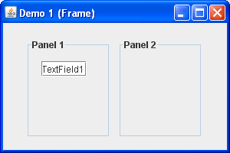
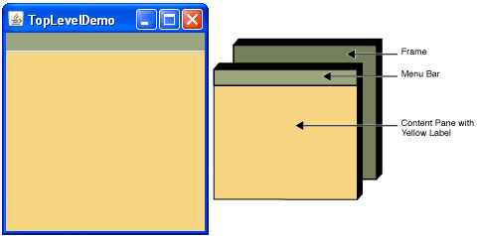
Ordinary Swing Components… Containers: JFrame, JPanel
They contain other components.
They use layout managers to determine the size and position of their child components.
JFrame is a top-level container.
JPanel is called general-purpose container.
Notes:
JFrame is a top-level container.
JPanel is called general-purpose container.

Slide 14
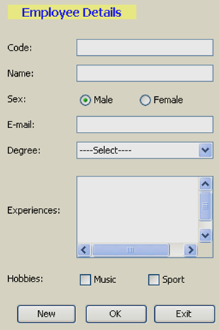
Ordinary Components
JLabel
JTextfield
JRadioButton (ButtonGroup)
JComboBox[cbx…]
JTextArea [txt…]
JScrollBar
JCheckBox [chbx…]
JButton

Slide 15
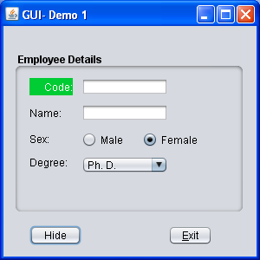
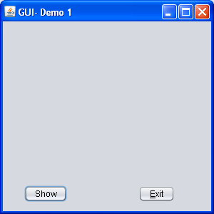
Demo 1
Objectives
Use a panel to group some components
Hide and show those as a whole through this panel
Disable the exit button on the frame
The exit button allows user close the application
GUI:

Slide 16
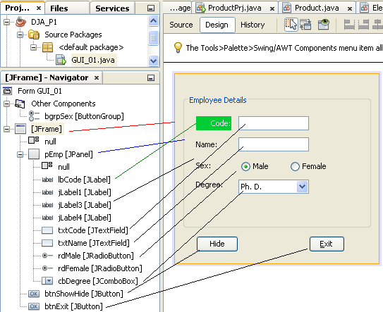
Demo 1
Design

Slide 17
Demo 1
Setup Properties
Class | Object name | Properties
JFrame | GUI_01 | Layout: null, defaultCloseOperation: DO_NOTHING Title: GUI-Demo 1
JPanel | pEmp | Layout: null, Border: tittleBorder
JLable | lbCode | Opaque: true, background: green, foreground: white horizontalAlignment: RIGHT, text: Code
JLabel | others | Text: Name, Sex, Degree
ButtonGroup | bgrpSex
JRadioButton | rdMale | buttonGroup: bgrpSex, Text: Male, Selected: true,
JRadioButton | rdFemale | buttonGroup: bgrpSex, Text: Female, Selected: false
JComboBox | cbDegree | Model:Ph. D., Master, Engineer, Bachelor, Technician
Button | btnHideShow | Text: Hide
JButton | btnExit | Text: Exit, mnemonic: E, TooltipText: Exit program

Slide 18
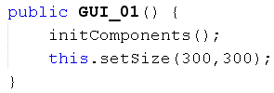

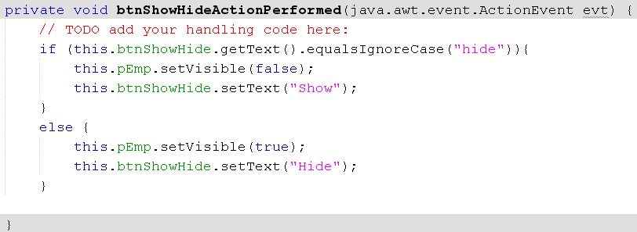
Demo 1
Code:
Constructor
Code for handling the event on the button Exit
Code for handling the event on the button ShowHide

Slide 19
Demo 1
View code at the end of the source file, inserted by NetBeans → Comment
View the contents of the method initComponents(), inserted by NetBeans, to explore anonymous classes, then verify them using Window Explorer

Slide 20
Summary
Two Kinds of Applications
Java Model for Event Management
About Java Foundation Classes (JFC)
A Strategy for Designing the GUI
Using Basic Swing Components

Slide 21
Thank You

