Slide 1

Lecture 02 Creating Graphical User Interface Part 3
How to use Tables

Slide 2
Objectives
How to present data in a table?
How to manage events on table?
How to customize a table?

Slide 3
Contents
The javax.swing.JTable class
Customize tables using javax.swing.table.AbstractTableModel
Replacing the cell editor of a table column

Slide 4
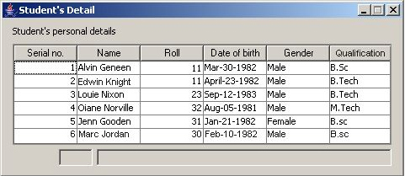
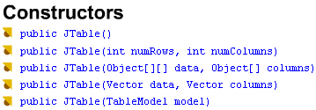
1- The JTable Class
Column Headers
ColumnModel
data
Data Model
View
class javax.swing.JTable
{ tableModel;
columModel;
selectionModel;
cellEditor;
editorComp;
cellRenderer;
tableHeader;
int editingColumn, edittingRow;
color ….
….
}
get/set
For more details:
docs-Java8/api/javax/swing/JTable.html
Common Event handling:
MouseEvent
MouseListener
public void mouseClicked( MouseEvent e)

Slide 5
JTable...
Common Methods
set/get/remove – setModel(..)
addColumn(TableColumn aColumn)
addColumnSelectionInterval(int index0, int index1)
int columnAtPoint(Point point) // get column index
createxxxx // create Model, Renderer, Editor, SelectionModel, TableHeader
updateUI()
………….
int getRowCount() int getColumnCount()
int getSelectedRow() int getSelectedColumn()
Object getValueAt(int i, int j) void setValueAt(Object obj ,int row, int col)
TableColum getTableModel().getColumn(int col)

Slide 6
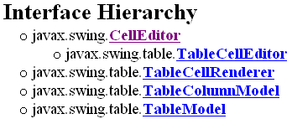
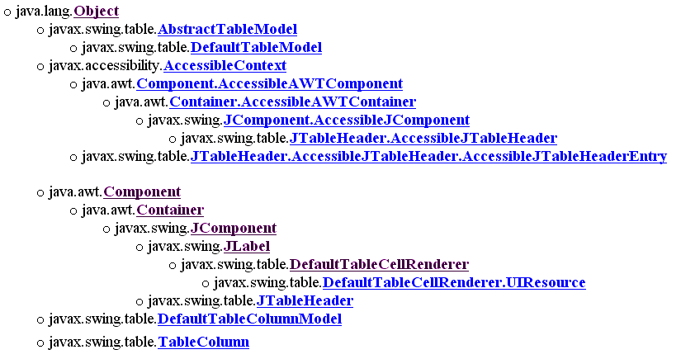
JTable…: Related Interfaces and Classes
Interfaces and classes are used in the
javax.swing.JTable class.
Each Defaultxxxxx class implements the
correlative interface.

Slide 7

JTable: Architecture
addRow()
rowCount
columnCount
…..
get/setValueAt(row,col)
font
color
…..
TableModel
TableHeader
ColumnModel
TableColumn
JTable
CellRender
color
lineColor
rowHeight
rowCount
columnCount
ColumnModel
TableColumn
add/removeColumn()
removeRow(…)
getColumn ( i)
……
CellRender
Maybe:
JCheckBox
JTextField
JComboBox
CellEditor
int rowAtPoint(Point)
int coloumnAtPoint(Point)
changeSelection(row,col,…)
int getSelectedColumn()
int getSelectedRow()
setSurrendersFocusOnKeyStroke (boolean)
set/getValueAt(…)…..
Width

Slide 8
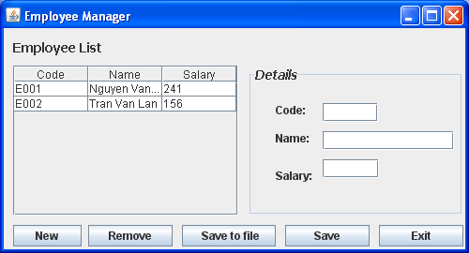
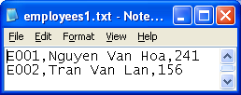
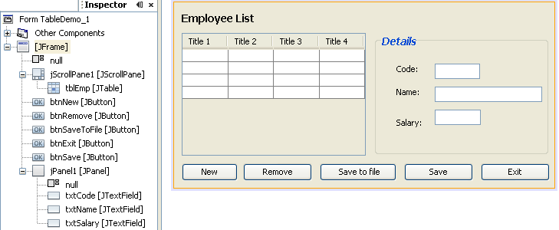
Demo 6: JTable
Managing Program is expected:
Initial employee details are stored in a file
GUI
Organization

Slide 9
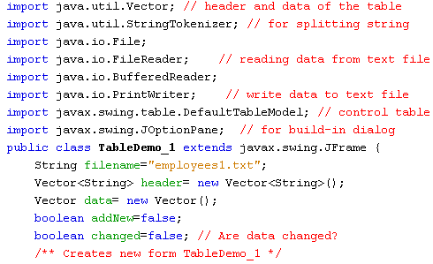

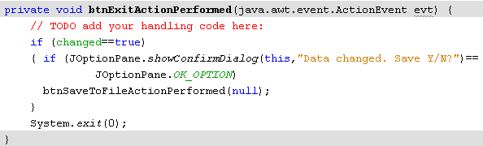
Demo 6: JTable…

Slide 10
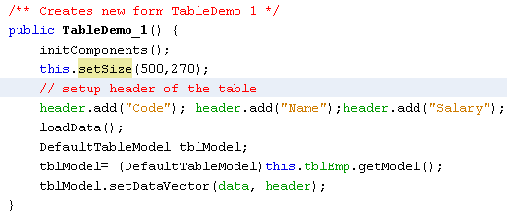

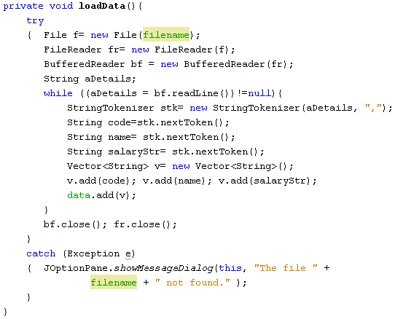
Demo 6: JTable…

Slide 11
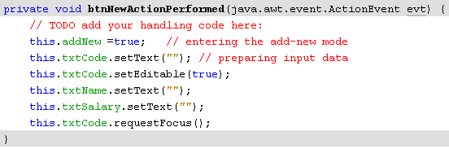
Demo 6: JTable…

Slide 12
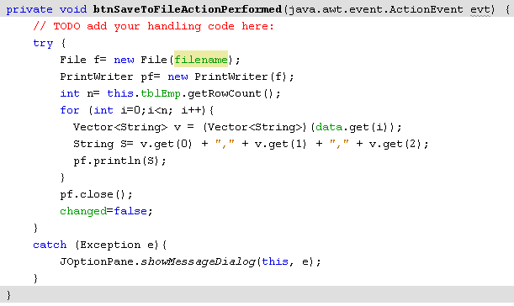
Demo 6: JTable…

Slide 13
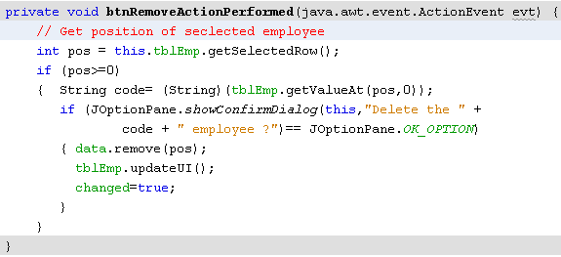
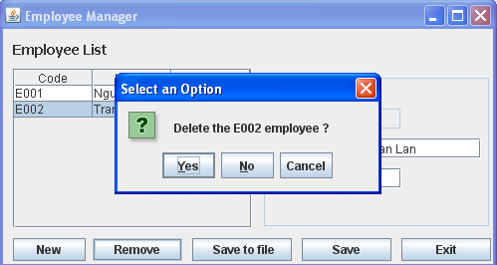
Demo 6: JTable…

Slide 14
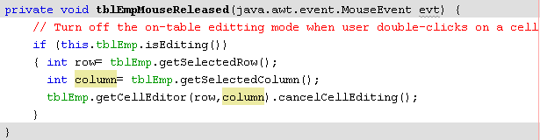
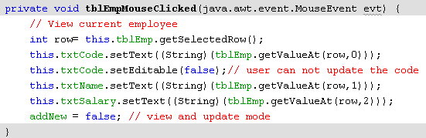
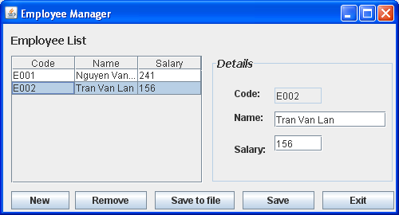
Demo 6: JTable…

Slide 15
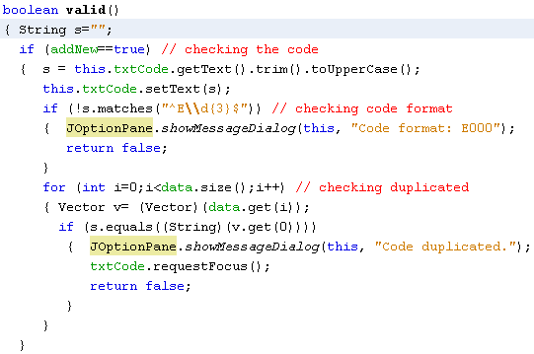
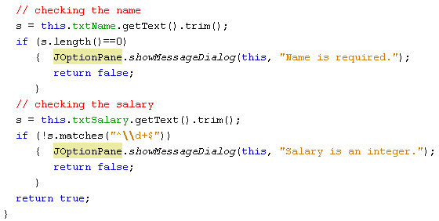
Demo 6: JTable…

Slide 16
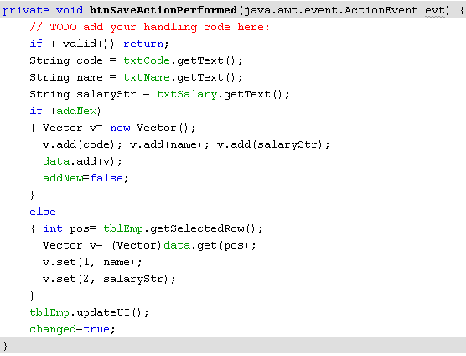

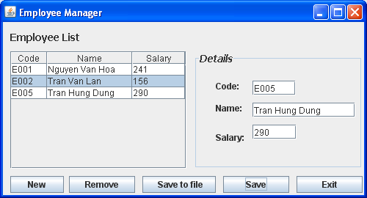
Demo 6: JTable…

Slide 17
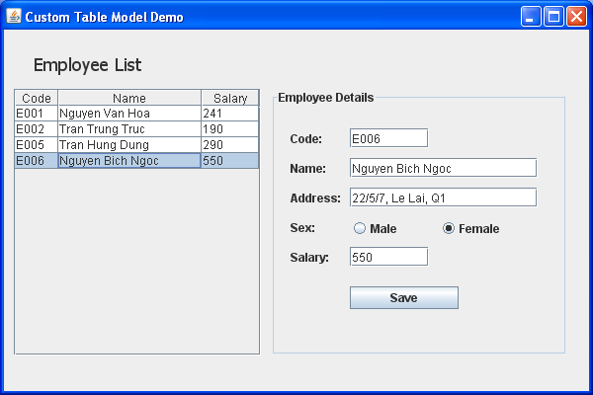
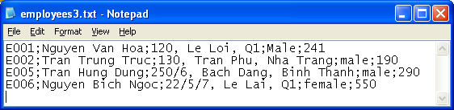
2- Custom TableModel
Some times, we want to present some main data columns only.
The class javax.swing.table.AbstractTableModel will help us.
5 columns
3 columns

Slide 18
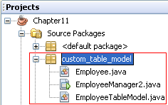
Demo 7: Custom TableModel
5 columns
3 columns

Slide 19
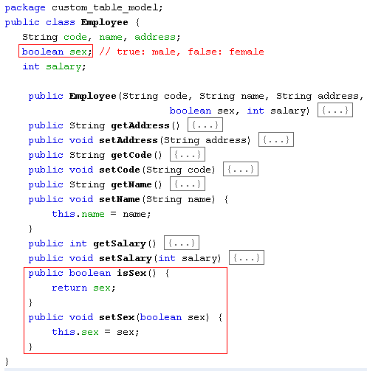
Demo 7: Custom TableModel…
Class for an employee

Slide 20
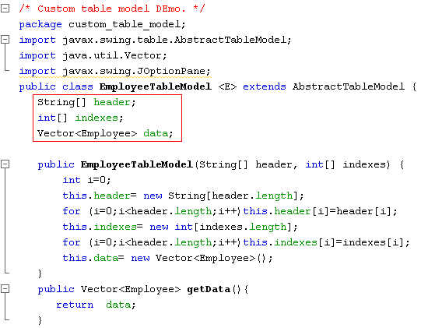
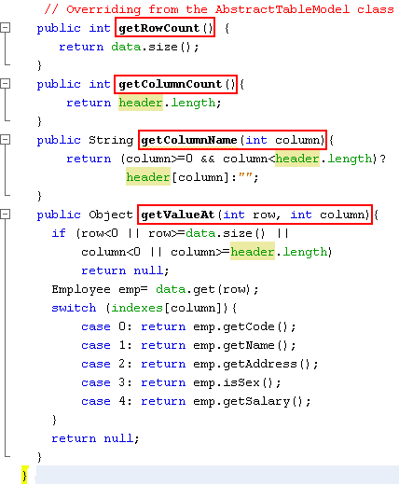
Demo 7: Custom TableModel…
Class for a list employee. This list will be a table model of a table
These methods indicate that how to get data from the model and present them on the table
indexes
0 | 1 | 2 | 3 | 4
code | name | address | sex | salary
0 | 1 | 4

Slide 21
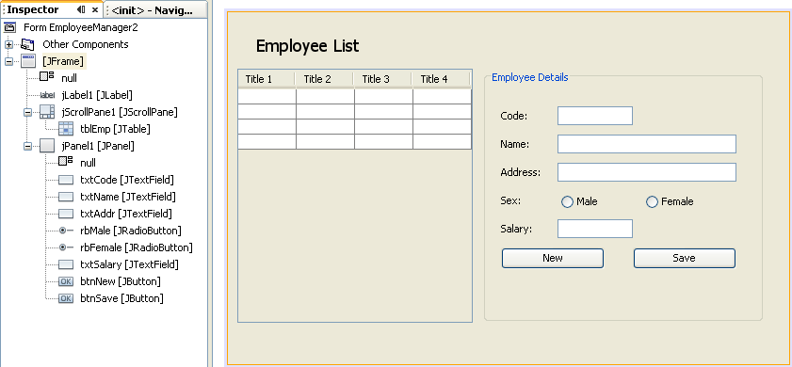
Demo 7: Custom TableModel…
GUI Design

Slide 22
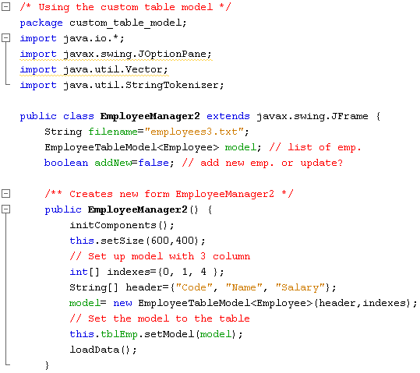
Demo 7: Custom TableModel…

Slide 23
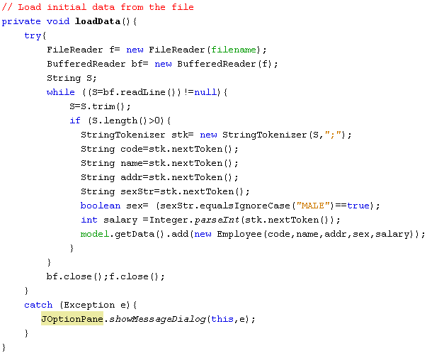
Demo 7: Custom TableModel…

Slide 24
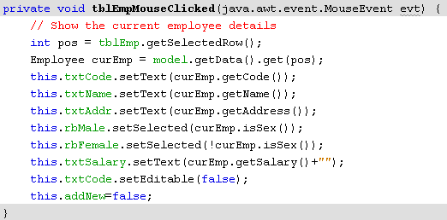
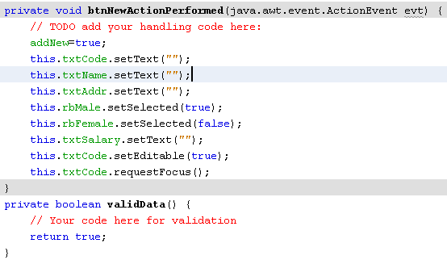
Demo 7: Custom TableModel…

Slide 25
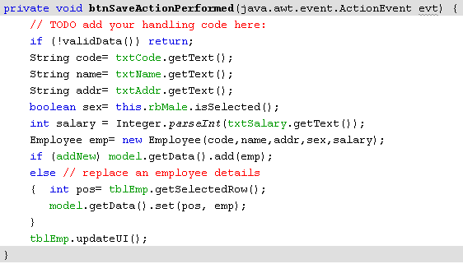
Demo 7: Custom TableModel…
Do yourself
- Add extra buttons to the GUI as below. Refer to the previous demontrations and complete this program
Algorithm for Saving the list to file:
Open file → PrintWriter pw
int n= model.getData().size();
for (int i=0; i<n; i++)
{ Employee emp = model.getData().get(i);
String S= emp.getCode() + “;” + emp.getName() + “;” +. . .
pw.println(S);
}
Close file
addNew=false;

Slide 26
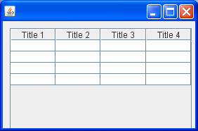
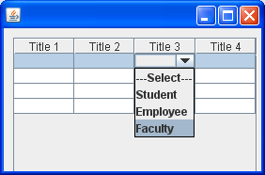
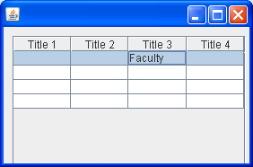
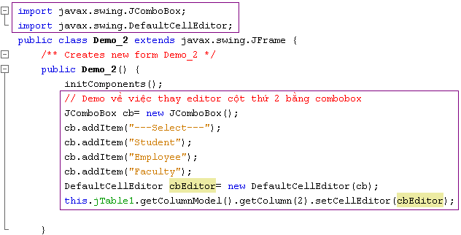
Demo 8: Replace Cell Editor

Slide 27
Summary
The javax.swing.JTable class
Customize tables using javax.swing.table.AbstractTabelModel
Replacing the cell editor of a table column

Slide 28
Thank You

