Slide 1

Lecture 02 Creating Graphical User Interface Part 6
Panes - Choosers

Slide 2
Contents
Using panes
Using Java Dialogs
Using file chooser and color chooser
Demonstrations

Slide 3
Panes
Swing panes provide some form of container service.
These services provide:
Layout managers
JSplitPane
JScrollPane
Dialog boxes
JOptionPane
JTabbedPane
JFileChooser
JColorChooser

Slide 4
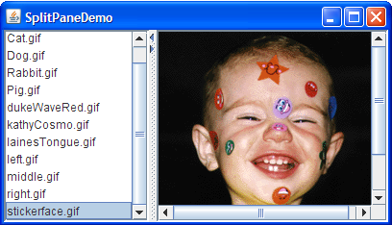
The JSplitPane Class
A JSplitPane displays two components, either side by side or one on top of the other. By dragging the divider that appears between the components, the user can specify how much of the split pane's total area goes to each component. You can divide screen space among three or more components by putting split panes inside of split panes

Slide 5
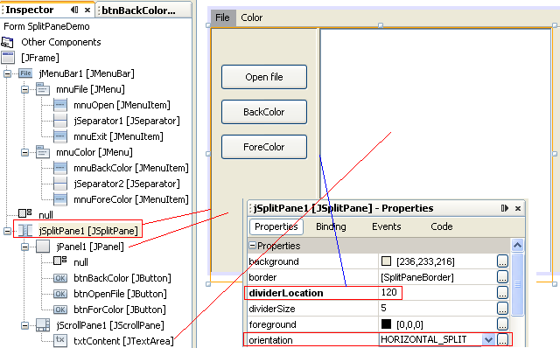
Demo 11- SplitPane-Choosers
How to use the JSplitPane, JFileChooser, JColorChooser classes?

Slide 6
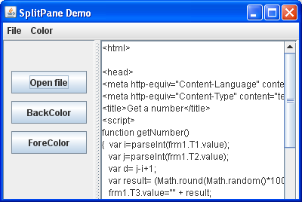
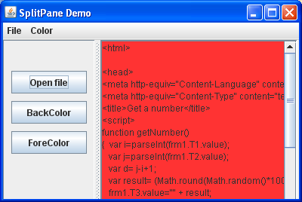
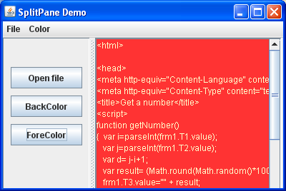
Demo 11- SplitPane-Choosers…

Slide 7
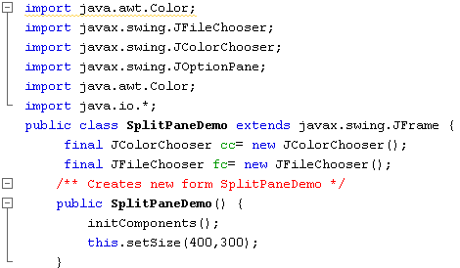
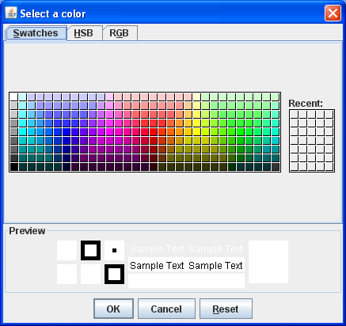
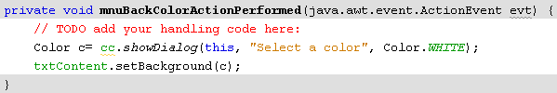
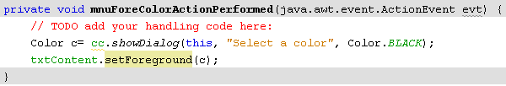


Demo 11- SplitPane-Choosers…

Slide 8
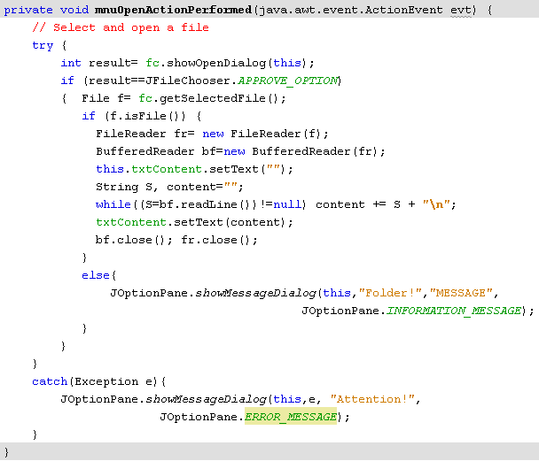

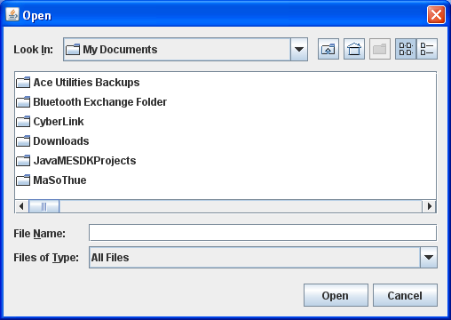

Demo 11- SplitPane-Choosers…

Slide 9
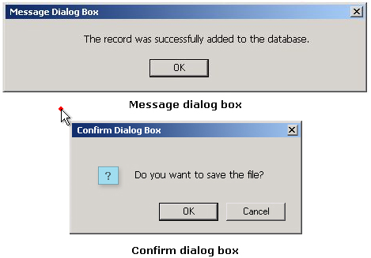
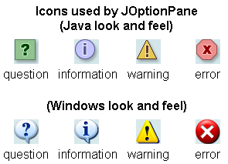
The JOptionPane Class
title
message
icon
buttons
How to change the Java Look and feel?
3 build-in mechanisms: Metal (default), Windows, Motif.
Refer to the Java Tutorial

Slide 10
Summary
Using panes
Using Java Dialogs
Using file chooser and color chooser
Demonstrations

Slide 11
Thank You

