Slide 1

Lecture 03 Custom Networking Part 2
Sockets
Chapter 13- Object Streams and RMI
(The java.net package)

Slide 2
Review
Platform: hardware + operating system.
Client: an application running in a computer (such as browser) can receive data from another (server).
Server: an application running in a computer (such as IIS- Windows Internet Information Service) can supply data to others (clients).
IP address (internet protocol): unsigned integer helps identifying a network element(computer, router,…).
IPv4: 4-byte IP address, such as 192.143.5.1
IPv6: 16-byte IP address
Port: unsigned 2-byte integer helps operating system differentiating a network communicating process.
Protocol: Rules for packaging data of a network communication because client and server can be working in different platform. Two common basic protocols are TCP and UDP

Slide 3
Review
TCP: (Transmission Control Protocol) is a connection-based protocol (only one connecting line only) that provides a reliable flow of data between two computers based on the acknowledge mechanism.
UDP: (User Datagram Protocol) is a protocol that sends independent packets of data, called datagrams, from one computer to another with no guarantees about arrival (many connecting lines can be used, acknowledge mechanism is not used). Many firewalls and routers have been configured not to allow UDP packets. Ask your system administrator if UDP is permitted.
Serialization: a process that converts object’s state (values in fields of the object) to a byte stream.
De- serialization: a process that splits data in a byte stream then set data to fields of an object.

Slide 4
Objectives
What is a socket?
How to develop applications using TCP protocol such as chatter?

Slide 5
Contents
Java Sockets
The java.net.Socket and java.net.ServerSocket classes
Sockets: How do they work?
Socket: How do we code?
Demonstration

Slide 6
1- Java Sockets
A socket is one endpoint of a two-way communication link between two programs running on the network. A socket is bound to a port number so that the TCP layer can identify the application that data is destined to be sent.
Main members:
Socket = IP + Port (IO Streams + Methods)

Slide 7
2- Socket and ServerSocket Classes
The java.net.Socket class implements one side of a two-way connection between your Java program and another program on the network
The java.net.ServerSocket implements server sockets. A server socket waits for requests to come in over the network. It performs some operation based on that request, and then possibly returns a result to the requester.

Slide 8
3- Sockets: How do they works?
Server:Mangalo
Client: Jane
Init
(Jane, xxxx)
(1) Make connection
(2) Receive the ACK from server
srvSocket(1234)
(2) Accept
(3) Create socket
(3) Create socket
ACKnowledge
socket(Jane,xxxx)
socket(Mangalo,1234)
outputStream
010010011001100
outputStream
101100100110010
Input stream
101100100110010
Input stream
010010011001100
automatically
(3) Loop
Process data in input stream.
Write data to output stream.
(3) Loop
Process data in input stream.
Write data to output stream.

Slide 9
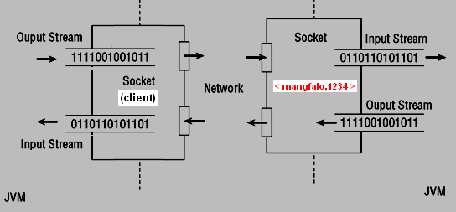
4- Sockets: How do we code?
Server Program
Name: mangfalo
or IP
Client Program
ServerSocket ss= new ServerSocket(1234);
Socket clientSoctket=ss.accept();
Socket srvSocket= new Socket(“mangfalo”,1234);
// Receive data
bf= new BufferedReader( new InputStreamReader(socket.getInputStream()));
aString= bf.readLine();
// Send data
os= new DataOutputStream (socket.getOutputStream());
os.writeBytes( aString); os.write(13); os.write(10); os.flush();

Slide 10
5- Java TCP Socket Demo.
Problem
A manager wants to communicate with his/her staffs. Each communication is distinct from others.
Write Java programs which allow this manager and his/her staffs carrying out their communications.
Each client program is used by a staff.
The program used by the manager has some threads, each thread supports a communication between the manager and a staff.
Manager site is specified by IP and the port 12340.

Slide 11
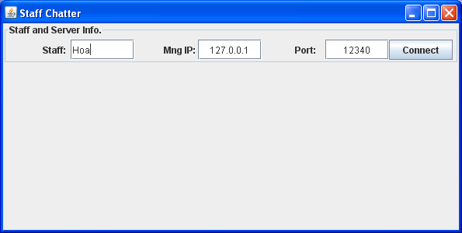
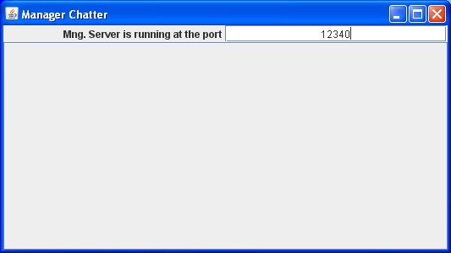

Java TCP Socket Demo.: GUIs
2 staffs and manager – when no connection is established

Slide 12
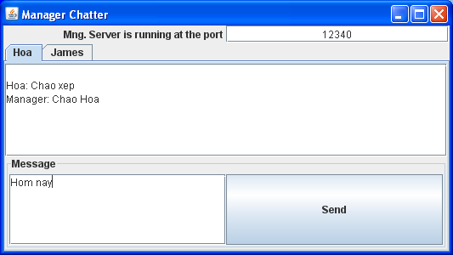
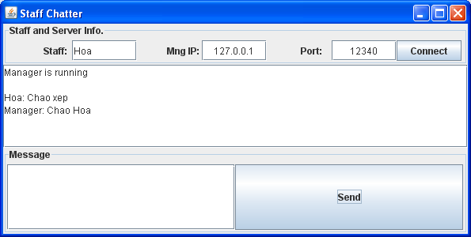
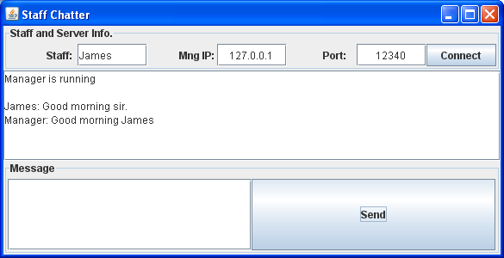
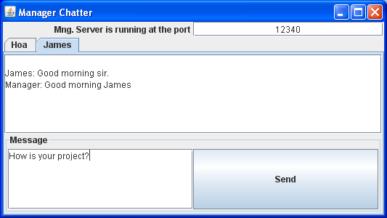
Java TCP Socket Demo.: GUIs
2 staffs and manager – when 2 connections is established

Slide 13
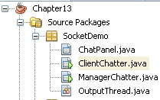
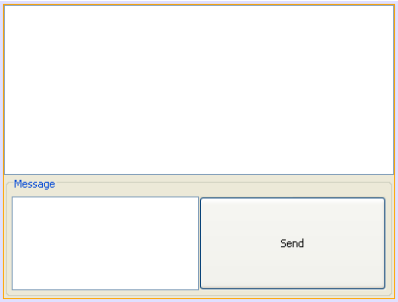
Java TCP Socket Demo.: Project architecture
ChatPanel: Panel for chatting, it is used in client and server.
ClientChatter: GUI client program for staffs
ManagerChatter: GUI Server program for manager
OutputThread: a thread helps presenting received data ( 1 time/second)

Slide 14
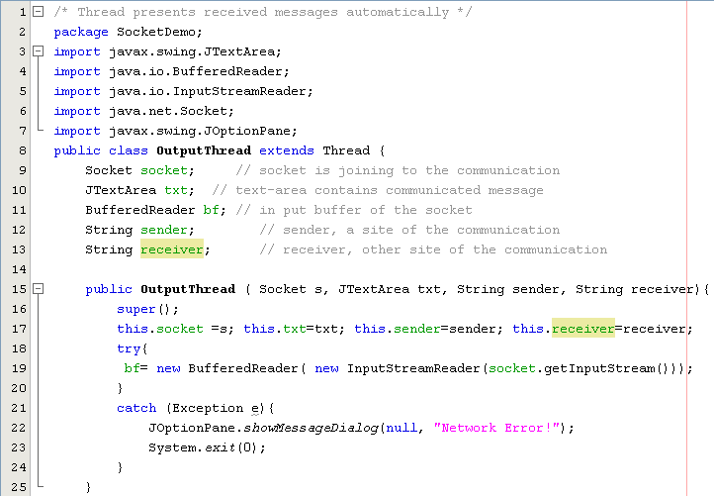

TCP Socket Demo...

Slide 15
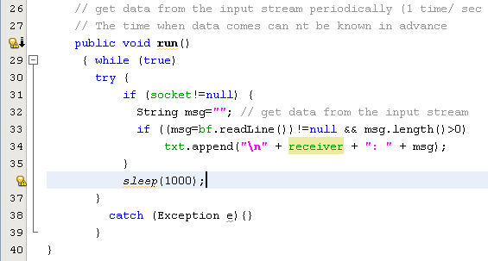
TCP Socket Demo...

Slide 16
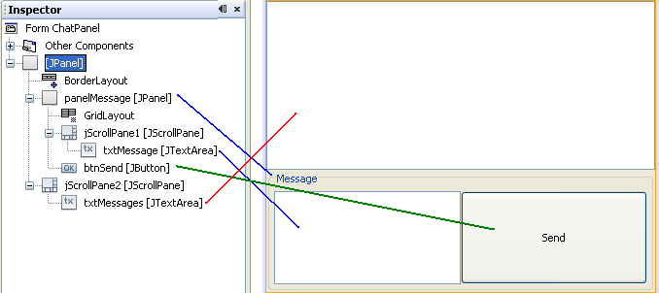
TCP Socket Demo...

Slide 17
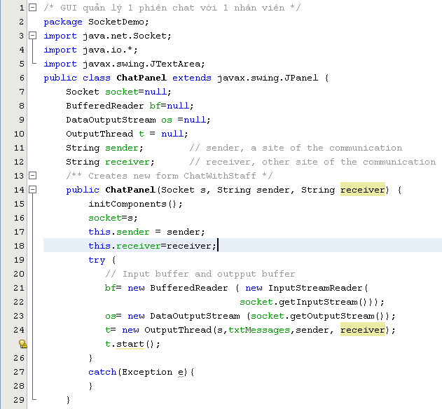
TCP Socket Demo….

Slide 18

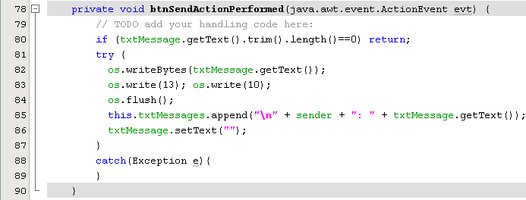
TCP Socket Demo….

Slide 19
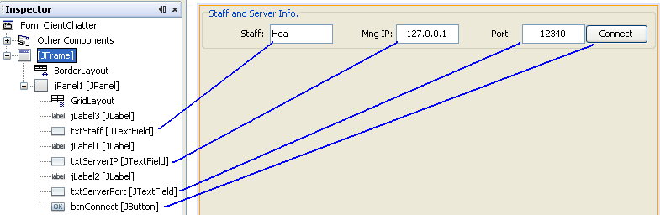
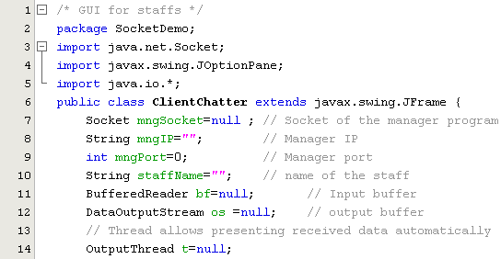
TCP Socket Demo….

Slide 20
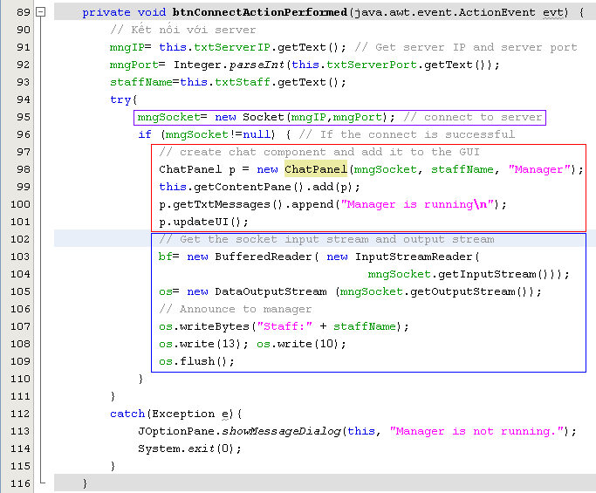
TCP Socket Demo….

Slide 21
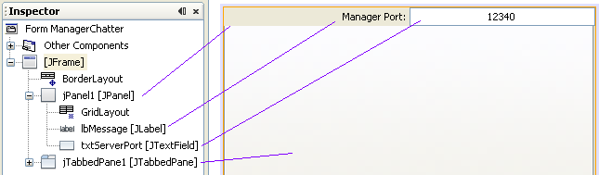
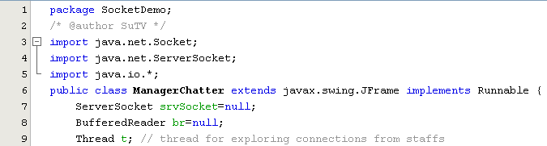
TCP Socket Demo….

Slide 22
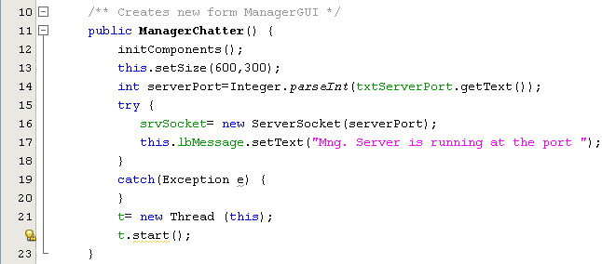
TCP Socket Demo….

Slide 23
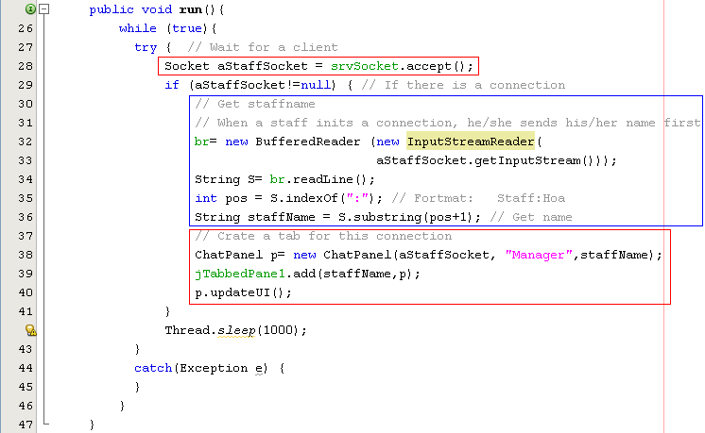
TCP Socket Demo….

Slide 24
Summary
IP and Port
TCP, UDP Protocols
Sockets and Ports
Client Sockets/ Server Sockets in Java
How to use TCP sockets

Slide 25
Thank You

