Slide 1

Lecture 03 Custom Networking Part 3
Remote Method Invocation
Book: Chapter 13- Object Streams and RMI
(The java.rmi package)

Slide 2
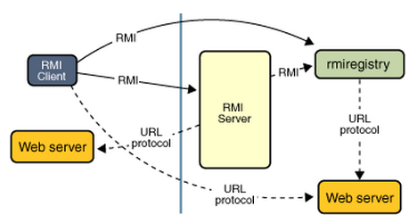
Why should we study this lecture?
Nowadays, distributed applications are popular. People need large applications, running based on a computer network (local area networks-LANs- or wide area network-WAN), including many sites working concurrently. Do you want to create such applications?
How do Java distributed applications work?
From Java8-Tutorial

Slide 3
Contents
Object Streams and Serialization
Java Remote Method Invocation (RMI)
Demonstrations

Slide 4
1- Object Streams & Serialization
Serialization: a process that converts object’s state to a byte stream .
Do you want to make yourself the way of serialization instead of the Java default one?
java.io.Serializable : no method is declared
java.io.Externalizable:
Methods are declared in the Externalizable Interface
void | readExternal(ObjectInput in) The object implements the readExternal method to restore its contents by calling the methods of DataInput for primitive types and readObject for objects, strings and arrays.
void | writeExternal(ObjectOutput out) The object implements the writeExternal method to save its contents by calling the methods of DataOutput for its primitive values or calling the writeObject method of ObjectOutput for objects, strings, and arrays.
A demonstration: Refer the book, page 446.

Slide 5
Remote Control Using Object Streams
Class Command
Operation
Operands
Class Result
…
Client
Create a Command object;
Connect to server
Write it to output stream of the socket
Wait for then get the result object from socket’s input stream.
Show the result.
Server
Wait for a connect from client
Get Command object from input stream of client socket.
Execute the command received to create a Result object
Write the result object to output stream of the client object
Demonstration: Book, page 447 .. 452

Slide 6
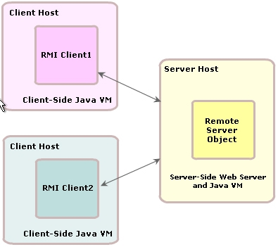
2- Remote Method Invocation (RMI)
The Java Remote Method Invocation (Java RMI) is a Java API that performs the object-oriented equivalent of remote procedure calls (RPC), with support for direct transfer of serialized Java classes and distributed garbage collection.
The original implementation depends on JVM class representation mechanisms and it thus only supports making calls from one JVM to another. The protocol underlying this Java-only implementation is known as Java Remote Method Protocol (JRMP).
It is the basic for protocols used in Java application server, JBoss for example.

Slide 7
General RMI Architecture
Remote JVM machine
bind
1
RMI Container
( rmiregistry.exe)
[ Name1, serverObject1]
[ Name2, serverObject2]
…
RMI Server
RMI Registry
Skeleton
4
return
call
look up
3
2
Stub
RMI Client
Local JVM machine
The Skeleton is ommited since Java 1.2

Slide 8
The Stub and Skeleton
A client invokes a remote method, the call is first forwarded to stub.
The stub is responsible for sending the remote call over to the server-side skeleton
The stub opening a socket to the remote server, marshaling (serializing) the object parameters and forwarding the data stream to the skeleton.
A skeleton contains a method that receives the remote calls, unmarshals (deserializing) the parameters, and invokes the actual remote object implementation.

Slide 9
Remote Method Invocation
Remote interface
Remote interface
Client
Server
Object A
Object B
The Skeleton is omitted sinceJava 1.2
Object B Stub
Object B Skeleton
R
E
M
O
T
E
R
E
G
I
S
T
R
Y
Remote Reference Layer
Remote Reference Layer
Transport Layer
Transport Layer
Notes:
Remote Reference Layer:
This layer is the middleware between the stub & skeleton layer and the underlying transport layer. This layer handles the creation and management of remote object references. It also connects clients to exported objects that are running on the server. Connection is a one-to-one (unicast) link. In Java 2 SDK, this layer was enhanced to support the activation of dormant remote service objects via Remote Object Activation.
Transport layer:
The transport layer is based on TCP/IP connections between machines on the network. It provides basic connectivity, as well as some rewall penetration strategies. All connections are stream-based network connections that use TCP/IP. Even if two JVMs are running on the same physical computer, they connect through their host computer's TCP/IP network protocol stack.

Slide 10
RMI… 6 Step plan
1- Create the remote interface
2- Create the remote class
3- Create the stub (from remote class using rmic.exe)
4- Create remote server object (use rmiregistry.exe and Naming.rebind(…) method
5- Create the client
6- Start server program then the client program.

Slide 11
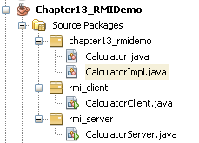
RMI Demo 1.

Slide 12
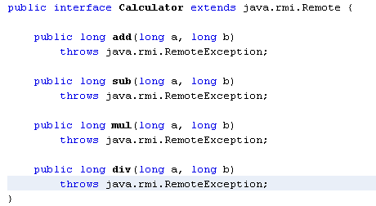
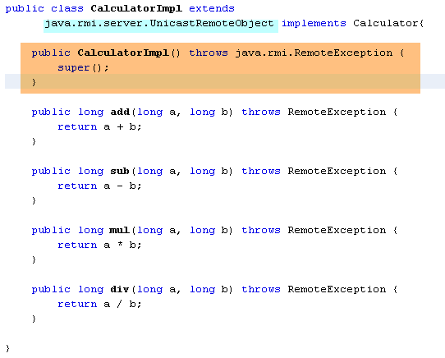
RMI Demo 1.
Step 1: Remote Interface:
Must extend java.rmi.Remote.
All methods in the remote interface must also throw java.rmi.RemoteException
Step 2: Remote class
Must extend java.rmi.server.UnicastRemoteIObject
Must implement remote interface
Must have a default constructor

Slide 13
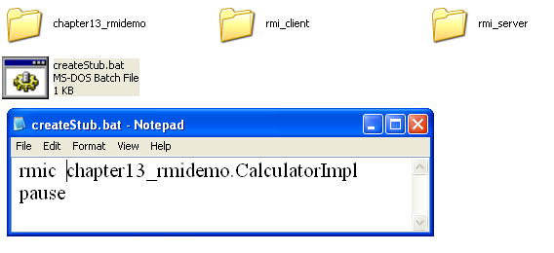
RMI Demo 1.
Step 3: Create Stub

Slide 14
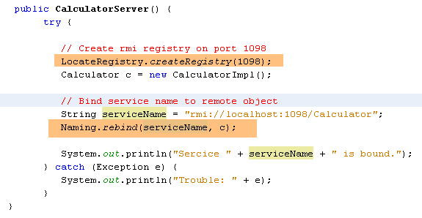
RMI Demo 1.
Step 4: CreateServer (Including creating rmiregistry)

Slide 15
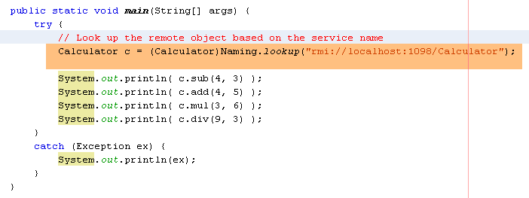
RMI Demo 1.
Step 5: Create Client

Slide 16
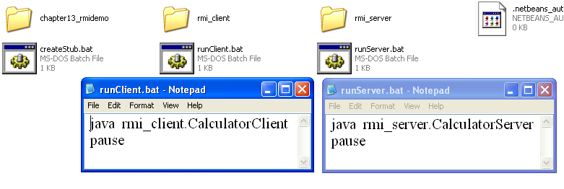
RMI Demo 1.
Step 6: Execute programs

Slide 17
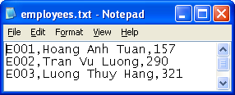
Demo 2: Data are stored in server
At server side
An initial list of employees is stored in the employees.txt file ( a line for an employee with the format: code, Name, salary).
A program running in console mode in which a remote server can support two operations:
Supply initial list of employees to a client program.
Save using override mode a list of employees transferred from a client program.

Slide 18
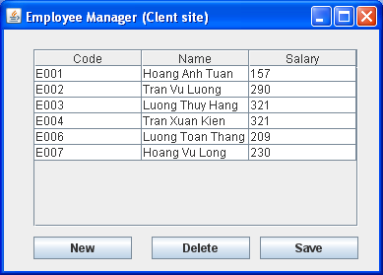
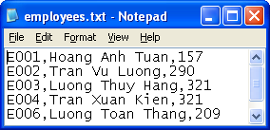
Demo 2…
At client side:
Initially, a list of employees is supplied from server will be presented on a table of the GUI.
User can
Add new employee ( the employee’s code must have the format E000 and it is not duplicated with existing employee codes.
Remove an employee.
Update employee details.
Save the list on server.

Slide 19
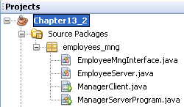
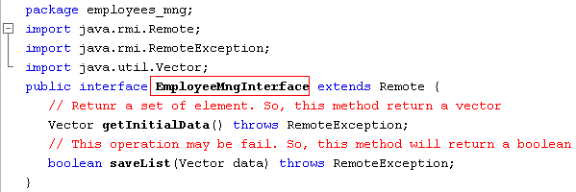
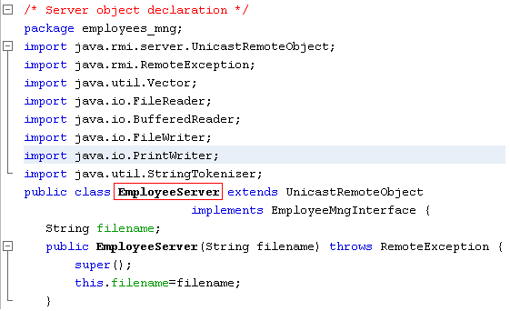
Demo 2: Remote Interface and Server Object

Slide 20
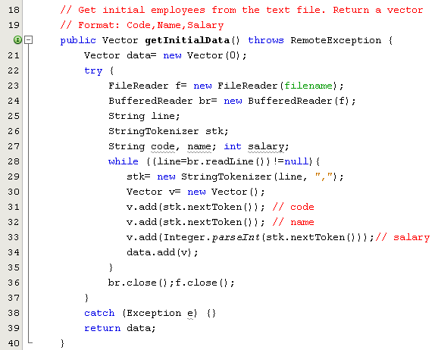
Demo 2: Server side

Slide 21
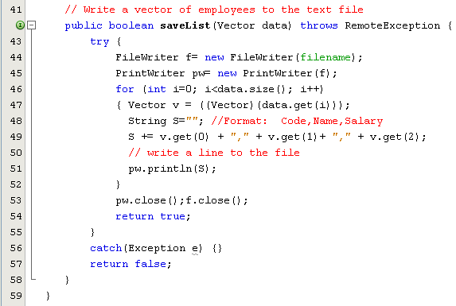
Demo 2: Server Object…

Slide 22
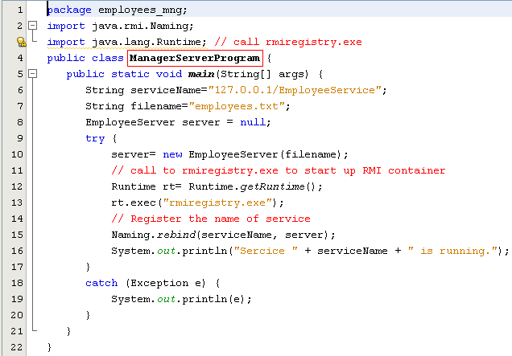
Demo 2: Server Program
// Using default RMI container in JVM
import java.rmi.registry.LocateRegistry;
String serviceName = "rmi://localhost:1098/EmployeeService”
LocateRegistry.createRegistry(1098);

Slide 23
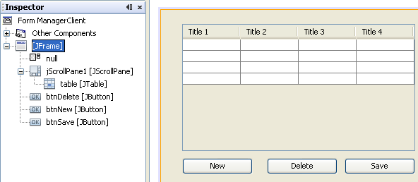
RMI Demo 2.
Client Program

Slide 24
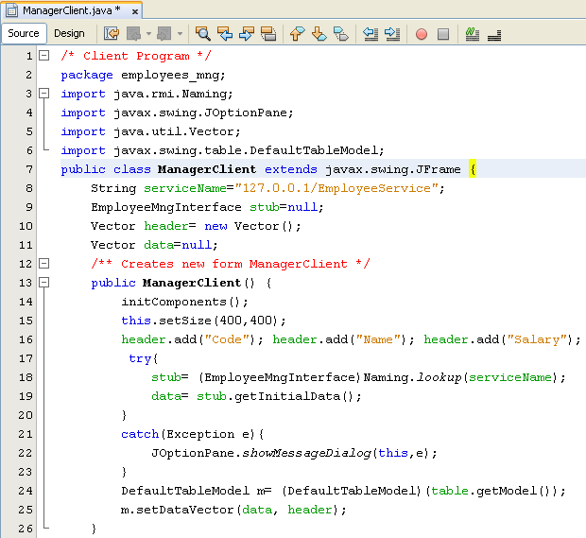
RMI Demo 2.
String serviceName = "rmi://localhost:1098/EmployeeService”

Slide 25
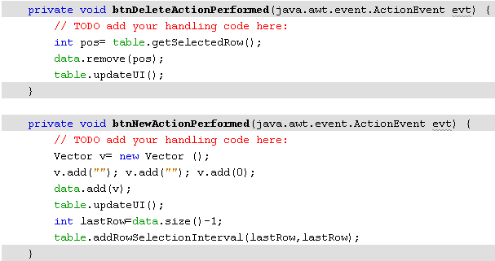
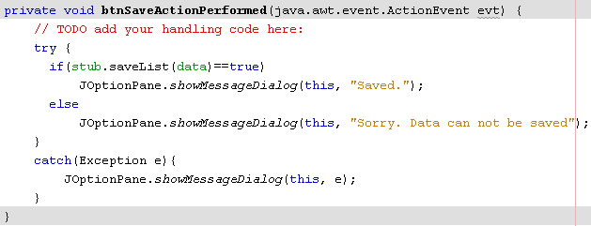
RMI Demo 2.

Slide 26
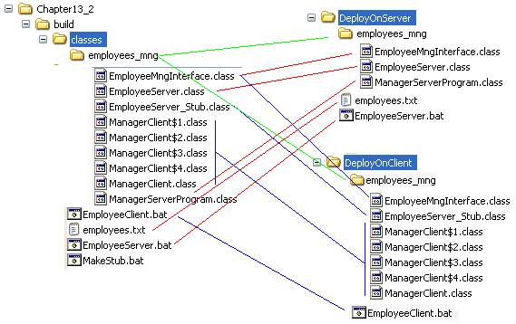



RMI Demo 2. - Deploying

Slide 27
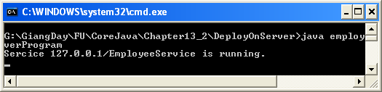
Result:
Step 1- Run server program
Step 2- Run client program

Slide 28
Summary
Remote Control using Object Streams
Remote Method Invocation
Remote interface, Class for Server object
Server Program, Client Program

Slide 29
Thank You

