Slide 1
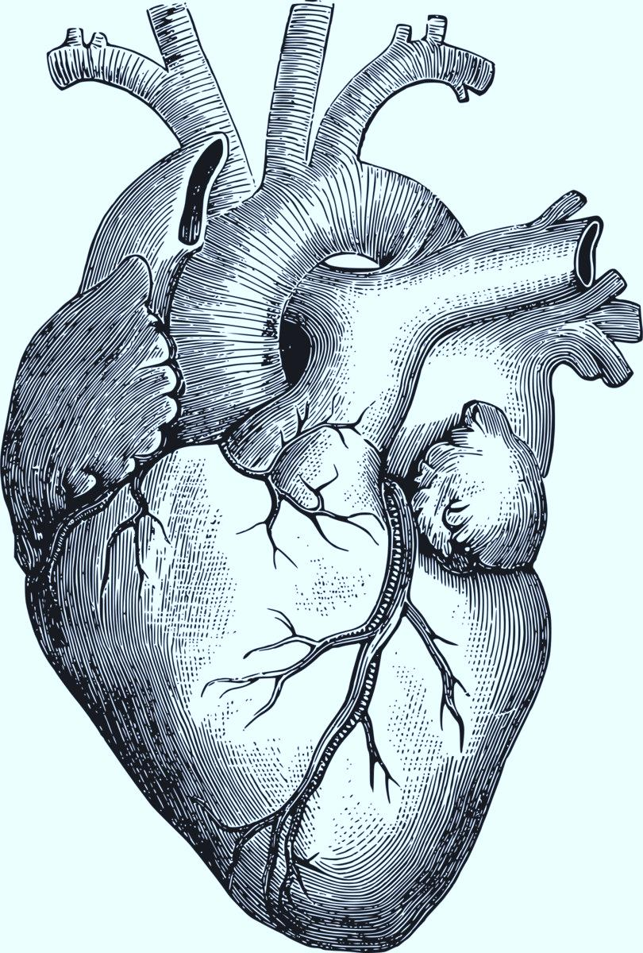

Heart Rate Variability
Sherpa vs. Miami students at 4500m elevation
Presented by: Sanjay Tamrakar

Slide 2
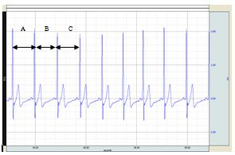

RR-Interval/RMSSD
The RMSSD is looking for the successive difference between the intervals
A-B (R-R)1 – (R-R)2 B-C (R-R)2 – (R-R)3…
The RMSSD calculates to:
RMSSD =
where N = number of RR interval terms
Notes:
RR interval- R corresponding to one of the peak

Slide 3
Data
Variable | Units |  | Description
Response Variables
SDNN (SD RR) | ms millisecond |  | Standard deviation of total ms between RR intervals. Not used, as the length of time is not defined and set for each measurement. So, this is simply an estimate of overall HRV and not specific enough.
RMSSD | ms |  | Square root of the mean squared differences between successive RR intervals.
pNN50 | % |  | Number of interval differences of successive RR intervals that are greater than 50 ms divided by the total number of intervals.
FFT LF/HF ratio |  |  | FFT stands for fast Fourier Transformation. LF and HF represent the relative value of power in proportion to the total power minus VLF (Very Low Frequency). Helps control for the change in total power that can be found between RR intervals. The ranges for qualifying as LF or HF are (.04-.15 Hz) and (.15-.4 Hz), respectively.
AR LF/HR ratio |  |  | AR stands for auto-regressive modeling. It uses an order J prior that is selected before hand. It allows for measurement without pre-specified intervals
Poincare plot, SD1 | ms |  | <--Same information as RMSSD***
Poincare plot, SD2 | ms |  | These two measure the distribution of signal in 2D space (SD1 consecutive interval measure, and SD2 more overall measure for whole time domain)
Predictor Variables
Oxygen Saturation | % | Amount of oxygen in blood
Mean RR | ms | Average ms of RR interval
Sherpa |  | 1 if individual is a Sherpa, 0 is student
7 possible HRV measures.
Mean heart rate
is negatively associated with HRV
7 Sherpa and 17 Students
Notes:
First part of our data analysis is to know understand our responses and the predictors

Slide 4
Task:
Narrow down number of Response(out of 7)
Check if difference of HRV exists in group Sherpa and group Student
What cause the difference? Saturation itself or group difference affect as well?
Find a reasonable model. How strong the difference it might happen?
Notes:
Exploratory data analysis and not confirmatory

Slide 5
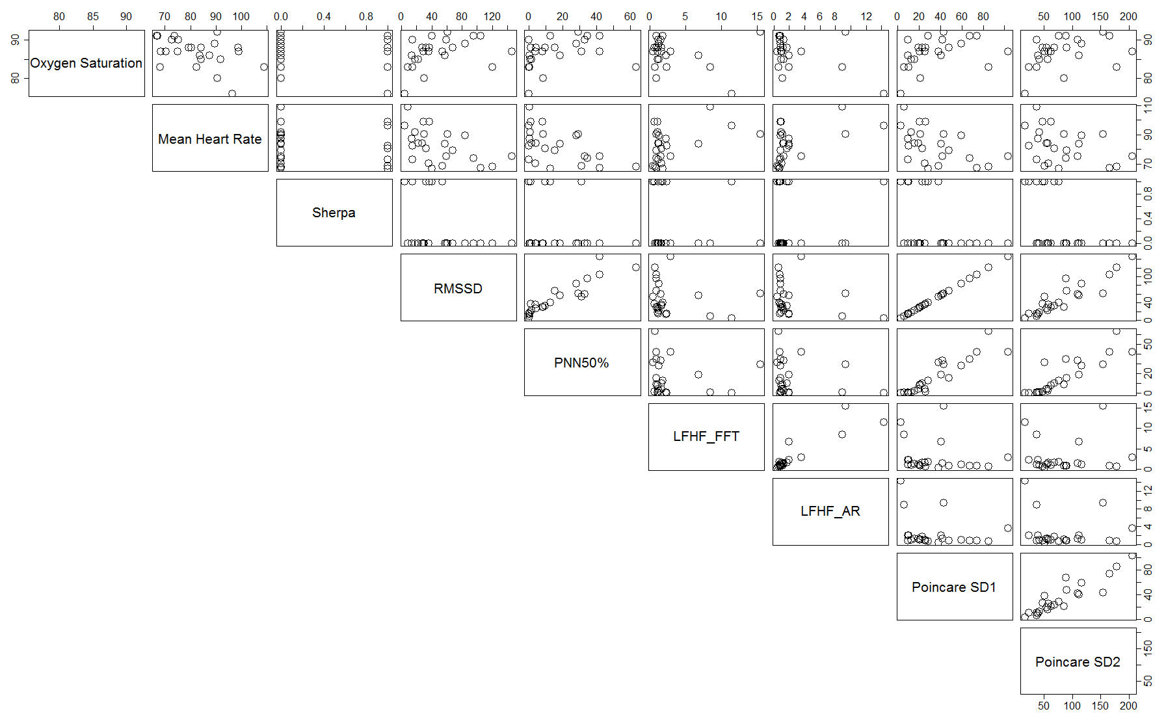
Scatter Plot for predictors on the first three and the
Scatter Plot for the six responses
Notes:
Oxygen sat. appears to have logarithmic relationship with RMSSD, pNN50, SD1 & SD2.
Resting HR should have negative association with HRV…does with RMSSD and pNN50, has positive association with ratios.
RMSSD, pNN50, SD2 closely related. RMSSD and SD1 display same information as each other.

Slide 6
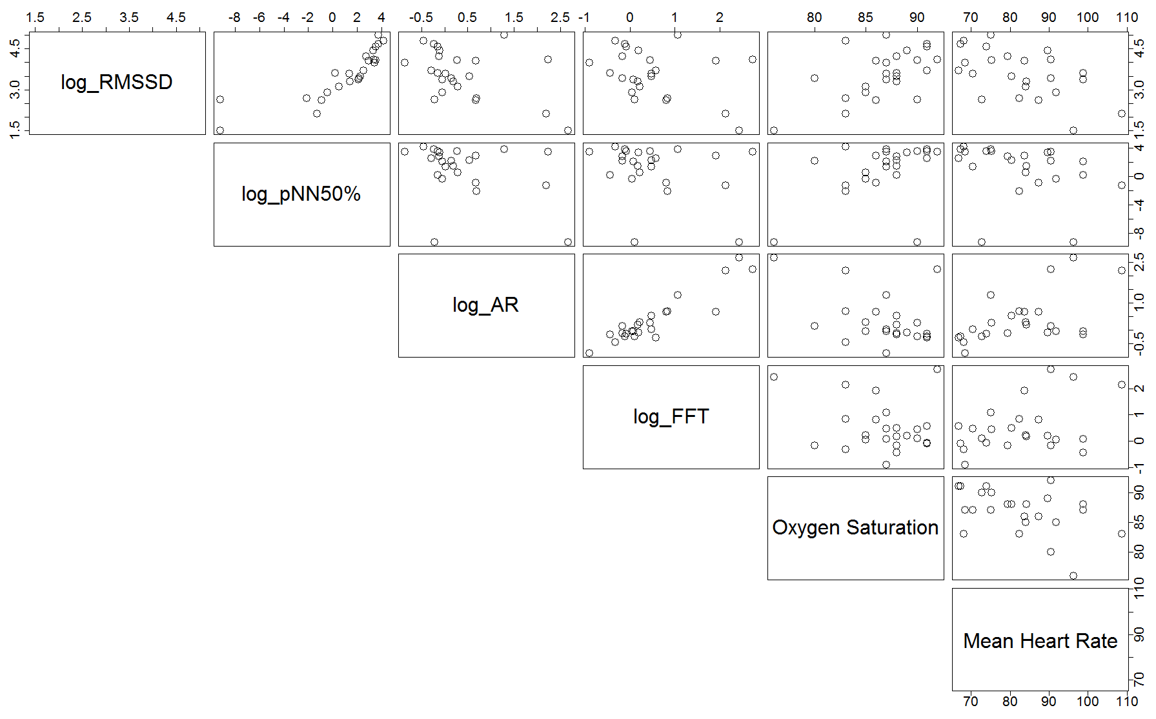
Scatter Plot for both the response variables
of interest
Notes:
Logging the response variables have made a clear relationship

Slide 7
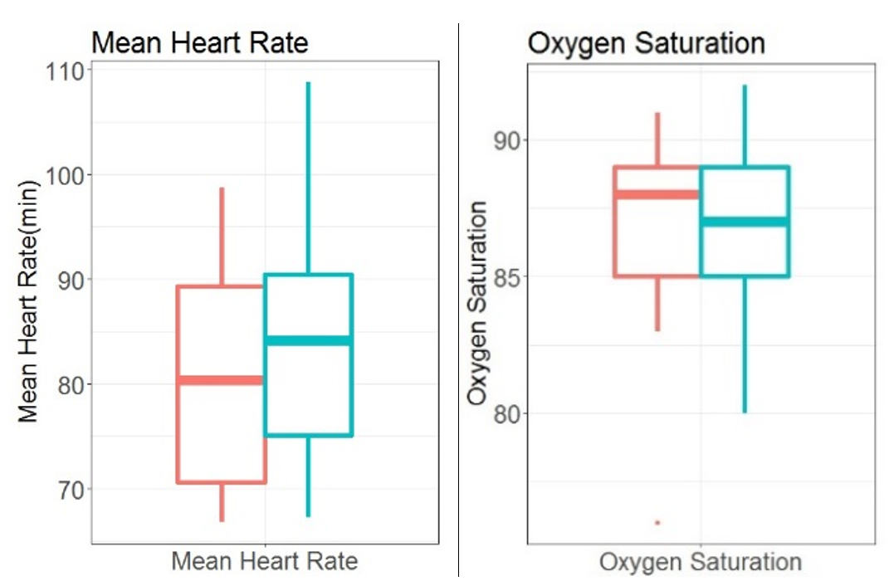
Sherpa
Student
Notes:
We see very little change in the both our predictors

Slide 8
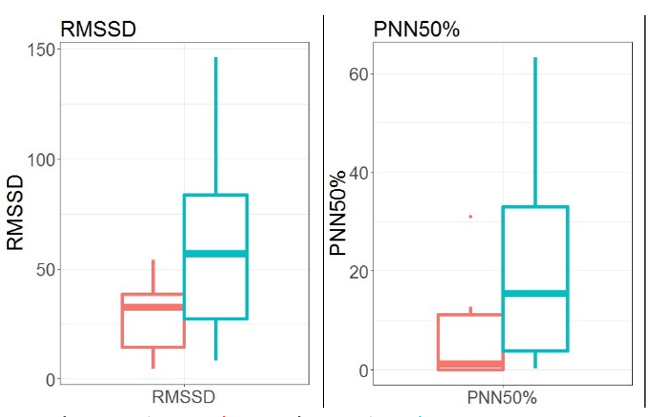
Sherpa
Student
Notes:
Outlier is circled. RMSSD and PNN 50 both has less variation for the sherpa
Spread larger for the students
Multiplicative or Exponential relationship between two groups – supports the log transformation

Slide 9
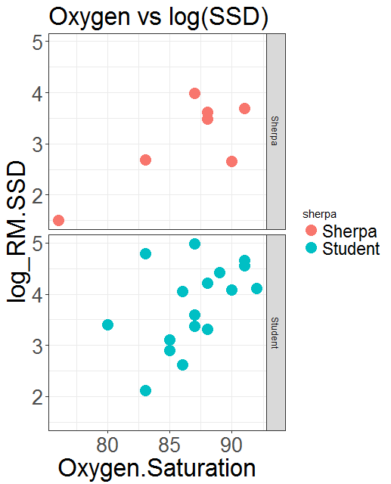
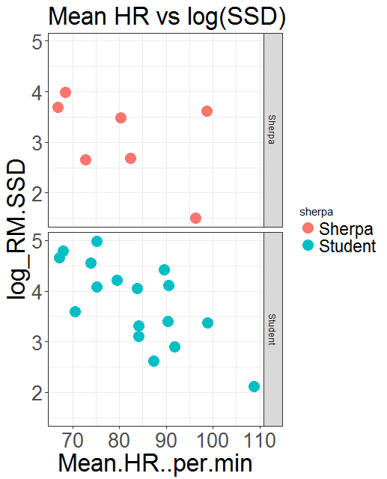
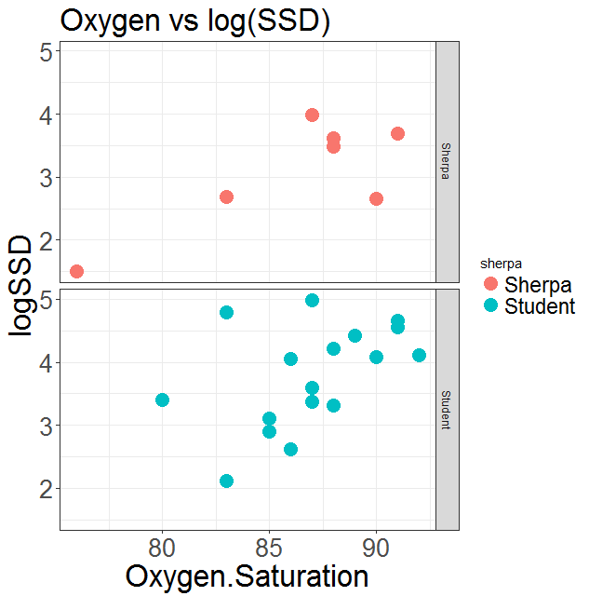
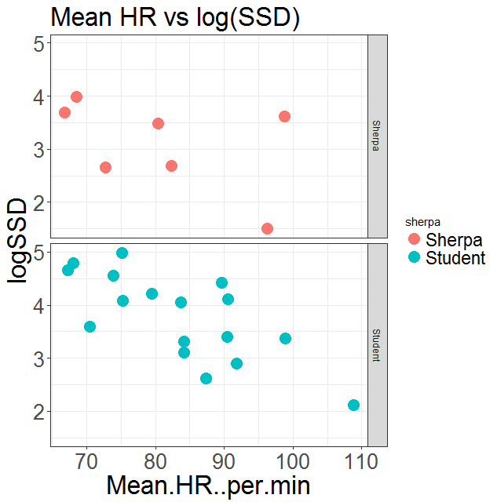
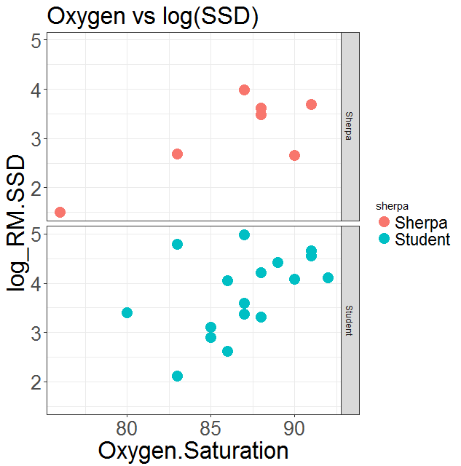
Interaction
Sherpa
Student
Notes:
Parallel lines no interaction; the more non-parallel they are the more stronger the interaction

Slide 10
Welch Two Sample T-test (RMSSD)
Two reasons:
Unequal variance
Unequal number of samples
Welch Two Sample t-test
data: finaldata[8:24, 3] and finaldata[1:7, 3]
t = 2.4895, df = 21.83, p-value = 0.02091
alternative hypothesis: true difference in means is not equal to 0
Notes:
Welch two sample test is more reliable when we have unequal variance and unequal number of samples; both are true in this case

Slide 11
Models
Basic Model:
log_RMSSD = β₀ + β₁*Oxygen_Saturation + β₂*HR/min + β₃*Sherpa + ε
Possible Interactions:
log_RMSSD = β₀ + β₁*Oxygen_Saturation + β₂*HR/min + β₃*Sherpa + β₄*Oxygen_Saturation*HR/min + β₅*Oxygen_Saturation*Sherpa + β₆*HR/min*Sherpa + ε

Slide 12

Basic Model
Coefficients:
Estimate Std. Error t value Pr(>|t|)
(Intercept) -0.98215 3.71943 -0.264 0.79444
Oxygen.Saturation 0.07975 0.03687 2.163 0.04283 *
Mean.HR..per.min -0.03464 0.01209 -2.866 0.00955 **
sherpaStudent 0.72117 0.27153 2.656 0.01517 *
Signif. codes: 0 ‘***’ 0.001 ‘**’ 0.01 ‘*’ 0.05 ‘.’ 0.1 ‘ ’ 1
Residual standard error: 0.5934 on 20 degrees of freedom
Multiple R-squared: 0.5967, Adjusted R-squared: 0.5362
F-statistic: 9.864 on 3 and 20 DF, p-value: 0.000335

Slide 13
Model with interactions
Pr(>|t|)
(Intercept) 0.251
Oxygen.Saturation 0.301
Mean.HR..per.min 0.142
sherpaStudent 0.474
Oxygen.Saturation*Mean.HR..per.min 0.141
Oxygen.Saturation:sherpaStudent 0.715
Mean.HR..per.min:sherpaStudent 0.215
Residual standard error: 0.56 on 17 degrees of freedom
Multiple R-squared: 0.6947, Adjusted R-squared: 0.587
F-statistic: 6.447 on 6 and 17 DF, p-value: 0.0011
Notes:
Added 1 interaction and check if the AIC increased

Slide 14
Model Output
Predicted(log(RMSSD)) = -0.98215 + 0.07975*Oxygen Saturation – 0.03464*Mean Heart Rate + 0.72117*Sherpa
Mean Heart Rate | Oxygen Saturation | Sherpa/Student | RMSSD | Difference Ratio
85 | 87 | 1 (Student) | 41.799 | (+)105.68%
 |  | 0 (Sherpa) | 20.322
Notes:
Let us say that an individual has a mean heart rate of 85 and oxygen saturation of 87, both around the average for an individual in this study.
For Sherpa, estimated log(RMSSD) = 3.012, making expected RMSSD 20.322. For students, you have estimated log(RMSSD) = 3.012 + 0.72117; so estimated RMSSD is 41.799. We can say that RMSSD will be exp(0.72117)=2.05 about two times higher for students relative to Sherpa It may be better to express this relationship as a percentage change from Sherpa to students. Thus, for a student and Sherpa that have the same mean heart rate and oxygen saturation, the student’s RMSSD will be (exp(0.72117)-1)*100% = 105% larger.

Slide 15
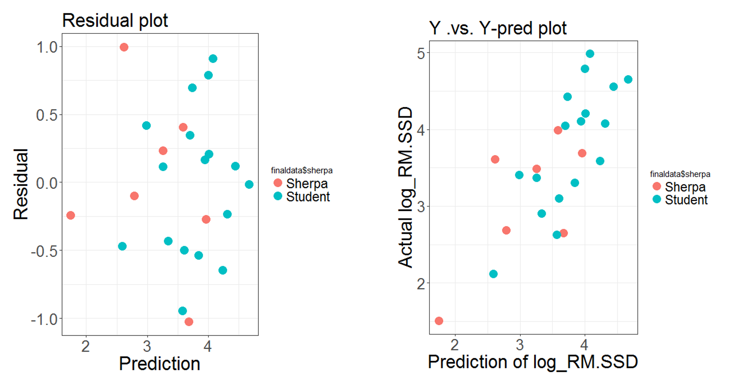
Residuals
Notes:
No fanning out; no clear pattern
Linear pattern – model predicted well

Slide 16

Questions???

