Slide 1


Entrepreneurship Exploration and Analysis
Presented by :
Nathaniel Coffin, David Swart, Sanjay Tamrakar, Jie Wang

Slide 2

Introduction
to help the small or medium ventures in the developing countries to survive, grow and thrive with the help of organizational sponsorship
to explore which sponsorship influences venture growth in the context of poverty
trying to explore significant difference in entrepreneurial growth by constructing reasonable models
data was collected from 3 years of pre- and post- training of 139 ventures among three countries. Training for countries 2 and 3 started in July 2014 and training for country 1 started in Aug 2014.

Slide 3

CHALLENGES IN DATA
missing values in several predictors
seasonality or periodicity
selection bias
Summary of missing values in the data
Predictor | Missing Proportion (%)
ent_age | 2.28
firm_age | 34.67
basecredit | 39.04
base_employees | 39.04

Slide 4
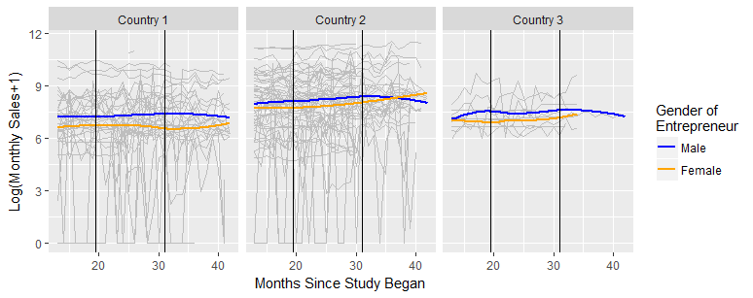
EXPLORATORY DATA ANALYSIS

Slide 5
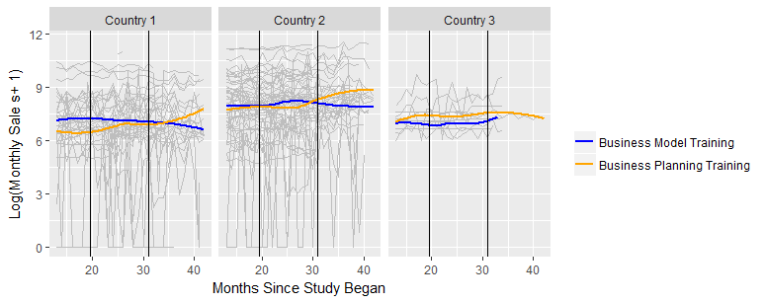
Business model vs business planning

Slide 6
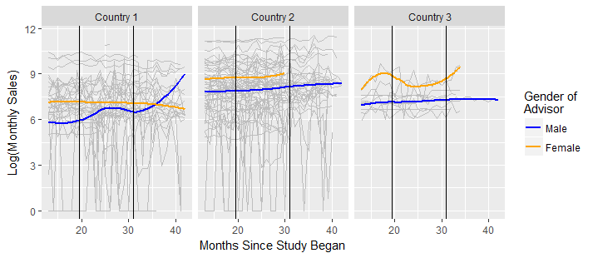
MALE VS FEMALE

Slide 7
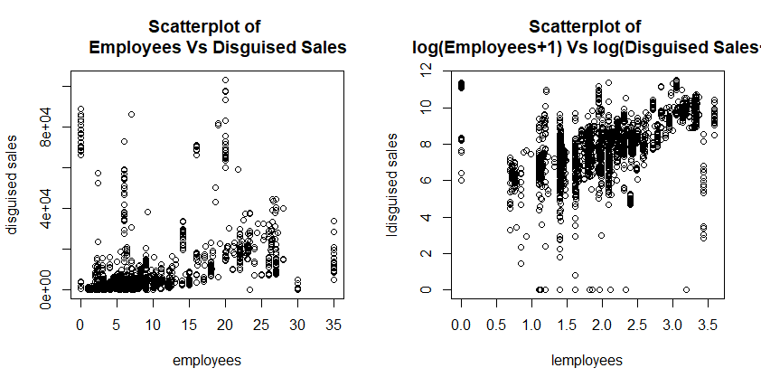
Scatterplot :Employees vs sales

Slide 8
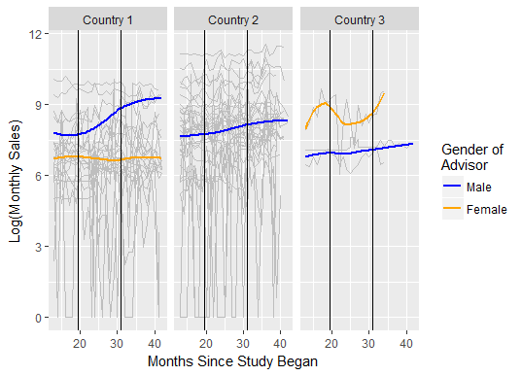
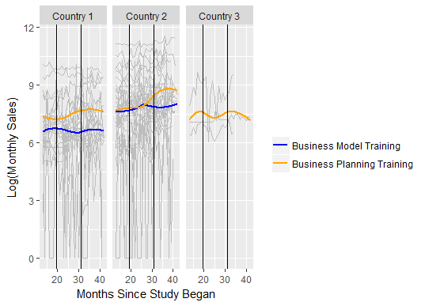
EDA – When firmage=0 removed

Slide 9
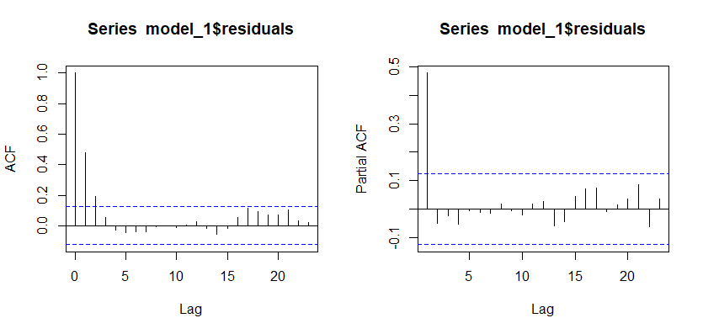
Model without Firm Age as a Predictor and Averaging Over Training States
The response variable was log(sales + 1)
These plots show that an AR(1) model seems appropriate
This is partly because some firms experienced several sequential months without any sales.

Slide 10
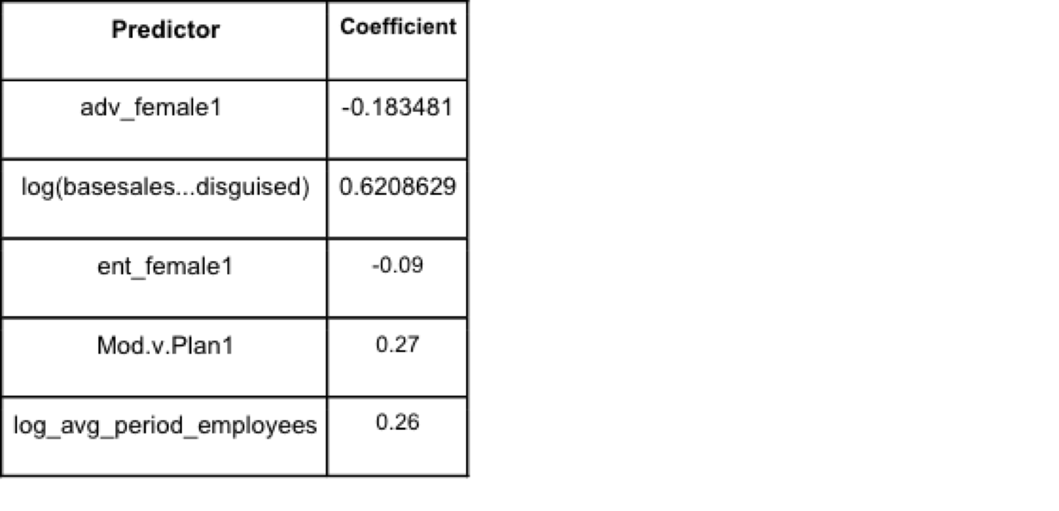
Related coefficients
Table 3: Predictors for the Reduced Data Set
The only significant predictors were
log(basesales...disguised) and log_avg_period_employees
Can’t measure growth because it doesn’t have any variable that represents time, instead test whether firms of each category generally do more sales. This should be correlated to growth so it almost tests growth.
The predictors of interest were not significant.

Slide 11
Modeling with Firm Age as a Predictor, average disguised _sale over training states
Step 1: Variable selection:
Started with the parameters of interest for hypothesis testing:
entrepreneur gender, advisor gender, the training program implemented for the firm, firm age
training periods ,Interaction effects between training state and entrepreneur gender, advisor gender, and training program respectively
Rules:
forward selection to find worthwhile predictors for the model, and we used AIC as a basis for whether a newly introduced predictor was worth keeping.

Slide 12
Related coefficients
Table 4: Predictors for the Reduced Data Set
Predictor | Coefficient | Predictor | Coefficient
intercept | -0.4347 | log(basesales...disguised) | 0.7792
adv_female | -0.1042 | Mod.v.Plan*Training.State1 | -0.1016
ent_female | 0.4324 | Mod.v.Plan*Training.State2 | 0.1018
firm_age | -0.0097 | ent_female*Training.State1 | -0.1385
Mod.v.Plan | 0.3622 | ent_female*Training.State2 | -0.0836
Training.State1 | 0.3258 | adv_female*Training.State1 | -0.1799
Training.State2 | 0.436 | adv_female*Training.State2 | -0.4062
Note: These coefficients are on a logarithmic scale, so their effects on the response are exponential rather than simply additive.

Slide 13
How do we make use of them for testing hypotheses?
H1: Venture age will experience reduced entrepreneurial growth gained from organization in Sponsorship.
t-test, p-value= 0.1862
Conclusion 1: firm age does not have a significant effect on the log average period sales during a fixed training period.

Slide 14
How do we make use of them for testing hypotheses?
H2: Female-led ventures in contexts of poverty will experience less entrepreneurial growth from organizational sponsorship than male-led ventures.
For Female-led vetures:
before training : Y*= β₂ent_female
after training, Y*=β₂ent_female +β₇Training.State2 + β₁₂ent_female*Training.State2,
so Y*=β₇Training.State2 + β₁₂ent_female*Training.State2
For male-led ventures
before training, ent_female and the training state variables are all 0,
after training ent_female=0, Training.State1=0, and Training.State2=1,
so Y*=β₇Training.State2
Test whether β₇Training.State2 + β₁₂ent_female*Training.State2 = β₇Training.State2
Conclusion 2: p-value of 0.6239, we have insufficient evidence to conclude that the mean change in firm growth differs between male and female-led ventures.

Slide 15
Linear Regression Model to Predict Monthly Sales Compensating for Seasonality and Missing Data
Ultimately seeks to test the same hypotheses as the other models.
Major focus on accounting for seasonality in the data and selection bias during the study from which the data were collected.

Slide 16
Procedure
Remove observations for which base sales and disguised sales are 0. These observations would be problematic once we log the two variables, and they make little sense within the context of the data set.
We would have liked to implement a parallel model to assign a discrete probability for disguised sales equaling 0 and a continuous probability for disguised sales being greater than 0, but this ended up being less important to the model, so the process was left out.
Build 8 models using different collections of predictors to account for seasonality in the response log(disguised sales). More details on this procedure might be included in an appendix as needed.
Average the predicted values for each observation in the data across all 8 models, then subtract the result from log(disguised sales)

Slide 17
Procedure (Continued)
Construct the model using a multivariate normal approach with a conditional mean formula. This accounts for the missing values in our data that normal regression would not be able to handle. (We tested and found this method was equivalent to the regression method within a very small margin of error)
Interpret the model and coefficients.

Slide 18
OUTPUT
Predictor | Coefficient | Standardized Coefficients
Intercept | -6.3146
log(basesales...disguised) | 0.6774 | 0.6993
lemployees | 0.3959 | 0.1835
Mod.v.Plan1 | -0.3715 | -0.1216
month*Mod.v.Plan1 | 0.01 | 0.0968
(Month- duringstart)*Mod.v.Plan1*(Training.State1 + Training.State2) | -0.0215 | -0.1052
Firm age | -0.0014 | -0.0105
Month* Firm age | -0.0004 | -0.0944
adv_female1 | -0.2276 | -0.0736

Slide 19
OUTPUT CONTINUED
month* adv_female1 | -0.0095 | -0.0893
(Month- afterstart)* adv_female1 * Training.State2 | -0.0068 | -0.0106
ent_female1 | 0.0046 | 0.0015
month* ent_female1 | 0.0047 | 0.0447
adv_female1* ent_female1 | 0.5511 | 0.1352
Month* ent_female1* adv_female1 | -0.0126 | -0.0893
(Month- afterstart)* ent_female1* adv_female1 * Training.State2 | 0.0476 | 0.0518
(Month- duringstart)*(Training.State1 + Training.State2) | 0.0182 | 0.1044
(Month- afterstart)* * Training.State2 | 0.0042 | 0.0086

Slide 20
Discussion
If Technoserv wishes to conduct more studies like this in the future, we have two major suggestions.
-> the ideal world goal of having a complete data set with values for every observation on every variable is nearly impossible, but we lost way too much data due to poor recording
-> needs to do a completely randomized experiment.

