Slide 1
Module 3 Technical Documents

Slide 2
Two Main Focuses
EPA/US Government websites
AMTIC website (http://www.epa.gov/ttn/amtic/)
EPA's Quality System for Environmental Data and Technology (http://www.epa.gov/quality1/)
e-CFR
List of EPA Regional Contacts

Slide 3
AMTIC Website
Code of Federal Regulations (CFR)
QA Requirements
QA Guidance

Slide 4
AMTIC Website CFR (Cont’d)
Find the CFR pertaining to monitoring information
Under “Regulations and Guidance”
40 CFR Part 50 (Appendices contain pollutant-specific FRMs)
40 CFR Part 53 Sets out requirements for acceptance of monitoring equipment and/or procedures as equivalent to equipment and/or procedures promulgated as FRMs and lists those that have been approved
40 CFR Part 58
Ambient monitoring Network requirements
The overarching QA requirements for ambient monitoring networks
Network Design requirements
Monitor siting requirements
e-CFR website (http://ecfr.gpoaccess.gov/cgi/t/text/text-idx?tpl=/ecfrbrowse/Title40/40tab_02.tpl)

Slide 5
AMTIC Website CFR (Cont’d)
Permitting Authority and Permittee (PSD Program Managers) should know where to locate and understand:
40 CFR Part 50 Methods
40 CFR Part 51 State Implementation Plan (SIP)
40 CFR Part 52 Federal PSD
40 CFR Part 58 QA
Auditors should know where to locate and understand:
40 CFR Part 50 Methods
40 CFR Part 58 Appendices A,C,D, and E for QA provisions

Slide 6
AMTIC Website (Cont’d) QA Requirements
Quality management system (QMS) documents are the responsibility of the permittee
Discussed in 40 CFR Part 58 Appendix A
Quality Management Plan (QMP)
Quality Assurance Project Plan (QAPP)
Project Standard Operating Procedures (SOPs)
All auditors are responsible for their own project SOPs based on contractual obligations to the permittee

Slide 7
AMTIC Website (Cont’d) QA Guidance
EPA Quality Assurance Handbook (Volume 2)
(http://www.epa.gov/ttn/amtic/files/ambient/pm25/qa/QA-Handbook-Vol-II.pdf)
EPA Green Book
(http://www.epa.gov/oaqps001/greenbk)
EPA Training Courses
(http://www.epa.gov/ttn/amtic/qapollutant.html)
(http://www.epa.gov/ttn/amtic/ncore/guidance.html)

Slide 8
EPA's Quality System for Environmental Data and Technology
http://www.epa.gov/quality1/
If you are developing a Quality Management Plan, see <Quality Management Tools - Quality Management Plans>
If you are writing a Quality Assurance Project Plan, see <Quality Management Tools - Quality Assurance Project Plans>
Also see <Quality Management Tools - Systematic Planning> for information about planning your project before you document this planning in a QA Project Plan.

Slide 9
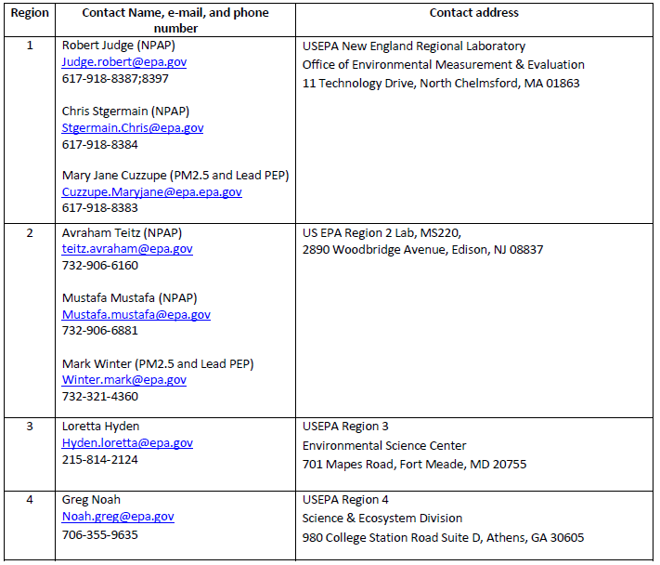
List of EPA Regional Contacts

Slide 10
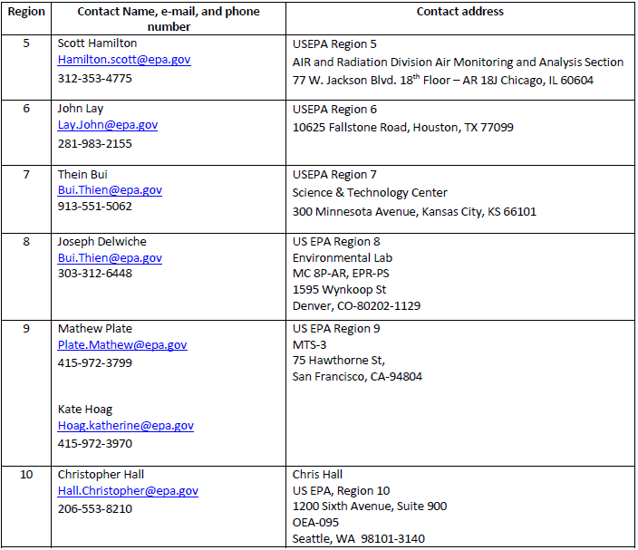
EPA Regional Contacts (Cont’d)

