Slide 1
40 CFR 58 Appendix A: Calculations for Data Quality Assessment (sec. 4-5) aka What Is Reality?
1-pt QC check statistics
Precision calcs
Bias calcs
Stats are designed to show us how far from the TRUTH we might be.
Ask questions! Get chocolate!

Slide 2
Measurement Error
Presented as a fraction of the “truth” (e.g., 10% off)
Precision
Random error
“wiggle” inherent in system
Estimated by (1) repeated measurements of “known,” and/or (2) side-by-side measurements of the same thing
Some imprecision is unavoidable
Bias
Systematic error
“jump” consistently high or low
bias can be eliminated (in theory)
Wash Dept of Ecology

Slide 3
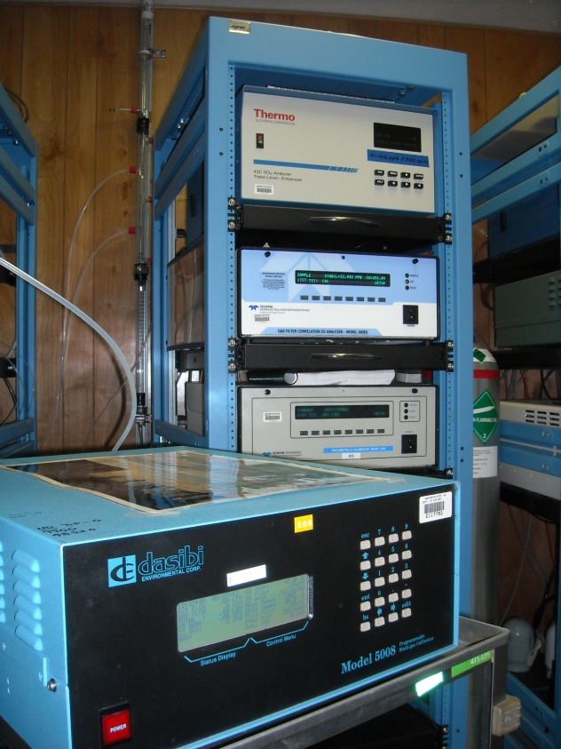
1-pt QC 0³ check data, in AQS:
SITE 20
Meas Val (Y) | Audit (known) Val (X)
85.1 | 91.1
81.6 | 91.1
83.4 | 92.4
84 | 92.4
87.4 | 92.4
78.4 | 92.4
85.4 | 92.4
85.4 | 92.4
80.6 | 88
83.5 | 88
83.5 | 88
80.8 | 88
81.5 | 88
93.5 | 88
84.8 | 88

Slide 4
d-sub-i = d_{i} = diff/known
Routine QC checks used to estimate BOTH
Both come from d-sub-i
Bias
Precision
sometimes it’s obvious
Sometimes it’s not:
Wash Dept of Ecology
Date of QC check
Another network…

Slide 5
Meas Val (Y) | Audit Val (X) | d-sub-i
85.1 | 91.1 | -7
81.6 | 91.1 | -10
83.4 | 92.4 | -10
84 | 92.4 | -9
87.4 | 92.4 | -5
78.4 | 92.4 | -15
85.4 | 92.4 | -8
85.4 | 92.4 | -8
80.6 | 88 | -8
83.5 | 88 | -5
83.5 | 88 | -5
80.8 | 88 | -8
81.5 | 88 | -7
93.5 | 88 | 6
84.8 | 88 | -4
d-sub-i values represent:
All of the measurements’ error during that day, week, month, quarter
The QC checks are supposed to be “randomized” so that they are a sample, or subset, of the whole universe of possible QC checks (the population), and then represent the population of QC checks you could do at any time
As a proportion of the “truth,” so “truth” is always on the bottom (diff/known; so error is quantified as a fraction of the truth so we can imagine it, e.g., 10%)
“error” = distance from truth at that moment

Slide 6
Meas Val (Y) | Audit Val (X) | d-sub-i
85.1 | 91.1 | -7
81.6 | 91.1 | -10
83.4 | 92.4 | -10
84 | 92.4 | -9
87.4 | 92.4 | -5
78.4 | 92.4 | -15
85.4 | 92.4 | -8
85.4 | 92.4 | -8
80.6 | 88 | -8
83.5 | 88 | -5
83.5 | 88 | -5
80.8 | 88 | -8
81.5 | 88 | -7
93.5 | 88 | 6
84.8 | 88 | -4
How can we apply these results to get bias and precision for ALL our measurements of ozone with this analyzer during this time period?

Slide 7

We assume that these results, and their distribution, is representative of all the QC checks we could have done:
There’s a reason no x-axis units
2.3.1.2 Measurement Uncertainty for Automated Ozone Methods. The goal for acceptable measurement uncertainty is defined for precision as an upper 90% confidence limit for the CV of 7%

Slide 8
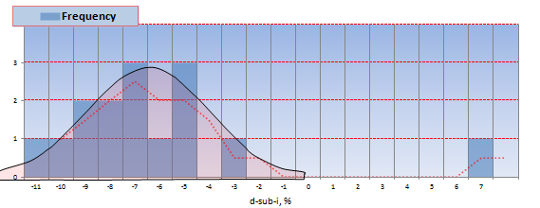
STDEV=4.56 (68% WITHIN THIS OF THE MEAN)
But we do not care about the low-imprecision tail
Only care about the extreme tail of high imprecision
Want to be able to say “90% confident that your precision is less than this value”

Slide 9
STDEV=4.56
10% upper tail
CFR eq’n 2:

Slide 10
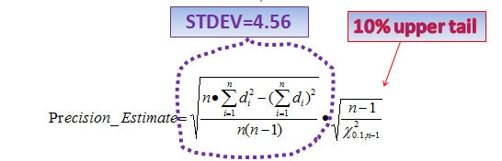
chi-sqrd(90%) = CHIINV(0.9,n) = 7.79
then 4.56 x SQRT(n-1/7.79) = 6.11 %

Slide 11

Use the DASC Tool to Understand Your QC Checks and Audit Results (like EPA does)
Calculations of measurement uncertainty are carried out by EPA, and PQAOs should report the data for all measurement quality checks
YOU do these calculations and charts easily, and save yourself time, money, and embarrassment

Slide 12
We will review each in both the DASC tool and the AMP256 report
First, what is the DASC tool?
DASC tool was produced specifically for us to calculate the data assessment statistics in CFR in AMTIC Quality Indicator Assessment Reports (AMP256)
http://www.epa.gov/ttn/amtic/qareport.html
Easy way to explain and calculate data assessment statistics in CFR
Excel spreadsheet
Matches AMP256 (by site)
Each equation is numbered and matches the numbers in CFR
Notes:
Can be used by the operator or QA personnel. Anyone that has access to the data (flows, QC checks, actual values.
Easy to use…just a matter of populating

Slide 13
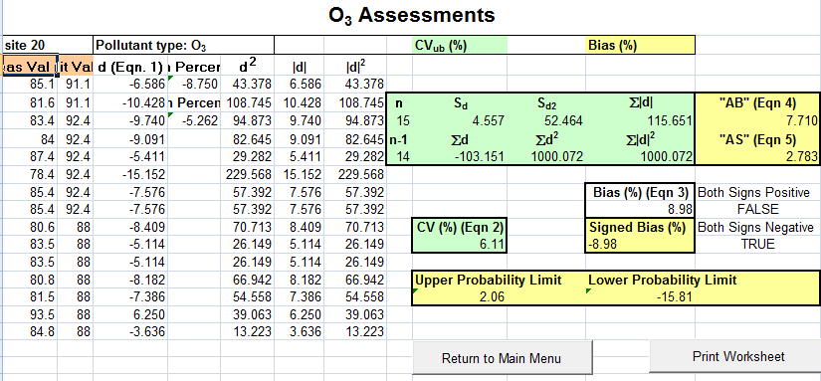
DASC Tool:

Slide 14
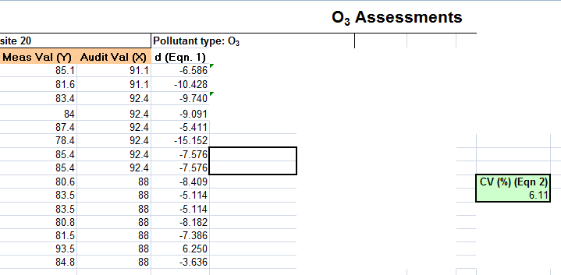
Precision in DASC = cell i13 = 6.11%

Slide 15
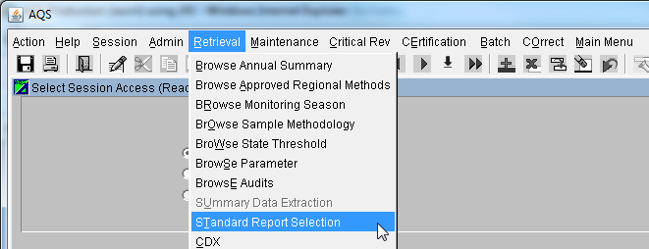
AMP256-Data Quality Indicators Report
AQS Standard Report to Compute the Statistics Outlined on 40 CFR Part 58 Appendix A
Part of the Annual Certification Process to Verify Submission of QA and routine Data to AQS
CORRESPONDS to what you can calculate in the DASC spreadsheet, as we will see.
Notes:
Donovan should I INSERT SCREENSHOT OF AQS STND REPORT SELECTION or are most attendees site operators who will never look at the AQS interface? If there are tribes in audience I would like to as the tribal site operators are the same people who upload into AQS

Slide 16
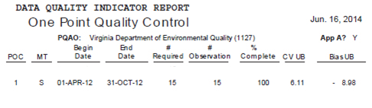
Does our 6.1% match AMP256?
90% Confidence Upper Bound of precision is 6.1%
“There is a 90% chance that our precision will not be greater than 6.1%”
Same as YOU can calculate any time using the DASC

Slide 17
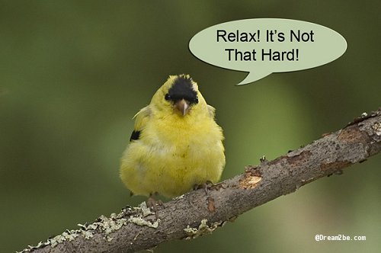
Summary of precision:
Calculated from routine QC checks d_{i}
Overall upper bound of CV calculated from d_{i}
you can be 90% sure that your true precision is less than this “upper bound of the CV” (eq’n 2)
Thanks Shelly Eberly!

Slide 18
Bias:
FINALLY look at where we are on the x-axis
(Remember precision only cares about width)
The goal for acceptable measurement uncertainty for bias is an upper 95 percent confidence limit for the absolute bias of 7 percent.
0

Slide 19
Meas Val (Y) | Audit Val (X) | d % (Eqn. 1)
85.1 | 91.1 | -7
81.6 | 91.1 | -10
83.4 | 92.4 | -10
84 | 92.4 | -9
87.4 | 92.4 | -5
78.4 | 92.4 | -15
85.4 | 92.4 | -8
85.4 | 92.4 | -8
80.6 | 88 | -8
83.5 | 88 | -5
83.5 | 88 | -5
80.8 | 88 | -8
81.5 | 88 | -7
93.5 | 88 | 6
84.8 | 88 | -4
Date of QC check
Control chart from the free DASC excel spreadsheet on AMTIC

Slide 20
Bias statistics (CFR App A, 4.1.3):
Remember that bias as well as precision starts from the difference between your instrument’s indicated value and the known (audit) value (meas-known)/known= d_{i}
bias (jump) is calculated from d_{i}
Bias just based on the AVERAGE of the d_{i} with the sign taken into account (if your analyzer is always higher than the known, you have a high ( + ) bias

Slide 21

Bias in CFR eq’n 3:
d % (Eqn. 1)
-7
-10
-10
-9
-5
-15
-8
-8
-8
-5
-5
-8
-7
6
-4
AB is the mean of the absolute values of the d_{i}’s = 7.7
t_{0.95,n-1} is the 95th quantile of a t-distribution
=TINV(2*0.05,n-1) = 1.76
AS is the STDEV of the abs value of these d_{i}’s = 2.78
So
Abs value of bias = 7.7 + 1.76 * (2.78/sqrt of n)
= 8.98

Slide 22
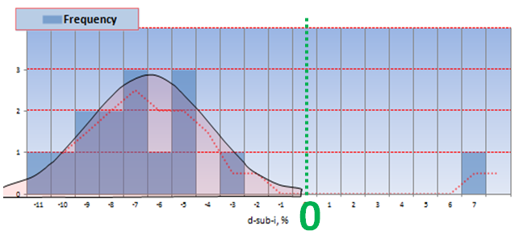
That 8.98 is the abs value of bias, now what’s its sign?
Look at 25% quartile and 75% quartile
If they straddle zero, bias is unsigned
If they’re both negative, bias is negative
If they’re both positive, bias is positive

Slide 23
Quartiles?
=QUARTILE(d-sub-i,1) = 25% quartile = -9
=QUARTILE(d-sub-i,3) = 75% quartile = -5

Slide 24
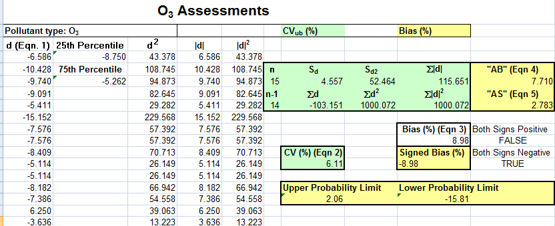
Sign of Bias:
Both quartiles are negative
Bias is negative 8.98 = -8.98
Agrees with DASC:

Slide 25
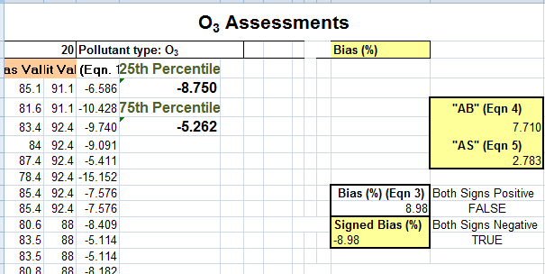
DASC bias in cell k13:

Slide 26
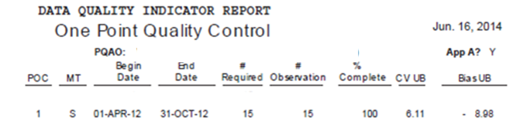
Does this match AQS standard report AMP256 ?:
Bias UB (upper bound of bias) = -8.98
(goal is upper 95 percent confidence limit for the absolute bias of 7 percent)

Slide 27
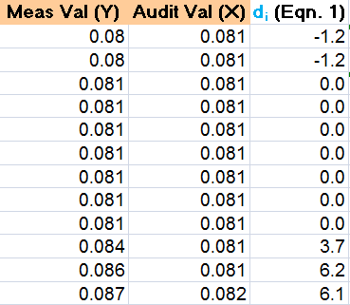
Both bias and precision are in the same sheet (O3 P&B) in the DASC and use the same input:
YOU can calculate Bias over any time period using DASC
Wash Dept of Ecology
Notes:
Discuss here how the gaps are where data were invalidated automatically cuz over 7% (the hourly data bracketed by these failed checks were also invalidated) and make sure you do not include your failed QC checks if you want to match exactly what is in the AMP256 report ALSO discuss how EPA calculates positive and negative, so if both the 25 and 75 percentiles are negative then negative overall bias, same with positive

Slide 28

Summary of gas bias:
Calculated from routine QC checks d_{i}
Overall upper limit of bias calculated from d_{i}
Then look at the sign (and the chart) for whether your analyzer is biased high (+) or low (-)
We are 95% confident that our 03 bias is less extreme than -9%

Slide 29
Do I invalidate pollutant data based on d-sub-i?
Validation tables in QA Handbook:
Critical Measurement Quality Objective O3=7%
See the Data Certification ppt, next up.
Date of QC check

Slide 30
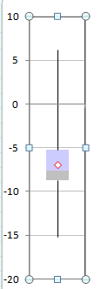
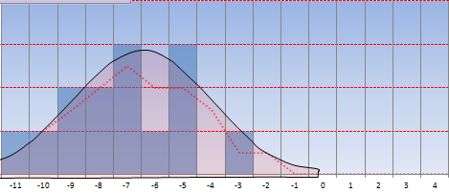
Median = 50% percentile = 7.6
25% percentile= -8.8
75% percentile = -5.3
Mean = -6.9

Slide 31
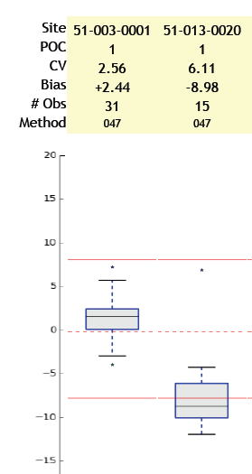

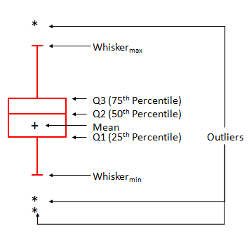

Slide 32
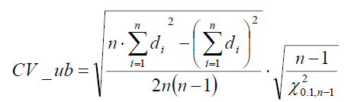
PM_{2.5} Precision
PM2.5 is the same as gaseous, except:
d-sub-i are from COLLOCATED, and the known is the average of the two PM2.5, so d-sub-i is
(RO-CO)/(avg of RO & CO)
Because the known is the avg of 2 measurements, add SQRT(2) to the denominator (divide by best estimate of truth)
STDEV
That’s the only difference in the precision stat from gas stats

Slide 33

PM_{2.5} Bias
PM2.5 bias same as gaseous, except:
known = PEP audit filter results, so the d-sub-i is the (field-PEP)/PEP
Don’t take abs value of the d-sub-i
D is avg of these d-sub-i values
n is # of PEP audits, and if n=3 then t=2.9
(as n grows, t goes to 1.65)
Use the 25% and 75% quartiles + or -
Stnd error
And lower confidence interval is D minus t*stnd error

Slide 34
PM10 statistics:
Bias confidence intervals based on monthly flow rate (FR) checks:
d-sub-i from FR
THEN bias statistics are the same as PM2.5
Flow rate “acceptability” limits are based on 6-month FR audits (with FR audit device not the same one you use for the monthly):
Limit = D +- 1.96 * STDEV
d-sub-i = (sampler-audit_FR)/audit_FR
and D is their average

Slide 35


Thank you!
Work with Tribal Air Agencies
Knowledge = Power; Let’s Share
Melinda Ronca-Battista melinda.ronca-battista@nau.edu; this presentation is on our YouTube channel

