Slide 1

Stock Analysis
Barry Murthy
Rafal Rudzinski
Tamilselvan Tamilmani

Slide 2
Agenda
Introduction
Objective
Data Set
Initial Analysis

Slide 3
Objectives
Classifying stocks by
Risk
Affordability
Industry
Volatility

Slide 4
Data Set
30 Minute Market positions for two weeks
A million data points
Analyst Ratings
News Data about the listed company

Slide 5
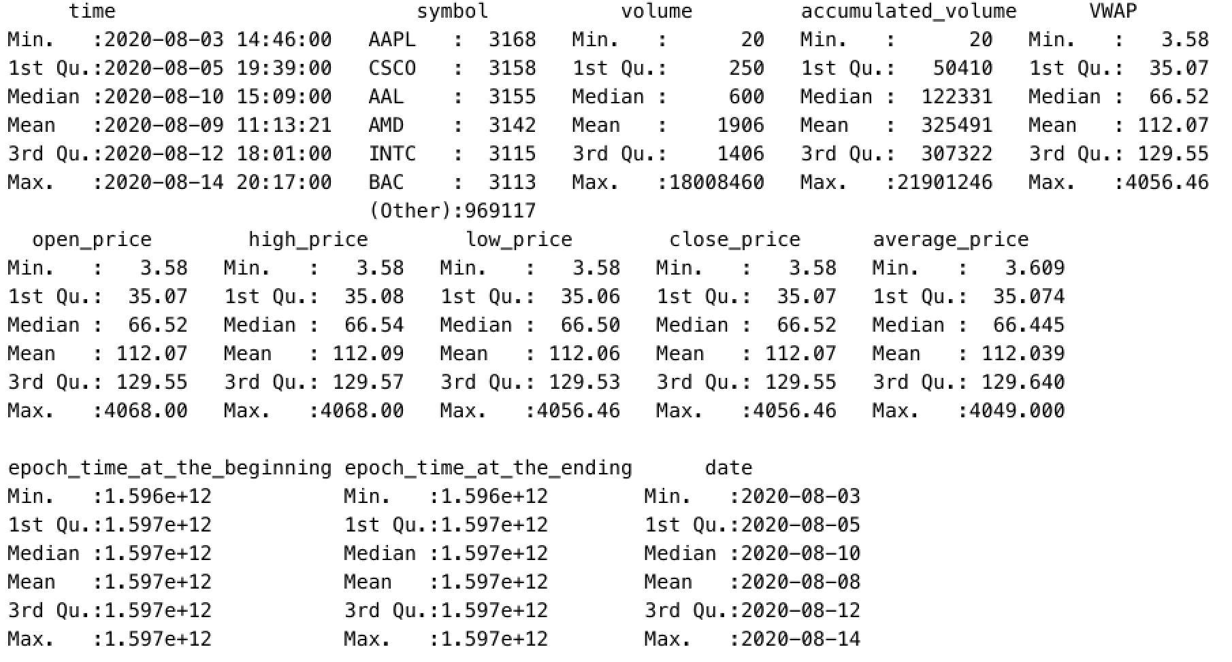
Summary Statistics

Slide 6
Cluster Based on Price change

Slide 7
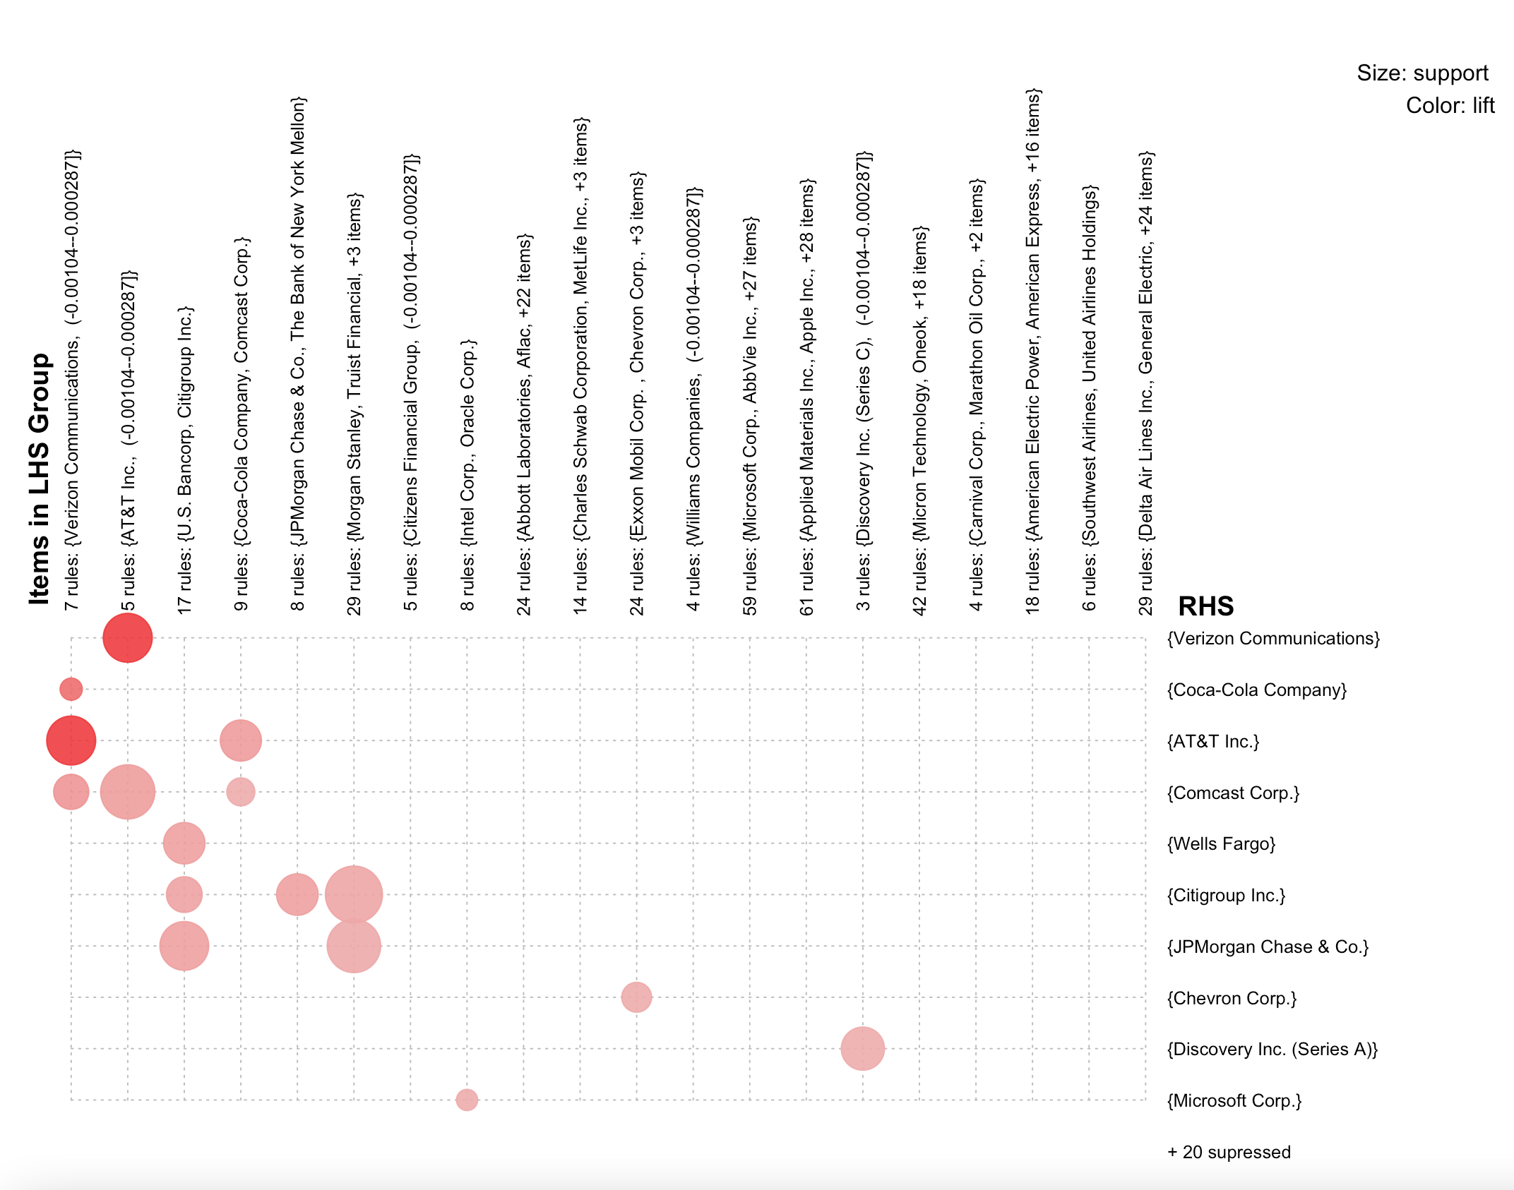
Rules Mined for Steep Changes

