Slide 1
Stock Analysis

Slide 2
Cluster Based on Price change

Slide 3
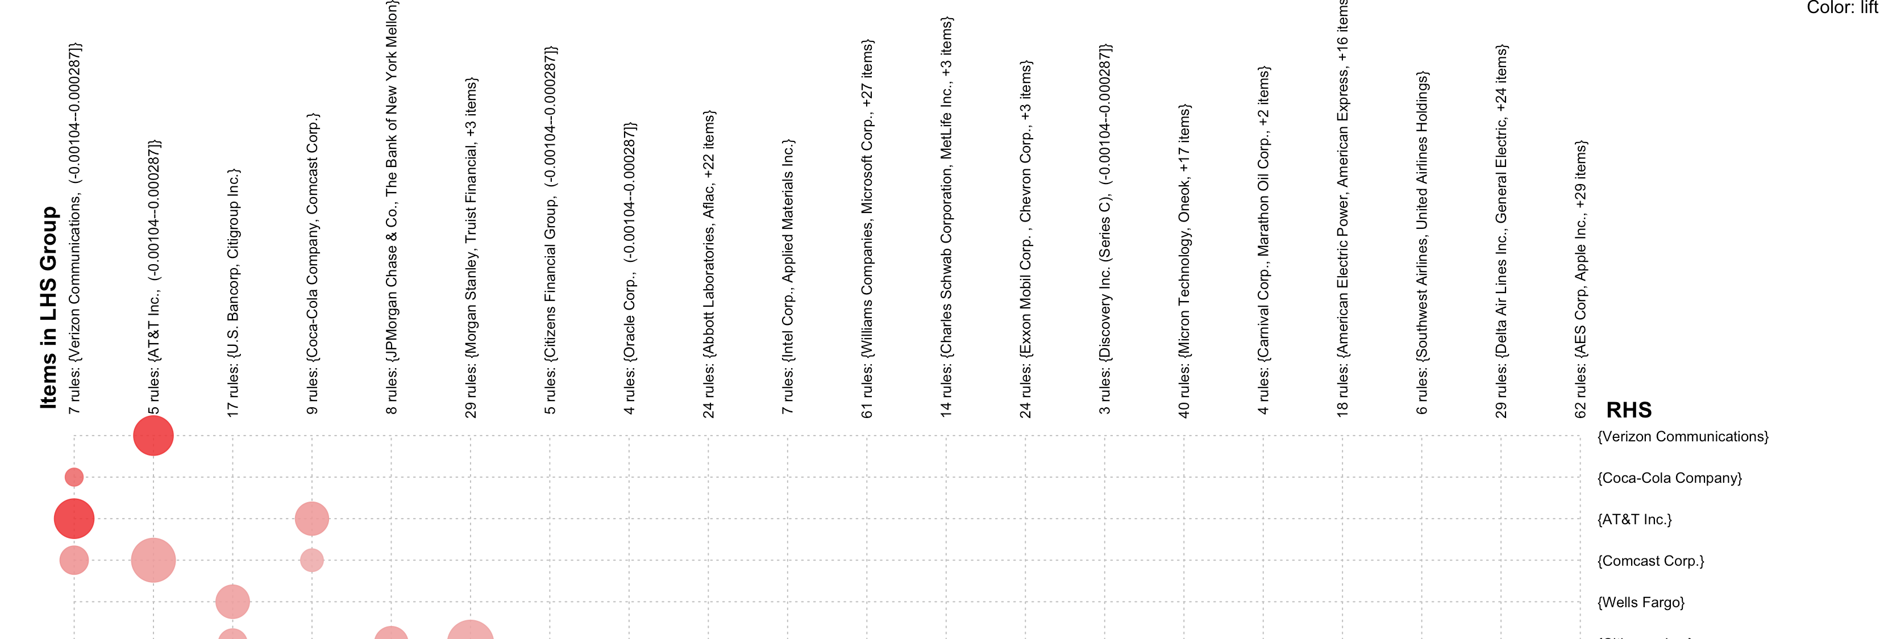
Rules Mined for Non-Average Changes

