Slide 1

GEORGIAN TECHNICAL UNIVERSITY
Cheff Mshia
Adaptive Memory and Interface Architecture for an AI-Driven Culinary Assistant
BACKEND & AI MEMORY SYSTEMS
FRONTEND & INTERFACE ARCHITECTURE
Tamta Termakozashvili
Nino Khorava
Adaptive correction memory, language detection, inference pipeline
“Gothic Kitchen” design system, responsive layout, usability verification
Supervisor: Mariam Chkhaidze • Bachelor's Thesis Defense
Notes:
This presentation is a joint defense of two complementary bachelor's theses on the Cheff Mshia system: adaptive backend memory and AI integration, and frontend interface architecture.

Slide 2


INTRODUCTION & PROBLEM STATEMENT
Two engineering problems, one system
Data Scarcity and Static Model Weights
Rigid Interfaces for Unstructured Intent
Web-crawled LLM training corpora are English-dominant [Brown et al.; Dodge et al.]. Georgian, spoken by approximately four million people, is a long-tail language with negligible digitized culinary text.
Legacy culinary software assumes exact keyword filters over rigid relational schemas. Real queries are unstructured: arbitrary leftover ingredients, compound dietary constraints, situational time limits.
Because model weights are static post-training, a correction accepted mid-conversation is not retained: the assistant reverted to describing the entity as exclusively boiled in the very next turn.
The interface must also remain legible in a low-light kitchen environment and absorb text of unpredictable length and script without layout shift — constraints most recipe UIs do not address.
Cheff Mshia — Joint Thesis Defense
2
Notes:
Two engineering problems motivated this system. On the backend side, large language models are trained on English-dominant web corpora, leaving Georgian, a long-tail language of roughly four million speakers, poorly represented; because model weights are static after training, corrections cannot persist across turns. On the frontend side, legacy culinary software depends on rigid keyword-based schemas that fail on unstructured natural-language requests, and must additionally remain usable in a low-light kitchen environment where text of unpredictable length and script must not break the layout.

Slide 3
SYSTEM ARCHITECTURE
A Model–View–Controller separation of concerns
1
2
3
4
5
6
Session validated
(UUID user_id)
→
detect_message_
language()
→
right_rcp_save() →
user_memory.json
→
build_prompt()
injects corrections
→
POST to Groq API
(last 12 messages)
→
Formatted response
returned to client
Figure: Request flow for POST /chat within the Flask backend (app.py)
MODEL
CONTROLLER
VIEW
Tamta Termakozashvili
Shared implementation
Nino Khorava
JSON-based persistence layer: chat history, favorites, and corrected-recipe records, isolated per user_id.
A minimal Flask application routing form submissions to templates and to the Groq inference API.
Jinja2 templates and the “Gothic Kitchen” CSS design system; contains no business logic.
Cheff Mshia — Joint Thesis Defense
3
Notes:
The application follows a Model-View-Controller separation of concerns. The Model, a JSON-based persistence layer for chat history, favorites, and corrected recipes, is the subject of Tamta's thesis. The View, the Jinja2 templates and the entire Gothic Kitchen design system, is the subject of Nino's thesis. The Controller, a minimal Flask layer connecting the two, is shared implementation. This separation allowed each thesis to be developed, tested, and evaluated independently.

Slide 4



BACKEND IMPLEMENTATION — TAMTA TERMAKOZASHVILI
Adaptive memory and linguistic stability
Recipe Correction Memory Engine
detect_message_language()
Groq / Llama-3.3-70b-versatile
correcting_stuff() detects correction markers in English and Georgian; right_rcp_save() de-duplicates by subject and persists the correction, which is re-injected into every subsequent prompt.
Two-tier detection: explicit keyword override, then dominant-script analysis over the Georgian Unicode block (U+10A0–U+10FF) versus Latin characters. Overall complexity O(n).
Grouped-Query Attention and a purpose-built Language Processing Unit (LPU) yield deterministic, low-variance token generation relative to general-purpose GPU inference.
Session retrieval: O(1) hash-table lookup • Correction persistence: O(n) file I/O • Multi-tenant isolation enforced via UUID-scoped user_id
Cheff Mshia — Joint Thesis Defense
4
Notes:
The backend implementation centers on three components. The Recipe Correction Memory Engine detects correction markers in the user's message, de-duplicates by subject, and persists the correction for injection into every future prompt. The language detection module applies a two-tier strategy — explicit keyword override, then dominant-script analysis over the Georgian Unicode block — with linear overall complexity. Inference runs on Groq's Llama-3.3-70b-versatile model, which combines Grouped-Query Attention with purpose-built LPU hardware for deterministic, low-variance token generation.

Slide 5
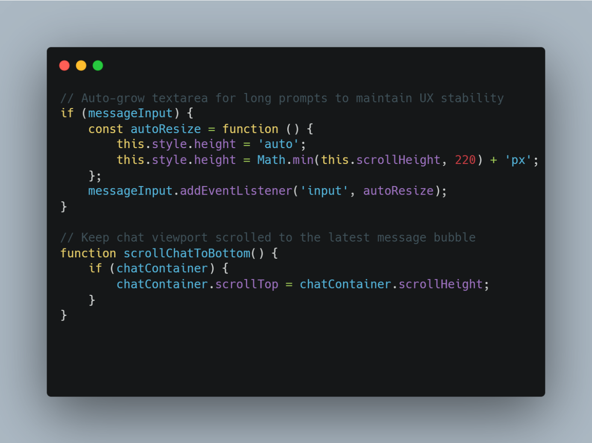
FRONTEND IMPLEMENTATION — NINO KHORAVA
A design system for a low-light environment
“Gothic Kitchen” design tokens
Colour and spacing values centralized as CSS custom properties (e.g., --gothic-purple, --gold), enabling high-contrast legibility under poor ambient lighting.
Spatial zoning model
A primary conversational area, a persistent favorites shortcut, and a navigation sidebar, built without an external UI framework.
Content-driven containers
Flexible, non-fixed-height chat bubbles absorb AI-generated text of unpredictable length and script (Georgian/Latin) without breaking layout margins.
Complexity analysis (§5.3): hash-based retrieval O(1) • sliding-window context O(k) • JSON serialization O(n) — consistent with the backend's own analysis.
Figure: Client-side interaction layer — auto-growing textarea, Enter-to-send handling, scroll-position restoration.
Cheff Mshia — Joint Thesis Defense
5
Notes:
The frontend is a hand-built, framework-free interface organized around the Gothic Kitchen design system, with colour and spacing values centralized as CSS custom properties for high-contrast legibility under poor kitchen lighting. The viewport is partitioned into a spatial zoning model: a primary conversational area, a favorites shortcut, and a navigation sidebar. Because AI-generated replies vary unpredictably in length and script, every container is built with content-driven, non-fixed-height sizing. The methodology chapter's own complexity analysis, hash-based retrieval, sliding-window context management, and JSON serialization, mirrors the backend's independently derived figures.

Slide 6


IDENTIFIED ENGINEERING DEFECTS
Four defects that shaped subsequent design decisions
Contextual Memory Volatility
Inference Latency & Rate-Limiting
Session Data Isolation Vulnerability
Dynamic Content Overflow
Corrections acknowledged mid-conversation were not retained; the model reverted to an inaccurate baseline description in the subsequent turn.
The initial Gemini API integration produced frequent HTTP 429 (Too Many Requests) responses under moderate load, degrading responsiveness.
Concurrent normal and incognito sessions exposed unscoped reads on the history and favorites routes, permitting cross-session data access.
AI-generated text of unpredictable length risked exceeding fixed-layout chat bubble boundaries, particularly across script boundaries.
A comprehensive log of sixteen identified and resolved defects is documented in Table 4.1 of the backend thesis.
Cheff Mshia — Joint Thesis Defense
6
Notes:
Development surfaced four defects with direct architectural consequences. First, contextual memory volatility: corrections were acknowledged but not retained across turns. Second, inference latency and rate-limiting under the initial Gemini integration. Third, a session data isolation vulnerability, discovered through concurrent normal and incognito browser testing, that exposed one user's history to another session. Fourth, a frontend defect: unpredictable AI-generated text length threatened to overflow fixed-layout chat containers. A comprehensive log of sixteen defects in total is documented in the backend thesis.

Slide 7
ENGINEERING SOLUTIONS & REMEDIATION
Each defect resolved by a targeted architectural change
Contextual Memory Volatility
Latency & Rate-Limiting
Session Isolation Vulnerability
Dynamic Content Overflow
Recipe Correction Memory Engine persists corrections to disk and re-injects them into every subsequent prompt.
Migration to Groq / Llama-3.3-70b-versatile: ~74.5% average latency reduction, 100% request success rate.
Mandatory user_id field on every record; all reads routed through get_user_history() / get_user_fav().
Content-driven, non-fixed-height CSS containers; verified at 1920px, 768px, and 360px viewports.
Shared engineering principle: the favorites-route vulnerability originated from duplicated route logic — duplicating a code structure duplicates its inherent defects.
Cheff Mshia — Joint Thesis Defense
7
Notes:
Each defect maps to a specific remediation. The memory engine resolves contextual volatility. Migration to Groq resolves the latency and rate-limiting problem, delivering an average latency reduction of approximately seventy-four point five percent and a full request success rate. The isolation vulnerability was resolved by requiring a user_id field on every record and routing all reads through scoped functions. The overflow defect was resolved with content-driven CSS containers, verified across three viewport widths. Across both theses, the shared lesson is that duplicating a code structure duplicates its inherent defects — this is precisely how the favorites-route vulnerability was introduced.

Slide 8
RESULTS AND EVALUATION
Quantitative verification, backend and frontend
Backend Storage & Isolation
< 1.2 ms average file read
< 4.5 ms average file write
~42 MB stable memory footprint (3-hour window)
0 leaks confirmed across 5 concurrent sessions
Frontend Latency & Verification
290 ms avg. end-to-end (σ = 18 ms, n = 100)
−74.5% average latency • 100% request success (Table 5.1)
7 / 7 functional test cases passed
WCAG AA contrast verified at 1920 / 768 / 360 px
Cheff Mshia — Joint Thesis Defense
8
Notes:
Quantitative results confirm both halves of the system. On the backend, migrating to Groq produced an average latency reduction of seventy-four point five percent across four tested context lengths, with a full request success rate, sub-1.2-millisecond file reads, sub-4.5-millisecond writes, a stable forty-two-megabyte memory footprint, and zero confirmed cross-session leaks. On the frontend, end-to-end latency across one hundred interactions averaged two hundred ninety milliseconds with a standard deviation of eighteen milliseconds; all seven functional test cases passed, and WCAG AA contrast was verified at desktop, tablet, and mobile viewport widths.

Slide 9
CONCLUSION AND FUTURE WORK
Adaptive intelligence, paired with an accessible interface
Personalized accuracy was achieved without parameter-level retraining, and a low-latency, accessible presentation layer was achieved without an external UI framework — validating the project's zero-cost architectural constraints.
Adaptive Memory
Accessible Interface
Verified Performance
Corrections persist and are re-injected into every prompt without fine-tuning (Tamta, Ch. 4).
A framework-free, WCAG AA-verified design system stable under unpredictable content (Nino, §7).
~74.5% latency reduction; 290 ms average end-to-end response; 7/7 tests passed.
Future Work: migration to PostgreSQL for concurrency-safe, atomic storage (both theses) • component-based front-end architecture (Nino) • asynchronous request handling and an expanded Georgian factual dataset (Tamta)
Cheff Mshia — Joint Thesis Defense
9
Notes:
In conclusion, this project demonstrates that personalized accuracy in a low-resource culinary domain does not require parameter-level model retraining, and that an accessible, low-latency interface does not require an external framework. Both results validate the zero-cost architectural constraints established at the outset. Future work spans both theses: migration to PostgreSQL for concurrency-safe storage, a component-based front-end architecture, asynchronous request handling, and an expanded factual dataset for Georgian cuisine.

Slide 10
Thank You
Questions and Discussion
Tamta Termakozashvili & Nino Khorava • Supervisor: Mariam Chkhaidze
Cheff Mshia — Joint Thesis Defense
10
Notes:
Thank you for your attention. We welcome any questions.

