Slide 1
who ❤ VP?
Tâm Trần

Slide 2
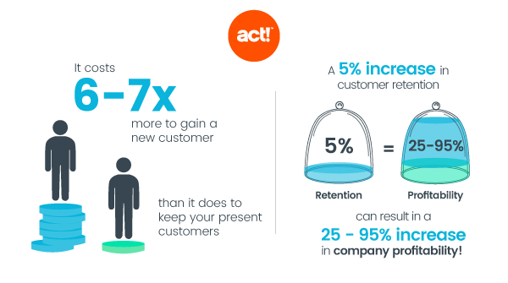
The importance of retention customers
Source: https://www.act.com/en-gb/what-is-customer-retention/

Slide 3
RETENTION CUSTOMERS - VP

Slide 4
RETENTION CUSTOMERS - VP

Slide 5
RETENTION CUSTOMERS - VP

Slide 6
CUSTOMER RETENTION AFTER 1 MONTH - VP

Slide 7
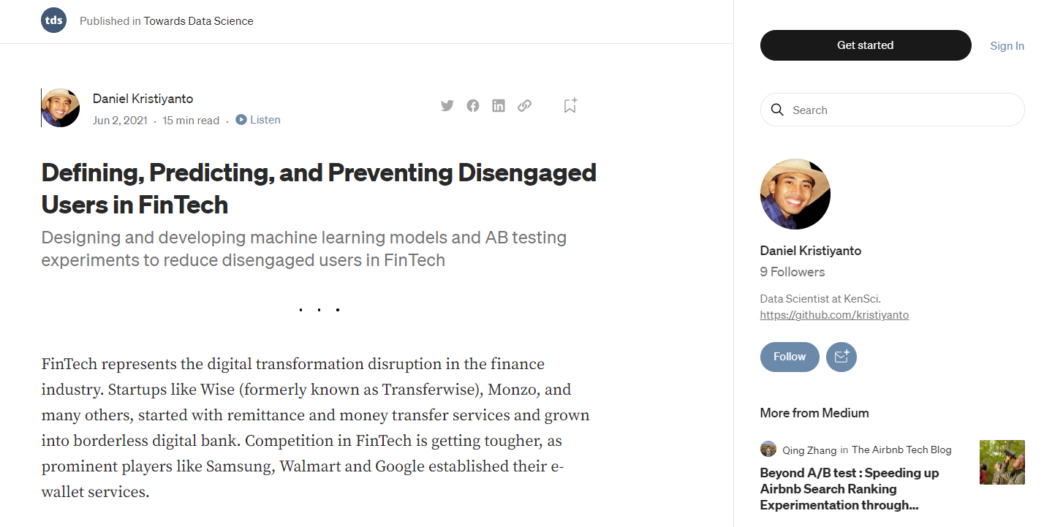
Source: https://towardsdatascience.com/defining-predicting-and-preventing-disengaged-users-in-fintech-30dcb3bc0460

Slide 8
TRAINING FEATURES
Predict:
Will the customer continue to make transaction in the next month?
VASTXN
No. rows: 6,161,767
From 12/3/2020 to 9/10/2022

Slide 9
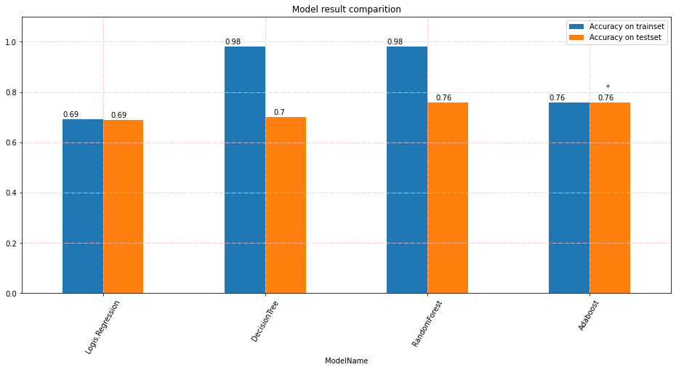
Model comparison

Slide 10
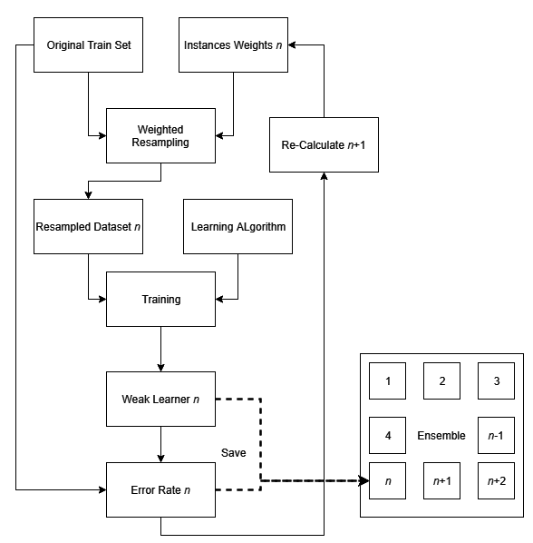
ADABOOST
WEIGHT OF EACH ROWS
Weight adjust based on error rate
One tree cannot amount to anything, three of them together can look like a mountain.
SELECT WEEKLEARNER

Slide 11
ADABOOST – fine tuning
ACCURACY ON TRAINSET
ACCURACY ON TESTSET
75,75%
75,75%
76,86%
76,89%

Slide 12
NEXT STEPS
+ TRY ON OTHERS MACHINE LEARNING MODELS: XGBOOST, Light GBM
+ TRY TO USING DEEPLEARNING WITH EXPECT TO REACH 80-85% OF ACCURACY
+ BRAINSTORM MORE FEATURES

Slide 13


Slide 14
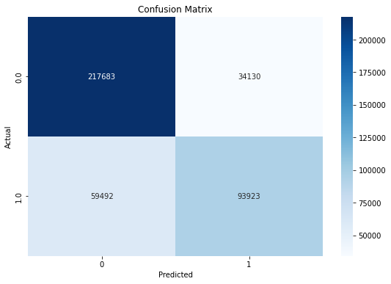
ADABOOST -

