Slide 1
Bioclimatic Regions of
Douglas Fir
By: Alanna Jajeh, Stephanie Gibbon*, and Tyler Sieckenius

Slide 2

Customer
Dr. Jeremy Johnson
Email: jsjohnson@tamu.edu
Phone#: (979) 845-7141

Slide 3
Dr. Johnson’s Research On Douglas Fir
Our client, Dr. Johnson, is a visiting assistant professor at Texas A&M in the college of Geoscience. He teaches a class called Patterns and Process of BioGeography. When Dr. Johnson isn't teaching he is researching the migration of Douglas Fir trees along the coast of Oregon and Washington. From the locations of these trees he is able to extract the bioclimatic values of each geographic location to show that the 19 Bioclimatic regions are functionally connected.
Notes:
Dr. Johnson didn't know web maps were a thing
So one difficulty was trying to take what dr. Johnson wanted and putting into web map form.
Also using d3.
Helps dr. Johnson by visualizing the co occurrence matrix we have improved how he is able to see what is uncorrelated and what is more correlated. This research will eventually go into his paper.
Imporve the science of Dr. Johnsons project.
This link will be published in Dr. Johnsons research.

Slide 4
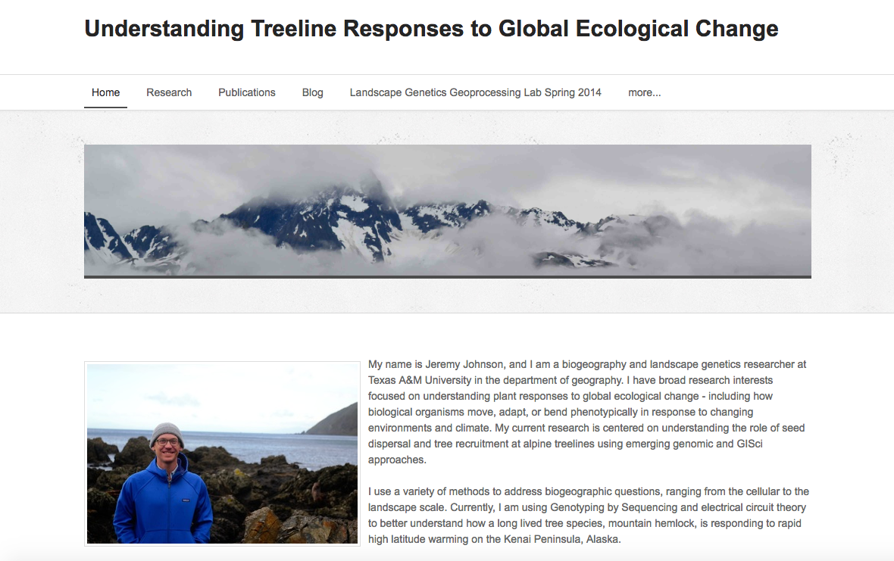
Dr. Johnson’s Current Website
Our project will be an addition to his website, where Dr. Johnson is going to post his new research paper.
http://treelinegenomics.weebly.com/

Slide 5
About
For our project we are making two different web maps.
Raster matrices containing the 5000+ points plotted against the 19x19 bioclimatic variables.
A Google Fusion map plotting the latitudes and longitudes of the 5000+ Douglas Fir sample locations.

Slide 6
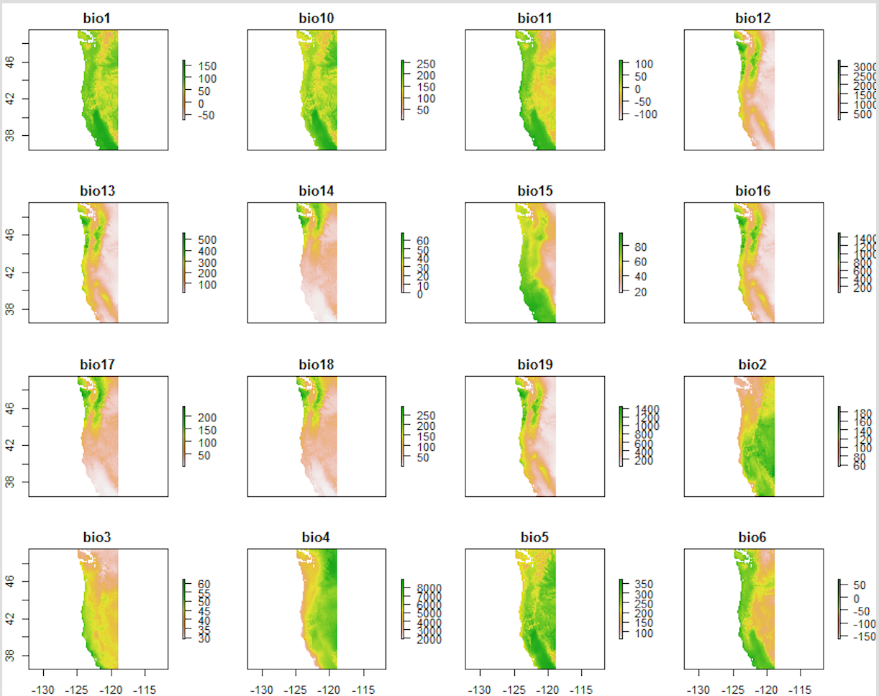
19 BioClimatic Variables
Notes:
These are the bioclimatic values that were extracted from douglas fir.
Variables are never changing here, but the species can change.
Look at the variable for
Ex bio 1 is mean annual temperature
Bio 10 mean temperature of warmest quarter

Slide 7
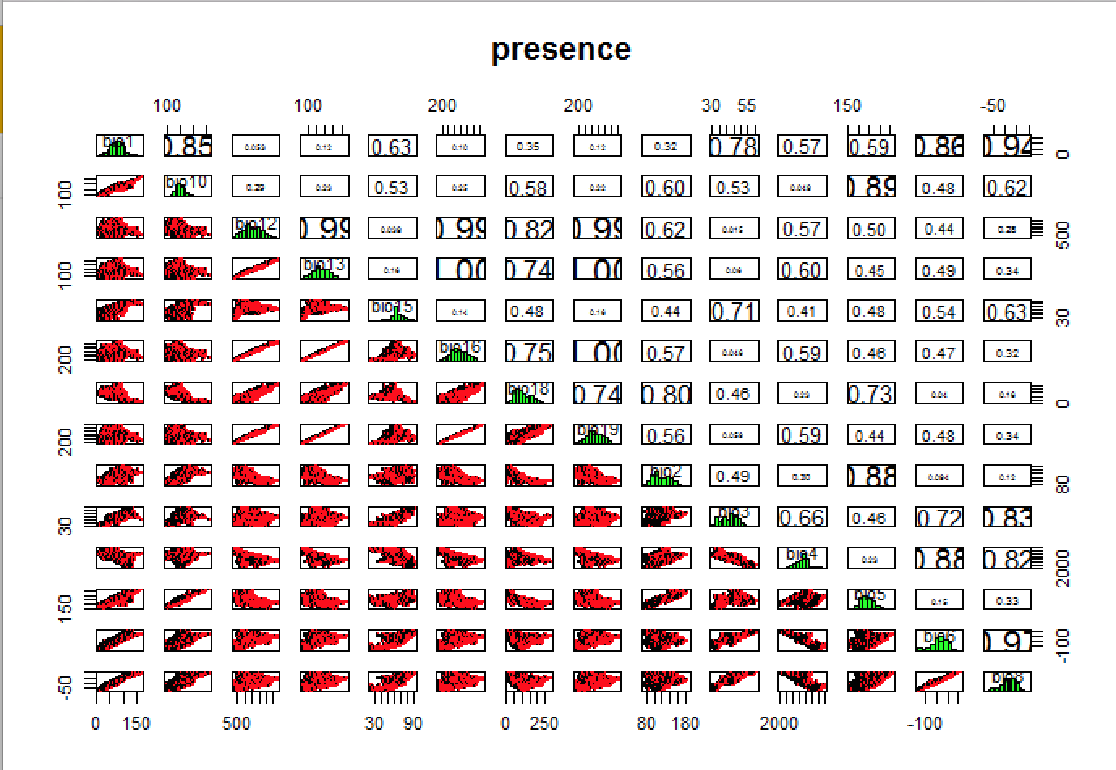
Dr. Johnson’s Current Matrix
Notes:
This is a before matrix showing…
The correlation matrix between the bioclimatic variables and the others.
Below the diagonal you see the plotted values,
Visualized in the actual values of the bioclimatic variables
Ex show Temp Vs Precipitation

Slide 8
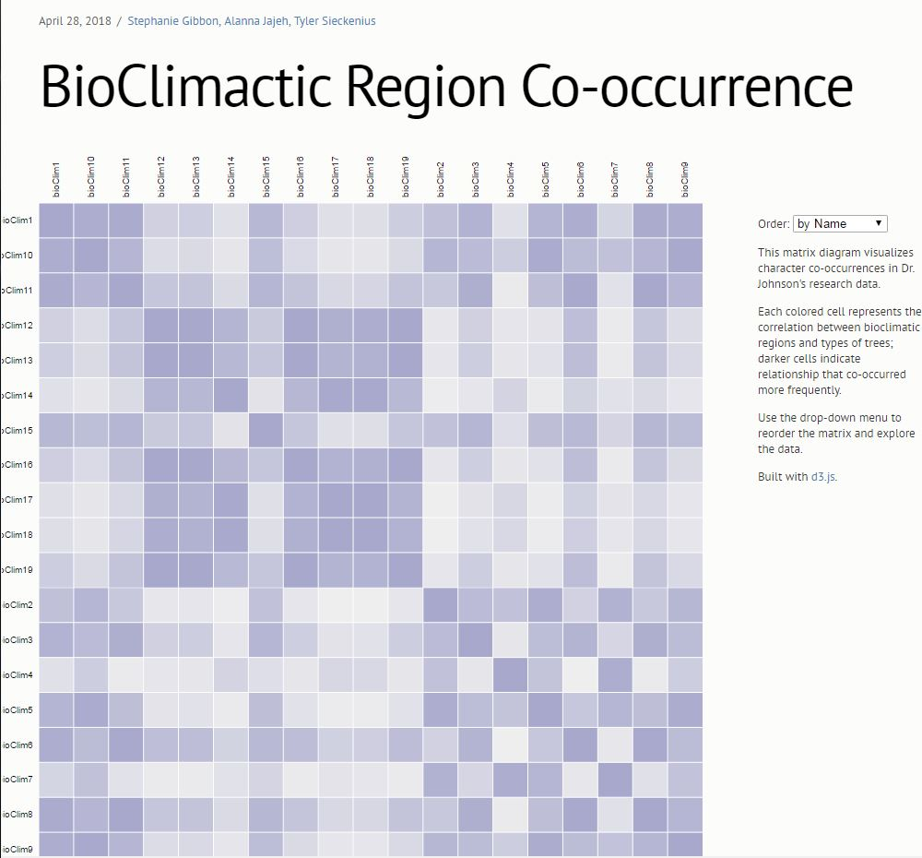
Matrix
In this matrix you can see the difference in the bio regions.
One challenge was getting there to be a perfect correlation. To fix this I created a loop with an if and else statement.
http://geog478-19.geog.tamu.edu/3_RescaleValues%20(2).html
Notes:
Explain Matrix…
The difference between this and the previous matrix is that we are able to see a numerical value associated with each correlation.
This will help further Dr. Johnson's research paper to see how functionally connected the douglas fir are.
As climate changes tree have a slow response to a change in temperature but if they are functionally connected the the douglas fir trees will be more resilient when climatic variables are changing.
Dr. Johnson plans on putting the link to this matrix in the research paper he will be publishing to showcase a better distribution model.
Challenges:
Had to figure out the code for when the bio regions are equal to one another that the correlation is one, because it’s a perfect correlation.
I did this by creating a loop that says if the x value and the y value are the same the correlation value will be one.
From there it was then important to change the color. Because the correlation of one is a perfect correlation it needs to be the brightest color.
***transparency represents the same category being represented - customer wanted all different colors but we think that that shows that it is all different categories*** - our judgement over his kind of thing - he doesn’t understand exactly how webmapping works
This will help him further his research to see how functionally connected the douglas fir are.
Oregon washington coastal range
As climate changes… trees have a slow response to a change in temperature
But if they are functionally connected then then the douglas fir trees will be more resilient when climatic variables are changing.
What determines how douglas fir can grow. From there you can create the distribution models and by looking at genetic variability.
Which ones are important for conducting the
Reduce the number
Create a better distribution model.

Slide 9
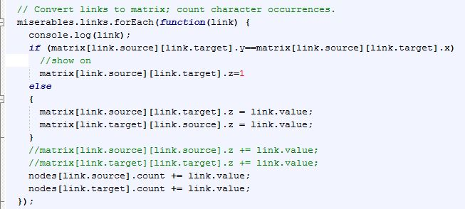
Code
Notes:
This code shows how we got the correlation into each matrix and then i created an if else statement so that if the correlation were one it would be a perfect correlation between bio 1 and bio 1.
Then to change the color to fit the needs of Dr. Johnson's web map we

Slide 10
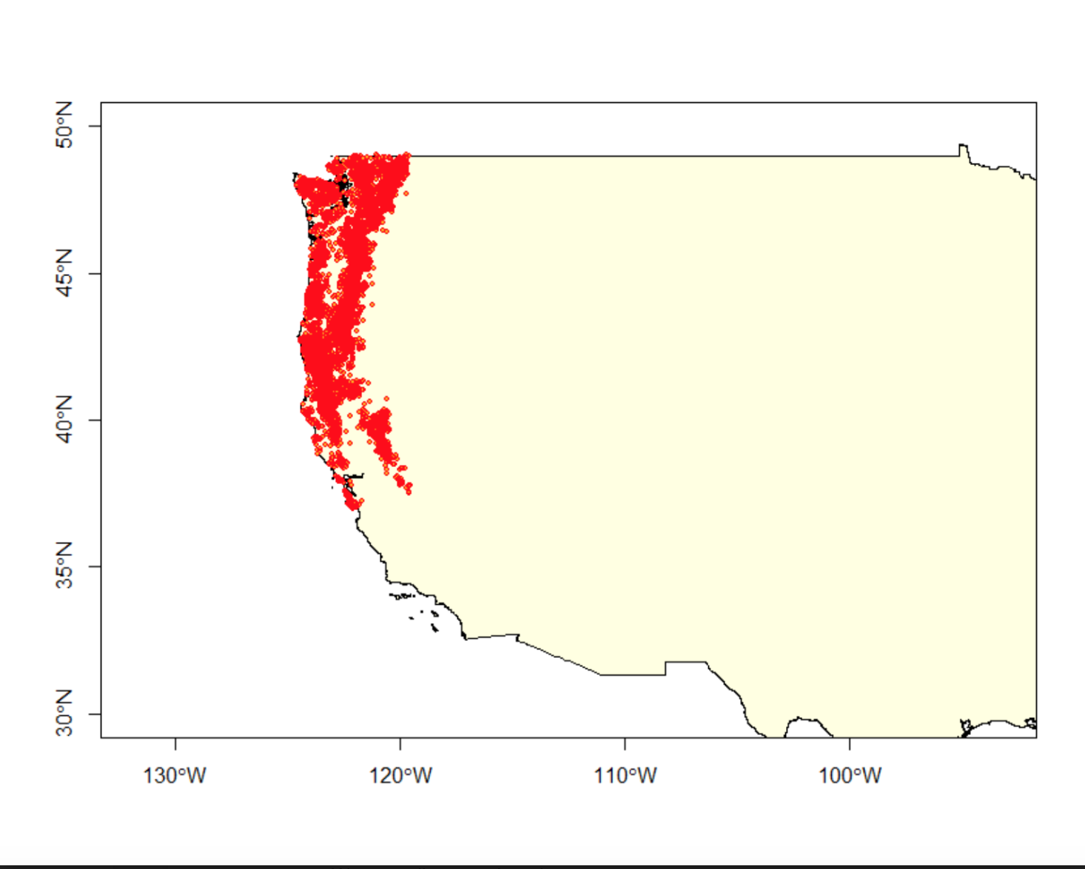
Dr. Johnson’s Current Map
Notes:
Area of interest. Talk about how this is his current map. Looks good but could be better. So we implemented a fusion map.

Slide 11
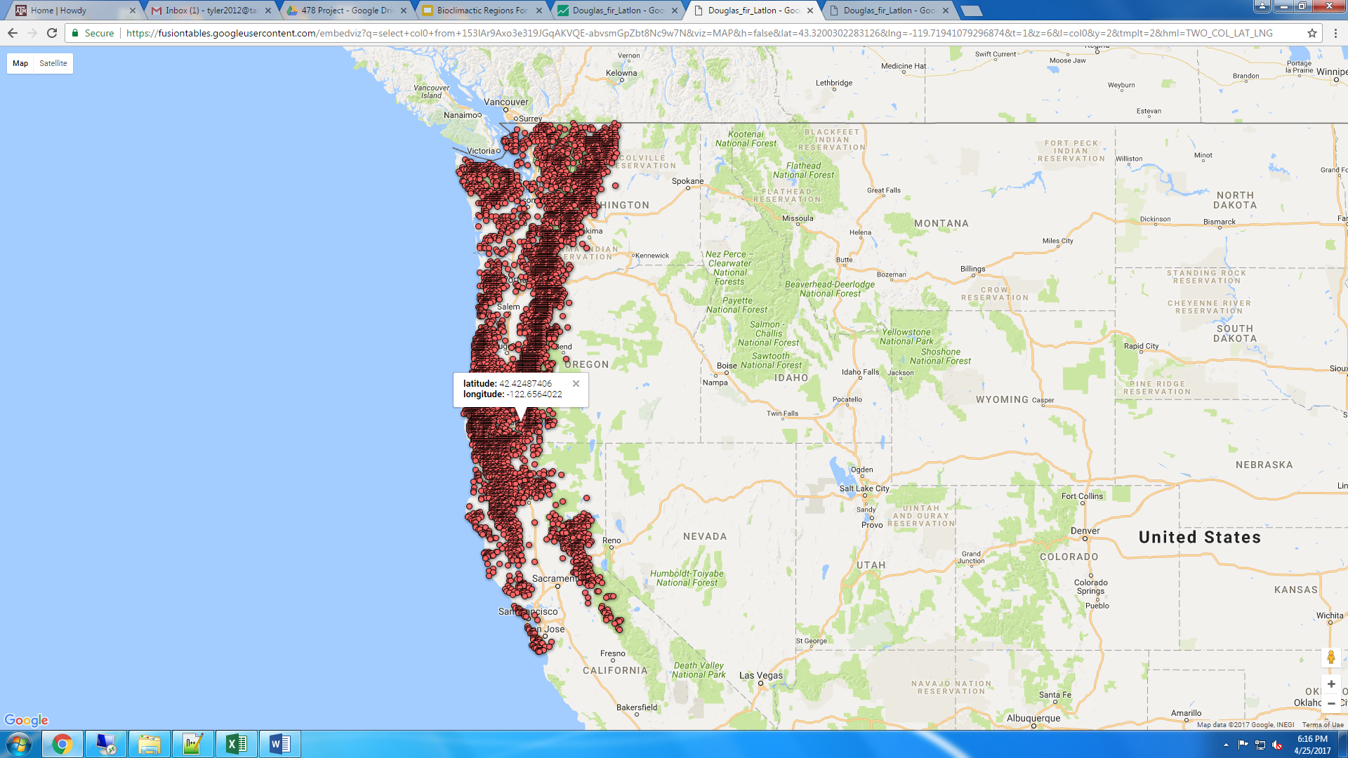
Fusion Google Map
https://fusiontables.google.com/embedviz?q=select+col0+from+153lAr9Axo3e319JGqAKVQE-abvsmGpZbt8Nc9w7N&viz=MAP&h=false&lat=43.3200302283126&lng=-119.71941079296874&t=1&z=6&l=col0&y=2&tmplt=2&hml=TWO_COL_LAT_LNG
Notes:
With this google fusion Map Dr. Johnson can use this to add to his research every time he is looking into other trees.
Talk about contribution to the research
Each time dr. Johnson conducts research on a new area he can add coordinates that he takes to the map. And each research project can separated by different color dots.
When you hover the mouse over a point it shows the Lat and Long of that point.
This map can also be represented as a heat map, but google charges money to publish a heat map with more than 1000 points.

Slide 12
Challenges
Trying to understand how to accomplish what Dr. Johnson wanted in a Web Map.
Understanding and manipulating the data provided
5,000+ random data points to input
We created a scatterplot that wasn’t in line with Dr. Johnson’s vision
Getting the correlation between the bioClim variables to equal 1
Fixed by writing specific code with a loop
Creating fusion map instead of a traditional Google API Map
Notes:
Dr. Johnson had a hard time understanding why some parts of the codes couldn't do certain parts. Like understanding why having 5000 points in the scatter plot code couldnt work.
There were so many points that you couldn’t compare all of the variables at once inside a scatterplot
Scatterplot Wasn’t helpful towards his research
Couldn't use a Google API because it can only handle 1000 points so the solution was to use a fusion map

Slide 13
Next
We are going to embed the code into Dr. Johnson’s website or have Dr. Johnson purchase a domain name.
Walk Dr. Johnson through the web maps and explain how he can add/edit the data as his research continues.

Slide 14
Questions
stephanie.gibbon2014@tamu.edu - Project Leader
alanna.jajeh@tamu.edu
tyler2012@tamu.edu

