Slide 1

Timber Ridge RV Park Project
Hailey Zabel
Leslie Galvan
Jordan Anderson

Slide 2
Project Customer
Timber Ridge RV Park
Hogan – Park Owner
979-307-5568 l timberridgervpark@gmail.com
1360 N. Harvey Mitchell Parkway, Bryan TX. 77803

Slide 3
Project Overview
Redesign the current Timber Ridge RV Park website
More professional
Aesthetically pleasing
Create digitized map layer for park

Slide 4

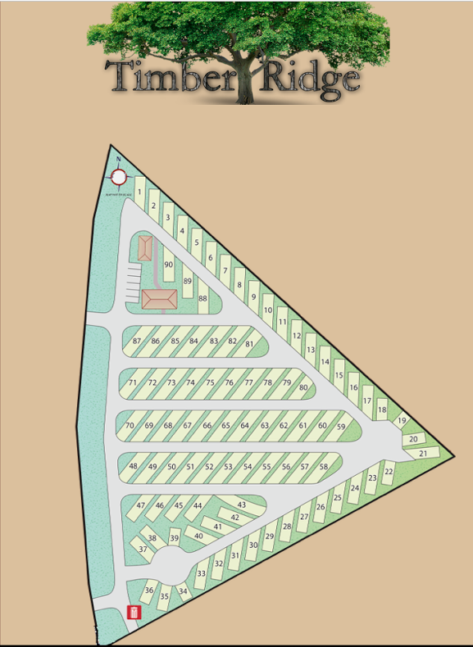
Current Website/Map

Slide 5
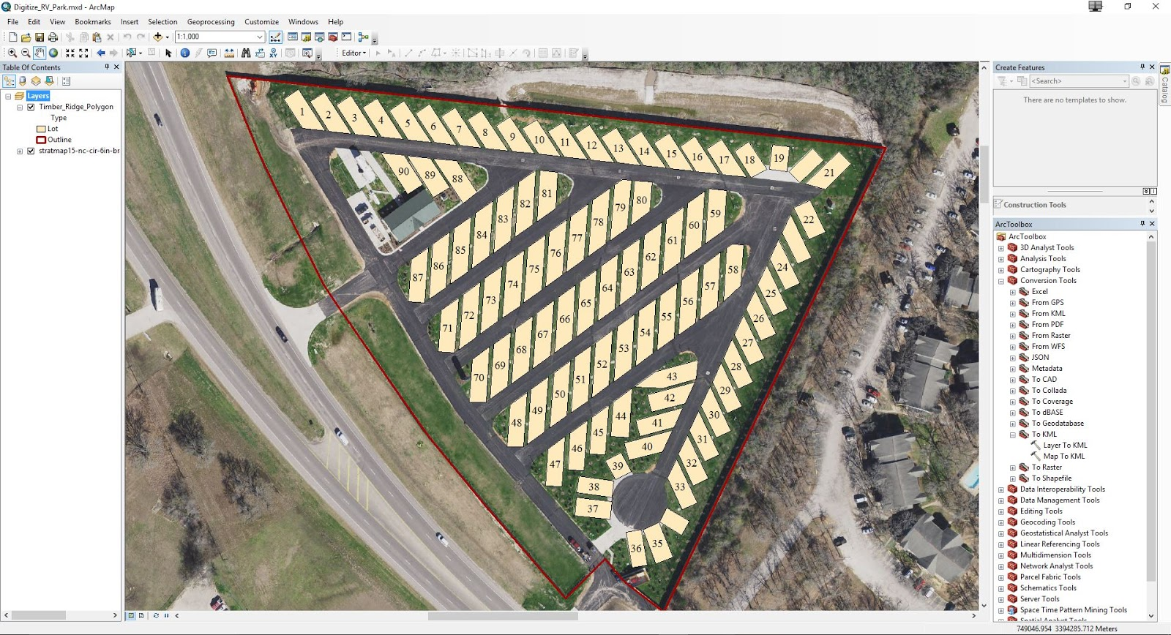
Digitized Map

Slide 6
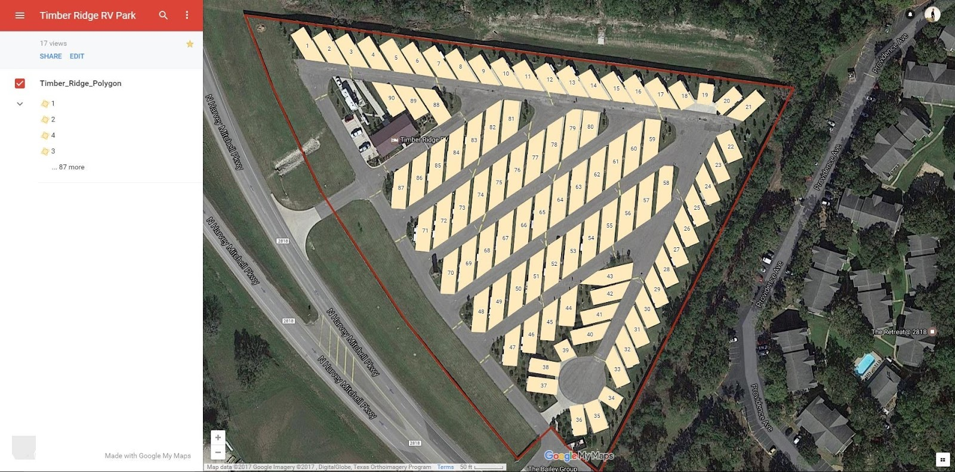
Digitized Map

Slide 7
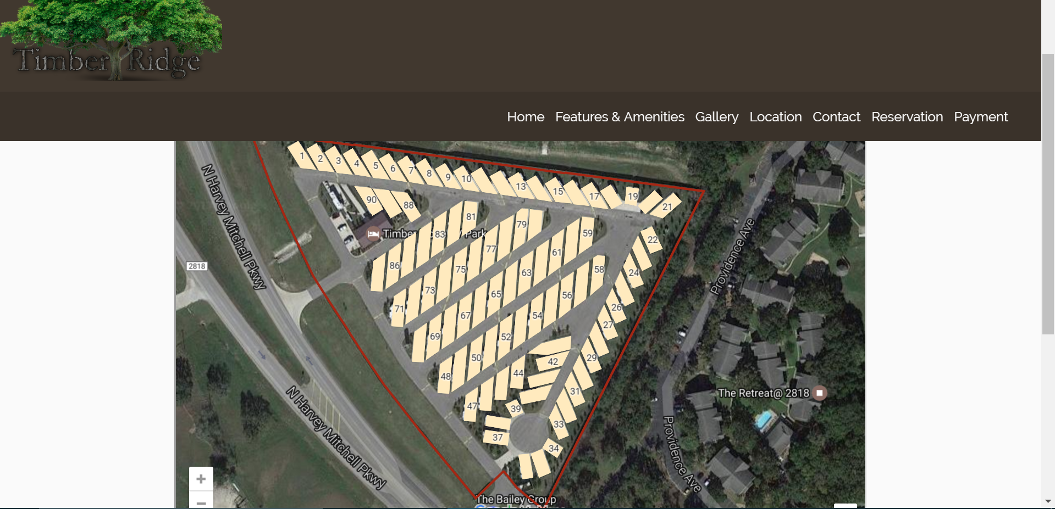
Digitized Map on Website

Slide 8
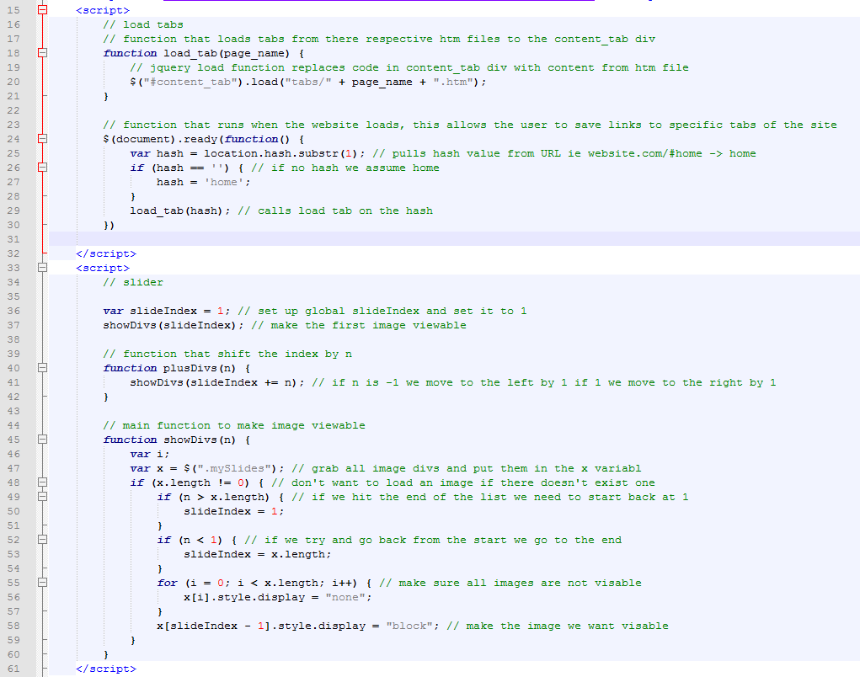


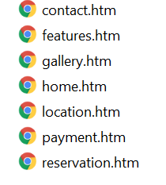
Code Snippets for Updated Version

Slide 9
Demo
http://lgalvan314.5gbfree.com/webgis/

Slide 10

Questions
Hailey Zabel – haileyzabel@tamu.edu
Jordan Anderson – anderson96@tamu.edu
Leslie Galvan - l_galvan317537@tamu.edu

