Slide 1
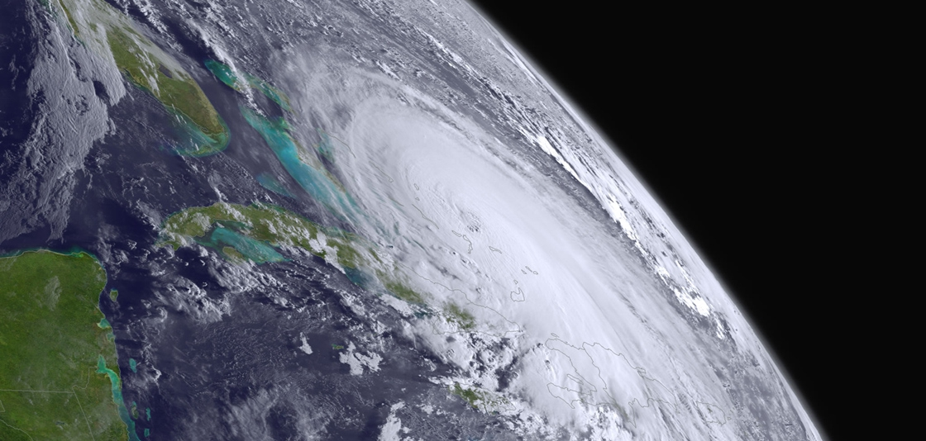
Historical Hurricane Story Maps
(Image source - http://www.noaa.gov/explainers/hurricane-forecasting)
Focus area: the Florida Keys
Jiyeon Kim
(kimjy1747@tamu.edu)
Sergio Torres
(sergioandrestorres@tamu.edu)
Client: Dr. Daniel Goldberg (Daniel.Goldberg@tamu.edu)
GEOG 478/678
May 1, 2017
Notes:
[Jiyeon]
Hi everyone, our project was to create story maps of hurricane paths, specifically those which have affected the Florida Keys.

Slide 2
Motivation for the project
1. Constant risk of damage from tropical storms and hurricanes.
2. Not much information on damage from each hurricane.
3. A site-specific story map of the historical hurricanes.
4. Integrated user experience.
Notes:
[Jiyeon]
Some motivations for the project are:
1. Because of the low elevation of the Florida Keys, there is a constant risk of tropical storms and hurricanes, subsequent threats of storm surges, which leads to flooding.
2. Despite the constant risk of storm damage, there is not much information on hurricane damage specific to the Florida Keys. This information is not readily available.
3. We wanted to create a site-specific story map of historical hurricanes by integrating all the different formats and media (such as maps, texts, images as well as short movie clips) we gathered from multiple sources.
4. Once completed, the project could benefit the community members, natural resource managers and other interested users. It could potentially aid them in analyzing the patterns of historical hurricanes, and to make educated and informed decisions prior to future hurricanes and storm events. (help analyze hurricane data, help make better decisions before hurricanes/storms)

Slide 3
Objectives
- Create a story map showing the historical hurricanes tracks (obtained from NOAA) which have affected the Florida Keys.
- Compare different story map templates in ArcGIS online to see distinctive features that each one can provide.
Notes:
[Sergio]
Our overall objectives were to create a story map using the historical hurricane tracks information from the NOAA webpage, to try different story map templates in ArcGIS online, and to compare each templates.

Slide 4
Method
1. Obtain the past storm track shapefile from the NOAA IBTrACS webpage.
2. Select only the past hurricane tracks which have passed through the Florida Keys using the Florida Keys shapefile.
3. Find relevant information on each hurricane, including:
Time of occurrence
Highest category occurring during a storm’s lifetime (not necessarily when each storm is passing though the Florida Keys)
Related graphics (e.g. charts, images of damage) and multimedia contents
4. Select a story map template which suits our project needs from www.arcgis.com
5. Integrate all the information (maps with the past hurricane tracks and all the relevant information).
6. Compare each template and evaluate the final product.
Notes:
[Jiyeon]
These are the steps that we have taken to complete the project.
We first obtained the past storm track shapefile from the NOAA IBTrACS webpage. Using the Florida Keys shapefile, we were able to select only the past hurricane tracks which have passed through the Florida Keys.
We then gathered all the relevant information on each hurricane, including time of occurrence, highest category occurring during a storm’s lifetime, and all the related graphics and multimedia contents.
Here I would like to point out that the highest category refers to the highest during the hurricane’s lifetime, not the category strength as it passed through the Florida Keys.
We selected two story map templates from ArcGIS online, put everything together and compared the two templates.

Slide 5
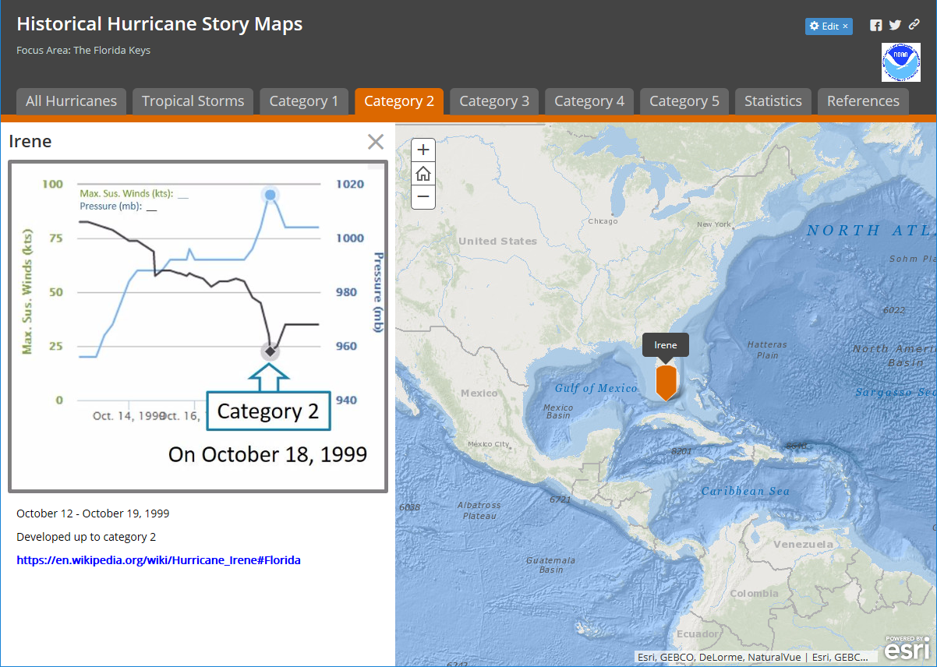
Screenshots and demo of each story map
1. SHORTLIST
Notes:
[Jiyeon]
This is a screenshot of the Shortlist story map template.
[Jiyeon’s note]
First we used a template called “shortlist.” This template is a story map with a tabbed structure. I created a tab with all the hurricanes, a tab for each hurricane category, a tab for statistics, and a tab with references. Within each tab, there’s a web map of hurricane tracks displayed on the right side, and on the left side, there are pages corresponding to each hurricane. Each page is tied to their hurricane track line shapefile. In each tab, if you click an image of a specific hurricane, you will be able to go to that specific hurricane image, and the maker or pin will be highlighted.

Slide 6
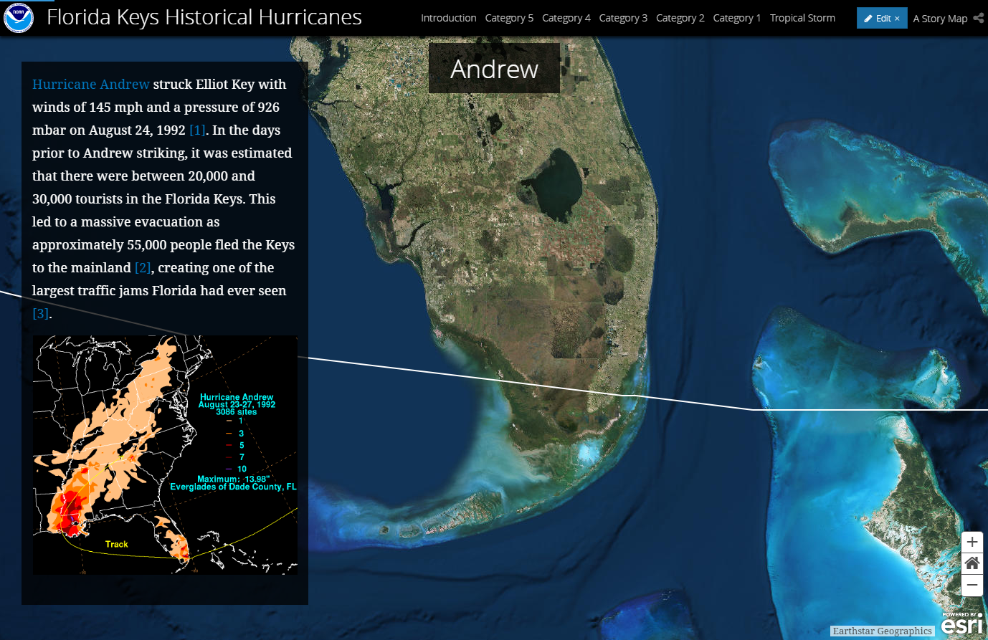
Screenshots and demo of each story map
2. CASCADE
Notes:
[Sergio]
So far we tried to create story maps using the two different story map templates.
This is a screenshot of the Cascade story map template.

Slide 7
Comparing Templates
CASCADE
shortlist
Pros:
Better aesthetic presentation
Allows for multiple images
Multimedia files
Can easily add links to other sites
Cons:
A LOT of scrolling
Requires high resolution media to look nice
Pros:
Well organized
Easier to navigate
Easier to learn and create (simple interface)
Cons:
Does not allow multimedia files
Every entry was only allowed a single image.
Every entry needs to be tied to a specific location marker.
Notes:
[Sergio]
This is a quick comparison of the two templates.

Slide 8
Potential for future improvement
More contents including media files could be added to the current story map templates.
1. Cascade
- Create a dropdown menu for bookmarks.
2. Shortlist
- Further Information on each hurricane’s damage specific to the Florida Keys could be added.
Add a real time means of updating the story map data whenever any new hurricane information becomes available.
Compare the current templates with other potential templates.
The methodology could be applied to other areas prone to hurricane damage.
Notes:
[Jiyeon]
There are a number of ways we could improve the current implementation of the story maps.
We would like to add more content, including media files to the story maps.
Specifically, for the cascade story map, a dropdown menu of hurricanes within each category could be created, for easier navigation.
And, for the shortlist story map, we would like to add more content, especially pertaining hurricane damage.
We would like to have a real time means of updating the story map data whenever any new hurricane information becomes available.
In addition to these two templates, others could be compared using the same data.
The methodology used is not exclusive to the Florida Keys and could potentially be applied to other areas prone to hurricane damage.

Slide 9
References
1. ESRI Story Maps
: https://storymaps.arcgis.com/en/ (accessed since February 2017)
2. Florida Keys, Wikipedia
: https://en.wikipedia.org/wiki/Florida_Keys (accessed on April 13, 2017)
3. NOAA Historical Hurricane Tracks webpage
: https://coast.noaa.gov/hurricanes/ (accessed since January 2017)
4. NOAA International Best Track Archive for Climate Stewardship (IBTrACS) webpage (All storms lines shapefile)
: https://www.ncdc.noaa.gov/ibtracs/index.php?name=ibtracs-data (accessed on March 21, 2017)
5. NOAA National Marine Sanctuaries Geographic Information System Data (Florida Keys Boundary Polygon)
: http://sanctuaries.noaa.gov/library/imast_gis.html (accessed on March28, 2017)
Notes:
[Jiyeon]
These are some of the references that we have used.

Slide 10


Acknowledgement
Dr. Daniel Goldberg
Dr. Cecilia Smith
Mr. Billy Hales
☺
http://gisday.tamu.edu/presenters/#/
http://gisday.tamu.edu/presenters/#/
Notes:
[Jiyeon]
We would like to take a moment to thank Dr. Goldberg for helping us throughout the project. We would also like to acknowledge the staff members in the Maps and GIS department in the library, especially Dr. Cecilia Smith and Mr. Billy Hales for their assistance during the initial phase of our project.
Thank you so much!

