Slide 1
Study Abroad Map
Rev on the Road
By: Natalie Boenker and Matthew Marcotte (Project Leader)

Slide 2
Customer
Study Abroad Department
Kerri- Administrative Associate II, kvance@exchange.tamu.edu
Chelsea- Graduate Assistant, cdowney@tamu.edu
Map will be solely used for promotional purposes on their website
In need of a visual representation of their programs on their website

Slide 3
Meetings
1st Meeting- Feburary 10th
Ideas for Map and Rev on the Road program
2nd Meeting- Feburary 28th
Photos and needed data for map
3rd Meeting- April 26th
Almost final map and received feedback for necessary changes

Slide 4
Deliverables
Discussed what they’d like us to create and what our limits are
Unrealistic animations of reveille
Wanted it to be limited info, but be able to spark interest in students
Easy to alter and add in the future
Can be integrated onto their website

Slide 5
The Reason
Study Abroad already has an interactive map, but is very lame
An interactive story map can encourage and excite students to participate
By spatially sharing experiences, we can also help students understand the scope of travel

Slide 6
The Process
Create a Google API map
Obtain data (testimonials/ pictures) from Study Abroad
Create JSON file containing all that data
Function (Java) to pull data and display on the map
Create easy navigation around map for user
Use CSS to style the map
Deliver code and map to Study Abroad department

Slide 7
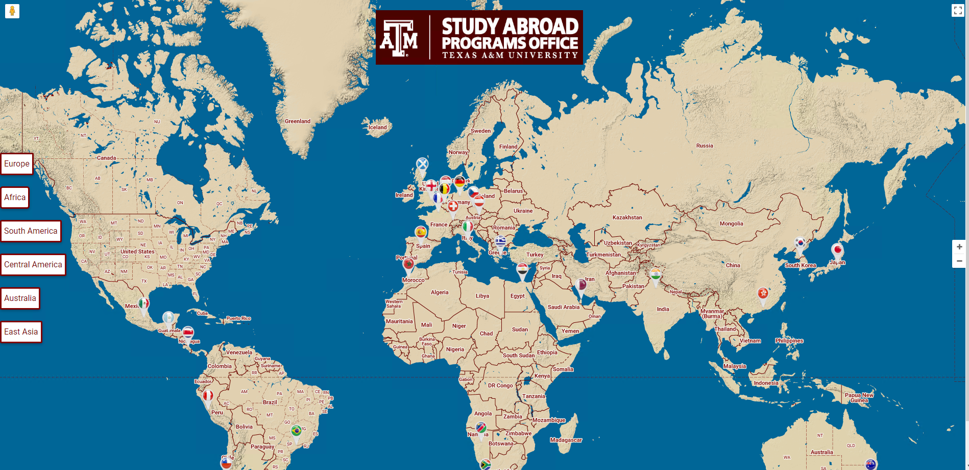

Slide 8
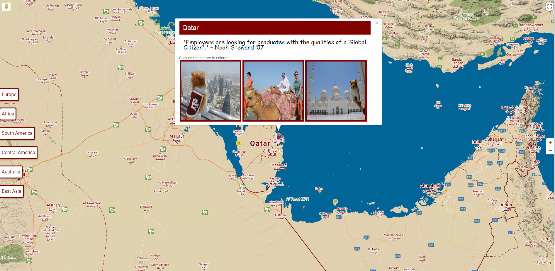

Slide 9
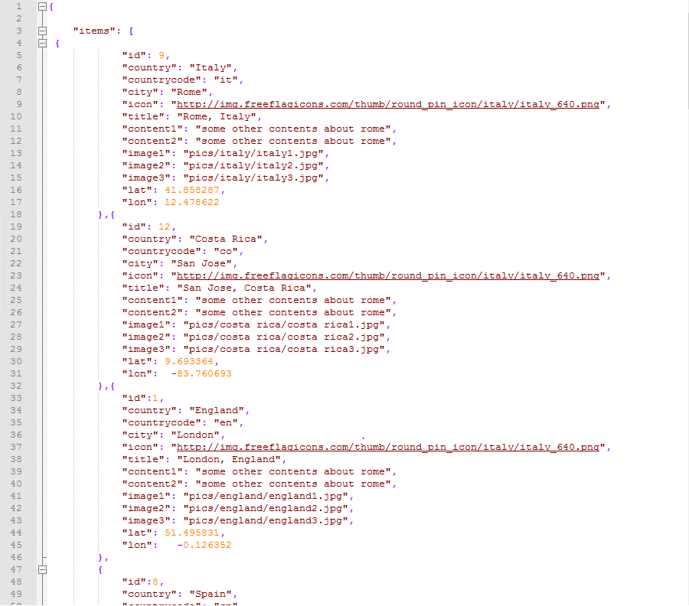
Data
Obtained locations with photos from study abroad department
Chose top 3 photos from each location
Find Lat and Long for each location
Used a different marker with the country’s flag for each location
Upload to hard drive
Used JSON file to keep code clean and readable

Slide 10
The Challenges
Some locations had only 2 photos, which caused an empty frame to appear at certain locations
Legend to help students navigate if they have poor geography knowledge
Pop-up window instead of new tab when clicking on the photos

Slide 11
Final Meeting
We showed our customer our final project and they loved it
They want to integrate it onto their website and will be working on that once we give them all the code
We will be available to help them with it until we graduate

Slide 12
The Final Map
Geog478-20.geog.tamu.edu
Providing a manual for them to use to upload new data and locations

Slide 13
Questions?
nboenker3@tamu.edu- Natalie Boenker
marcottematthew@tamu.edu- Matthew Marcotte (project leader)

