Slide 1
The Gates of North An Interactive Map of Northgate
Mary Trapp (Team Leader), Clayton Merrill, Kyle Schultze & Nicole Newman

Slide 2
Our Motivation
The motivation for this project is to give college students, who are of age, a way to plan their night out before they start drinking so they can make fiscally responsible and safe decisions.

Slide 3
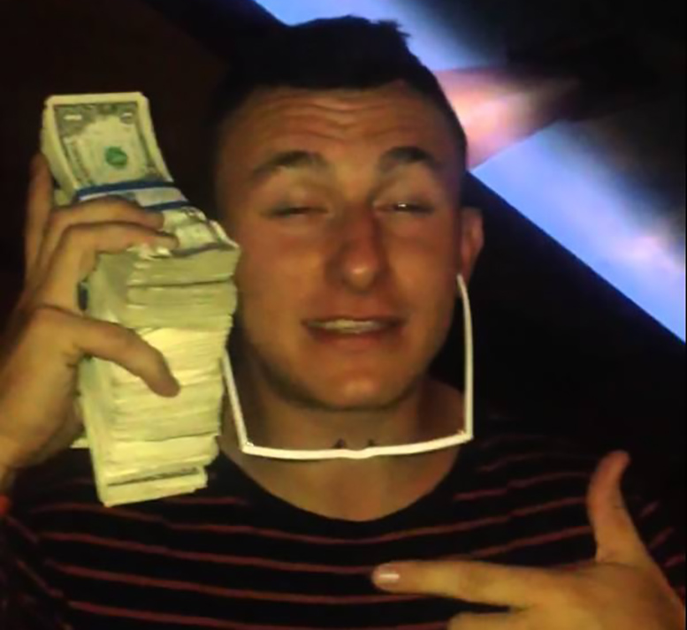
Our Customer
College students of age

Slide 4
Overview
Our hope was to create a web map that showed the locations of bars, parking garages, and public restrooms that once clicked on would show daily specials and popular drinks of their respective bars.
We decided to pursue this project because it will enable college students who are already burdened with student loans and other costs a means to plan their night out and hopefully save money

Slide 5
Goals
Create a webmap that shows specials and popular drinks of bars on Nortgate
Create a way for users to leave reviews of each specific bar
Create an admin page and database to store specific information for individual bars to make upkeep easier
Publish the webstite

Slide 6
Tasks
Understand how to use Google’s API
Find the best way to display bar data upon clicking on an icon
Get in contact with all of the bars on Northgate to retrieve their specials and most popular drinks
Make a login page and comment section

Slide 7
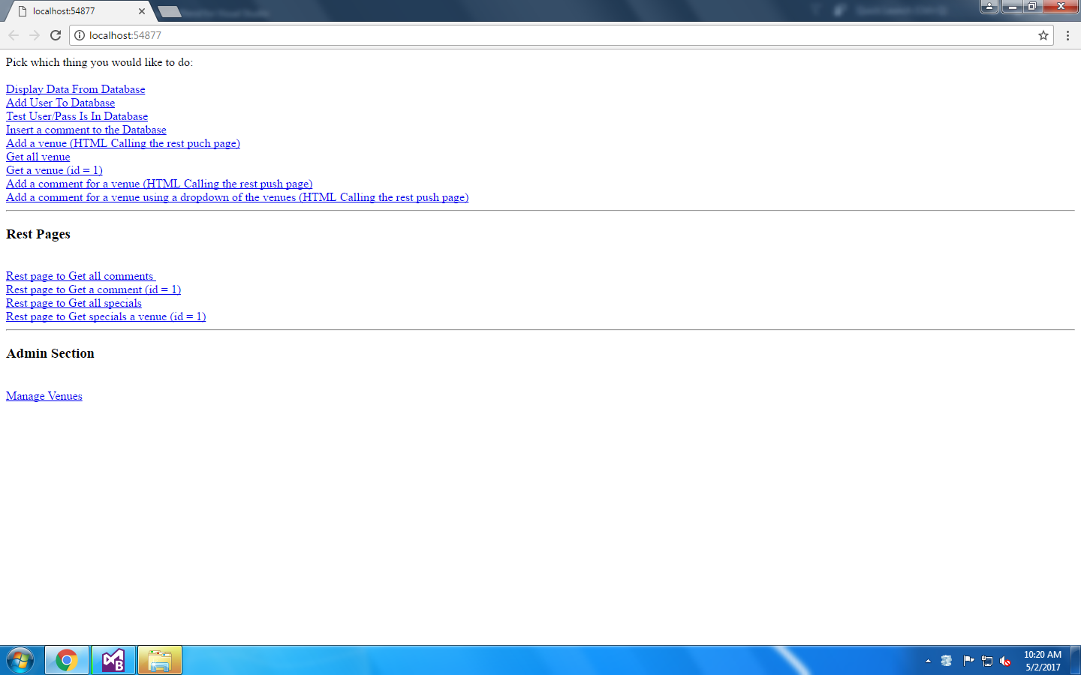
Deliverables

Slide 8
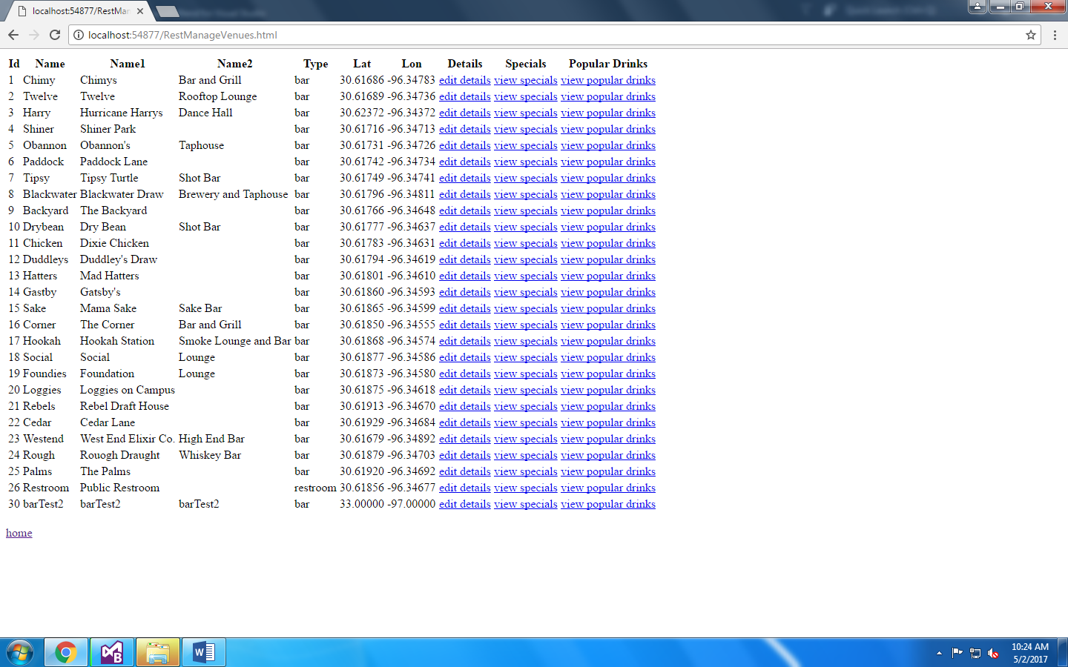

Slide 9
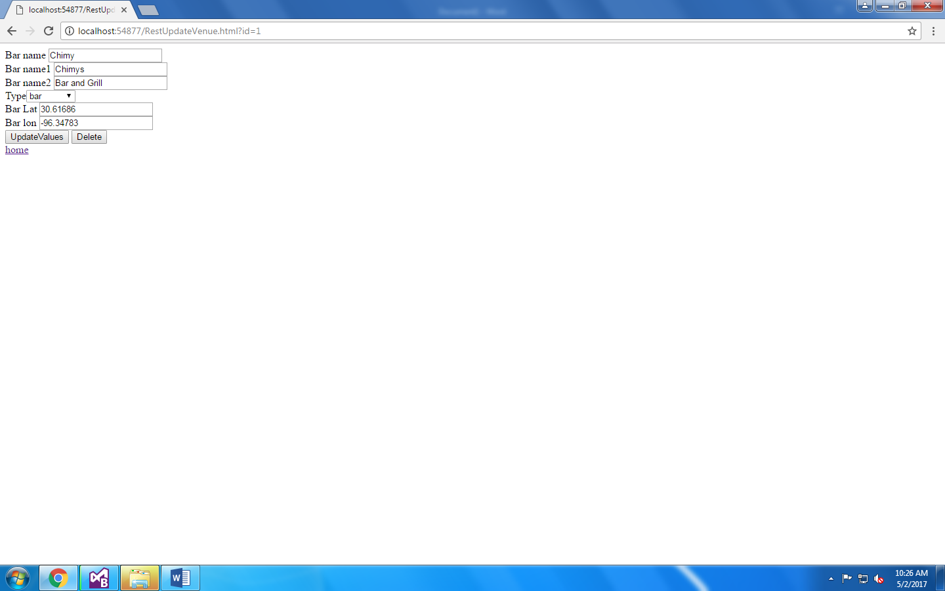

Slide 10
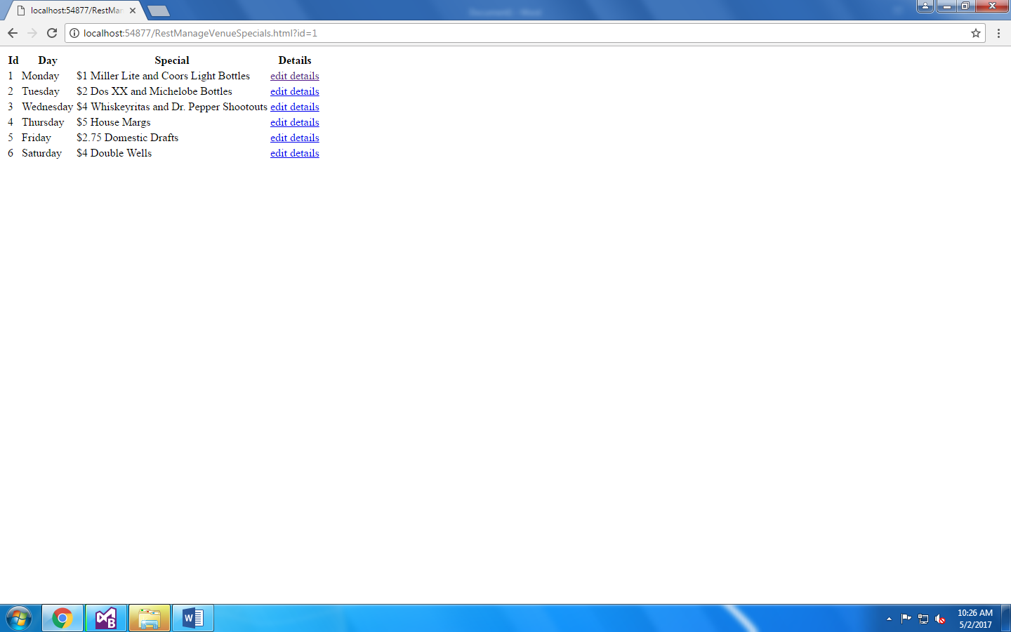

Slide 11
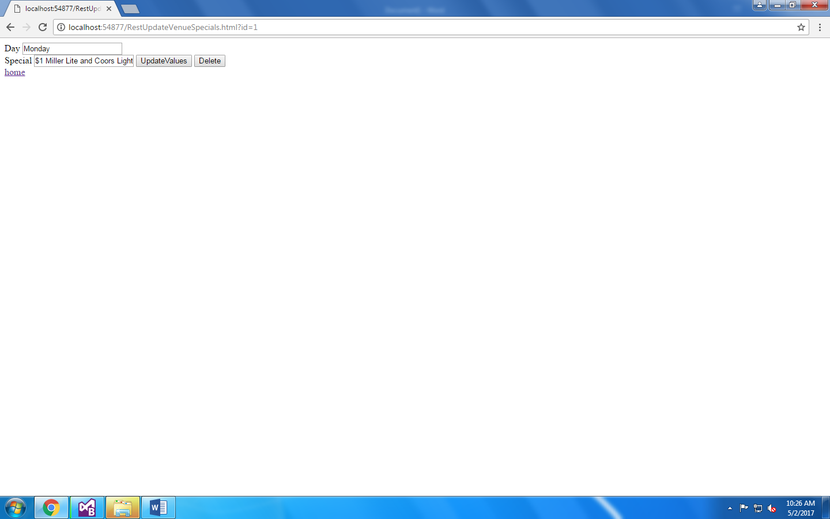

Slide 12
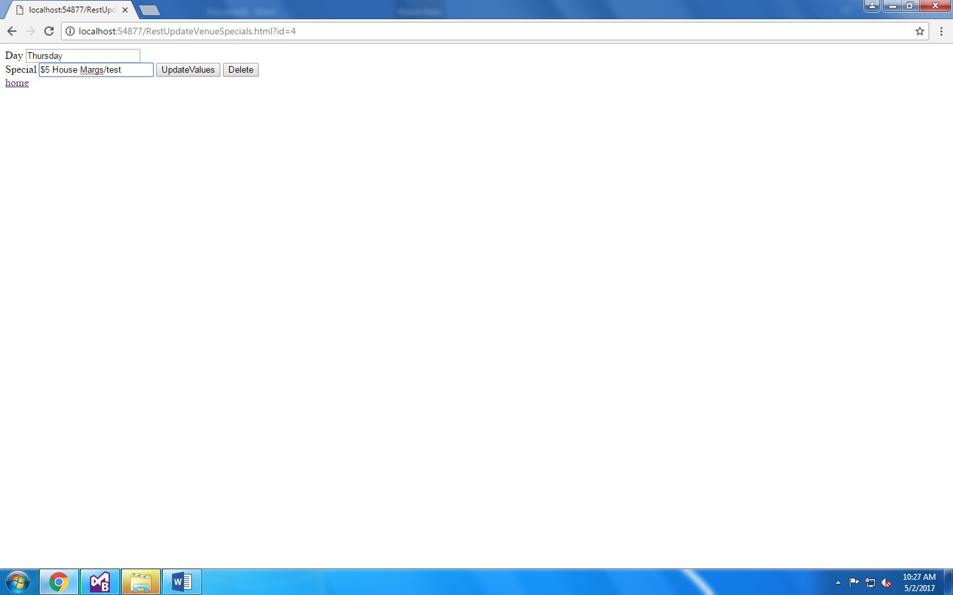

Slide 13


Slide 14
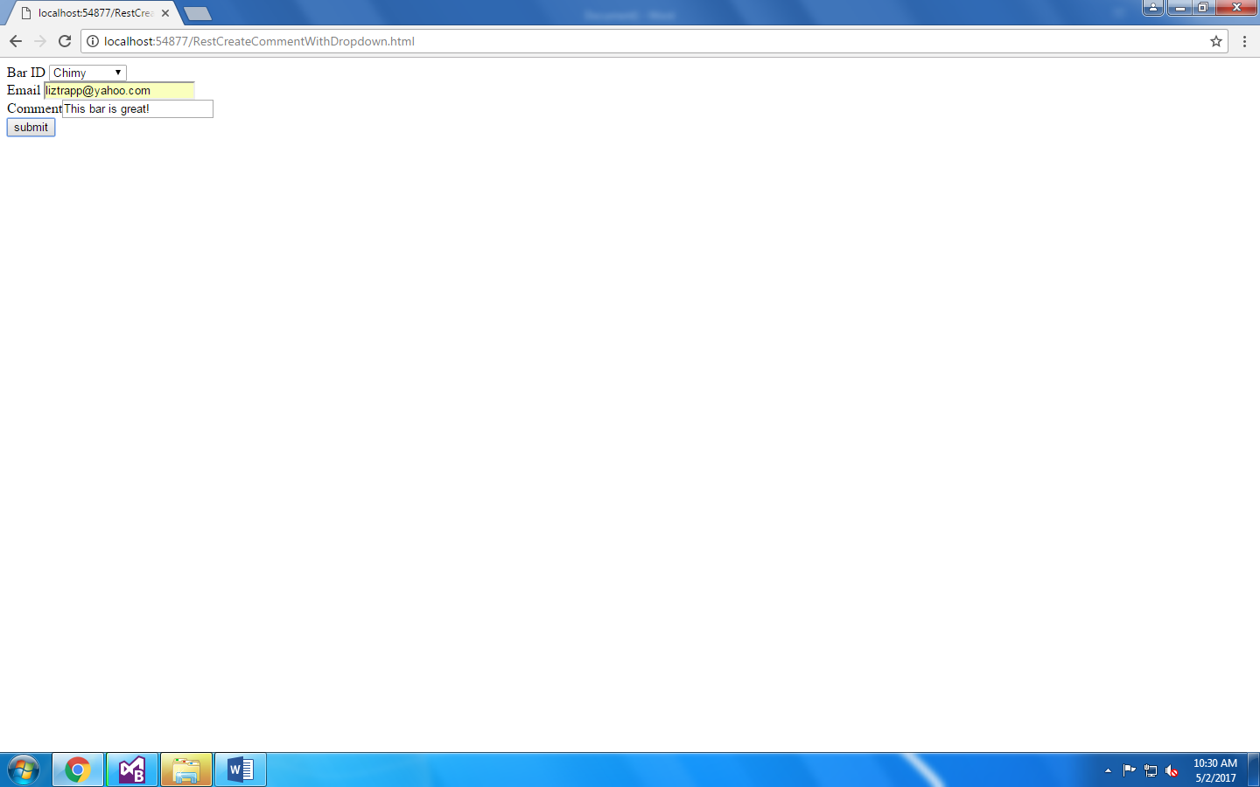

Slide 15
Challenges
Visual Studio
C#
Creating a database that stores information on the bars and reviews
Verifying conflicting information from websites versus the source
Connecting the database to the webpage

Slide 16
What’s Left?
There are still a few style choices to fix
Getting a Domain
Creating contracts with the bars for advertising
Finish linking parts of the database page to the webpage

Slide 17

Special Thanks to
Dr. Daniel Goldberg for lending his time and expertise in helping us finish our project
Daniel.Goldberg@tamu.edu

Slide 18
Questions?

