Slide 1
Geocoding Visualization
Authors: Daniel Huseman, Paul Barth,
Kevin Eblimit, Kendall Hartman

Slide 2
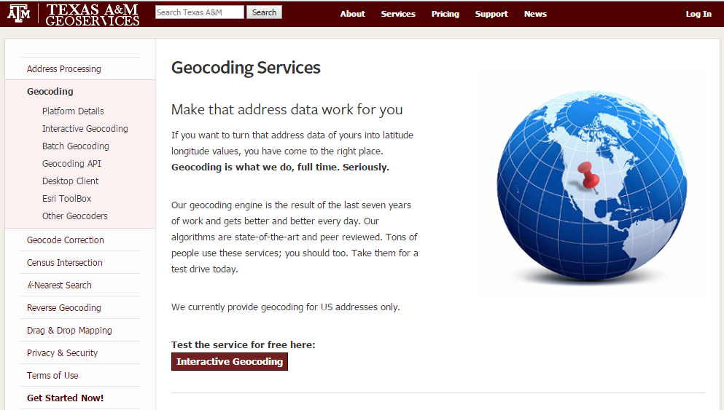
Purpose
To visualize the accuracy of geocoded outputs based on an input address.

Slide 3
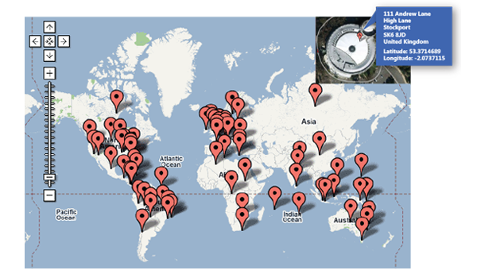
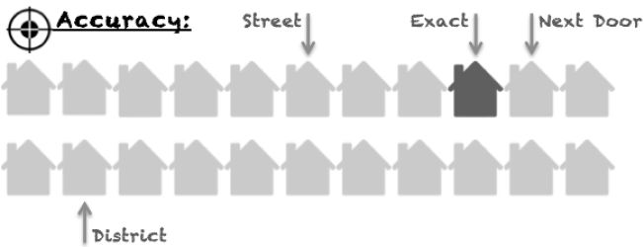
Many potential outputs, which is correct?

Slide 4
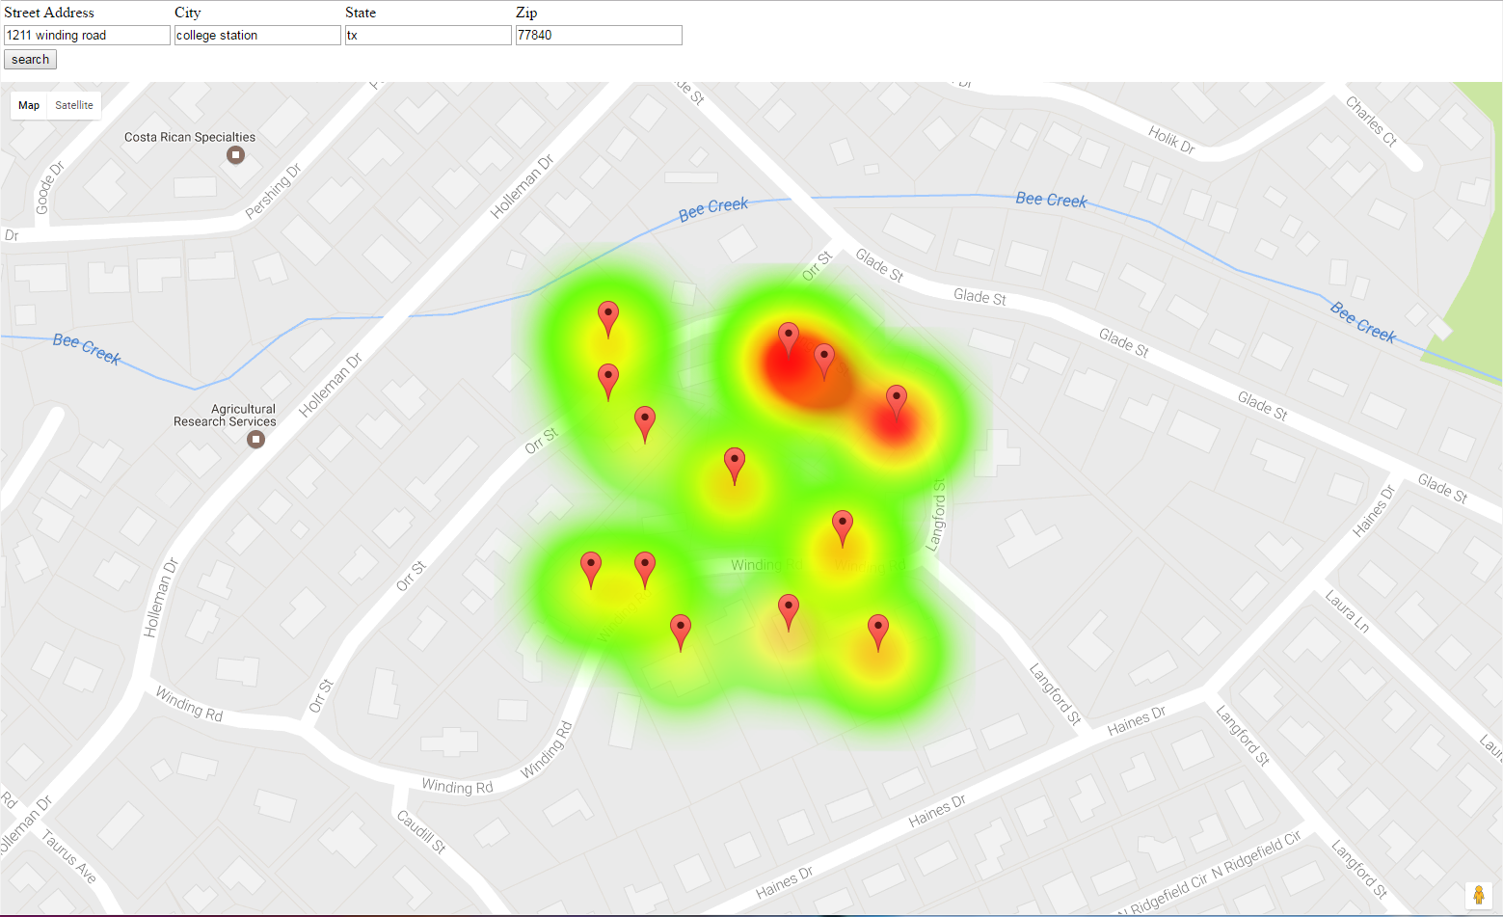
Geocode Accuracy by Match Score
Notes:
Currently displaying fake data until we can replace it with the real data from the multiple outputs of the geocoder.

Slide 5




Challenges
We experimented with additional visualizations of the data, such as from plot.ly and a 3D Contour visualization from JS Fiddle but had little successful progress in getting them to work.

Slide 6
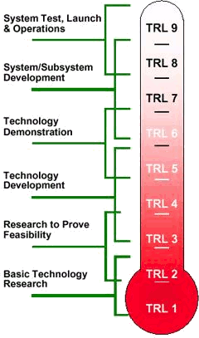
Technological Readiness Level 6
We are able to demonstrate its functionality using fake data.
Once real data is implemented, the project will be at TRL 8, and ready to be published.

Slide 7
Future Work
Get geocoder to display all outputs
Implement on main Texas A&M Geocoding Services website
Increase functionality and aesthetics of graphical user interface

Slide 8
Questions?
Daniel Huseman, huseman@tamu.edu
Paul J. Barth, paul.barth@tamu.edu
Kevin Eblimit, kabuduaini@tamu.edu
Kendall Hartman, kenhartman04@tamu.edu
@GIS_Memes

