Slide 1


ECEN 403
Medical Assistant Robot: Randolph Rozean Christian Rodriguez Lorenzo Delcroix Casey Clarke

Slide 2

Executive summary
Problem statement:
Today doctors have limited options for diagnosis methods outside of their own intuition and training
At times doctors can be inconsistent with diagnoses
Our medical assistant robot will:
Provide suggestions and validation for doctors’ intuition
Allow the doctor to be consistent
Robot will track recent cases and doctors’ previous decisions

Slide 3
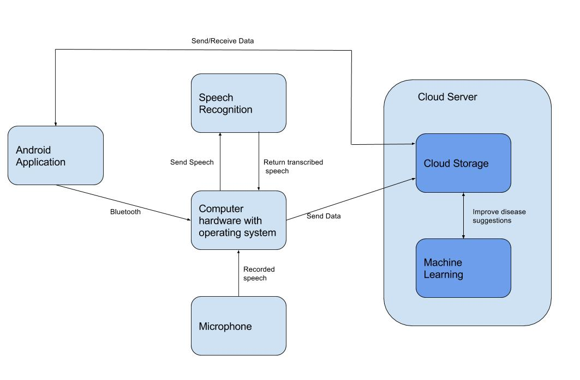
System Overview
Lorenzo Delcroix
Casey Clarke
Randolph Rozean
Christian Rodriguez
Notes:
Cloud server and database

Slide 4
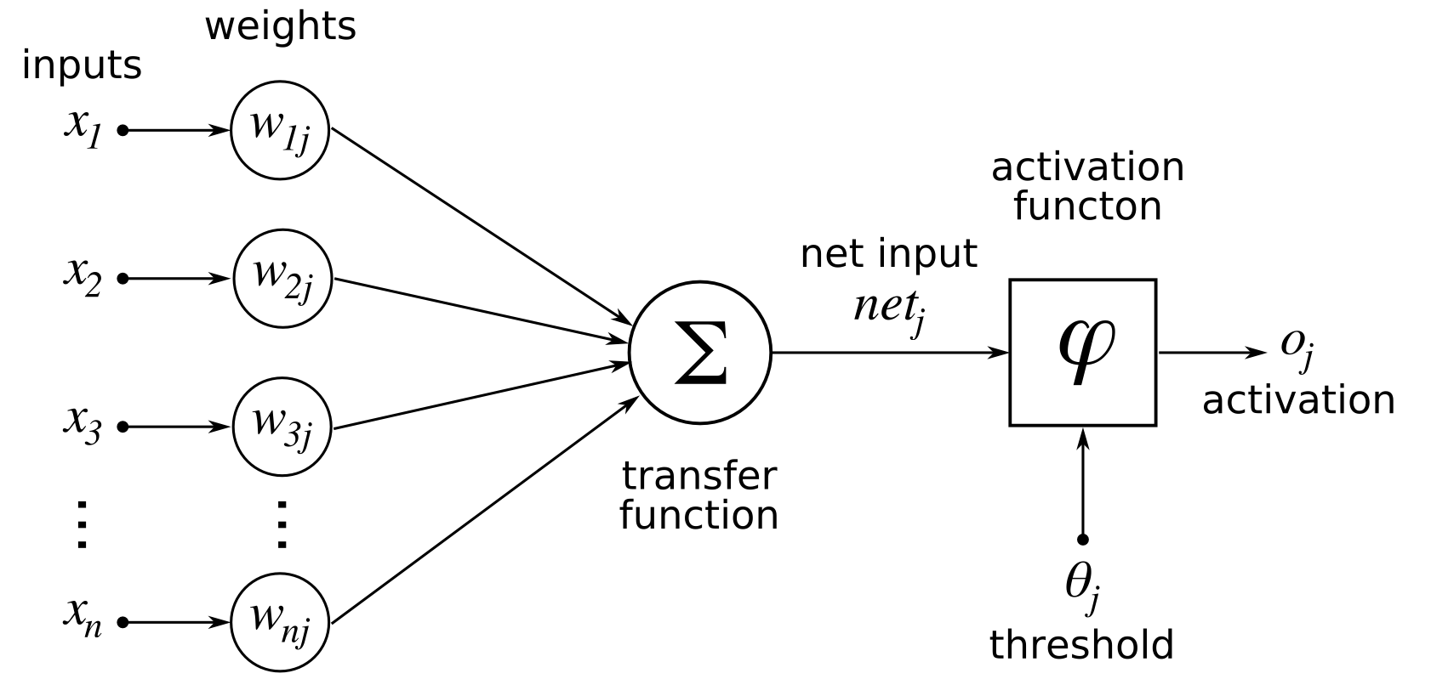
Machine Learning Subsystem
Evaluates inputs to give a trained diagnoses suggestion.
Provides a method of taking inputs and learning the most probable diagnosis.
Takes inputs from the queries, user input from the application, and general disease information.

Slide 5
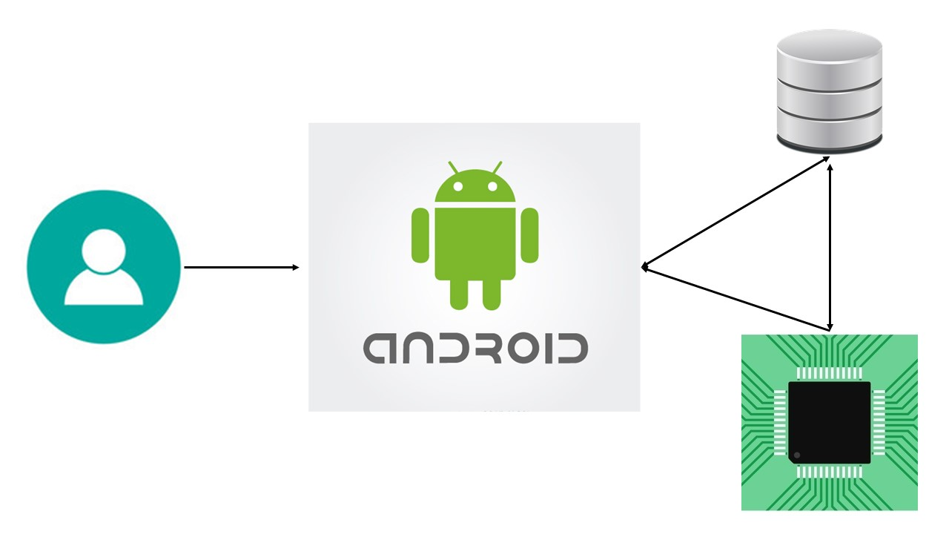
Android Application Subsystem
Provides GUI to user’s android tablet
Communicates with the Microcontroller via Bluetooth
Communicates recommendations to/from cloud server

Slide 6
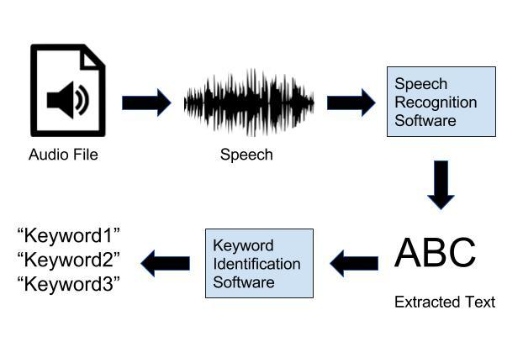
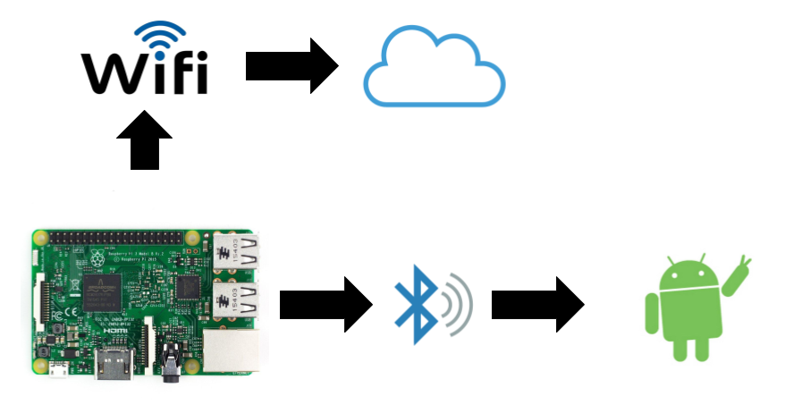
Microcontroller and Speech Recognition Subsystem
Speech Recognition:
Subsystem takes an audio file and extracts the speech into text.
Resulting texts is parsed to extract symptoms as keywords.
Keywords are sent to cloud database and machine learning subsystems
Microcontroller:
Make use of Raspberry Pi
Bluetooth functionality to communicate with android app.
Will feature a high quality microphone.
Subsystem will communicate with the cloud database to store and retrieve information.

Slide 7
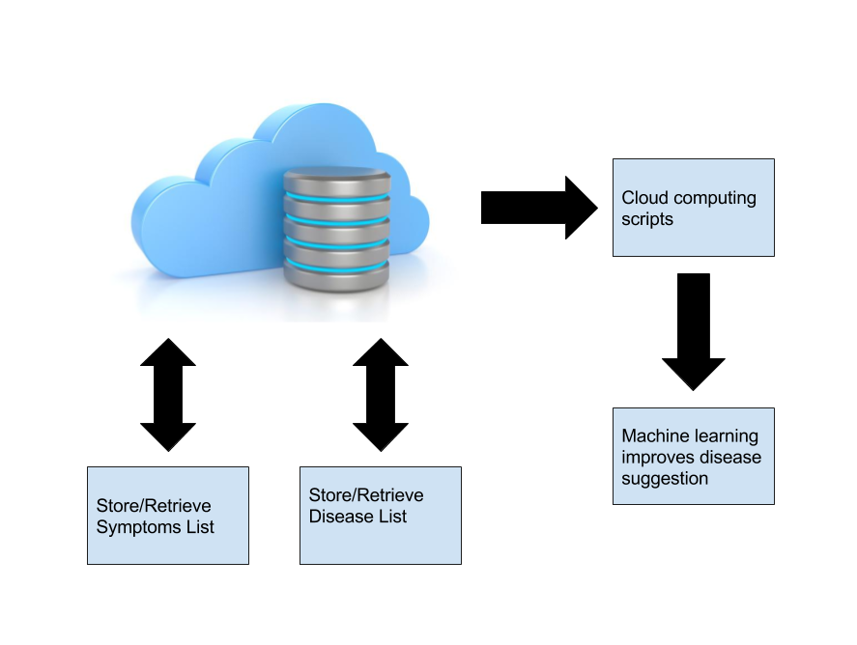
Cloud Storage and Cloud Computing Subsystem
Cloud database
EC2 Amazon Web Services
SQL: stores symptoms and diseases
Provides ways of retrieving/updating/adding/removing symptoms and diseases
Provides ability to run applications in the cloud
machine learning algorithm

Slide 8
Execution and Validation
Currently: have outlined needs for each system, tentatively selected parts, begun preliminary designs, created basic cloud server structure, and neural layering done
 | October 18th | November 1st | November 15th | November 29th | December 6th
Machine Learning | 25% Neural Net Layer | 50% Neural Net Layer & intermediate testing | 75% Neural Net Layer | Trained Neural Net | Comms w/ Database & Testing
Android App | 90% GUI | Comms w/ controller & intermediate testing | Info from cloud server | Info to cloud server | 97% GUI & Testing
Controller | 50% Wifi connection | 75% receive information | Send audio file & intermediate testing | All programs set up | Refine & Test
Cloud Server | Java server structure setup & intermediate testing | SQL database setup | Program to extract keywords | Populated database | Connection to controller & Testing

