Slide 1
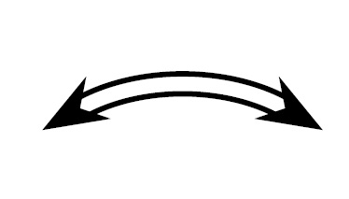
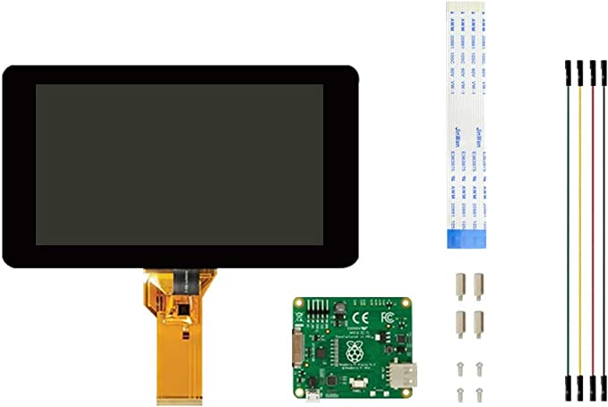
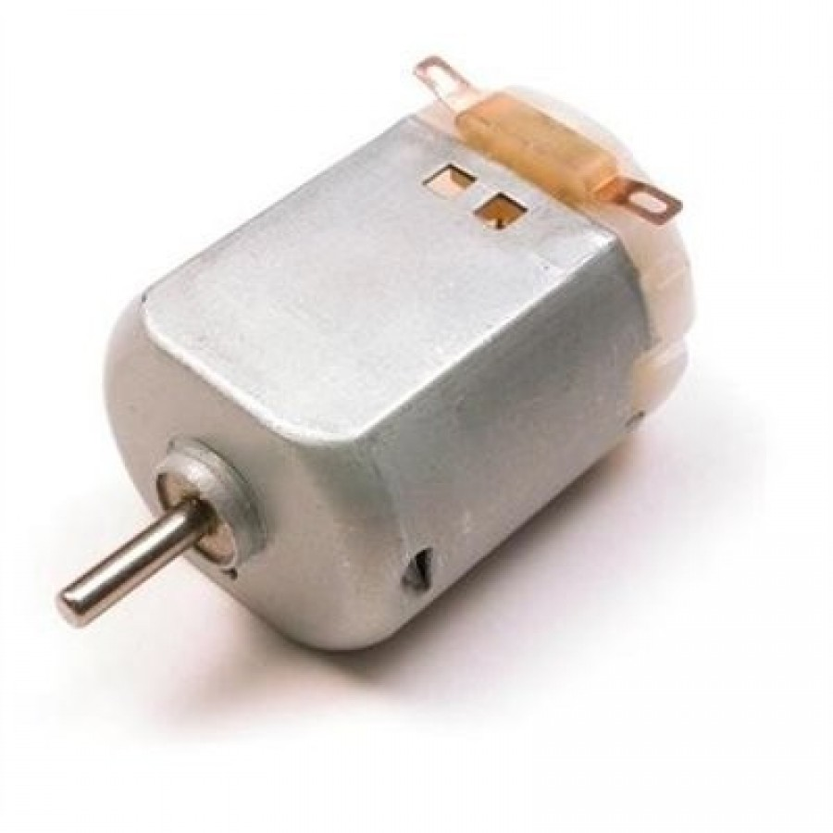
Solar Radiation
180° Zenith Angle
Charge Controller
DC-DC Converter
GUI & Database
Load
Solar Panel
Battery
Switches
ADC
Voltage/Current Sense
MCU
Motor
PCB
User Interaction
Minimum Desk Boundary

Slide 2
GUI & Database
Charge Controller
DC-DC Converter
Load
Solar Panel
Battery
Switches
ADC
Voltage/Current Sense
MCU
Motor
PCB
User Interaction
Minimum Desk Boundary

Slide 3
ADC
Motor
MCU
Solar Panel
Charge Controller
Battery
Buck Boost Converter
Load
5.5V
100mA
3.7V
2.5V - 3.7V
3.0V
200mA

