Slide 1
Arcade
Developers: Krishna Calindi, Kanishk Chhabra, Antonio Rosales, Tejas Singhal, Ze Sheng, Junchao Wu, Nandinii Yeleswarapu
Client: Professor Philip Ritchey

Slide 2
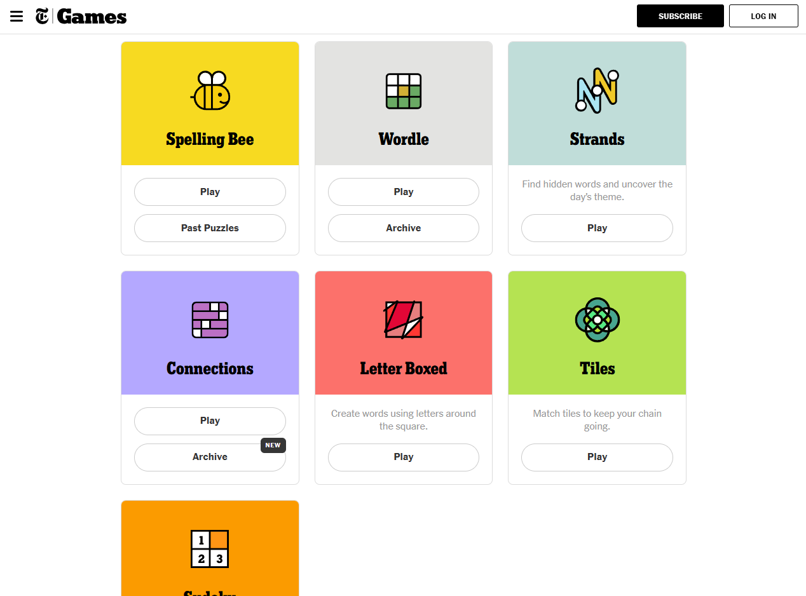
NYT Games Page

Slide 3
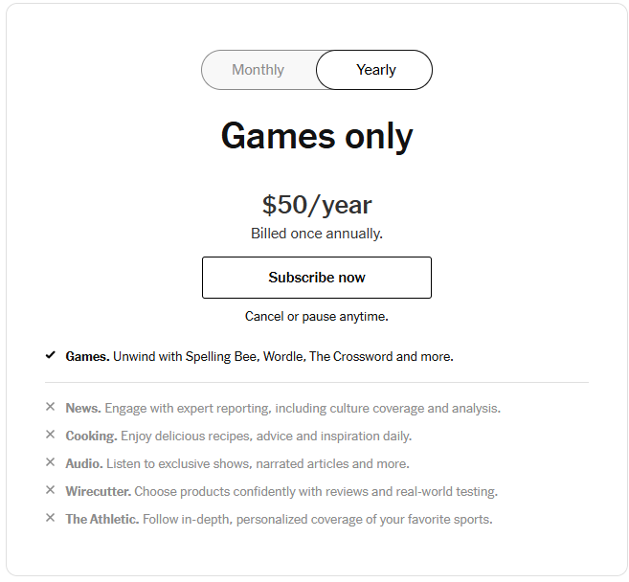
Problem
Unfortunately, some features are hidden behind a paywall...

Slide 4
Problem
Unfortunately, some features are hidden behind a paywall...
Playing some games requires users to create a NYT account

Slide 5
Problem
Unfortunately, some features are hidden behind a paywall...
Playing some games requires users to create a NYT account
Features not accessible to client:
E.x. setting daily/weekly puzzles, changing game styling, etc...

Slide 6
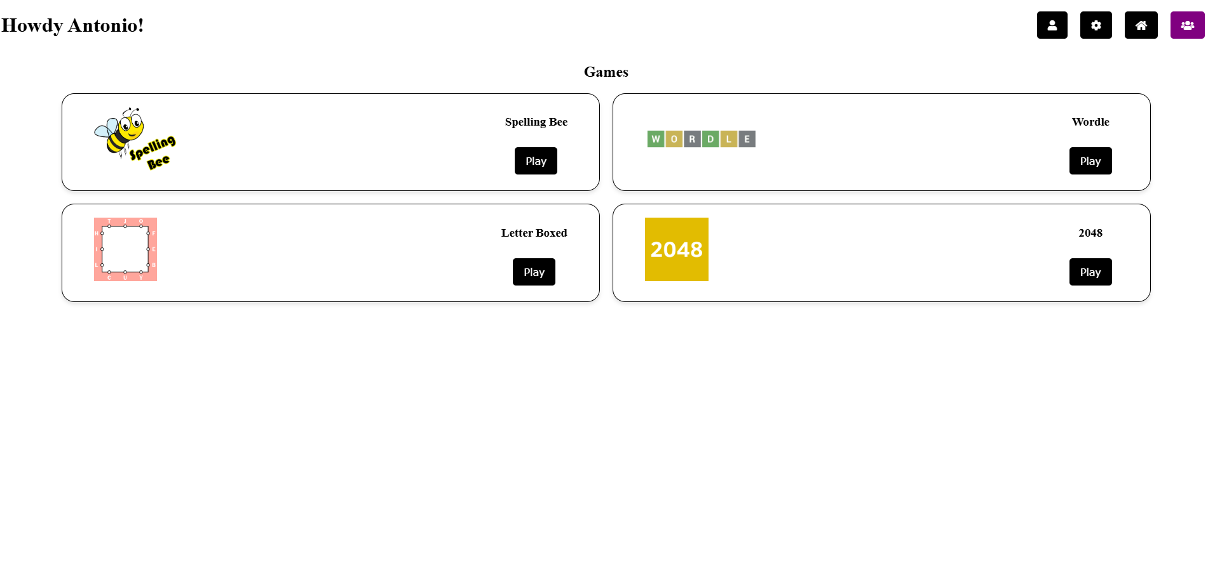
Arcade App

Slide 7
Feature Overview
Play games:
Spelling Bee
Wordle
Letter Boxed
2048
Register as user or freely access as guest
Allow users to login with Google, GitHub, and/or Spotify

Slide 8
Feature Overview
Game-management
Daily puzzle
Aesthetics
User-role management
System admins can assign and manage user roles

Slide 9
Notable Design Choices
Technologies
Ruby on Rails
Database
Relational DB to model relationships between users, roles, games, etc...
PostgreSQL
Data Modeling
User-Role Management
Users have many roles
Active vs. Inactive

Slide 10
Lessons on SE Practices
Teamwork
Communication
Scrum Master and Product Owner
Project planning
Breakdown of tasks
Assignment of responsibilities
Prioritization of features
Project management
Progress tracking (Jira)
Version and branch control (Git and GitHub)
Development vs. Production

Slide 11
Demonstration Time!

