Slide 1

Jimmy - Gym Buddy Finder
Connecting College Students Through Fitness
Find your fitness partner today!

Slide 2
TABLE OF CONTENTS
01
02
03
04
05
06
Functional Aspects
Technical Aspects
Testing & Quality Assurance
Development Journey and Design Insights
Future Scope
Product Demo

Slide 3

PROBLEM VS SOLUTION
PROBLEM
SOLUTION
Balancing health and academics is tough for students, especially in a new environment.
Jimmy connects students with similar fitness goals, fostering motivation and accountability.

Slide 4

What is Jimmy?
A fitness-focused platform for students to find workout buddies on campus.

Slide 5
01
FUNCTIONAL ASPECTS

Slide 6
KEY FEATURES
User Accounts
Registration via authenticated university email-ids
Profiles
Includes fitness background, preferences, and photos
Matching
Compatibility-based matching with update notifications
Messaging
Chat to know the partner more and coordinate workouts
Search
Filters for workout types, locations, goals, partner age and gender
REGISTRATION
PROFILE
SETUP
MATCH
MESSAGE
MEET

Slide 7

BENEFITS
FOR STUDENTS
FOR UNIVERSITY
Improved fitness levels and gym attendance.
Build friendships and sports teams.
Personalized fitness journey.
Enhanced campus engagement.
Contribution to student well-being.

Slide 8
02
TECHNICAL ASPECTS

Slide 9







TECHNOLOGY STACK
BACKEND
FRONTEND
AUTHENTICATION
DEPLOYMENT
DATABASE
FILE STORAGE

Slide 10
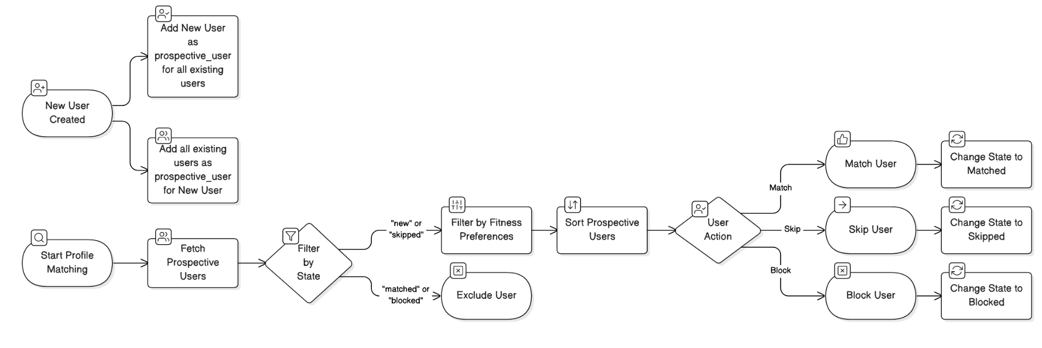
KEY IMPLEMENTATIONS - Profile Matching Algorithm
MARS
JUPITER
SATURN
Mars is full of iron oxide dust, giving this planet its reddish cast
Jupiter is the biggest one and the fourth-brightest object in the sky
Saturn is a gas giant, composed mostly of hydrogen and helium

Slide 11

KEY IMPLEMENTATIONS - Real Time Messaging Feature
Connecting Gym Buddies in Real-Time
Private 1:1 Conversations
Enables two users to exchange messages in a private chat.
Facilitates coordination for workout schedules and fitness plans.
Encrypted Message Storage
Messages are stored securely with encryption, ensuring user privacy.
Protects sensitive conversations from unauthorized access.
Real-Time Communication
Powered by ActionCable for WebSocket-based messaging.
Instant updates keep users engaged without refreshing the page.

Slide 12

03
TESTING & QUALITY ASSURANCE

Slide 13

TESTING & QUALITY ASSURANCE
Jimmy ensures robust functionality and code quality through rigorous testing practices
Testing Highlights
RSpec Testing: Achieved >90% coverage for unit and integration tests.
Cucumber Scenarios: Extensive >90% coverage for end-to-end user workflows.
Comprehensive validation checks to ensure data integrity and smooth user interactions throughout the application.
Coverage & Quality Tools
SimpleCov: Tracks and reports testing coverage across the codebase.
CodeClimate: Achieved an A-rated code quality, ensuring maintainability and reliability.

Slide 14

04
Development Journey and Design Insights

Slide 15
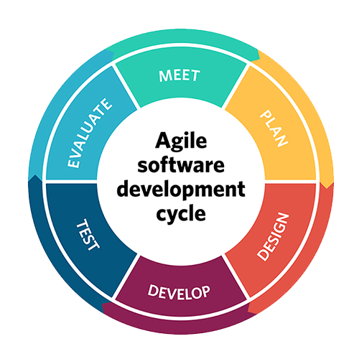
AGILE METHODOLOGY
Followed Agile practices with 4 bi-weekly sprints to manage and deliver the project incrementally.
Sprint work included incorporating new features, backlog prioritization, robust testing, and incremental deployment of each feature based on set plan.
Conducted weekly client meetings to gather feedback and ensure alignment with the client’s vision. These sessions helped refine features and adjust priorities as needed.
Retrospectives at the end of each sprint helped refine processes and enhance efficiency.

Slide 16

DESIGN CHOICES
Mobile-First Design:
Ensured a responsive UI to enhance usability on mobile devices, as most students access apps on their phones.
Encrypted Messaging:
Prioritized user privacy and security by encrypting messages at rest.
Scalability with Modular Architecture:
Adopted a modular codebase to simplify future enhancements.

Slide 17

05
FUTURE SCOPE

Slide 18

FUTURE SCOPE
Advanced rank-based matching algorithms for enhanced compatibility check.
Group Fitness Matching
Expand beyond 1:1 connections to group-based matching.
Integration with Campus Resources
Partner with university gyms and sports centers for increased participation.

Slide 19

06
PRODUCT DEMO

Slide 20
THANKS

