Slide 1
Apartment Finder
By Team Code Bros

Slide 2
Members:
Kaiyuan (Kelvin) Gao (Scrum Master)
Hanson Yu (Product Owner)
Pengcheng Liao
Junru Liu
Winston Liu
Lucas Lyu

Slide 3

Project Introduction and Proposal:
Our client: JJ group is a professional team lead by Jennifer Juang, an agent and locator of Texas Association of Realtors. They help international student find housing near campus in Texas.
What our client wants: A website/platform for increased visibility and better accessibility for their customers.
What is our project about (What we provided): A CRM (Customer Relation Management) application for our client.
Key features that we built to achieve their needs:
Dynamic info updates for available property in real time.
Login system for different types of users (Admin and customer).
Appointment scheduling system.

Slide 4
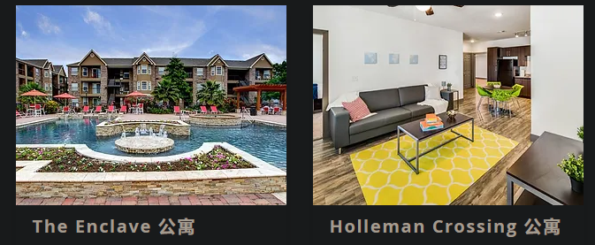
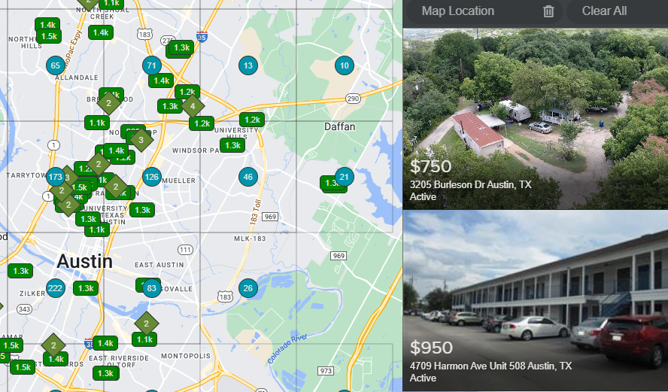
Key Features
Dynamic info updates for available property in real time:
Real estate group that have their apartment buildings near campus
Landlords/Individual lessor owns their house and what to lend it out
Information needs to updated separately

Slide 5
Key Features
Login system for different types of users (Admin and customer):
As customer, you can send contact information to the admin, and schedule meeting with the admin
As admin, you can update information of available apartments, and read message from the customer
Appointment scheduling system:
Customers are able to schedule multiple appointments with JJ group
JJ group can reschedule the appointment

Slide 6







Tech Stack
Version control and other APIs:
Front end:
Back end:

Slide 7
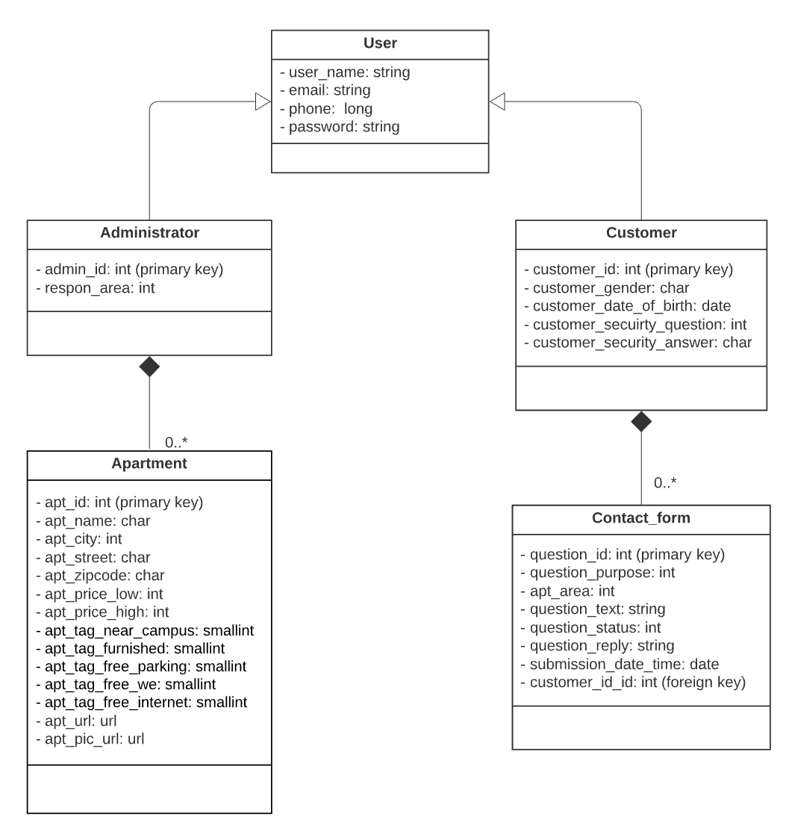
Database Structure

Slide 8
Challenges:
Deployment issues with AWS and Heroku:
Each hosting service had different .config files
Reactjs: Heroku -> no
Reactjs: AWS -> yes
Database migration to a live environment:
Similar to the issues above, configure and setting up database in different services can be annoying
Django: AWS-> no
Django: Heroku-> yes
Technical issues with non-technical clients
We like to getting into technical detail, but they won’t understand
However, …….

Slide 9
What we’ve learn from the process:
Our client is not engineer, so design the product in the perspective of the client.
Immediate and effective team communication is an essential factor to keep up with the progress.
Version controls is definitely important for iterative development.
Pair programming and code review can be useful.

Slide 10
Up Next: Demo
Case 1: User Login, submit contact forms and schedule appointments with JJ lease group
Case 2: JJ lease group login and reply contact form messages and manage appointment
Case 3: JJ lease group updates apartment informations

