Slide 1

Probabilistic Calling Context
Michael D. Bond Kathryn S. McKinley
University of Texas at Austin

Slide 2
Why Context Sensitivity?
Static program location not enough
at com.mckoi.db.jdbcserver.JDBCInterface.execQuery():213

Slide 3
Why Context Sensitivity?
Static program location not enough
at com.mckoi.db.jdbcserver.JDBCInterface.execQuery():213
at com.mckoi.db.jdbc.MConnection.executeQuery():348
at com.mckoi.db.jdbc.MStatement.executeQuery():110
at com.mckoi.db.jdbc.MStatement.executeQuery():127
at Test.main():48

Slide 4
Why Context Sensitivity?
Static program location not enough
at com.mckoi.db.jdbcserver.JDBCInterface.execQuery():213
at com.mckoi.db.jdbc.MConnection.executeQuery():348
at com.mckoi.db.jdbc.MStatement.executeQuery():110
at com.mckoi.db.jdbc.MStatement.executeQuery():127
at Test.main():48
Motivated by
  Complex programs
  Small methods
  Virtual dispatch

Slide 5
Why Context Sensitivity?
Static program location not enough
at com.mckoi.db.jdbcserver.JDBCInterface.execQuery():213
at com.mckoi.db.jdbc.MConnection.executeQuery():348
at com.mckoi.db.jdbc.MStatement.executeQuery():110
at com.mckoi.db.jdbc.MStatement.executeQuery():127
at Test.main():48
Motivated by
  Complex programs
  Small methods
  Virtual dispatch
call
call
return
return
C/Fortran method
Java/C# method

Slide 6
Context Is Nontrivial
 | API calls
Program | Call sites | Distinct contexts
antlr | 4,184 | 128,627
bloat | 3,306 | 600,947
chart | 2,335 | 202,603
eclipse | 9,611 | 226,020
fop | 2,225 | 37,710
hsqldb | 947 | 16,050
jython | 1,830 | 628,048
luindex | 654 | 102,556
lusearch | 507 | 905
pmd | 1,890 | 847,108
xalan | 1,530 | 17,905

Slide 7
Example: Residual Testing
Does behavior occur at production time that did not occur at testing time?
class SimpleWindow {
close() {
...
}
}
class EditorWindow {
close() {
...
}
}

Slide 8
Example: Residual Testing
Does behavior occur at production time that did not occur at testing time?
autoUpdate() {
...
for all windows w
w.close();
...
}
class SimpleWindow {
close() {
...
}
}
inputHandler() {
...
case CLICK_EXIT:
w.checkUnsaved();
w.close();
...
}
class EditorWindow {
close() {
...
}
}

Slide 9
Example: Residual Testing
Does behavior occur at production time that did not occur at testing time?
autoUpdate() {
...
for all windows w
w.close();
...
}
class SimpleWindow {
close() {
...
}
}
inputHandler() {
...
case CLICK_EXIT:
w.checkUnsaved();
w.close();
...
}
class EditorWindow {
close() {
...
}
}
Bug!

Slide 10
Example: Residual Testing
Does behavior occur at production time that did not occur at testing time?
autoUpdate() {
...
for all windows w
w.close();
...
}
class SimpleWindow {
close() {
...
}
}
New behavior indicates bugs
inputHandler() {
...
case CLICK_EXIT:
w.checkUnsaved();
w.close();
...
}
Context sensitivity helps find new behavior
class EditorWindow {
close() {
...
}
}
Bug!

Slide 11
Two-Phase Dynamic Analyses
Training
Production
Behavior observed
New or anomalous behavior detected

Slide 12
Two-Phase Dynamic Analyses
Residual testing
Anomaly-based
bug detection
Anomaly-based intrusion detection
What behavior occurs at production time that did not occur at testing time?
[Vaswani et al. ’07]
What new behavior occurs during a buggy program run?
[Hangal & Lam ’02]
Does a program exhibit anomalous behavior?
[Inoue ’05]
Training
Production
Behavior observed
New or anomalous behavior detected

Slide 13
Probabilistic Calling Context
Adds context sensitivity to dynamic analyses
Maintains value representing context
  Unique with high probability
  New value → new context → walk stack
High accuracy: <0.1% false negatives
Low overhead: 3% overhead, 0-8% for clients
Training
Production
Behavior observed
New or anomalous behavior detected

Slide 14
Outline
Introduction
Previous approaches
Maintaining the PCC value
Evaluation
  Accuracy
  Performance

Slide 15
Previous Approaches
Tracking context [Ammons et al. ’97] [Spivey ‘04]
  Maintain CCT position at each call/return
Walking the stack [Nethercote & Seward ‘07]
Path profiling [Ball & Larus ’96] [Melski & Reps ’99]
  Call graphs large → path explosion
  Virtual dispatch complicates instrumentation

Slide 16
Previous Approaches
Tracking context [Ammons et al. ’97] [Spivey ‘04]
  Maintain CCT position at each call/return
Walking the stack [Nethercote & Seward ‘07]
Path profiling [Ball & Larus ’96] [Melski & Reps ’99]
  Call graphs large → path explosion
  Virtual dispatch complicates instrumentation
Sampling [Zhuang et al. ’06]
  Sacrifices coverage for low overhead

Slide 17
Outline
Introduction
Previous approaches
Maintaining the PCC value
Evaluation
  Accuracy
  Performance

Slide 18
PCC Function
f ( V , cs )
  V is PCC value
  cs is call site ID

Slide 19
PCC Function
f ( V , cs )
V ← f ( V , cs₁ )
  V is PCC value
  cs is call site ID
V ← f ( V , cs₂ )
cs₁
cs₂
V ← V_{saved}
V ← V_{saved}

Slide 20
PCC Function
f ( V , cs ) ≡ 3V + cs (mod 2³²)
  V is PCC value
  cs is call site ID

Slide 21
PCC Function
f ( V , cs ) ≡ 3V + cs (mod 2³²)
Motivated by MPI datatype hashing [Langou et al. ’05] [Gropp ’00]
Cheap to compute
Desirable properties:
  Non-commutative
  Composition efficient to compute

Slide 22
Differentiating Similar Contexts
V ← 3V + cs₂
A
V ← 3V + cs₁
A
V ← 3V + cs₁
V ← 3V + cs₂
B
B
C
C
… → A() → B() → …
… → B() → A() → …

Slide 23
Differentiating Similar Contexts
V ← 3V + cs₂
A
V ← 3V + cs₁
A
V ← 3V + cs₁
V ← 3V + cs₂
B
B
C
C
Non-commutative
  f ( f (V , cs₁ ) , cs₂ ) ≠ f ( f (V , cs₂ ) , cs₁ )

Slide 24
Efficiency at Inlined Calls
A
V ← 3V + cs₁
V ← 3V + cs₂
B
C

Slide 25
Efficiency at Inlined Calls
A
A
V ← 3V + cs₁
V ← 3V + cs₂
V ← 3 ( 3V + cs₁ ) + cs₂
B
B
C
C

Slide 26
Efficiency at Inlined Calls
A
A
V ← 3V + cs₁
V ← 3V + cs₂
V ← 9V + 3cs₁ + cs₂
B
B
C
C

Slide 27
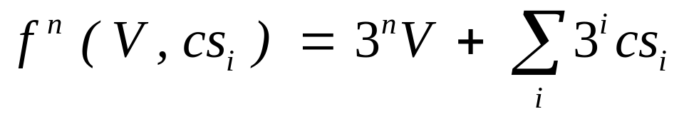
Efficiency at Inlined Calls
A
A
V ← 3V + cs₁
V ← 3V + cs₂
V ← 9V + 3cs₁ + cs₂
B
B
C
C
Composition efficient to compute

Slide 28
Outline
Introduction
Previous approaches
Maintaining the PCC value
Evaluation
  Methodology
  Evaluating potential clients
  Accuracy
  Performance

Slide 29
Methodology
Implementation in Jikes RVM 2.4.6
  Available on Jikes RVM Research Archive
Deterministic calling context profiling
  Maintains CCT node at each call & return
Benchmarks: DaCapo, SPEC JBB2000, SPEC JVM98
Platform: 3.6 GHz Pentium 4 w/Linux

Slide 30
How Clients Use PCC
Record values
New value → new context → walk stack
Training
Production
Behavior observed
New or anomalous behavior detected

Slide 31
Evaluating Potential Clients
Global hash table
Check values
(no new values)
Record values
Training
Production
Behavior observed
New or anomalous behavior detected

Slide 32
Evaluating Potential Clients
Memory overhead: proportional to contexts
Global hash table
Check values
(no new values)
Record values
Training
Production
Behavior observed
New or anomalous behavior detected

Slide 33
Evaluating Potential Clients
Anomaly-based intrusion detection
Residual testing
Upper bound
Check PCC value at
system calls
(Network, I/O, OS)
Check PCC value at
Java API calls
(calls to java.*)
Check PCC value at
all calls

Slide 34
Ideal Accuracy
PCC maps context to value
  New PCC value → new context
  Familiar PCC value → probably familiar context

Slide 35
Ideal Accuracy
PCC maps context to value
  New PCC value → new context
  Familiar PCC value → probably familiar context
 | Expected conflicts (false negatives)
Distinct contexts | 32-bit values | 64-bit values
100,000 | 1 (0.0%) | 0 (0.0%)
1,000,000 | 116 (0.0%) | 0 (0.0%)
10,000,000 | 11,632 (0.1%) | 0 (0.0%)
100,000,000 | 1,155,170 (1.2%) | 0 (0.0%)
1,000,000,000 | 107,882,641 (10.8%) | 0 (0.0%)
10,000,000,000 | 6,123,623,065 (61.2%) | 3 (0.0%)

Slide 36
Ideal Accuracy
PCC maps context to value
  New PCC value → new context
  Familiar PCC value → probably familiar context
 | Expected conflicts (false negatives)
Distinct contexts | 32-bit values | 64-bit values
100,000 | 1 (0.0%) | 0 (0.0%)
1,000,000 | 116 (0.0%) | 0 (0.0%)
10,000,000 | 11,632 (0.1%) | 0 (0.0%)
100,000,000 | 1,155,170 (1.2%) | 0 (0.0%)
1,000,000,000 | 107,882,641 (10.8%) | 0 (0.0%)
10,000,000,000 | 6,123,623,065 (61.2%) | 3 (0.0%)
API calls

Slide 37
Ideal Accuracy
PCC maps context to value
  New PCC value → new context
  Familiar PCC value → probably familiar context
 | Expected conflicts (false negatives)
Distinct contexts | 32-bit values | 64-bit values
100,000 | 1 (0.0%) | 0 (0.0%)
1,000,000 | 116 (0.0%) | 0 (0.0%)
10,000,000 | 11,632 (0.1%) | 0 (0.0%)
100,000,000 | 1,155,170 (1.2%) | 0 (0.0%)
1,000,000,000 | 107,882,641 (10.8%) | 0 (0.0%)
10,000,000,000 | 6,123,623,065 (61.2%) | 3 (0.0%)
All calls

Slide 38
Ideal Accuracy
PCC maps context to value
  New PCC value → new context
  Familiar PCC value → probably familiar context
 | Expected conflicts (false negatives)
Distinct contexts | 32-bit values | 64-bit values
100,000 | 1 (0.0%) | 0 (0.0%)
1,000,000 | 116 (0.0%) | 0 (0.0%)
10,000,000 | 11,632 (0.1%) | 0 (0.0%)
100,000,000 | 1,155,170 (1.2%) | 0 (0.0%)
1,000,000,000 | 107,882,641 (10.8%) | 0 (0.0%)
10,000,000,000 | 6,123,623,065 (61.2%) | 3 (0.0%)
Near-perfect accuracy

Slide 39
PCC’s Accuracy
 | System calls |  |  | Java API calls
Program | Dynamic | Distinct | Conf. | Dynamic | Distinct | Conf.
antlr | 211,490 | 1,567 | 0 | 24,422,013 | 128,627 | 3
bloat | 12 | 10 | 0 | 1,159,281,573 | 600,947 | 40
chart | 63 | 62 | 0 | 258,891,525 | 202,603 | 4
eclipse | 14,110 | 197 | 0 | 132,507,343 | 226,020 | 5
fop | 18 | 17 | 0 | 9,918,275 | 37,710 | 0
hsqldb | 12 | 12 | 0 | 81,161,541 | 16,050 | 0
jython | 5,929 | 4,289 | 0 | 543,845,772 | 628,048 | 48
luindex | 2,615 | 14 | 0 | 39,733,214 | 102,556 | 0
lusearch | 141 | 11 | 0 | 113,511,311 | 905 | 0
pmd | 1,045 | 25 | 0 | 537,017,118 | 847,108 | 79
xalan | 137,895 | 59 | 0 | 2,105,838,670 | 17,905 | 0

Slide 40
PCC’s Accuracy
 | System calls |  |  | Java API calls
Program | Dynamic | Distinct | Conf. | Dynamic | Distinct | Conf.
antlr | 211,490 | 1,567 | 0 | 24,422,013 | 128,627 | 3
bloat | 12 | 10 | 0 | 1,159,281,573 | 600,947 | 40
chart | 63 | 62 | 0 | 258,891,525 | 202,603 | 4
eclipse | 14,110 | 197 | 0 | 132,507,343 | 226,020 | 5
fop | 18 | 17 | 0 | 9,918,275 | 37,710 | 0
hsqldb | 12 | 12 | 0 | 81,161,541 | 16,050 | 0
jython | 5,929 | 4,289 | 0 | 543,845,772 | 628,048 | 48
luindex | 2,615 | 14 | 0 | 39,733,214 | 102,556 | 0
lusearch | 141 | 11 | 0 | 113,511,311 | 905 | 0
pmd | 1,045 | 25 | 0 | 537,017,118 | 847,108 | 79
xalan | 137,895 | 59 | 0 | 2,105,838,670 | 17,905 | 0

Slide 41
PCC’s Accuracy
 | All calls
Program | Dynamic | Distinct | Conf.
antlr | 490,363,211 | 1,006,578 | 118
bloat | 6,276,446,059 | 1,980,205 | 453
chart | 908,459,469 | 845,432 | 91
eclipse | 1,266,810,504 | 4,815,901 | 2,652
fop | 44,200,446 | 174,955 | 2
hsqldb | 877,680,667 | 110,795 | 1
jython | 5,326,949,158 | 3,859,545 | 1,738
luindex | 740,053,104 | 374,201 | 12
lusearch | 1,439,034,336 | 6,039 | 0
pmd | 2,726,876,957 | 8,043,096 | 7,653
xalan | 10,083,858,546 | 163,205 | 6

Slide 42
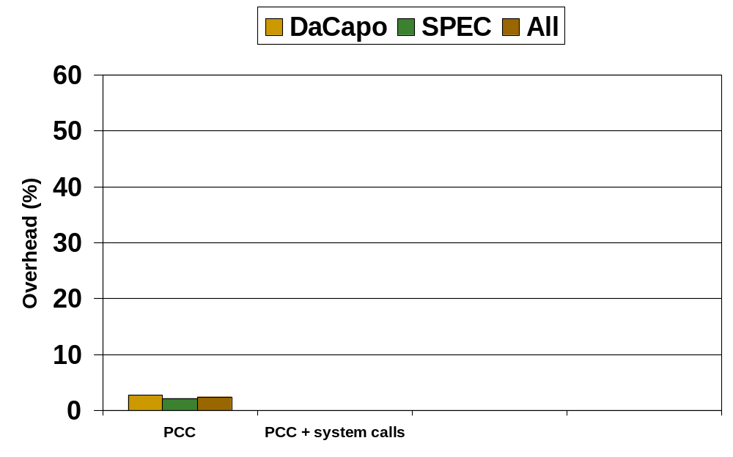
PCC’s Execution Time Overhead
3%

Slide 43
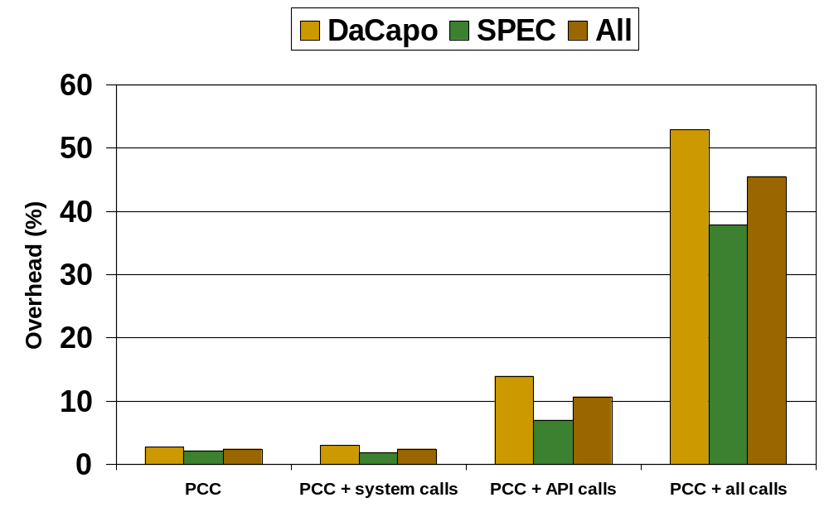
PCC’s Execution Time Overhead
3%

Slide 44
Summary
PCC maintains calling context value
  New value indicates new behavior
Low overhead
  Maintaining PCC value adds 3%
  Checking PCC value 0-8%
  Memory overhead proportional to contexts
High accuracy
  Less than 0.1% false negative rate
PCC adds context sensitivity to clients that detect anomalous behavior

Slide 45
Summary
Thank you!
PCC maintains calling context value
  New value indicates new behavior
Low overhead
  Maintaining PCC value adds 3%
  Checking PCC value 0-8%
  Memory overhead proportional to contexts
High accuracy
  Less than 0.1% false negative rate
PCC adds context sensitivity to clients that detect anomalous behavior

Slide 46
Extra slides

Slide 47
Context Sensitivity Mostly Unused
Do paths capture enough behavior?
C/Fortran method
call
call
return
return
Java/C# method

