Slide 1


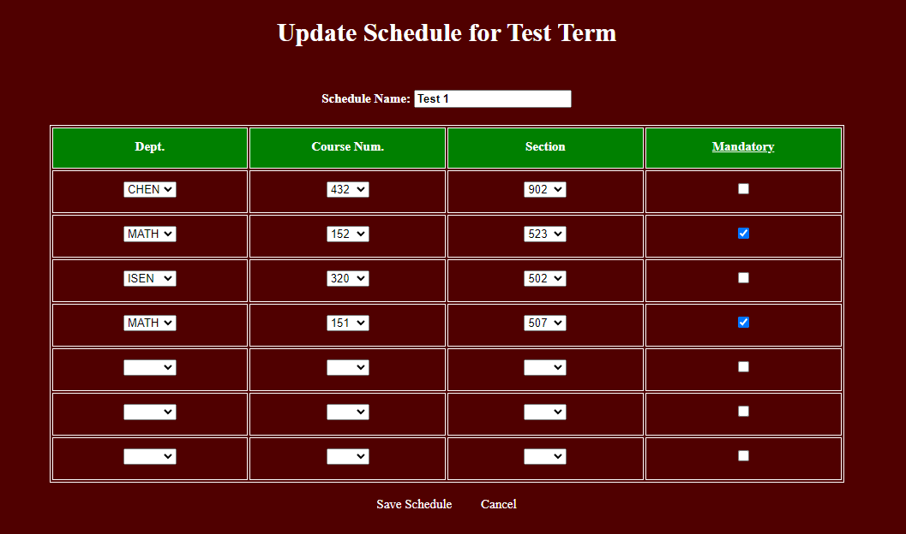
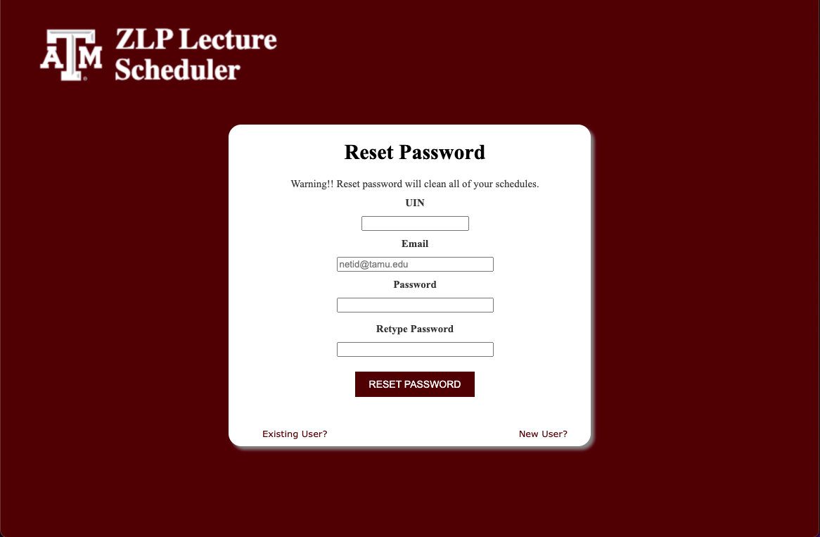
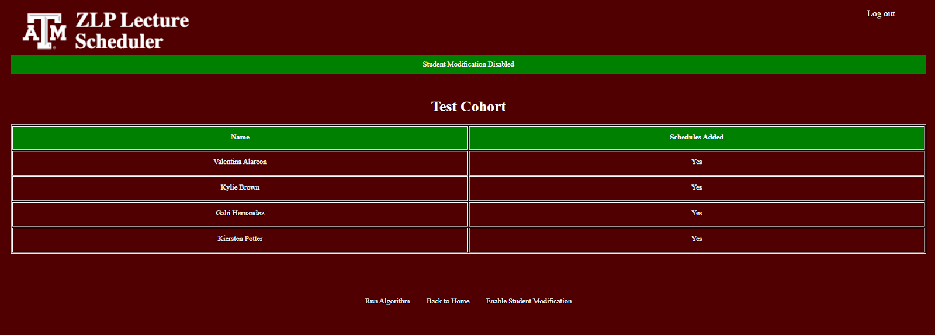
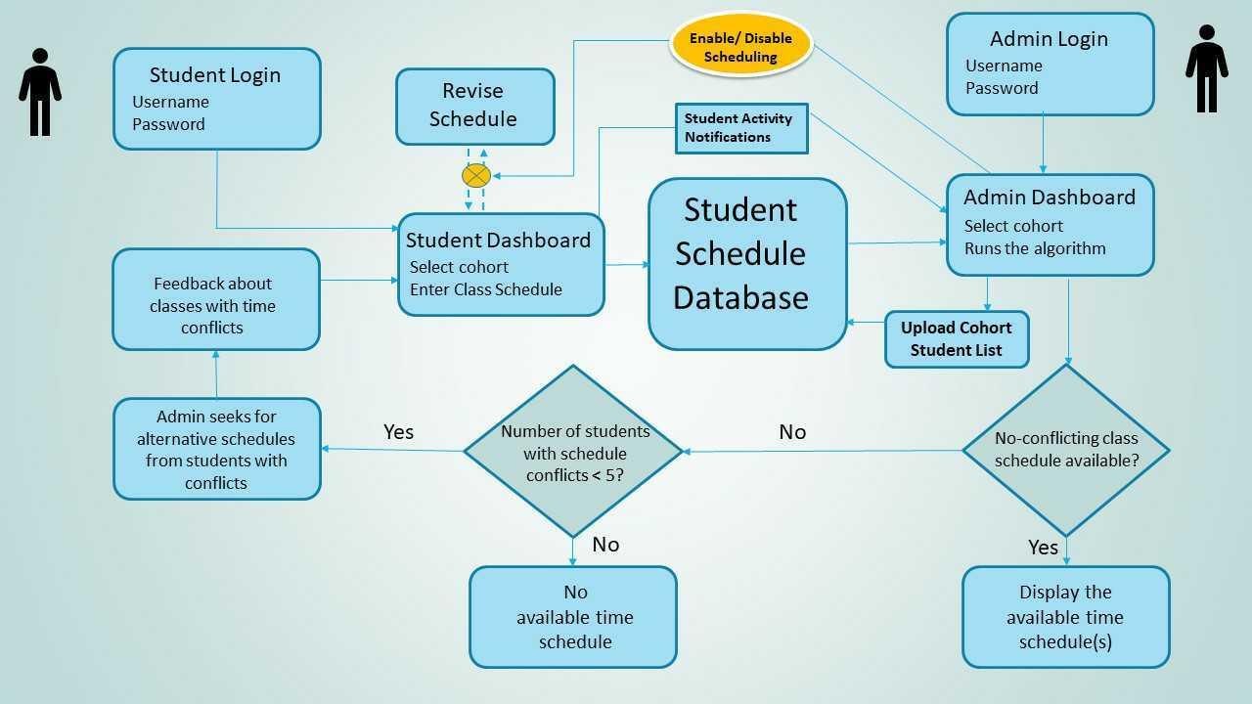
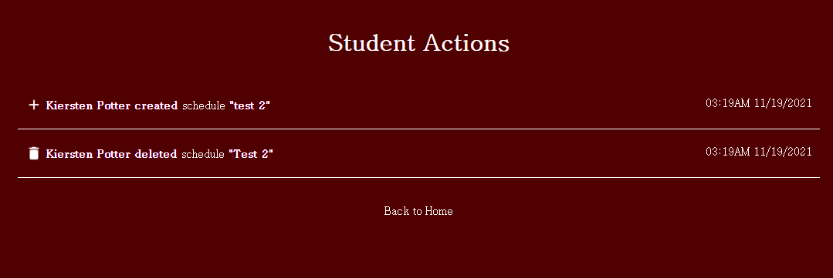
Zachry Leadership Program Lecture Scheduler
Ali Furkan Budak, Jordan Griffin, Fardeen Hasib Mozumder, Jongyong Park,
Adrita Anika, Md Messal Monem Miah, Ankur Nath, Han-Yi Wang
Project Advisors: D.M.H Walker, Seth Sullivan, Gayathri Krishna
Zachry Leadership Program Lecture Scheduler
Ming Dang, Bethany Witemeyer, Sanghyeon Lee, Shih-Chiang Wei, Austin Dauzat, Han-Yi Wang Litong Zhang
Advisors: Hank Walker, Seth Sullivan, Maria Polyzoi
Background
Administrator Features
Student Features
The Zachry Leadership Program is divided into three cohorts of 30 students each.
We took over a legacy website that was designed to assist the director in finding an appropriate 2-hour time window for weekly meetings with the students.
Fix the bug that prevented admins from running the common time finder algorithm twice.
Created a student actions tab on the admin dashboard page that displays the history of student schedule modifications.
Added ability to toggle student schedule modification.
Notify the admins to rerun the algorithm when student modifications cause potential collision.
Allow adding a new student to an existing cohort.
Streamline selection of current active term.
Allow students to edit existing schedules.
Account claiming and password resetting no longer depend on 3rd party mailer.
Motivation & Contribution
The legacy website contained multiple flaws, and the test coverage was insufficient.
Our client expressed concerns about user friendliness and a crash-causing bug.
We improved ease of use of the system, addressed the flaws, and increased test coverage to 84 percent.
Updating Schedule
Software Design
Reset Password
Disable Student Modification
Challenges & Lessons Learned
Effective communication is critical to success and scheduling is difficult.
Planned meetings are more effective.
It takes time to understand legacy code.
Create reasonable and attainable goals.
Details of student actions

