Slide 1
Fields & Properties
Handling your class data

Slide 2
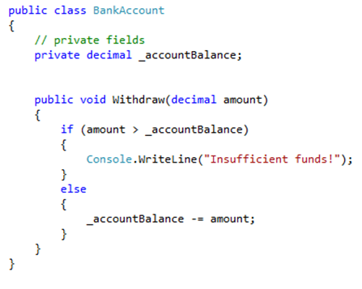
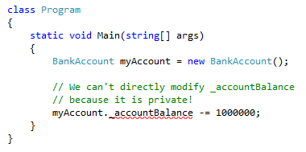
What is a field?
Fields are variables that belong to your class.
A field can be of any type, including user defined types like other classes
A field has scope in the entire class. So any method in the class can see the field.
Most often, fields are used to store information that we want to keep private within our class. In this way, the data can only be manipulated in the ways that we approve of.
We can mark fields as public, but this is not common. Public data is most often exposed as properties.

Slide 3
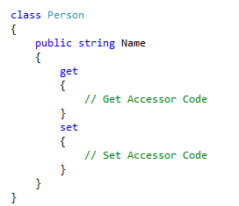
Properties
Properties represent items of data in a class or class instance.
They are very similar to fields in that they have a name, a type, and they can be assigned to and read from
Unlike a field they can execute code and have two accessor methods available to them

Slide 4
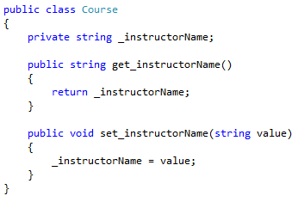
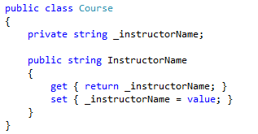

Properties are methods
In other languages, there is no such thing as a property. To get the same effect as properties other languages use methods.
In C#, we can declare a property by putting a code block after the property name and placing get and set blocks inside. The private field that the property uses is called the backing field.
We can omit the backing field and the code blocks for get and set. This is called an auto-property.
All three of these examples do the same thing. Most developers prefer the 3rd example because it is short.

Slide 5
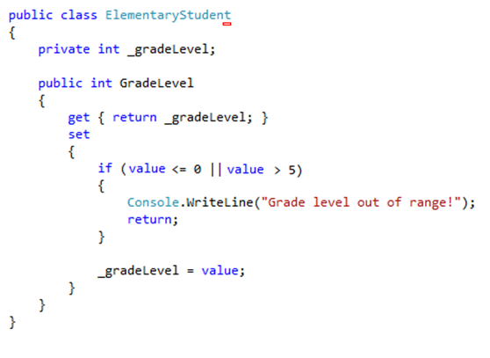
Properties give control
Unlike fields, properties give us full control over reading and writing the data in our class. For example:
So as developers we can write code in our get and set accessors to protect the class data and prevent it from being corrupted or set to values that do not make sense.

Slide 6
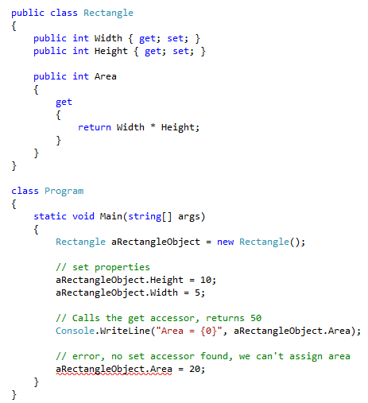
Properties as calculated fields
Sometimes we have data in a class that is dependent on other fields or properties. We often refer to these as dependent or calculated fields.
We can omit the set accessor of a property which makes the property read-only.
We can also use the syntax “private set” to make a property that anyone can read, but only the class itself can modify… though this is not very common.

Slide 7
In Conclusion
Use private fields for data you want to hide or protect.
Use properties for data you want to expose.

