Slide 1
Static vs Non-Static
A.K.A. Static vs Instance Members

Slide 2
The title is deceptive…
There is a static keyword but there is no “non-static” keyword. The absence of the keyword static means that whatever is defined belongs to an instance (created with the new keyword).
You can mark many things static, including classes, methods, fields, properties, operators, events, constructors…

Slide 3
What does static mean?
In short, it means that whatever is marked as static does not belong to any object instance created, it belongs to the class itself.
This has some interesting repercussions:
Static members can not use instance members.
If a class is static, all members must also be static.
You can not instantiate a static class
You can not inherit a static class
There is only ever one copy of a static.

Slide 4
Why should I make something static?
We can make something static when it belongs to a class, but does not depend upon any instance members.
Ask yourself: “Is this operating on an instance of a type, or is it just related to the type?”
The math value pi is a good example of this. It is not related to any particular circle, it is related to all circles.

Slide 5
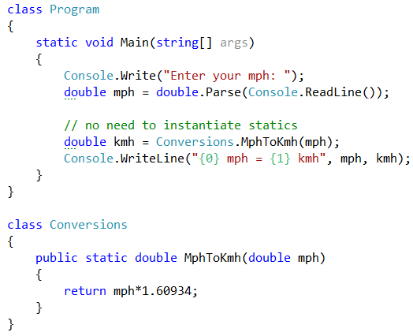
Statics belong to the class
We do not have to instantiate an object to use its static members.
Console.WriteLine()
Console.ReadLine()
int.Parse()
are all static methods

Slide 6
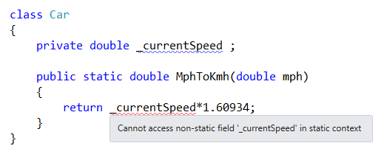
Statics can not use instance members

Slide 7
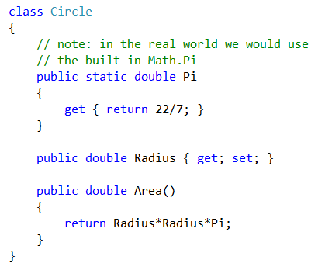
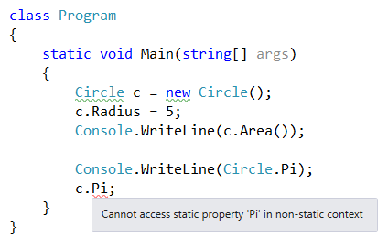
Statics & Object Instances
Instances can use static members
But static members cannot be used from instantiated objects

Slide 8
So what do we make static?
Application settings
paths to directories and files
database information
server information
log settings
General calculations
the Math class in C# has statics like Pi, Powers, Square Roots, Trigonometry Functions, etc
General purpose data
any object that there should only ever be one of (aka the Singleton)
Methods that do general tasks like formatting

Slide 9
Static pros and cons
Statics are great
Statics are bad
They are often very slightly more efficient
Using them is less code to write than instantiating objects
Moving general purpose methods to their own classes can keep the code cleaner
When classes become dumping grounds for unrelated items
When we need to extend our code (static classes can not be inherited)
When they reach into instances of objects (perhaps it belongs in the instance)

