Slide 1

Coursera capstone project
Battle of Neighbourhoods

Slide 2


A food comparison
There are more pizza places in Surat or indian restaurants in Milan?
This research wants to find:
How many pizza places are there in Surat
How many indian restaurants there are in Milan
Making a comparison of both the cities

Slide 3

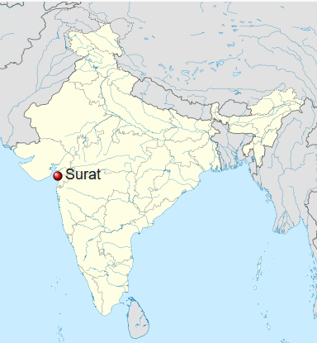
Surat
Surat is a city in Gujarat, India. It is located towards the southern part of the coastline. Surat has a population of 33441435 with a density of 10226 ab/km². Surat is called the diamond city as it is the hub for diamond cutting and polishing.

Slide 4
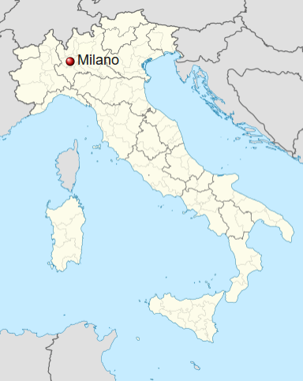
Milan
One of the most famous cities of Europe, is located in northwest of Italy, has a population of 1390434 and a density of 7653,62 ab/km^2. It’s considered the capital of fashion and the region is general has the most famous companies of Italy.

Slide 5

The data
Foursquare API let us having access to a great quantity of data using our research query. In this case I looked for all the places that have the name ‘pizza’ in it in the city of Surat, while in Milan i looked for all the places with ‘indian’ in it.
Having all these data, I created a dataframe that is possibile to analyze and visualise using the folium lybrary.

Slide 6
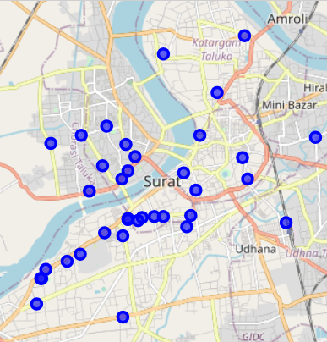
Surat
These are all the entries in a 5km radius, and is kinda surprising to have obrained just 36 results in such a big city. The reason is probably linked to the fact that pizza is sold in bars, that got excluded from our research.

Slide 7
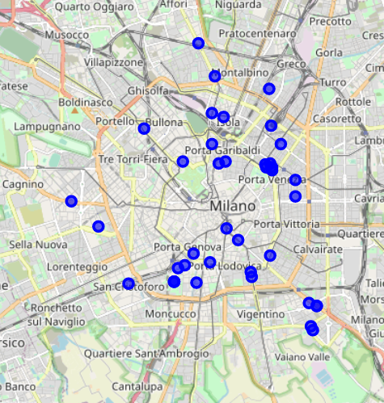
Milan
In the same radius we found 41 places, that is quite surprising knowing that the city is smaller than surat. The reason is the same, because obviously not all indian restaurants have the word ‘indian’ in their name.

Slide 8

Making further analyses
Using the cluster function we can create clusters of places that are nearby in order to locate the bigger concentration.

Slide 9
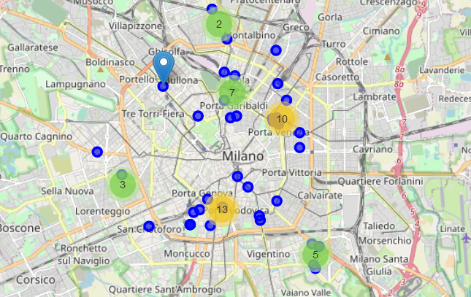
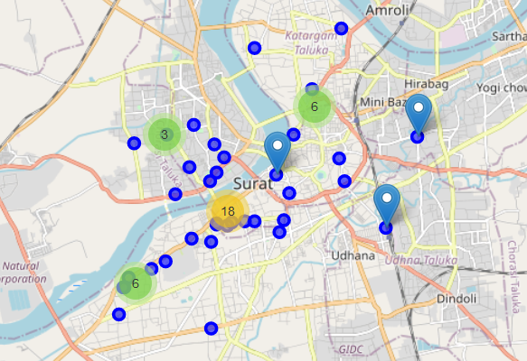
As easily expected, the higher concentration of places is nearby the city center, but to find optimal areas we should look also if they are nearby places with high concentration of people like offices or universities.

