Slide 1
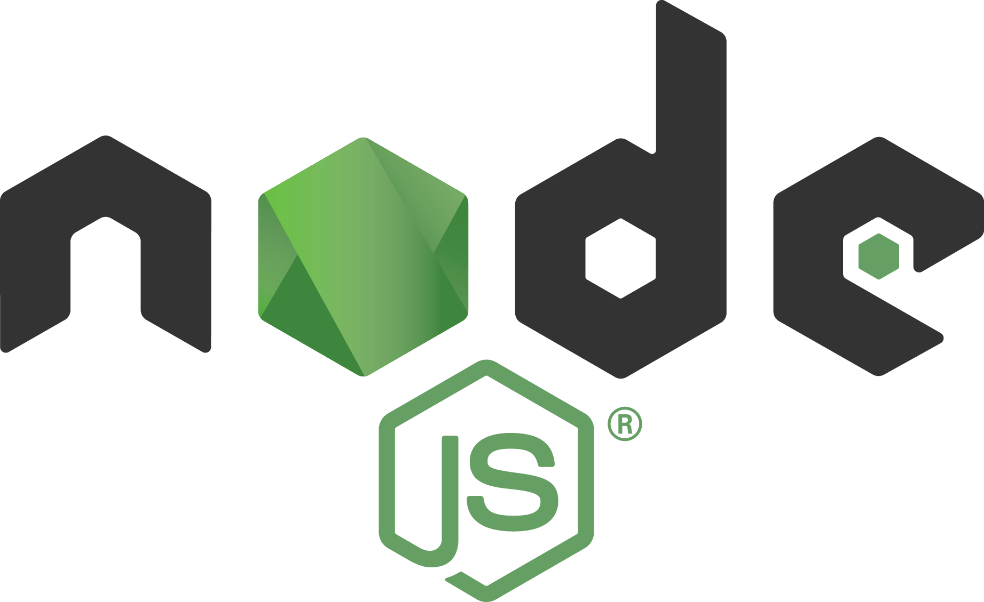
Node.js Presentation

Slide 2
What is Node.js
Node is just another server like Apache, IIS, TOM etc. But unlike those servers Node doesn’t deal with PHP, .NET or JAVA. It executes JavaScript in the server side. Yes, JavaScript without a browser; that’s Node. Node itself is not made in JavaScript completely; rather its wrappers are made in C. It just executes JavaScript. Node is not a framework, it’s a server. It’s not multi-threaded. It runs in a single thread with callback concept.
Node:
A platform which allows us to run Javascript on a computer/server
Read / delete and update files
Easily communicate with a database.
It uses Javascript
Very Fast (runs on the V8 engine & non blocking code).
Many open source packages.
Real-time services.

Slide 3
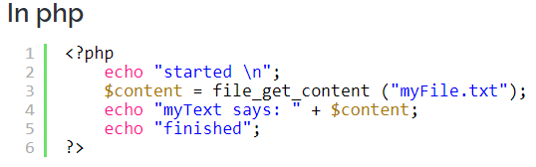
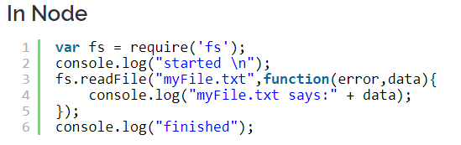
Node.js (Non-Blocking Code)
This is the strongest reason to select node as your server. Node is completely event driven and majority of the code runs basing on callbacks. This approach helps the application not to pause or sleep, but to become available for other requests.
If you notice the code, you will find in php, in line no#3, it will start reading the file and before finishing up reading the file it can’t do anything else. That means php blocks the execution there.
Whereas in case of Node, in line no#3 it starts reading the file and assigns a callback to it, and proceeds to the next line. It continues executing the other parts of the program and whenever the “fs” finished reading the myFile.txt, the callback will be called to process necessary statements.

Slide 4
V8 engine
JavaScript
Node.js is made with C++ and it has embedded V8 engine :
V8 compiles JavaScript directly to native machine code before executing it, instead of more traditional techniques such as interpreting bytecode or compiling the whole program to machine code and executing it from a filesystem. The compiled code is additionally optimized (and re-optimized) dynamically at runtime, based on heuristics of the code's execution profile. Optimization techniques used include inlining, elision of expensive runtime properties, and inline caching, among many others.
C++ Node.js V8
Machine Code

Slide 5
Where Node can be the best solution
Web Socket Server The non-blocking architecture of node makes it the best suited solution for socket server applications or broadcasting like applications. Chat servers can become more efficient and real time using Node.js as their base.
Fast file upload client With node you can upload multiple files at a time. That means it is possible that a part of file1 and another part of file2 is in the server at a given point of time. This approach makes file uploading dramatically fast.
Data streaming As node deals with callback concept, it can easily be used for streaming data flow. It can be really useful for Travel industry where they fetch results from different APIs of different suppliers.
Ad server Ad servers should be the fastest servers. Because, from a advertiser’s point of view, if we can load the ads before all the contents of the page is loaded, we may catch the visitor. Another is if my ads load slower, the visitor might navigate to somewhere else. So ad servers really need to be fast and thus Node should be used.
Stock exchange software Things has to be very much real time in case of stock updates. Node helps us to develop real time web applications.

Slide 6
Modules A module encapsulates related code into a single unit of code. When creating a module, this can be interpreted as moving all related functions into a file.
Simple Module
// hello.js console.log('Hello World');
// app.js require('hello.js');
Define Global
// foo.js foo = function () { console.log('foo!'); }
// app.js require('./foo.js'); foo();
Export Anonynous Function
// bar.js module.exports = function () { console.log('bar!'); }
// app.js var bar = require('./bar.js'); bar();

Slide 7
Modules
Named Functions
// fiz.js exports.fiz = function () { console.log('fiz!'); }
// app.js var fiz = require('./fiz.js').fiz; fiz();
Export Anonymous Object
// buz.js var Buz = function () {}; Buz.prototype.log = function () { console.log('buz!'); }; module.exports = new Buz();
// app.js var buz = require('./buz.js'); buz.log();
Export Named Object
// baz.js var Baz = function () {}; Baz.prototype.log = function () { console.log('baz!'); }; exports.Baz = new Baz();
// app.js var baz = require('./baz.js').Baz; baz.log();

Slide 8
Modules
Export Anonymous Prototype
// doo.js var Doo = function () {};
Doo.prototype.log = function () { console.log('doo!'); } module.exports = Doo
// app.js var Doo = require('./doo.js');
var doo = new Doo();
doo.log();
Export Named Prototype
// qux.js var Qux = function () {}; Qux.prototype.log = function () { console.log('baz!'); }; exports.Qux = Qux;
// app.js var Qux = require('./qux.js').Qux; var qux = new Qux(); qux.log();
Pros & Cons
Named exports - one module, many exported things
Anonymous exports - simpler client interface

Slide 9
Node.js in Atom IDE
First you have to download and install node.js.
To see the version of Node.js (cmd node -v) in command prompt.
I use Atom IDE . I saw that is the most common IDE for node.js and it has many features.
Install platform-ide-terminal in settings of Atom (File-Settings-Install). It’s a terminal for IDE.
To RUN a Node file just write : node NameOfApp.js and the file will be executed.

Slide 10
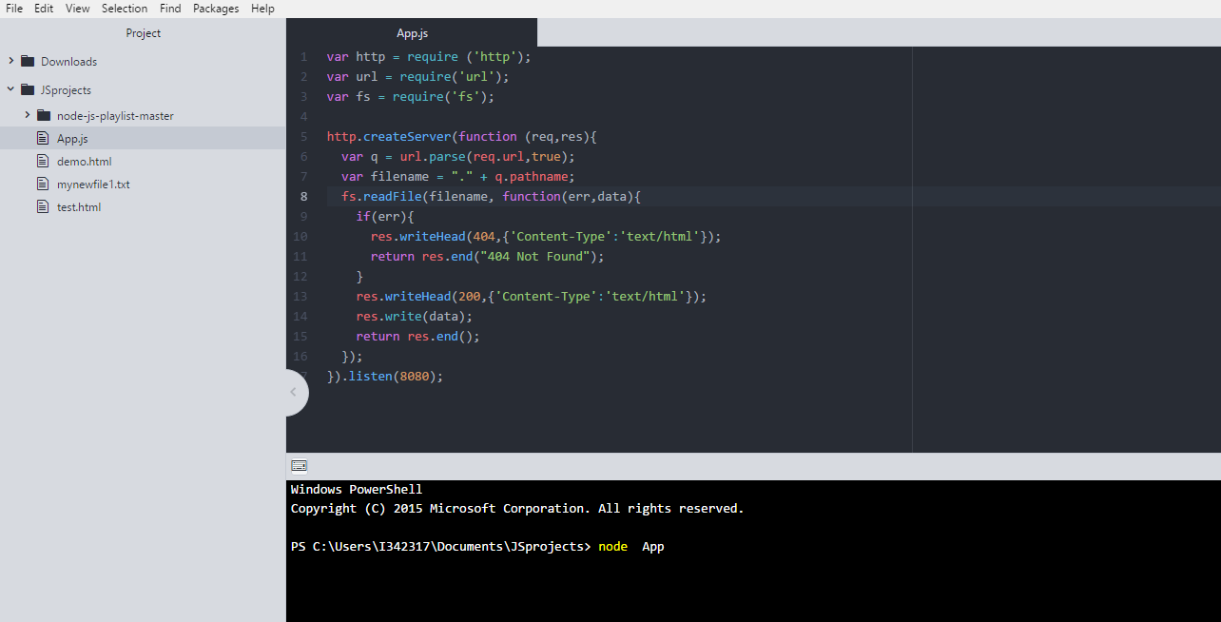
Example of Local Server
Here we have a simple example where we create local a server.
We execute the App.js as you see in the terminal and then we search in our browser the: http://localhost:8080/demo.html
Or
http://localhost:8080/test.html
These are the two html files in our directory.
With listen(8080) we simply choose our localhost

Slide 11
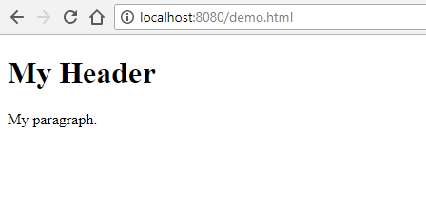
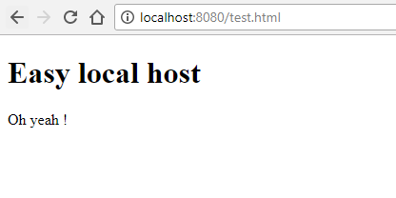
Example of Local Server
This is the demo.html file of our directory as you see in the previous slide.
This is the test.html file of our directory as you see in the previous slide.

Slide 12
Creating local RESTful for A Library
First is important to have the package.json file with the this structure: { "name": "pac", "version": "1.0.0", "description": "just a test", "main": "App.js", "dependencies": { "express": "^4.15.4", "lodash": "^4.17.4", "upper-case": "^1.1.3" }, "devDependencies": {}, "scripts": { "test": "echo \"Error: no test specified\" && exit 1", "start": "node server.js" }, "author": “test", "license": "ISC“ }
Then we create the users.json file we want to upload with this structure: { "user1" : { "name" : “kostas", "password" : "password1", "profession" : "teacher", "id": 1 }, "user2" : { "name" : “makis", "password" : "password2", "profession" : "librarian", "id": 2 }, "user3" : { "name" : “stavroula", "password" : "password3", "profession" : "clerk", "id": 3 } }

Slide 13
Creating local RESTful for A Library
Finaly we create the server.js file in which we create the local server for our local RESTful Api. We execute the .js like: node name.js
var express = require('express'); var app = express(); var fs = require("fs"); app.get('/listUsers', function (req, res) { fs.readFile( __dirname + "/" + "users.json", 'utf8', function (err, data) { console.log( data ); res.end( data ); }); }) var server = app.listen(8081, function () { var host = server.address().address var port = server.address().port console.log("Example app listening at http://127.0.0.1:8081/listUsers", host, port) })

Slide 14
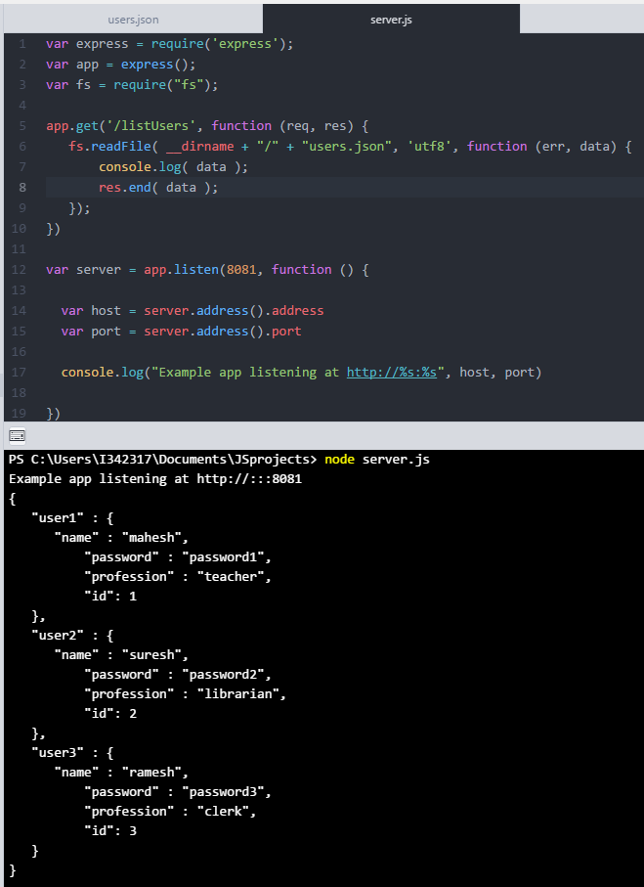
Creating local RESTful for A Library (Atom IDE)
Here, we execute in the terminal the server.js file
req is an object containing information about the HTTP request that raised the event. In response to req, we use res to send back the desired HTTP response.
Express module with two words:
Allows to set up middlewares to respond to HTTP Requests.
Defines a routing table which is used to perform different actions based on HTTP Method and URL.
Allows to dynamically render HTML Pages based on passing arguments to templates.

Slide 15
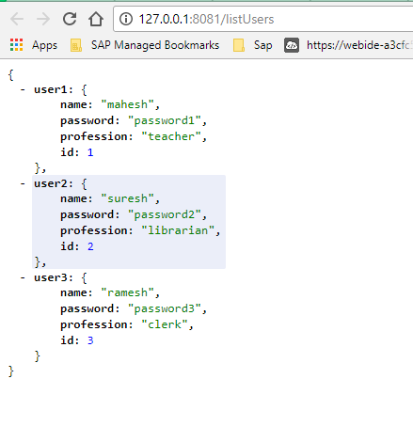
Creating local RESTful for A Library (Atom IDE)
Browser results:
As we can see we have a json file in our localhost.

Slide 16
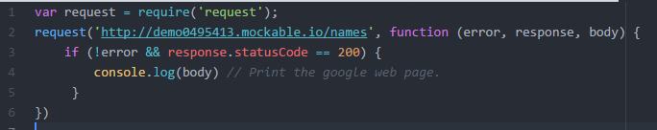
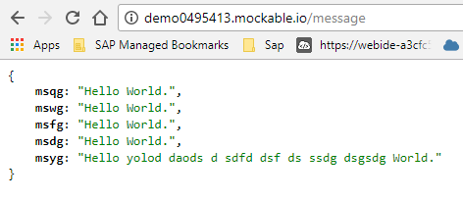
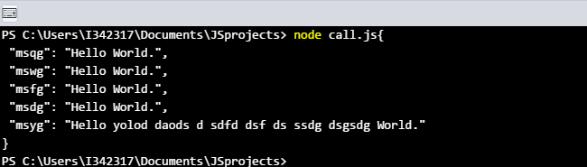
GET API from URL in browser
First, I created an API in mockable.io : Then I execute this Node.js code: Terminal Results after the execution of call.js file.

Slide 17
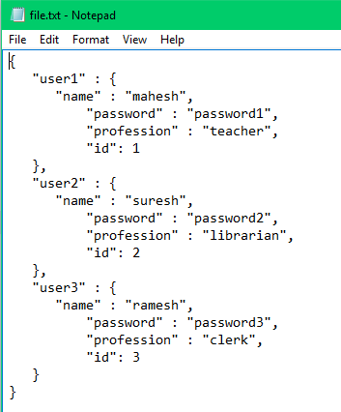
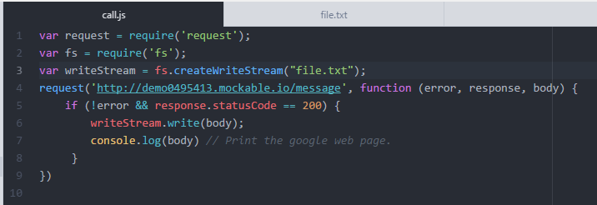
GET API from URL in browser & import to text file
With a new module and some modifications we put this json file into a text file. Text file:
The code:

Slide 18
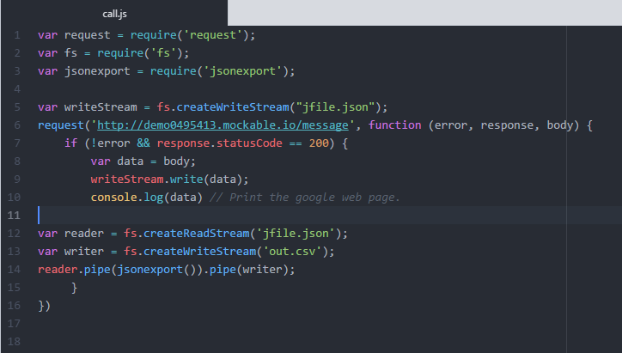
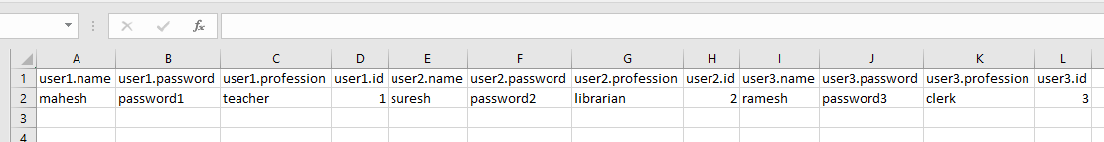
GET API from URL in browser & import to csv file
Now we use the jsonexport library.
We put the data from API to the json file.
We read-write the the data to out.csv file.

Slide 19
Node.js - Express Framework
First we install Express by using NPM:
npm install express –save
Then we install the modules:
body-parser − This is a node.js middleware for handling JSON, Raw, Text and URL encoded form data.
cookie-parser − Parse Cookie header and populate req.cookies with an object keyed by the cookie names.
multer − This is a node.js middleware for handling multipart/form-data.
In the CMD:
npm install body-parser –save
npm install cookie-parser --save
npm install multer --save
Express is a minimal and flexible Node.js web application framework that provides a robust set of features to develop web and mobile applications. It facilitates the rapid development of Node based Web applications. Following are some of the core features of Express framework:
Allows to set up middlewares to respond to HTTP Requests.
Defines a routing table which is used to perform different actions based on HTTP Method and URL.
Allows to dynamically render HTML Pages based on passing arguments to templates.

Slide 20
Node.js - Express Framework
Request & Response:
Express application uses a callback function whose parameters are request and response objects.
app.get('/', function (req, res) {
// --
})
Request Object − The request object represents the HTTP request and has properties for the request query string, parameters, body, HTTP headers, and so on.
Response Object − The response object represents the HTTP response that an Express app sends when it gets an HTTP request.

Slide 21
Node.js - Express Framework
Routing Example: All files have to be in the same directory. server.js (file) var express = require('express'); var app = express(); var fs = require('fs'); app.get('/', function (req, res) { console.log("Got a GET request for the homepage"); res.send('Hello GET'); }) app.post('/', function (req, res) { console.log("Got a POST request for the homepage"); res.send('Hello POST'); }) app.delete('/del_user', function (req, res) { console.log("Got a DELETE request for /del_user"); res.send('Hello DELETE'); }) app.get('/list_user', function (req, res) { fs.readFile('test.html', function(err, data) { res.writeHead(200, {'Content-Type': 'text/html'}); res.write(data); return res.end(); }); })
app.get('/file', function (req, res) { console.log("Got a GET request for /file"); fs.readFile('jfile.json', function(err, data) { res.write(data); return res.end(); }); }) app.get('/ab*cd', function(req, res) { console.log("Got a GET request for /ab*cd"); res.send('Page Pattern Match'); }) var server = app.listen(8081, function () { var host = server.address().address var port = server.address().port console.log("Example app listening at http://%s:%s", host, port) })

Slide 22
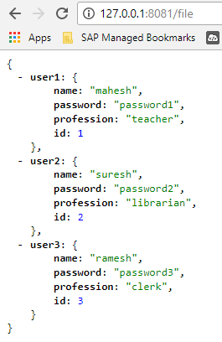
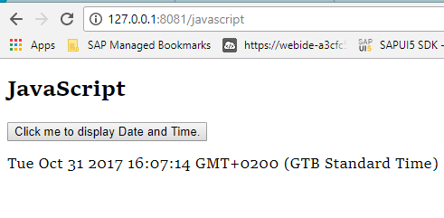
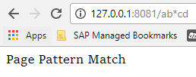
Node.js - Express Framework Results in browser: the files are in the same directory that server.js located.
Local Host with /javascript (it’s just an html file with a button in JavaScript)
Local Host with /file (a json file)
Local Host with /ab*cd

Slide 23
Thank you Panagiotis Tamvakidis

