Slide 1
Desktop Testing RanoREX -
Group E
1451022 – Hồ Nhật Hoài
1451050 – Lê Văn Tâm
TA: Trương Phước Lộc

Slide 2
Table of Contents
I. Introduction
II. Comparison
III. Conclusion

Slide 3


I. Introduction
1. Test tools
RANOREX
TestComplete

Slide 4

2 - SUT
An open source password manager program that helps us manage all our passwords in a database and keep them encrypted.
KeePass

Slide 5
II. Comparison
1. Keyword-Driven
Login
Add new entry
Validation
Delete entry
Save and close SUT

Slide 7
Added a new entry
→ Set the attributes for title, username, password, URL
→ Chose an icon
→ Set the expiration value

Slide 8
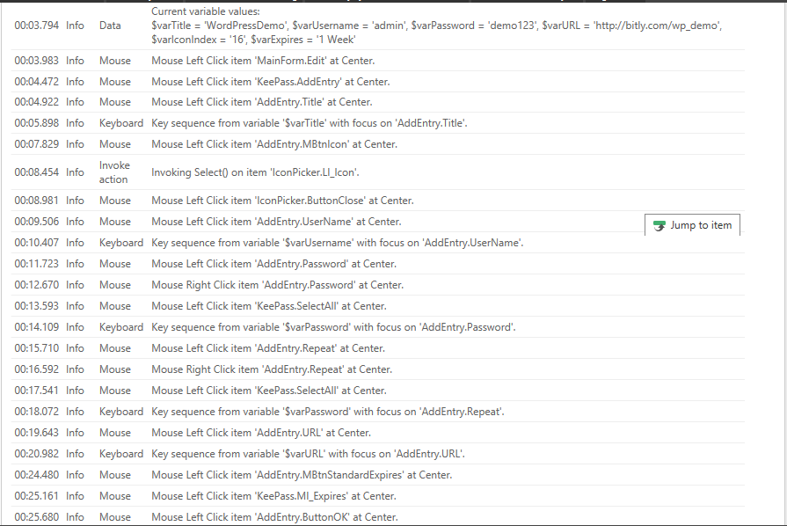
Entry: $varTitle=”WordPressDemo”; $varUsername=”admin”; $varPassword=”demo123”; $varURL=”http://bitly.com/wp_demo”

Slide 9
2. Data-Driven
Variable in the repositories which are connected to external file (CSV file).
For each input action, a variable will be attached to it as below
Action | Title | Username | Password | URL | Expires | IconIndex
Variable | varTitle | varUsername | VarPassword | varURL | varExpires | varIconIndex

Slide 10
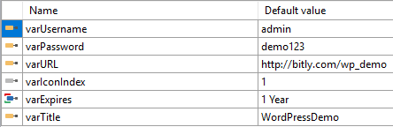

Slide 12
3. Script Testing
Programming language used to test: C#
Reusable steps in keyword-driven testing

Slide 13
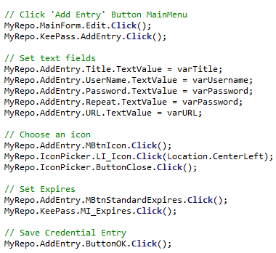
13

Slide 15
4. Image-based
Using image to validate icon

Slide 16
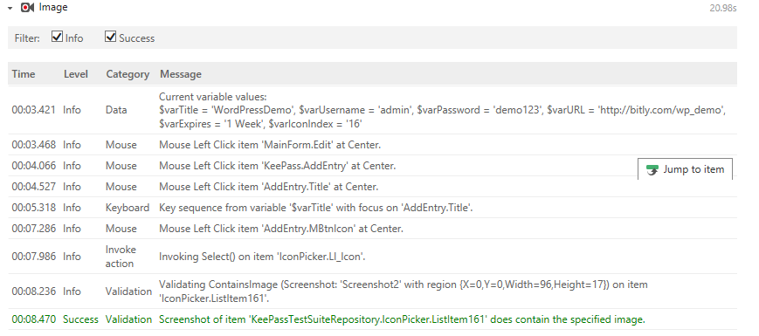
16

Slide 17
III. Conclusion
 | Ranorex | TestComplete
Pro | Offers a more realistic way of testing (like how the mouse cursor is moved or how a word is typed,…) Display debugging logs in real time. Provides validation Actions that verifies a chosen object’s attribute. Has an IDE similar to Visual Studio, fit for those who codes a lot. Offers more comprehensive test report. | Move around with mouse cursor without trace and type in word by copy-paste. Faster. Has object mapping and test steps on different pages so we can look at them separately. Has a Record Script
Cons | - Has not a Record Script | Cost more than Ranorex. Test execution takes longer. More complicated and is mostly used by advance testers. Doesn’t provide image-based testing.

Slide 18
RANOREX is BETTER!!!

