Slide 1
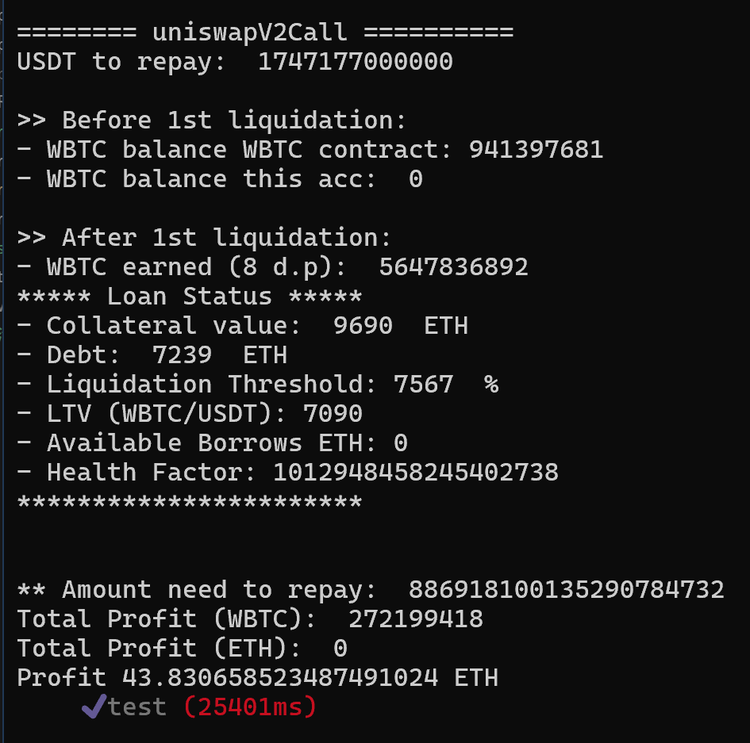
Solution Overview
Calculate Debt to Repay
Borrow USDT with ETH
Liquidate Positions with USDT
Repay Flash Loan
Exchange Remains to WETH
Total Profit Earned
Debt Rapid (USDT)
43.8307 ETH
1747177 USDT

Slide 2
Calculate Debt to Cover
Formular: debtToCover = (userStableDebt + userVariableDebt) * LiquidationCloseFactorPercent
debt repay | threshold | profit
1204949000000.00 | 40.00000 | 39.625573513
1355568000000.00 | 45.00000 | 41.641670284
1506187000000.00 | 50.00000 | 43.005439546
1566434000000.00 | 52.00000 | 43.368297475
1626682000000.00 | 54.00000 | 43.626790924
1656806000000.00 | 55.00000 | 43.716898117
1686929000000.00 | 56.00000 | 43.780910347
1717053000000.00 | 57.00000 | 43.818831488
1732115000000.00 | 57.50000 | 43.828006724
1747177000000.00 | 58.00000 | 43.830658523
1748081000000.00 | 58.03000 | 43.830610109
1751997000000.00 | 58.16000 | 43.830129275
1762239000000.00 | 58.50000 | 43.826786749
1777301000000.00 | 59.00000 | 43.816391112
1807424000000.00 | 60.00000 | 43.776030760
1958043000000.00 | 65.00000 | 43.182786948

