Slide 1
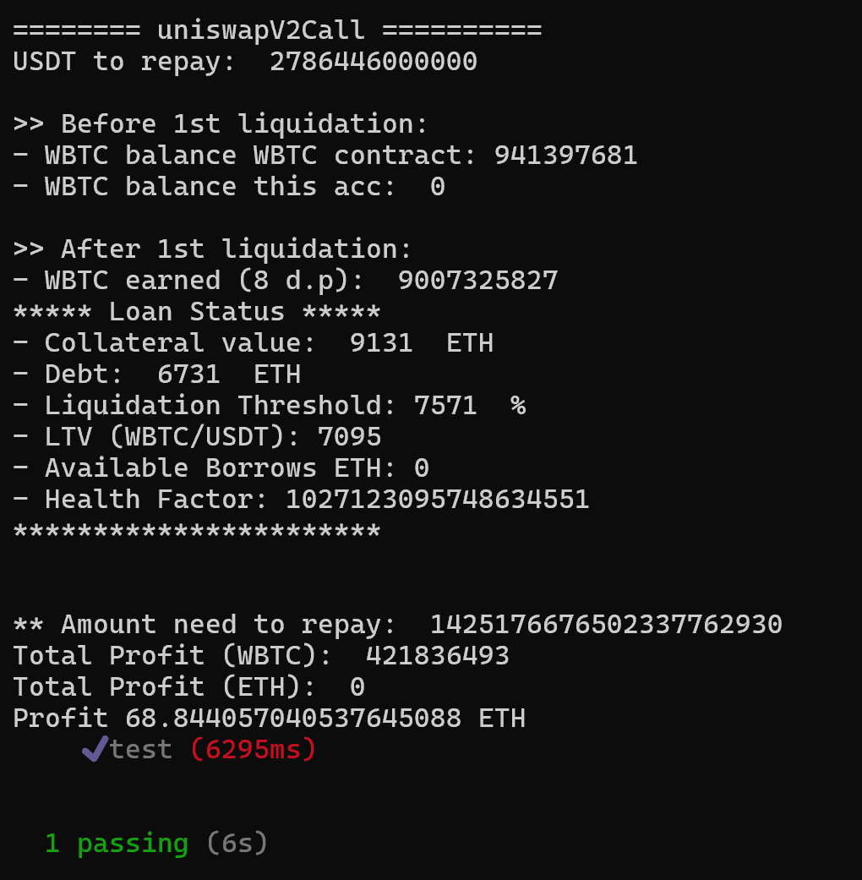
Solution Overview
Calculate Debt to Repay
Borrow USDT with ETH
Liquidate Positions with USDT
Repay Flash Loan via SushiSwap
Exchange Remains to WETH
Total Profit Earned
Debt Repaid (USDT)
68.844057 ETH
2,786,446 USDT

Slide 2
Calculate Debt to Cover
Formular: debtToCover = (userStableDebt + userVariableDebt) * LiquidationCloseFactorPercent
debt repay | threshold | profit
1506187000000.00 | 50.00000 | 54.252700614
1807424000000.00 | 60.00000 | 60.313934488
2108662000000.00 | 70.00000 | 64.763225931
2409899000000.00 | 80.00000 | 67.593581862
2681013000000.00 | 89.00000 | 68.750844896
2711137000000.00 | 90.00000 | 68.797898339
2741261000000.00 | 91.00000 | 68.828618240
2771384000000.00 | 92.00000 | 68.842997229
2786446000000.00 | 92.50000 | 68.844057041
2795483000000.00 | 92.80000 | 68.842730725
2801508000000.00 | 93.00000 | 68.841028744
2831632000000.00 | 94.00000 | 68.822704670
2861756000000.00 | 95.00000 | 68.788017566
3012374000000.00 | 100.00000 | 17.874341150

