Slide 1
Impact of Proximity to Preventive Care Services on Hospitalization Rates
Analyzing Access and Health Outcomes for Diabetes and Heart Disease
Tamya Louis, Mélisa Teglas, and Don Ross

Slide 2

Project Overview
Goal: Analyze how proximity to healthcare services impacts hospitalization rates.
Focus: Diabetes and heart disease management.
Key Areas:
Healthcare access patterns.
Accessibility gaps at the county level.
Visualization of facility distribution.

Slide 3
Objectives
Identify patterns in healthcare access using socioeconomic and health data.
Evaluate gaps in healthcare accessibility.
Use geographic data to visualize healthcare facility distribution.

Slide 4
Datasets Used
Socioeconomic Indicators Dataset
Population statistics, income, density.
Health Facilities Dataset
Locations and types of healthcare facilities.
Health Outcomes Dataset
Diabetes and heart disease rates.

Slide 5
ETL Process Overview
Extract:
1
Public datasets in CSV format.
Transform:
2
Standardized column names.
Addressed missing values.
Merged data on county fields.
Feature Engineering: Created population density categories.
Load:
3
Stored data in SQLite database using SQLAlchemy.

Slide 6
Database Design
Database Choice: SQLite
Lightweight, efficient, no server required. SQL was selected over NoSQL because we needed relationships between the tables. This enabled us to quantify the findings across the tables by different county.
Table Schema:
County, population, density, diabetes rates, facility type, latitude, longitude.

Slide 7
Ethical Considerations
Data Privacy:
Public data, no PII, HIPAA-compliant.
Bias Mitigation:
Avoids reinforcing disparities.
Transparency:
Documented processes.
Usage Guidelines:
Informational insights only, not for medical decisions.

Slide 8
Visualizations
Hospitalization rates by county
Number of available healthcare facilities by county

Slide 9
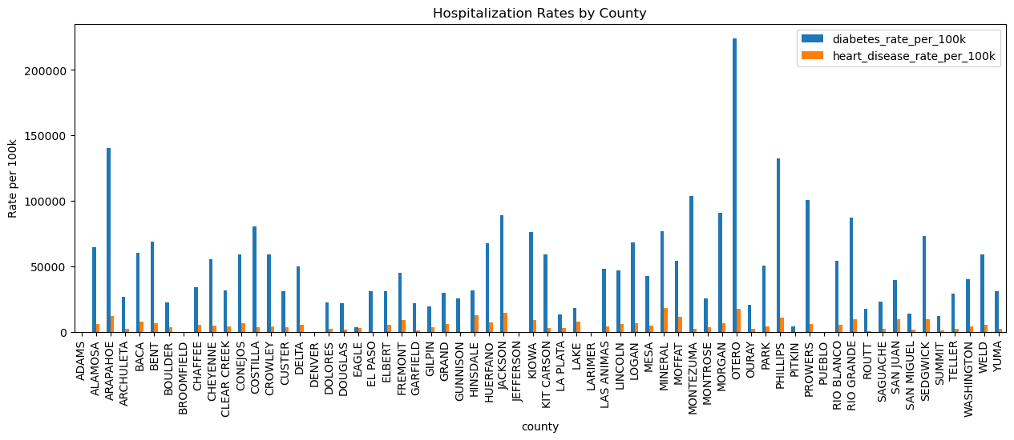
Hospitalization Rates by County

Slide 10
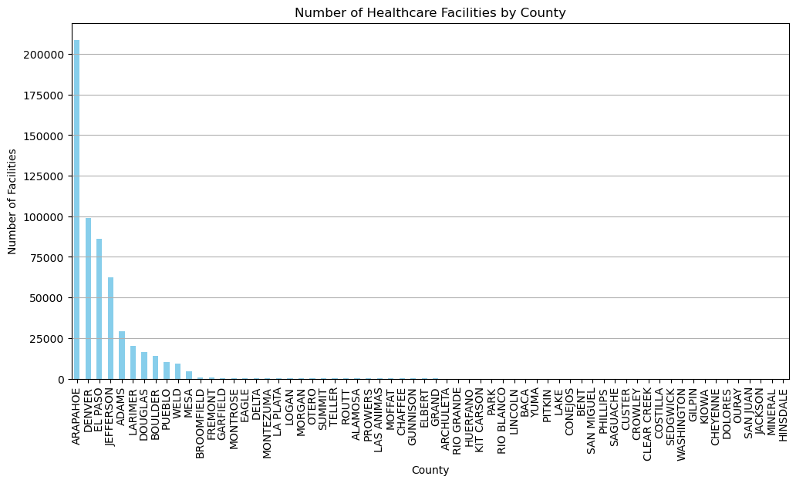
Number of Healthcare Facilities by County

Slide 11
How to Use the Project
Prerequisites:
Python, Jupyter Notebook, libraries (pandas, sqlalchemy, folium, matplotlib).
Steps to Run:
Clone GitHub repository.
Launch Jupyter Notebook.
Load, transform, and analyze data.
Database Viewing:
SQLite CLI or DB Browser for SQLite.

Slide 12
Conclusion
Key Insights:
Patterns in healthcare access.
Identified accessibility gaps.
Next Steps:
Refine models and expand to other health conditions.
Explore interventions for improving access.

Slide 13

Thank you

