Slide 1
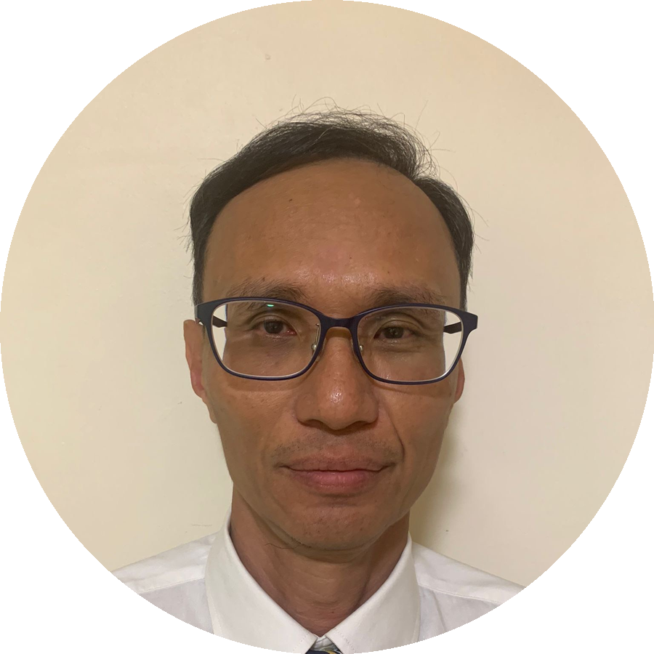
SILICON TECHNICAL MANAGER · IMAGE SENSORS · SINGAPORE
Tam Yoke Weng
More than 25 years of analog IC design — spanning design, tapeouts, silicon validation, and technical documentation — now extending into cloud infrastructure and DevOps.
tamyokeweng@gmail.com
linkedin.com/in/tam-yoke-weng-7856343a

Slide 2
ABOUT ME
Deep silicon expertise, now building in the cloud
Analog IC design specialist with three decades of experience across the full silicon lifecycle — from design and tapeout, through silicon validation, to technical documentation and knowledge transfer. Currently expanding that foundation into cloud infrastructure, automation, and DevOps practices.
Design Cycles
Silicon Validation
Tam Yoke Weng
Numerous full design-to-tapeout cycles across memory and I/O IP.
Hands-on validation and bring-up across multiple silicon generations.
28 years in analog IC design
Technical Leadership
Cloud Transition
Cross-functional collaboration and structured knowledge transfer.
Applying engineering rigor to Azure infrastructure and automation.
TAM YOKE WENG
2

Slide 3


CURRENT FOCUS
What I'm building and learning right now
WORKING ON
LEARNING NOW
Azure Cloud Logistic Management System
Terraform · Kubernetes · GitOps
A Flask-based web service deployed to Azure with a full CI/CD pipeline and Platform as a Service, demonstrating practical automation and operational monitoring.
Building fluency in infrastructure-as-code and container orchestration to complement hands-on Azure delivery — with a focus on repeatable, GitOps-driven deployments.
Flask web service
Infrastructure-as-code with Terraform
Azure App Services, MySQL storage, Virtual Network, Virtual Machine, Entra ID and
Container orchestration with Kubernetes
CI/CD pipeline (Azure DevOps)
https://dev.azure.com/TamYokeWeng/flask_app/_build
GitOps deployment practices
TAM YOKE WENG
3

Slide 4





TECH & TOOLS
Skills spanning silicon and the cloud
Cloud & Infra
Microsoft Azure (App Services, VM, Storage), Azure DevOps, Terraform
Languages
Python, Bash
Frameworks & Services
Flask, Docker, Kubernetes
Tools
Git, GitHub Actions, Docker
Domain Knowledge
Analog IC design workflows, semiconductor toolchains, memory & I/O IP design
TAM YOKE WENG
4

Slide 5


FEATURED PROJECTS
Selected work across cloud and silicon
Azure Cloud Logistic Management System
Analog IC Design — Memory IP
Analog IC Design — I/Os
Analog circuit design and verification for memory IP.
Completed 12 memory module designs for 55nm and 40nm technology nodes, with 100% successfully validated in silicon and meeting all specifications
A Flask web service with Azure deployment and a CI/CD pipeline, demonstrating practical infrastructure-as-code and operational monitoring.
Analog I/O circuit design for semiconductor interfaces, including test vectors and validation summaries.
REPO
REPO
REPO
azure-cloud-flask_app
TAM YOKE WENG
5

Slide 6

HOW I WORK
Principles I bring to every project
Clear, maintainable solutions
Focus on pragmatic automation for operations, favoring solutions the whole team can understand and maintain.
Incremental, tested changes
Prefer incremental changes backed by tests, monitoring, and clear runbooks over large, risky rewrites.
Collaboration & knowledge transfer
Emphasize cross-functional collaboration and structured knowledge sharing across teams.
TAM YOKE WENG
6

Slide 7


LET'S CONNECT
Thank you
Open to conversations on analog IC design, cloud infrastructure, and the engineering practices that connect them.
EMAIL
tamyokeweng@gmail.com
LINKEDIN
linkedin.com/in/tam-yoke-weng-7856343a
Tam Yoke Weng · Silicon Technical Manager (Image Sensors) · Singapore

