Slide 1

A Smart Medicine Reminder System for Improved Patient Compliance
Professional Masters in Information Technology
Supervisor : Professor Shamim Al Mamun, PhD
Institute of Information Technology
Jahangirnagar University
Savar, Dhaka-1342
Date: 11.10.2025

Slide 2
PRESENTED BY
Gazi Tamzeed Hossain.
Id : 212110
Session : Summer 2021 (Regular Batch)

Slide 3
Contents
Objectives.
System Features.
System Design.
User Interfaces.
Implementation.
Result and Discussion.
Future Works.
Conclusion.

Slide 4
Objectives
Ensure patients take medicines at the right time and dose.
Minimize missed doses and medication errors.
Provide SOS alerts and nearby hospital/pharmacy information.
Enhance patient convenience and safety.

Slide 5
System Features
Medicine time reminder (with alarm & notification).
Medicine management (add/edit/delete medicines).
SOS emergency message feature.
Medicine history tracker.
Nearby hospital and pharmacy locator.

Slide 6
System Design
Care Assistance
Searching Hospital
Searching Medicine Shop
Alarm /
Notification
Emergency SOS
Medicine History
Adding Medicine
Log in/Log out
Fig; System Overview

Slide 7
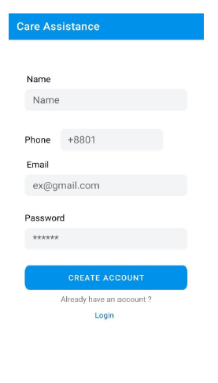
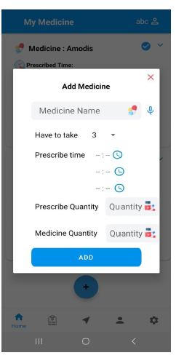
User Interfaces (UI)
Fig: Login Interface
Fig: Medicine Adding Interface

Slide 8
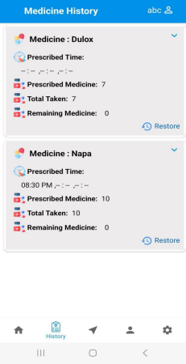
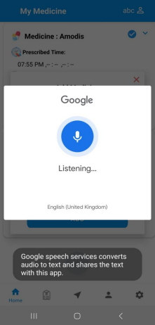
User Interfaces (UI)(Cont’d)
Fig: Medicine History Interface
Fig: Voice Input Interface

Slide 9
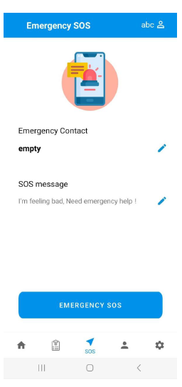
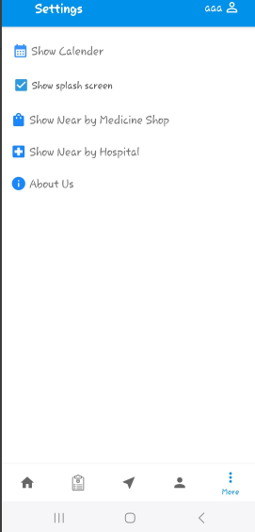
User Interfaces (UI)(Cont’d)
Fig: Emergency Message Interface
Fig: Setting Interface

Slide 10
Implementation
Programming Language: Java.
Frontend (UI): XML (Android Studio).
Database: Firebase Database.
Tools: Android Studio, Google Maps API.
Platform: Android OS.

Slide 11
Result and Discussion
Users received accurate reminders on time.
Easy to add and manage multiple medicines.
SOS and location features improved safety.
Enhanced medication adherence and reliability.

Slide 12
Future Works
AI-Based Personalization.
Multi-Language Support.
OCR(Optical Character Recognition) Implementation.
Doctors Appointment.

Slide 13
Conclusion
The medicine reminder application has been developed to make it easier for users to take their medications. By providing timely reminders, dosage information, and an easy-to-use interface, the application aims to minimize the risk of missed doses, overdose, and medication mismanagement. Therefore,
the system establishes a solid foundation for integrating digital solutions into healthcare management.

Slide 14
Thank You

