Slide 1
TT’S ARCADE

Slide 2
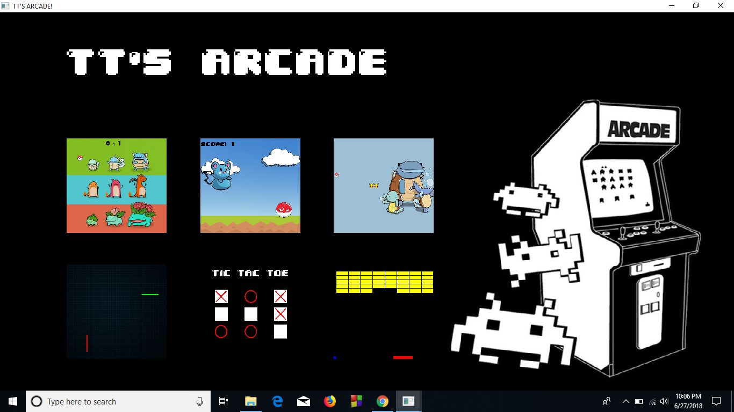

Slide 3
TT’S ARCADE is a collection of 6 mini games
Each game has its own scoring policy
Users can select which game to play at a time using the cursor

Slide 4
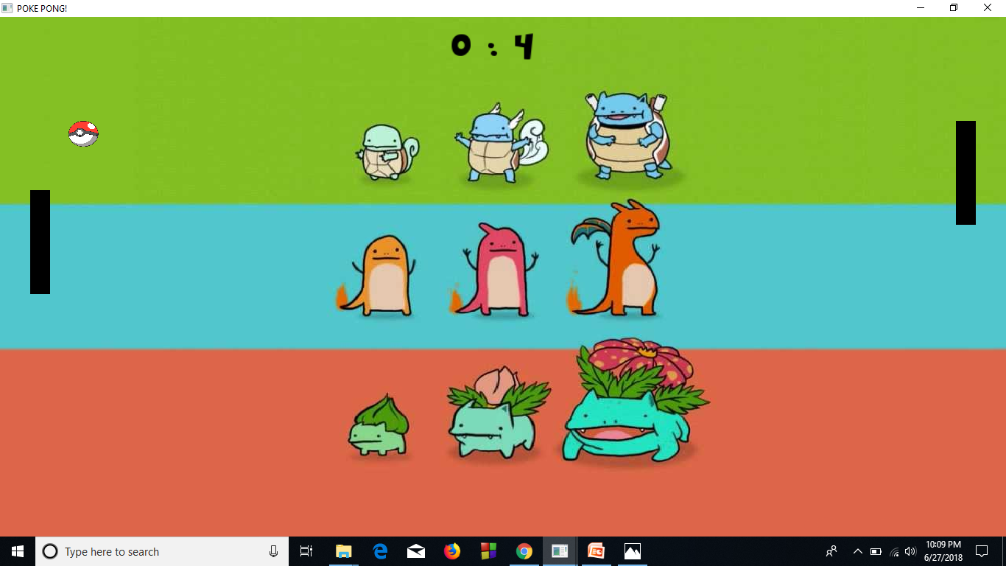
POKE PONG

Slide 5
POKE PONG is to be played by a user and the computer
The poke ball has to hit the bars to score a point
The one to score 10 points first wins

Slide 6
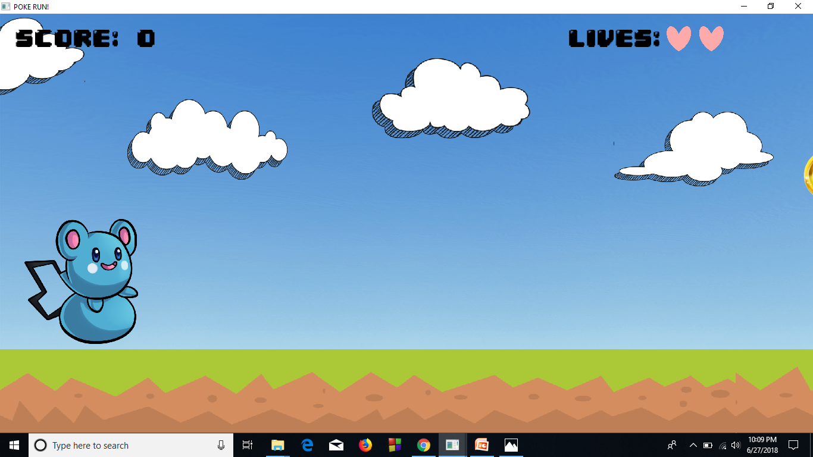
POKE RUN

Slide 7
POKE RUN is played by one user
The blue pokemon has to jump over the red pokemon and collect the golden rings
Each ring earns 100 points
User gets 3 lives
User dies when all lives are used up

Slide 8
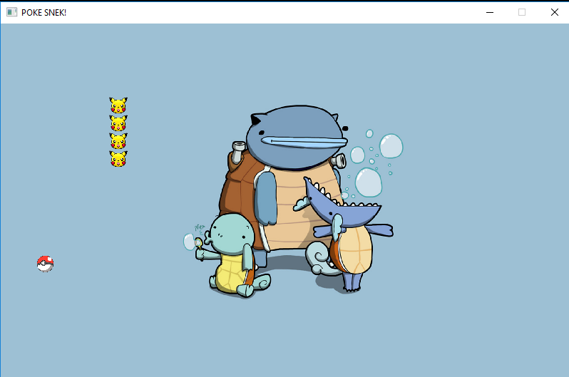
POKE SNEK

Slide 9
POKE SNEK has a snake of pikachu heads
Every time it eats a poke ball, its length increases
If it hits the boundaries or eats itself, the game is over

Slide 10

THE TRON GAME

Slide 11
THE TRON GAME has to be played by two users
The two users, the red and the green lines, cannot intersect each other
If they do, the game is over

Slide 12
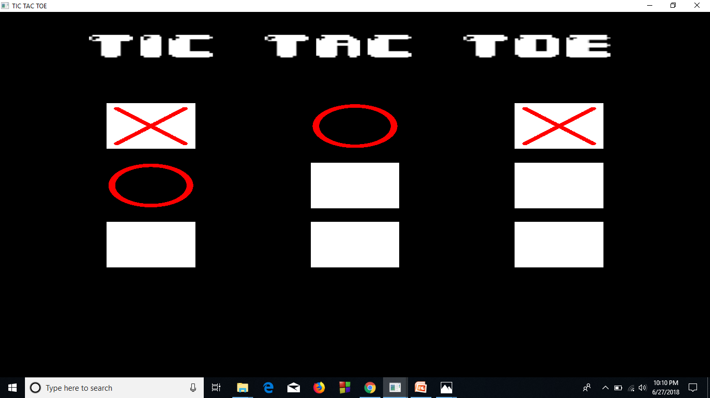
TIC TAC TOE

Slide 13
TIC TAC TOE has to be played by two users
Users get alternate chances to mark an ‘X’ or an ‘O’ on the tiles
The one who matches a vertical or horizontal or diagonal line of the same pattern first wins

Slide 14
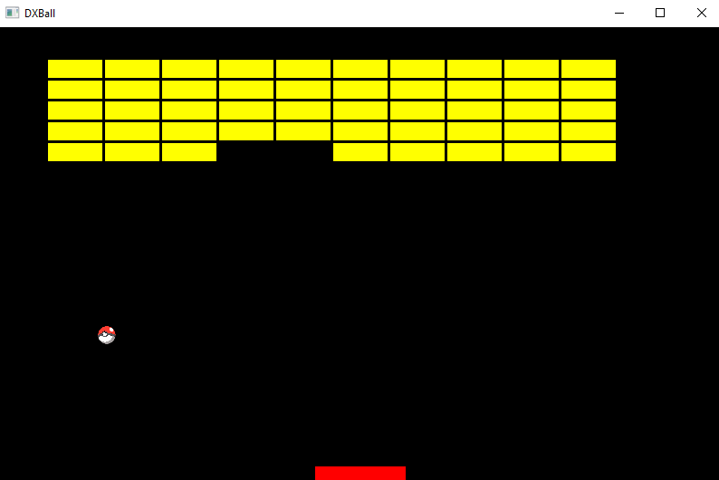
DXBALL

Slide 15
DXBall is played by one user
User has to hit the tiles by the ball and make them disappear
User must not let the poke ball fall out of the tray
If he does, the game is over

