Slide 1
Reimagine IaC with the most widely adopted AI coding assistant
Agentic InfraOps
Jonathan Vella
Sr. Cloud Solutions Architect, Microsoft
https://aka.ms/agenticinfraops

Slide 2
About me
Jonathan Vella
Senior Partner Solution Architect, Microsoft
12+ years in Azure infrastructure & modernization
Focus: Agentic AI, Automation, Azure at Scale
Work across EMEA on secure, scalable, efficient cloud platforms
Today: Applying Agentic InfraOps to help IT Pros ship enterprise‑grade infrastructure faster.

Slide 3


Slide 4


The Copilot effect
The world’s most widely adopted AI coding tool.
Accelerated Time-to-Production Infrastructure
Enterprise-Grade Quality at Scale
Comprehensive Documentation as a Byproduct
Notes:
Based on Agentic InfraOps’ structure and goals, here are 3 highly impactful outcomes of using GitHub Copilot:
1. Accelerated Time-to-Production Infrastructure
The 7-step agentic workflow transforms requirements into validated, deploy-ready Bicep templates in hours instead of days/weeks. Custom agents (project-planner → azure-principal-architect → bicep-implement) automate what traditionally requires multiple consultants, iterations, and reviews.
2. Enterprise-Grade Quality at Scale
Custom agents embed Azure Well-Architected Framework, Azure Verified Modules (AVM), and security best practices directly into the development process. Teams without deep Azure expertise can now produce infrastructure code that meets enterprise standards—unique naming, zone redundancy, Azure AD-only auth, proper tagging—automatically enforced through agent instructions.
3. Comprehensive Documentation as a Byproduct
Instead of documentation being an afterthought, the workflow generates complete artifacts at each step: architecture assessments, cost estimates, ADRs, compliance matrices, diagrams-as-code, operations runbooks, and as-built documentation. This creates audit trails and knowledge transfer materials simultaneously with the infrastructure code.
Bottom line: What previously required specialized Azure architects, IaC experts, and technical writers working sequentially can now be orchestrated by a single engineer using coordinated AI agents—dramatically improving delivery speed while maintaining (or exceeding) quality standards.

Slide 5
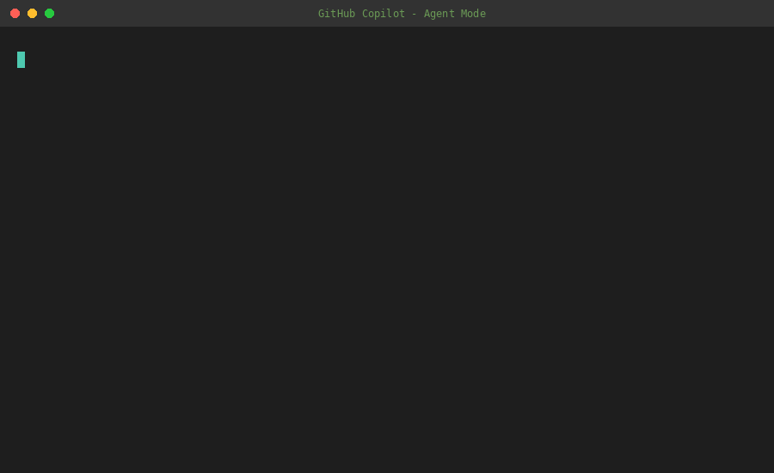
Shipping Infra with Confidence

Slide 6
The future is agentic workflows
Azure IT Pros with
AI agents sidekicks

Slide 7
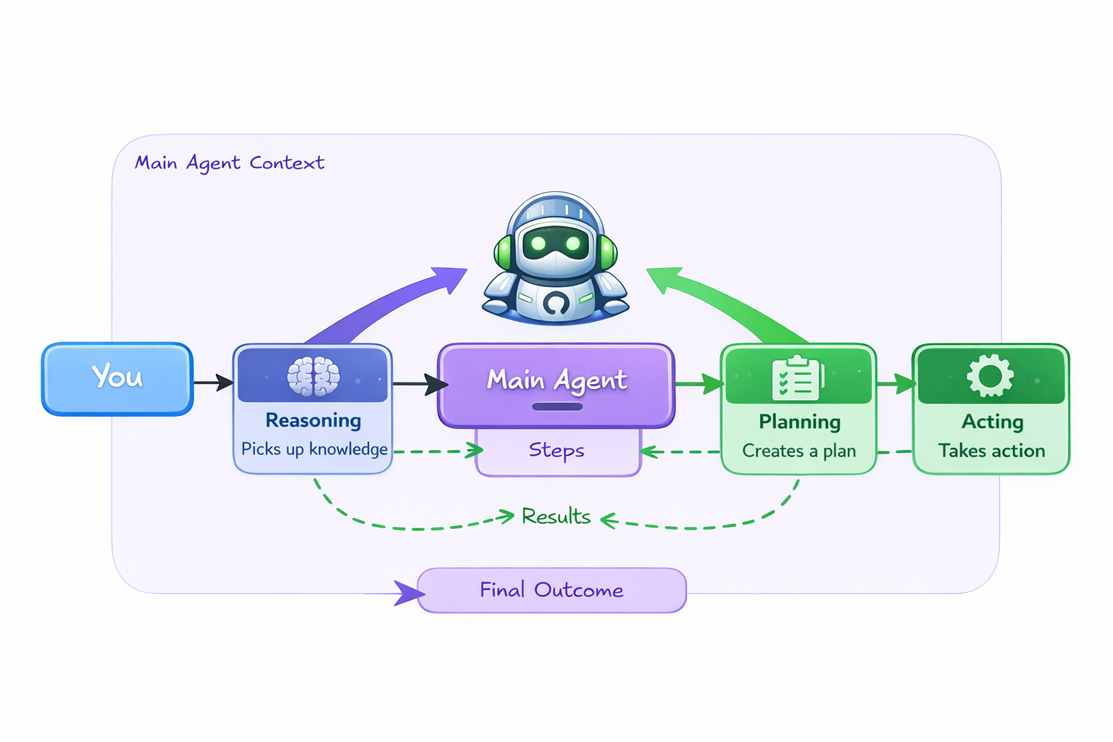
Agentic AI

Slide 8
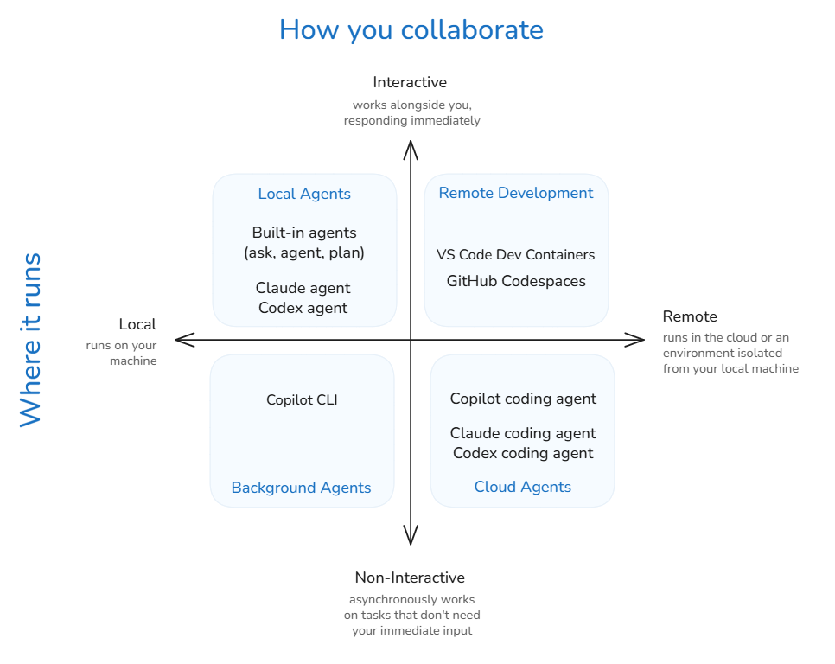
Agent Types

Slide 9
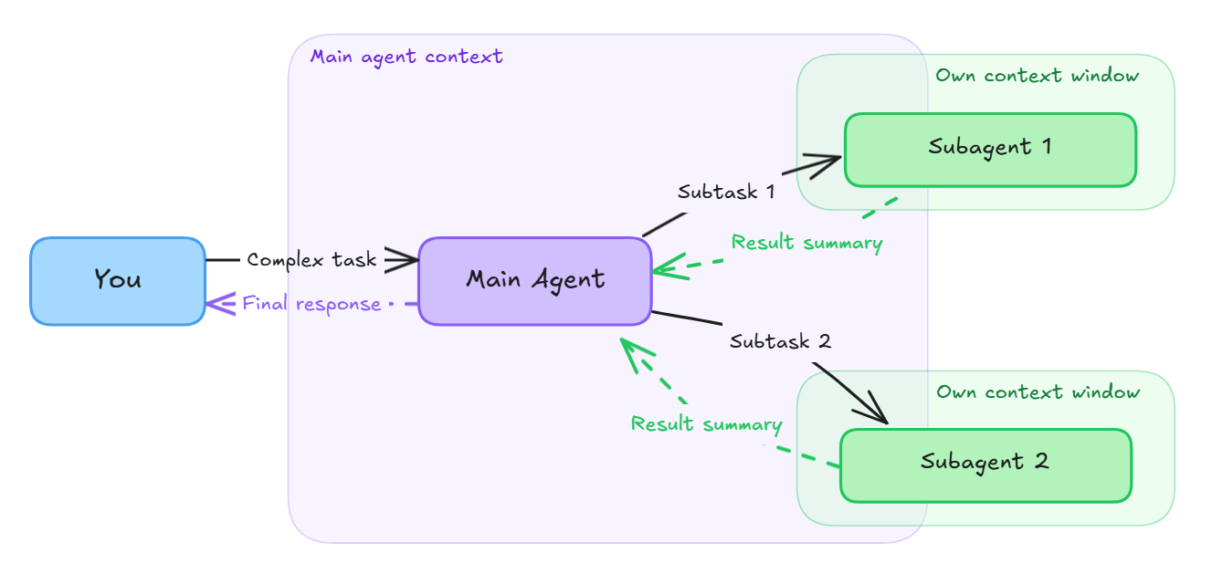
Agents &
Subagents

Slide 10
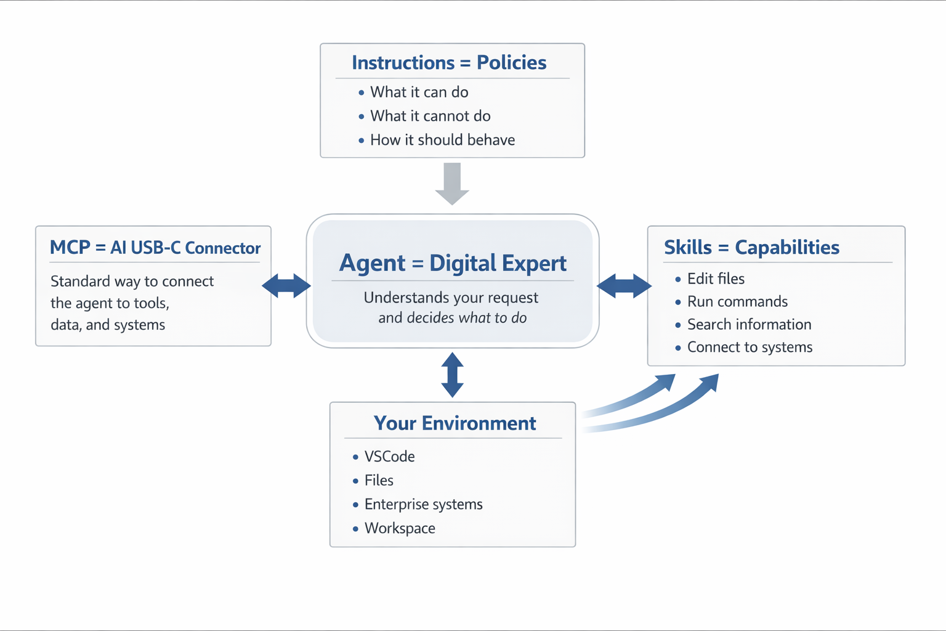
Put
simply….

Slide 11
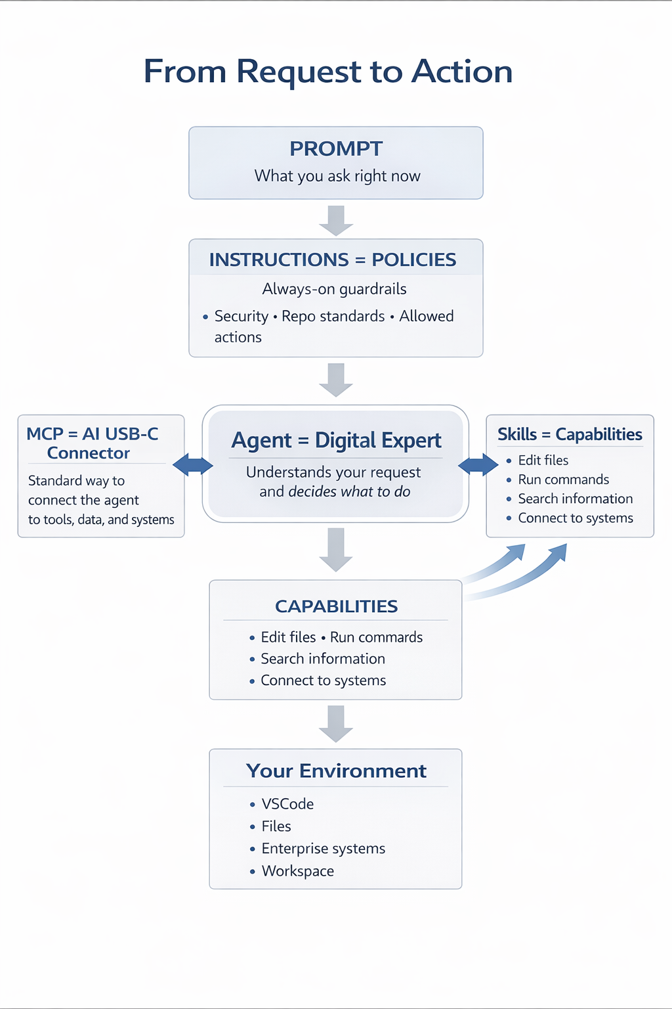
Intent-driven
approach

Slide 12
1 - Visual Studio Code
2 - GitHub Copilot Pro+/Ent
3 - Docker (or similar)
4 - Azure Subscription
5 - Curiosity
Requirements

Slide 13


Demo: Agentic InfraOps

Slide 14
Resources
GitHub Copilot in VS Code
Get started with GitHub Copilot in VS Code
Plans for GitHub Copilot - GitHub Docs
Run Your AI Coding Agent in Containers - Beginner's Guide
Agentic InfraOps, Accelerator, MicroHack
Hacker Scoreboard

Slide 15
Thank you

