Slide 1




Demand Momentum
Regulatory Pressure
Improving Economics
Tightening emissions regulations and ICE phase-out targets continue to push EV adoption across major economies.
Total cost of ownership improves as battery prices fall and fuel and maintenance savings become clearer to consumers.
Broader Model Availability
Institutional Demand
Expanding model availability across price segments and vehicle types lowers adoption barriers.
Corporate fleet electrification and government procurement add stable, large-volume demand.
Global EV Market Outlook 2027
01

Slide 2



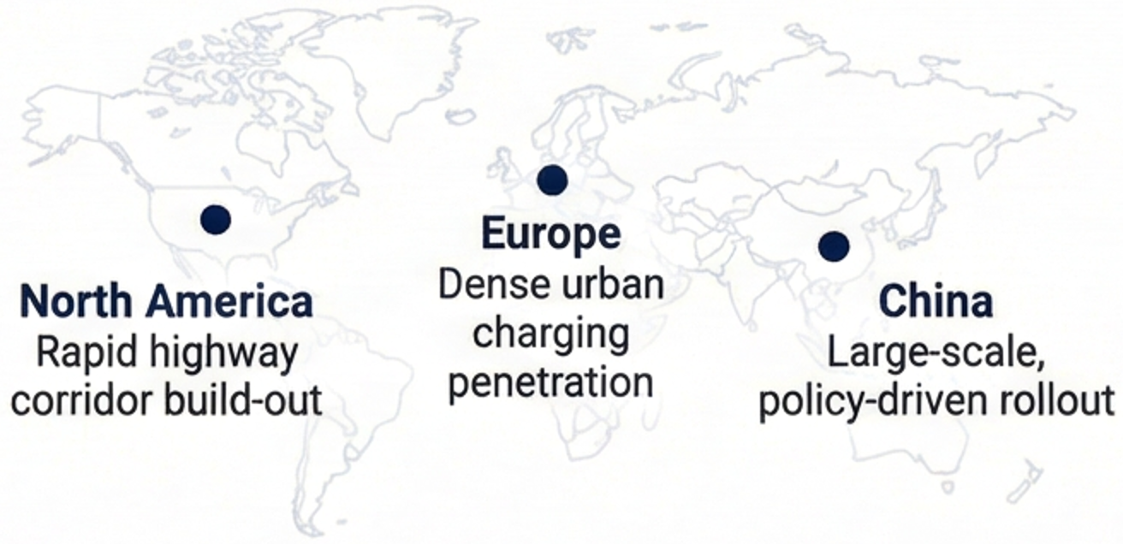
Technology & Infrastructure
Energy Density vs. Cost per kWh
Fast-Charging Capability Improves User Experience
Higher range, lower cost
Reduced Charging Time
Energy Density (Wh/kg)
Cost per kWh (USD)
Conventional Charging
High-Power DC
Ultra-Fast Charging
60–90 min (80% charge)
30–40 min
15–20 min
Battery energy density continues to improve, extending driving range. Cost per kWh declines structurally, supporting mass-market affordability.
Reduces range anxiety
for mainstream users.
Chemistry Mix Shift
Network Expansion & Regional Gaps
LFP gains share driven by safety and cost stability.
Longer cycle life improves total cost of ownership.
Next-generation chemistries target higher density and reduced critical mineral dependence.
Public charging networks expand across major urban corridors.
Private and fleet charging grows alongside commercial EV adoption.
Deployment pace varies significantly by region.
North America Rapid highway
corridor build-out
Europe Dense urban
charging
penetration
China Large-scale,
policy-driven rollout
NMC / High-Nickel
LFP
Next-Gen
Global EV Market Outlook 2027
02

Slide 3




Competition & Investment
REGIONAL COMPETITIVE POSITIONING
CAPITAL FLOW PRIORITIES
China
United States
Europe
Control over critical materials
Ownership of scalable technology platforms
Integrated charging ecosystems
Manufacturing scale leadership
Cost efficiency across supply chain
Advanced technology platforms
Strong policy and subsidy support
Regulatory alignment and ESG focus
Premium EV positioning
RETURN CONCENTRATION BY 2027
KEY AREAS OF INTENSIFYING COMPETITION
Scale
+
Cost
Discipline
+
Regulatory
Alignment
Batteries
Software &
Platforms
Vertically Integrated
Supply Chains
Integrated players outperform fragmented competitors
Cell chemistry, cost
curve, energy density
OS integration, ADAS,
data ecosystems
Upstream control, cost
resilience, delivery certainty
Concentrated Shareholder Returns
Global EV Market Outlook 2027
03

