Slide 1
Knowledge Representation
Chapter 10

Slide 2
Outline
  a general ontology
  the basic categories
  representing actions
  mental events & mental objects
  an extended example
  reasoning about categories
  reasoning involving defaults
  truth maintenance systems

Slide 3
Ontological Engineering
Complex domains
  e.g. internet shopping agents
  require very general & flexible representations
    should include actions, time, physical objects, beliefs, ….
  ontological engineering
    is the process of finding/deciding on representations for these abstract concepts
  somewhat like Knowledge Engineering
    but at a larger scale
    generalized to a more complex real world

Slide 4
Ontological Engineering
We use a general framework of concepts
  an upper ontology
    "upper" due to the diagrammatic convention of putting the most general at the top

Slide 5
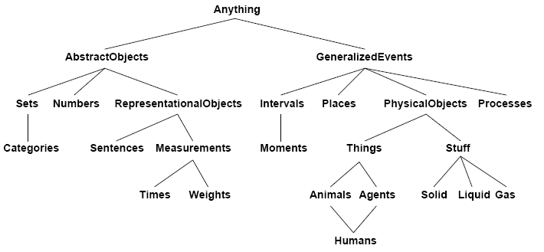
Ontological Engineering
a sample upper ontology

Slide 6
Ontological Engineering
our initial discussion may have omitted them
  there are limitations to a FOL representation
  e.g. there are exceptions to generalizations
    they hold only to some degree
    "tomatoes are red"
    but there are green, yellow, even purple tomatoes
  exceptions & uncertainty are important topics
    however, they are orthogonal to a general ontology
      & their discussions are deferred
      e.g. uncertainty later in Ch 13
Notes:
Orthogonal:直交的

Slide 7
Ontological Engineering
usefulness of an upper ontology?
  as an example, the circuit ontology of Ch 8.4
  was limited by a lack of representation for
    timing information
    implementation technology of the logic gates
    reliability
    costs factors, etc
is there one general purpose ontology?
  the philosophical answer is: Possibly

Slide 8
Ontological Engineering
our goal
  develop a general purpose ontology
  one that's usable in any special purpose domain
    with the addition of domain-specific axioms
  in any sufficiently demanding domains
    different areas of knowledge must be unified
    involves several areas simultaneously
  We will use it later for the internet shopping agent example

Slide 9
Ontological Engineering
we begin with objects & categories
  organizing objects into categories
    though physical interaction involves individual objects
    reasoning processes need to operate at the level of categories

Slide 10
Objects & Categories
We take a example
  a shopper might have the goal of buying a basketball, rather than a particular basketball such as BB.
FOL representation of categories (Alternative approaches)
  1. use predicates
    Basketball (b)
    then the category as the set of its members
  2. or, treat the category as an object
    reify the category: Basketballs
    allows Member(b, Basketballs) or b ∈ Basketballs
    allows Subset(Basketballs, Balls) or BasketBalls ⊂ Balls
    so, treat categories as more complex objects
    with Member, Subset relations defined for them

Slide 11
Category Organization
The category mechanism
  organizes & simplifies a KB through inheritance
    all instances of food are edible
    fruit is a subclass of food
    apples is a subclass of fruit
    then an apple is edible
  subclass relations organize categories
    into a taxonomy or taxonomic hierarchy
    as used in the natural sciences: botany, biology, ...
      & many other disciplines
      Dewey Decimal system(杜威的书目编排法) in library science, etc
Notes:
Taxonomy:分类学

Slide 12
FOL & Categories
Expressiveness of FOL
  state facts about categories
    relating objects to categories
    or quantify over members of categories
  express relations between categories
    disjoint
      no members in common between categories
    exhaustive decomposition
      any individual must be in one of the categories
    partition
      an exhaustive disjoint decomposition of a category

Slide 13
FOL & Categories
Categories:
  1. state facts & quantify over members
    An object is a member of a category. For example:
    BB₉ ∈ Basketballs
    A category is a subclass of another category. For example:
    Basketballs ⊂ Balls
    All members of a category have some properties. For example:
    x ∈ Basketballs ⇒ Round (x)

Slide 14

FOL & Categories
    Members of a category can be recognized by some properties. For example:
    Orange(x) ∧ Round(x) ∧ Diameter(x)=9.5” ∧ x ∈Balls ⇒ x ∈ Basketballs
    A category as a whale has some properties. For example:
  the more general categories
    are categories of categories

Slide 15
Relations Among Categories
2. express relations between categories
  A. disjoint categories
  for s, a set of categories
    two or more categories are disjoint
    if they have no members in common
    a predicate defined as follows
Disjoint(s) ⇔
(∀ c₁,c₂ c₁∈s Λ c₂∈s Λ c₁≠ c₂ Intersection(c₁,c₂) ={})
    example: Disjoint ({Animals, Vegetables})

Slide 16
Relations Among Categories
B. exhaustive decomposition
  for a category c
    any individual must be in one of the categories
      a set of categories s is an exhaustive decomposition of a category c if all members of the set c are covered by categories in s
      predicate defined as follows
ExhaustiveDecomposition
(s,c) ⇔ (∀i i∈c ⇔ ∃c₂ c₂∈s Λ i∈c₂)
    example: ExhaustiveDecomposition({Americans, Canadians, Mexicans}, NorthAmericans)

Slide 17
Relations Among Categories
C. partition
  a partition is a disjoint exhaustive decomposition
      the predicate is defined as follows
Partition (s, c) ⇔ Disjoint(s) Λ ExhaustiveDecomposition(s, c)
    example: true or not?
Partition({Americans, Canadians, Mexicans}, NorthAmericans)

Slide 18
FOL & Categories
categories may also be defined
  in terms of necessary & sufficient conditions for membership
  example: a bachelor is an unmarried adult male
    x ∈ Bachelors ⇔ Unmarried (x) Λ x ∈ Adults Λ x ∈ Males

Slide 19
Physical Composition
one object may be part of another
  use a PartOf relation
    allows grouping of objects into PartOf hierarchies
    similar to the subset, subclass hierarchy of categories
      PartOf(Bucharest, Romania)
      PartOf(Romania, EasternEurope)
      PartOf(EasternEurope, Europe)
  Properties: the PartOf relation is reflexive and transitive
    PartOf(x, x)
    PartOf(x, y) Λ PartOf(y, z) ⇒ PartOf(x, z)
    allows the inference: PartOf(Bucharest,Europe)

Slide 20
Physical Composition
categories of composite objects
  often given by structural relations among parts
  example: a biped has 2 legs attached to a body
Biped (a) ⇒ ∃ l₁ l₂ b Leg(l₁) Λ Leg(l₂) Λ Body(b) Λ
PartOf(l₁, a) Λ PartOf(l₂, a) Λ PartOf(b, a) Λ
Attached(l₁, b) Λ Attached(l₂, b) Λ
l₁ ≠ l₂ Λ [∀l₃ Leg(l₃) Λ PartOf(l₃, a) ⇒ (l₃ = l₁ V l₃ = l₂)]
    the awkward specification of "exactly two" relaxed later
    objects composed of parts in its PartPartation
      may derive properties from them:
        e.g. mass of a composed object is the sum of the masses of parts
      though that's not the case for categories
Notes:
Biped:两足动物

Slide 21
Physical Composition
there may also be composite objects
  that have parts but no specific structure
    use the idea of a bunch
  BunchOf ({Apple1, Apple2, Apple3})
  a composite, unstructured object
    define BunchOf in terms of PartOf relation
    each element of s is a part of the BunchOf(s)
    ∀x, x ∈ s ⇒ PartOf(x, BunchOf(s))

Slide 22
Measurements
measured properties of objects
  real objects have length, width, mass, cost, ...
  we refer to values assigned to these properties as measures
  express them by
    combining a units function with a number
    Length(l₁) = Cm(3.8)
    Cost(BasketBall₇) = $(29)
  we can do conversions
    between different units for the same property
    by equating multiples of 1 unit to another
    Cm(2.54 x d) = Inches(d)

Slide 23
Measurements
measured properties of objects
  one issue with the approach is that many "measures" have no standard scale
    beauty, difficulty, tastiness, ...
  the key aspect of measures is not their numeric values, but the ability to order them、 compare them with ordering symbols >, <
e₁ ∈ Exercise Λ e₂ ∈ Exercise Λ Write(Norvig, e₁ ) Λ Write(Russell, e₂ ) ⇒ Difficult(e₁)>Difficult(e₂)
e₁ ∈ Exercise Λ e₂ ∈ Exercise Λ Difficult(e₁)>Difficult(e₂) ⇒ ExpertedScore(e₁)<ExpertedScore( (e₂)

Slide 24
Substances & Objects
Some things we wish to reason about
  can be subdivided, yet remain the same
  we'll use a generic term:
    stuff (opposed to thing)
  stuff
    corresponds to mass nouns of Natural Language
  things
    correspond to count nouns
  Water vs Book, Butter vs Dog, ....

Slide 25
Substances & Objects
mass nouns (stuff) vs count nouns (things)
  in general, for stuff, mass nouns:
    intrinsic properties define the substance
    these are unchanged under subdivision: colour, taste, ...
      at least under macroscopic subdivision
  while for things, countable nouns:
    we include extrinsic properties
    that change under subdivision: weight, length, shape, ...
Notes:
Intrinsic:本质的，内在的

Slide 26
Substances & Objects
this distinction yields 2 category hierarchies
substance vs. object
  with the most general in each: stuff vs. thing
    stuff, the most general substance category
      specifies no intrinsic properties
    thing, the most general discrete object category
      specifies no extrinsic properties
  of course, all actual physical objects
    belong to both categories
    categories are therefore co-extensive
    they refer to the same entities

Slide 27
Actions, Situations & Events
Reasoning about outcomes of actions
  is central to the idea of a KB agent
    recall that when we mentioned action sequences for the Wumpus World agent
    we required a different copy of an action description for each time the action was executed
Use the ontology of situation calculus
  situations are the results of executing actions
    a method of computation, or any process of reasoning by the use of symbols

Slide 28
Situation Calculus/情景演算
Components for situation calculus
  1. an agent with actions that are logical terms
    Forward(), Turn(Right), ...
  2. situations: represented by logical terms
    consisting of the initial situation S₀ plus
      all situations generated by applying an action to a situation
    Result(a, s) names the situation that results
      from action a executed in situation s
  3. fluents are
    functions & predicates that vary over situations
      location of the agent, Wumpus' health (alive or dead), ...
    as a convention, the situation is the last argument of a fluent
      e.g. ¬Holding(G₁, S₀)

Slide 29
Situation Calculus
Components for situation calculus also allows
  4. Atemporal or eternal predicates & functions
    Gold(G₁), LeftLegOf(Wumpus)
      so there's no situation argument
  We still take the wumpus example
    on the next slide

Slide 30
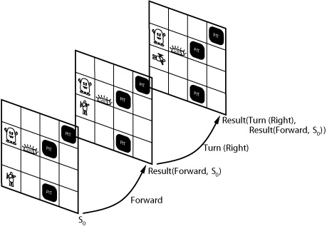
Situation Calculus
situation calculus & the Wumpus World

Slide 31
Situation Calculus
now we add an ability to reason about action sequences
  A. executing the empty sequence leaves the situation unchanged
    Result([ ], s) = s
  B. executing a non-empty sequence is the same as executing the first action then executing the rest in the resulting situation
    Result([a]seq, s) = Result(seq, Result(a, s))

Slide 32
Situation Calculus
Reasoning about action sequences includes
  the projection task
    a Situation Calculus agent should be able to deduce the outcome of a sequence of actions
  the planning task
    a Situation Calculus agent should be able to find a sequence that achieves a desirable effect
  note that planning
    requires a suitable constructive inference algorithm

Slide 33
Situation Calculus
Describing change in situation calculus
  the simplest version
    uses possibility and effect axioms for each action
  a possibility axiom & an effect axiom specify
    A. when it is possible to execute an action
    B. what happens when a possible action is executed
  The general forms of these axioms
  a possibility axiom
    Preconditions ⇒ Poss(a, s)
  an effect axiom
    Poss(a, s) ⇒ changes resulting from action a

Slide 34
Situation Calculus
A situation calculus example
  change over time in Wumpus World
  conventions & notes
    1. omit universal quantifiers if scope is a whole sentence
    2. simplify the agent's moves as just Go
    3. variables & their ranges
      s ranges over situations
      a ranges over actions
      o ranges over objects (including the Agent)
      g ranges over gold
      x & y range over locations

Slide 35
Situation Calculus
A situation calculus example: Wumpus World
  sample possibility axioms
At(Agent, x, s) Λ Adjacent (x, y) ⇒ Poss(Go(x,y), s)
Gold(g) Λ At(Agent, x, s) Λ At(g, x, s) ⇒ Poss(Grab(g), s)
  sample effects axioms
Poss(Go(x,y), s) ⇒ At(Agent, y, Result(Go(x, y), s))
Poss(Grab(g), s) ⇒ Holding(g, Result(Grab(g), s))
  these apparently allow an agent
    to make a plan to get the gold
  note, however
    that the effects axioms specify what changes but not what stays the same

Slide 36
Situation Calculus
To make a plan to get the gold requires
  representing that gold's location stays the same
    over the sequence of agent actions
  this is the basis of the frame problem
    the need to represent things that stay the same
    & to do it efficiently
      since almost everything does stay the same
  one possible approach is to use frame axioms
    explicit axioms to say what stays the same
      example: agent's moving does not affect objects not held
At(o, x, s) Λ (o ≠ Agent) Λ ¬Holding(o, s) ⇒ At(o, x, Result(Go(y, z), s))
  but, with F fluent predicates & A axioms we'll need A * F frame axioms to describe

Slide 37
The Frame Problem
the Representational Frame Problem
  is the need for A * F frame axioms to describe
    that other objects are stationary unless held
    in general
      that things not directly involved in an action stay the same
  plus, there are other related problems
    the Inferential Frame Problem
      project the results of a t-step sequence of actions how to decide efficiently whether fluents hold in the future
    the Ramification Problem
      how to deal with secondary (implicit) effects if an agent is holding the gold it moves with the agent
    the Qualification Problem
      ensure that all necessary conditions for an action's success have been specified

Slide 38
The Frame Problem
The following illustrates an approach
  to solving the Representational Frame Problem
  using A * E axioms (rather than A * F)
    where E is the maximum number of effects of any action
      so is generally much less than F (# of fluent predicates)
  use successor state axioms
      specify the truth value for each fluent in the next state as a function of the action & fluent truth value in the current state
    the general form
Action is possible ⇒ (Fluent is true in result state ⇔ Action's effect made it true V It was true before & the action left it unchanged)
  The unique names axiom states a disequality for every pair of constants in the knowledge base.

Slide 39
The Frame Problem
The Representational Frame Problem
  successor-state axioms
    sample successor state axiom for the agent's location
Pos(a,s) ⇒ (At(Agent,y,Result(a,s)) ⇔ a=Go(x,y) V (At(Agent,y,s) Λ a≠Go(y,z)))
  translation into English
    the agent is at y after executing an action either if the action is possible and consists of moving to y or if the action is possible and the agent was already at y and the actions is not a move to somewhere else complete specification of next state means frame axioms are not needed

Slide 40
Event Calculus
A more general event calculus is appropriate
  when actions have duration
      event calculus uses an explicit time dimension
      fluents hold at points in time rather than in situations
      the axioms use Initiates & Terminates relations
  Event calculus is a new representational formalism
    still has many unresolved issues
    Event Calculus Axiom:
    T(f,t₂) ⇔ ∃ e,t Happens(e,t) Λ Initiates(e,f,t) Λ (t < t₂) Λ ┐Clipped (f,t,t₂)
    Clipped (e,f, t₂) ⇔ ∃ e,t₁ Happens(e, t₁) ΛTerminates(e,f, t₁) Λ (t < t₁) Λ (t₁ < t₂)
    Happens(TurnOff(LightSwitchl) ,1:00)

Slide 41
Generalized Events
    World War II, for example, is an event
    a SubEvent relation is similar to the PartOf relation
      with reflexive & transitive properties
    so, WW II is an event
      as is the BattleOfBritain, a subevent of WWII
      SubEvent(BattleOfBritain, WWII)

Slide 42
Generalized Events
Examples for the Generalized Event ontology
    the 20th century is an interval of time
      intervals include all space, between 2 time points
    Period(e) is a function that
      denotes the smallest time interval enclosing some event e
    Duration(i) is a function that
      denotes the length of time occupied by an interval
    a place
      is a space-time chunk with fixed spatial borders
    In (x, y) is a predicate that
      denotes 1 event's spatial projection is PartOf another's
    Location(e) is a function that
      denotes the smallest place enclosing event e

Slide 43
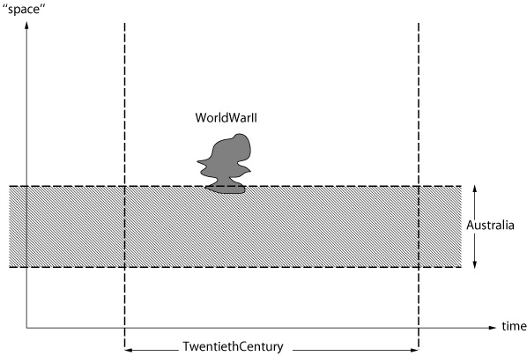
Generalized Events
illustrating generalized events in space-time

Slide 44
Generalized Events
We can introduce categories of events
  WWII belongs to the category Wars
  in this ontology categories can be complex terms
    not just constants as previously
      recall BasketBalls

Slide 45
Generalized Events
Categories of events
  categories as complex terms
    fewer arguments, more general
    more arguments, more specific
  some simple examples:
Go(x,y) ⊆ GoTo(y)
Go(x, y) ⊆ GoFrom(x)
  we can introduce an abbreviation: E(c, i)
    specifies that an element of the category of events c is a subevent of the event or interval i

Slide 46
Generalized Events
    E(c,i) ⇔ ∃ e, e ∈c Λ SubEvent(e,i)
    “Shankar flew from New York to New Delhi yesterday “
∃ e, e ∈Fly(Shankar, New York，New Delhi) Λ SubEvent(e,Yesterday)
➔
  E(Fly(Shankar, New York, New Delhi),Yesterday)

Slide 47
Generalized Events, Fluent Calculus
Processes
  events may be discrete with a clear beginning, middle, & end
  they may be in process or liquid event categories
    i.e. any subinterval of the event is in the same category
    analogous to the substances discussed earlier
    states refer to processes of continuous non-change
  a fluent calculus representation language
    allows forming more complex states & events
      by combining primitive ones
    such as the event of 2 things happening at once is denoted by the Both function: Both(e1, e2)
      this is often shown in abbreviated notation as e1 • e2

Slide 48

Fluent Calculus
illustrations
    from left to right:
    (a) Both(e1, e2), (b) OneOf(e1, e2), (c) Either(e1, e2)
      note: the • function is commutative, associative
      like logical conjunction
      the others are 2 possibilities for versions of "disjunction"
    T is a predicate for the relation: throughout
      a: T(Both(p, q), i), or alternatively: T(p • q, i)
      b: T(OneOf(p, q), i)
      c: T(Either(p, q), i)

Slide 49
Generalized Events
This representation is also extensible
  to capture properties of time intervals
  moments (having zero duration) & intervals
  this requires a time scale & points on the scale
    then we define Start, End, Time & Duration functions
      Start, End ➔ earliest, latest moments of an interval
      Time ➔ point of a moment on the time scale
      Duration ➔ difference between end & start times
    & we can add several predicates
  to allow reasoning about time intervals
    Meet(i, j), Before(i, j), After(j, i),
    During(i, j), Overlap(i, j)

Slide 50
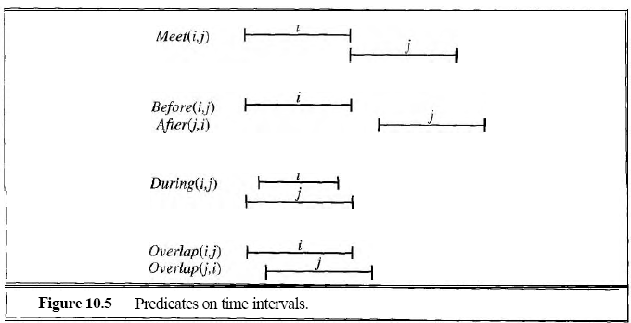
Generalized Events
Illustrations of time interval predicates

Slide 51
Generalized Events
This representation is also extensible
  to physical objects
    they occupy chunks of space-time
  we can describe the changing properties of objects using state fluents
  an example: object USA, population fluent
    E(Population(USA, 271,000,000), AD1999)
    using the E(c, i) notation, interpret as
      an element of the category of events c is a subevent of the event or interval I
    T(President(USA)=George Washington, AD1790)

Slide 52
Mental Events, Mental Objects
A formal theory of beliefs
  propositional attitudes
    Believes, Knows, and Wants
  and reification
    Turning a proposition into an object

Slide 53
Mental Events, Mental Objects
referential transparency
  the property of being able to substitute a term freely for an equal term
Opaque(不透明)
  one cannot substitute an equal term for the second argument without changing the meaning

Slide 54
Mental Events, Mental Objects
A theory of beliefs
  includes the relationships
    between agents & mental objects
    believes, knows, wants, …
  a simple example from the Superman domain
    Believes(Lois, x)
      but, if x is Flies(Superman)
      & predicates like Believes only have ground terms as arguments
    then, let Flies(Superman) be a function that specifies a mental object
      that is, a reification of the idea that Superman flies

Slide 55
Mental Events, Mental Objects
An agent can now
  reason about the beliefs of agents
  but still requires further development
    reified objects & events capture part of a belief ontology
    however, we also need to reify descriptions of objects to allow an agent to believe one description of an object but not another
    the Superman example
      Lois believes Superman flies but believes Clark cannot
      although Superman & Clark are 2 names (descriptions) for the same person

Slide 56
Mental Events, Mental Objects
Beliefs become relations
  relations with a second argument that is referentially opaque
    contrary to standard First-Order Logic, which is referentially transparent
  Referential transparency of First-Order Logic
    is the property that allows substituting a term for an equal term without changing the meaning in the Superman example,
    that Clark and Superman
      are 2 names for the same person

Slide 57
Mental Events, Mental Objects
Referential opacity
Available alternative approaches include
  1. modal logic
    it includes modal operators that are referentially opaque
    this approach is not explored further here

Slide 58
Mental Events, Mental Objects
Referential opacity
alternatives include modal logic, or
  2. add a syntactic theory of mental objects to FOL
    with mental objects represented by strings
      the KB consists of strings representing sentences believed by agent
      e.g. the notation "Flies(Clark)"
    the unique string axiom states
      strings are identical iff they consist of exactly the same sequences of characters
    now it becomes possible
      for Clark = Superman but "Clark" ≠ "Superman"

Slide 59
Mental Events, Mental Objects
Defining
  The syntax, semantics, proof theory
  for the string representation, in FOL, we need to add a denotation function: Den
    that maps from a string to the object it denotes
  we also add a Name function
    that maps from the constant denoting an object to the string naming it

Slide 60
Mental Events, Mental Objects
If the agent believes p and believes p⇒q, then it will also believes q
Axiom:
  Agent(a) ∧Believes(a,p) ∧Believes(a,”p ⇒q”) ⇒ Believes(a,q)
  Agent(a) ∧Believes(a,p) ∧Believes(a, Concat(p, “⇒”, q) ⇒ Believes(a,q)

Slide 61
Mental Events, Mental Objects
To make inferences requires
  we need a way to preserve variables when using strings
  the ability to concatenate strings
    to build strings from values of variables
  an example
    Concat(p "⇒" q), abbreviated as p ⇒ q
    its semantics:
      substitute the values of the variables p, q in forming the string

Slide 62
Mental Events, Mental Objects
Finally, to make inferences requires
  adding rules to capture inferences like
  adding inference rules dedicated to beliefs
An example:
if an agent believes something, then it believes that it believes it
Agent(a) Λ Believes(a, p) ⇒ Believes(a, "Believes (Name(a), p)")

Slide 63
Mental Events, Mental Objects
Notes:
  given the above changes/additions
  the agent is now capable, using FOL inference
    of deducing any consequence of its beliefs
  thus the agent is infallible, logically omniscient
  there have been attempts
    not completely successful to date
    to define limits on this infallibility, omniscience

Slide 64
Mental Events, Mental Objects
Some further extensions, simply listed here
  to capture mental events beyond simple belief
  to Know
    that a proposition is true
  to KnowWhether
    a proposition is the case or not
  to KnowWhat
    the content of something that is known
  to reflect changes in belief over time
    we can use the operators, mechanisms of event calculus

Slide 65
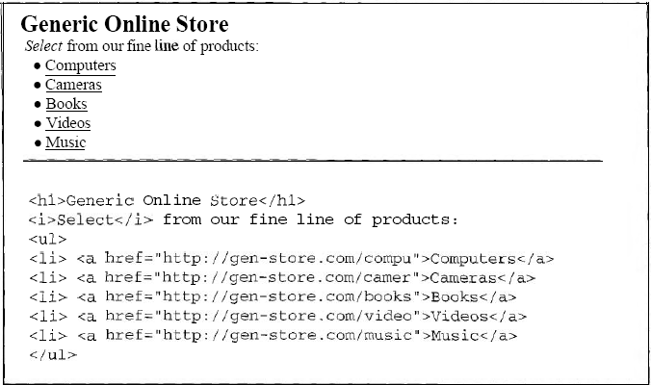
An Internet Shopping Agent
Look at the store online

Slide 66
An Internet Shopping Agent
Extended Knowledge Engineering example
  this example describes an agent to help a buyer
    find product offers on the internet
    given a user's description, a query
    the input is
      a product description (more or less precise)
    the output is
      a list of web pages that offer the product for sale
  1. The agent's environment
    is the internet, WWW

Slide 67
An Internet Shopping Agent
Extended Knowledge Engineering example
  2. the agent's percepts
    are web pages (highly complex character strings)
  the perception process involves
    extracting useful information from the percepts
    a deceptively difficult task
      given the richness of web pages
      which may include links, forms, images, animations, scripted content, ....

Slide 68
An Internet Shopping Agent
Extended Knowledge Engineering example
  3. the task:
    1. find relevant offers, &
    2. filter them to present the best ones to the user
  build the agent using First-Order Logic
    include the category representation & manipulation
      that was outlined earlier
    also include procedural attachment
      as a mechanism, for example, to retrieve web pages

Slide 69
An Internet Shopping Agent
Finding offers
  collect web pages & associated urls
    that contain text "matching" the user's query
  they need to be both
    1. relevant to the query
    2. contain something that constitutes an offer
RelevantOffer(page,url,query) ⇔ Relevant(page,url,query) Λ Offer(page)
  This task involves
    parsing text of pages for appropriate tags & keywords

Slide 70
An Internet Shopping Agent
Example:
  Amazon ∈OnlineStores∧Homepage(Amazon,”amrzon.com”)
  Relevant(page,url,query) ⇔ ∃ store,home store ∈OnlineStore ∧Homepage(store,home)∧ ∃ url2 RelevantChain(home,url2,query)∧Link (url2,url)∧page=GetPage(url)

Slide 71
An Internet Shopping Agent
Finding relevant product offers
  find relevant pages: Relevant(x,y,z)
  in part, this is a search task
    so we might use an existing internet search engine
    Alternatively, we might start from an initial set of online storefronts
      attempt to follow relevant category links from the home pages
    to eventually find offers of specific products

Slide 72
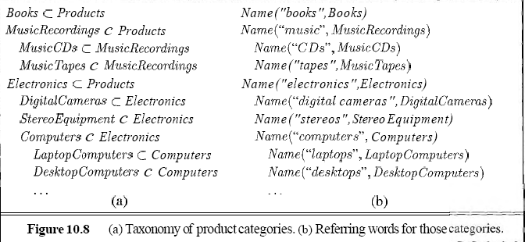
An Internet Shopping Agent
Finding relevant product offers
  what are the relevant connected pages?
    deciding relevance requires a rich category vocabulary
    a hierarchy (taxonomy) of product categories

Slide 73
An Internet Shopping Agent
Determining relevance of content to a query
  the agent also needs to
    associate strings found in pages with the categories
    use a Name predicate for the string - category relation
Possible Examples:
Name("music", MusicRecordings)
Name("CDs", MusicCDs)
Name("DVDs", MusicDVDs)
    Determining relevance
      if the text extracted from the page names the category or a subcategory or a supercategory
RelevantCategoryName(query, text) ⇔
∃ c₁,c₂ Name(query, c₁) Λ Name(text, c₂) Λ (c₁ ⊆ c₂ V c₂ ⊆ c₁)

Slide 74
An Internet Shopping Agent
Some problems with names
  synonymy
    multiple names for same category
      “马铃薯” “土豆”
  ambiguity
    one name that applies to 2 or more categories (apple )
    increases the links followed
    & adds to the difficulty of deciding relevance
  to deal optimally with the range of names
    in users' queries & store labels
    ultimately would require
      full natural language understanding
    an approximate solution
      uses simple rules for plurals, alternative spellings, etc

Slide 75
An Internet Shopping Agent
Still need to actually retrieve pages
  use the GetPage(url) function
    with procedural attachment
  when a subgoal involves the GetPage function
    execute an appropriate http procedure
  so it appears to the shopping agent
    that all web pages are always present as part of the KB

Slide 76
An Internet Shopping Agent
To find a best offers
  we need to compare them
    a form of the information extraction problem (see Ch23)
  we'll assume there are wrapper programs
    to extract product information from pages
    to get important details of the products offered
    & add corresponding assertions to the KB
    likely there is a hierarchy of wrappers
      for details ranging from more general to more specific
      possibly even dedicated to a particular store's format

Slide 77
An Internet Shopping Agent
Having found offers
  we need to compare them
  if offered products vary on 1 or more features
    compare the offers based on corresponding features
    text uses an example with laptop computers
    features might include
      cpu speed/model
      amount of ram
      hard drive type
      hard disk size
      type of optical drive
      type of networking and/or video connections
      price
      and so on

Slide 78
An Internet Shopping Agent
Comparing offers
  use a Dominates relation
    Dominates (OfferX, OfferY)
    OfferX is better on at least 1 attribute, not worse on any
    then present the user with the list of undominated offers
Summary
  FOL declarative structure
    facilitates extension to additional tasks
  representation for the product hierarchy is key
    once built
    it simplifies the remainder of the agent building problem

Slide 79
Reasoning About Categories
Organizing & reasoning with categories
  the semantic networks approach
  conveniently represents
    objects and categories of objects
    plus some relations among them
  was originally proposed (early 20th century)
    as an alternative to conventional logic
  semantic network approach
    turns out, when fully analyzed is actually a form of logic with an alternative notation, syntax

Slide 80
Reasoning About Categories
Semantic networks
  visualize the knowledge base as a graph
    nodes (bubbles) are categories & individual objects
    links are Subset & MemberOf relations
  this type of representation
    allows very efficient algorithms, for category membership inference
    just follow links upward

Slide 81
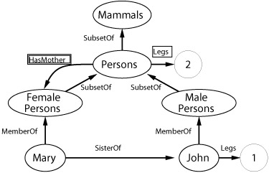
Semantic Networks
Inheritance reasoning in semantic nets
  follow MemberOf & SubsetOf links
    up the hierarchy
  stop at the category with a property link
    to infer the property for an individual

Slide 82
Semantic Networks
The representation allows other relations
  to be captured in additional arcs

Slide 83
Semantic Networks
Inheritance reasoning in semantic nets
  1. an example: the HasMother relation
    applies between individuals, not categories
    this is indicated by the double box special notation

Slide 84
Semantic Networks
Inheritance reasoning in semantic nets
  2. multiple MemberOf, SubsetOf links are possible
    but multiple inheritance may produce conflicting values
  3. properties of every member of a category
    are indicated by the single box notation
  4. standard links represent binary relations

Slide 85
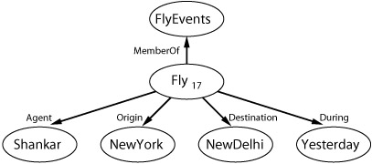
Semantic Networks
Inheritance reasoning in semantic nets
  4. standard links represent binary relations
    n-ary relations can be represented
    example: Fly (Shankar, NewYork, NewDelhi, Yesterday)
    process for representing n-ary relations involves
      reifying the proposition as an event in an appropriate event category so Fly (Shankar, NewYork, NewDelhi, Yesterday)

Slide 86
Semantic Networks
Summary
  the semantic net advantages
    simplicity of inference
    ease of visualizing, even for large nets
    ease of representing default values for categories
    & ease of overriding defaults by more specific values
  but, awkward or impossible
    to capture many of FOL's representational capabilities
    negation, disjunction, existential quantification, ...
    when extended to do so, it loses its attractive simplicity

