Slide 1

Customer Shopping Behaviour Analysis
Examining 3,900 purchases across multiple product categories to uncover insights on spending habits, customer segmentation, and subscription patterns for strategic business decisions.

Slide 2
Dataset Overview
3,900
18
37
Total Purchases
Data Columns
Missing Values
Comprehensive transaction records analyzed
Rich feature set covering demographics and behavior
Only in Review Rating column
Customer Demographics
Shopping Behaviour
Discount Applied, Promo Codes
Age, Gender, Location
Previous Purchases, Frequency
Subscription Status
Review Rating, Shipping Type

Slide 3

Data Preparation Journey
01
Data Loading & Exploration
Imported dataset using pandas, examined structure with df.info() and
summary statistics
02
Missing Data Handling
Imputed missing Review Rating values using median rating per product
category
03
Feature Engineering
Created age_group and purchase_frequency_days columns for deeper
analysis
04
Database Integration
Connected to MY SQL and loaded cleaned data for SQL analysis

Slide 4
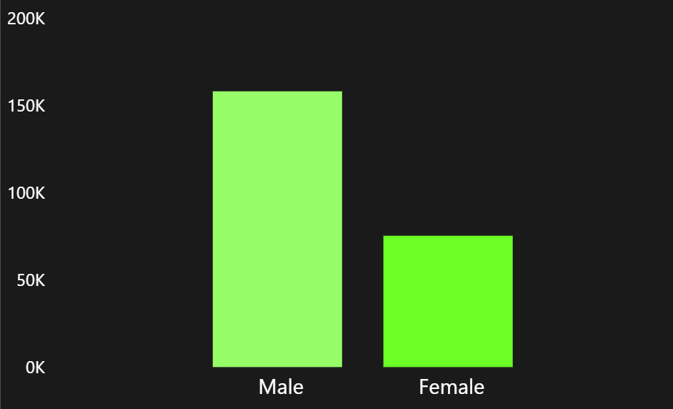

Revenue Insights
High-Spending Discount Users
Identified 839 customers who used discounts but still spent above average purchase amount.
These savvy shoppers represent a key segment for targeted promotions.
Male customers generate $157,890 in revenue compared to $75,191 from female customers, revealing significant gender-based spending differences.

Slide 5





Top-Rated Products
Gloves
Sandals
Boots
Rating: 3.86
Rating: 3.84
Rating: 3.82
Hat
Skirt
Rating: 3.80
Rating: 3.78
Customer satisfaction scores reveal which products deliver the best experience and should be featured prominently in marketing campaigns.

Slide 6


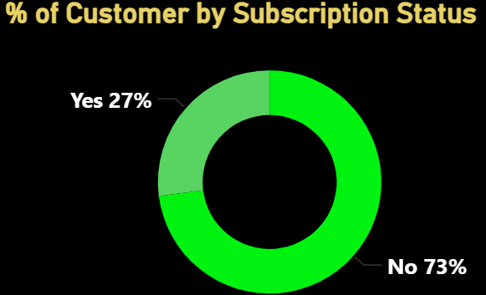
Shipping & Subscription Analysis
$60.48
$58.46
Express Shipping Average
Standard Shipping Average
Express shipping customers spend slightly more per transaction.
Subscription Status Impact
Subscribers: 1,053 customers, $59.49 avg spend, $62,645 total revenue
Non-subscribers: 2,847 customers, $59.87 avg spend, $170,436 total revenue
Similar spending patterns but huge untapped subscription potential.

Slide 7
Discount-Dependent Products
50%
49.66%
49.07%
Hat
Sneakers
Coat
48.17%
47.37%
Sweater
Pants
These products show the highest percentage of discounted purchases, indicating price sensitivity. Review discount strategies to maintain profitability while driving sales.

Slide 8
Customer Segmentation
Loyal Customers
Returning Buyers
New Shoppers
3,116 customers form the backbone of
revenue
701 customers show promise for
loyalty conversion
83 customers represent growth
opportunity
Among repeat buyers (>5 purchases): 958 are subscribers vs. 2,518 non-subscribers, revealing significant subscription conversion potential.
New

Slide 9
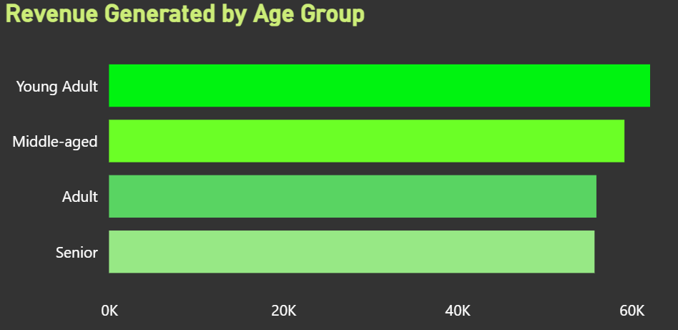
Category Performance
1
2
Accessories
Clothing
Top sellers: Jewelry (171), Sunglasses (161), Belt (161)
Top sellers: Blouse (171), Pants (171), Shirt (169)
3
4
Footwear
Outerwear
Top sellers: Sandals (160), Shoes (150), Sneakers (145)
Top sellers: Jacket (163), Coat (161)

Slide 10



Strategic Recommendations
Increase Subscriptions
Enhance Loyalty Programs
Offer special perks and personalized deals to attract more subscribers from the 2,847 non-subscribers.
Provide incentives for the 701 returning customers to convert them into loyal buyers.
Optimize Discount Strategies
Review policies for high-discount products like hats and sneakers to maintain profitability.
Improve Product Promotion
Feature top-rated items like gloves and sandals prominently
Refine Targeted Marketing
Focus on young adults and express shipping users

