Slide 1

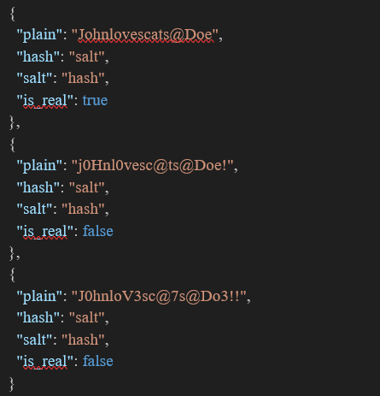
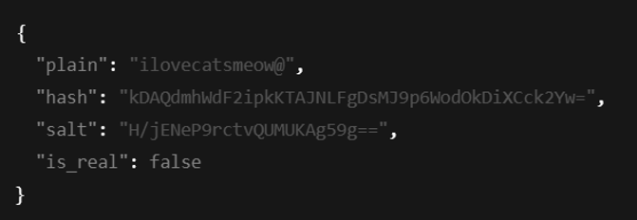
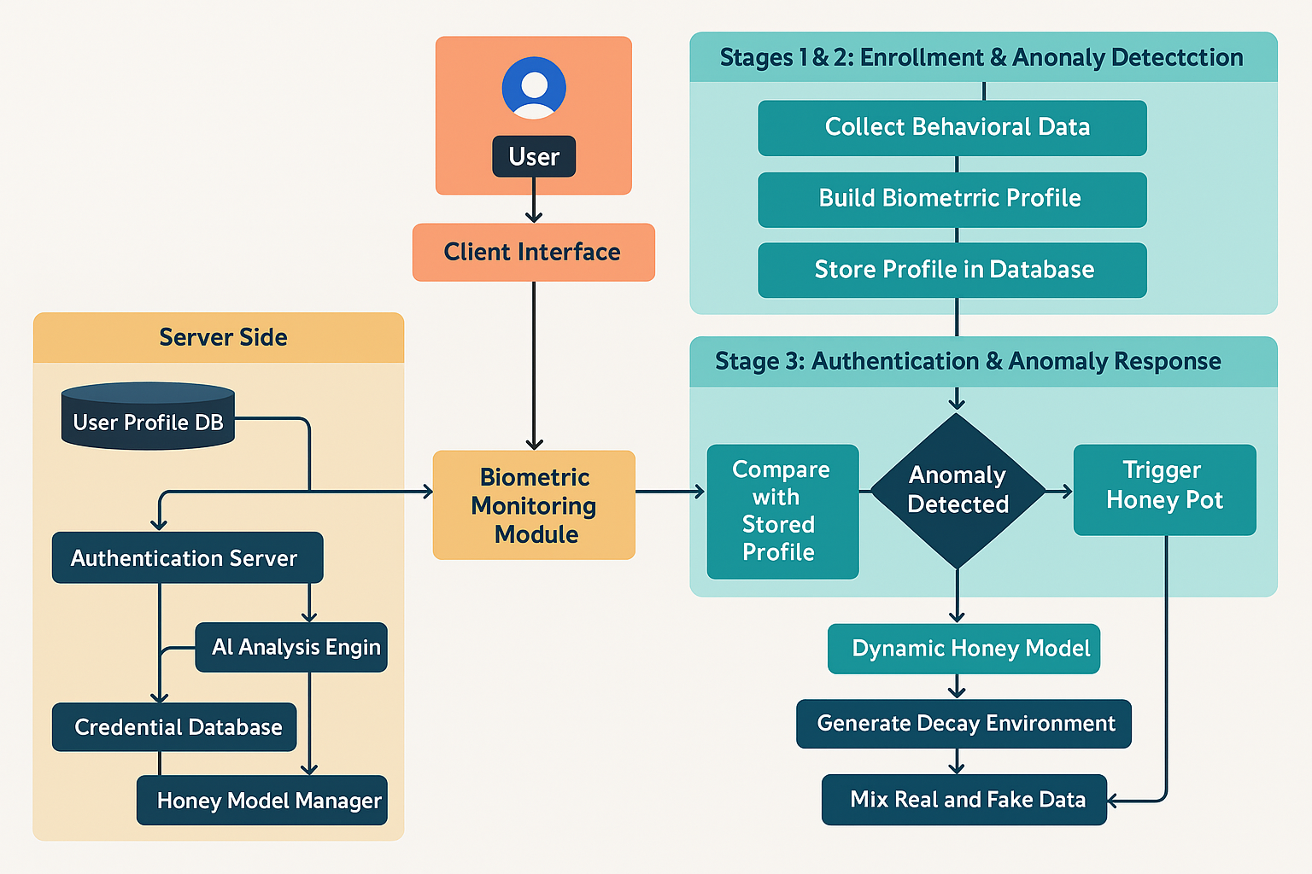
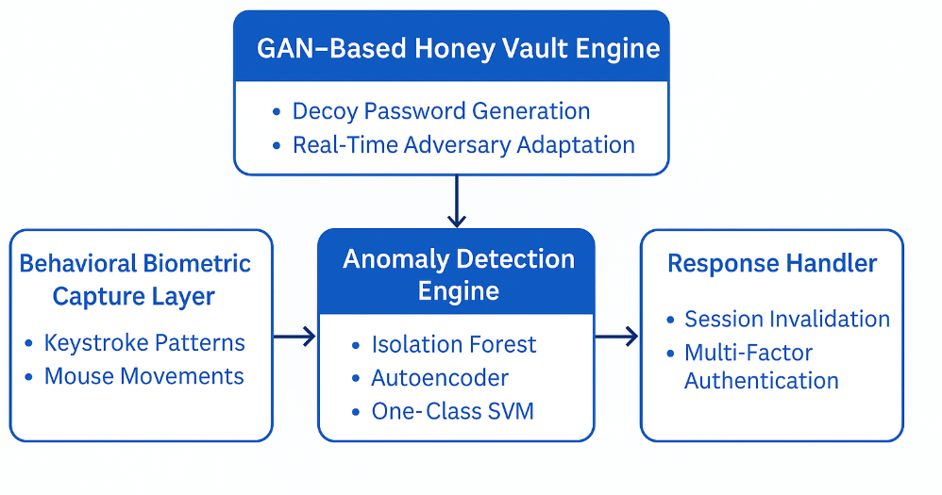
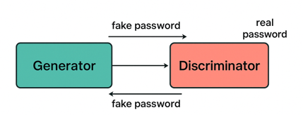
AI – Augmented Adaptive Honey Vaults
Ayush Pandey – 21BCI0035 | Tanish Sancheti – 21BCE2459 | Sanskar Jotwani – 21BCE2785
Dr. Somasundaram SK | School of Computer Science and Engineering
Introduction
Results
Traditional authentication systems using static passwords are vulnerable to modern cyber threats like phishing, credential stuffing, and brute-force attacks. Honey vaults add a deceptive layer by introducing fake credentials, but they often lack adaptability. This project proposes an AI-augmented honey vault system that leverages behavioral biometrics and dynamic deception strategies to enhance authentication security.
The developed AI-Augmented Adaptive Honey Vault system demonstrated excellent performance in multiple key areas. Machine learning models achieved over 95% accuracy in detecting anomalous behavior, significantly enhancing the system’s ability to identify unauthorized access attempts in real time. The GAN-generated honey tokens achieved a realism score of 99%, making them virtually indistinguishable from real user credentials and highly effective at misleading attackers. In simulated environments, including phishing and brute-force attack scenarios, the system consistently confused attackers with dynamic decoy data, delaying their progress and triggering alerts. Behavioral biometrics also proved effective in distinguishing legitimate users from imposters with high precision. The combination of these technologies resulted in a highly resilient system capable of adapting to evolving threats while minimizing disruptions to authentic users.
Motivation
The motivation behind this project stems from the inadequacy of static deception models in dealing with modern, dynamic cyberattacks. Traditional honey vaults fail to personalize their decoy strategies or adapt in response to evolving threats, resulting in a high risk of compromise. Attackers are increasingly able to identify static decoys and extract real credentials by recognizing predictable patterns. Furthermore, existing systems often lack integration with behavioral biometrics, which could provide a critical layer of personalized authentication. This project seeks to revolutionize deception-based authentication by developing a system that continuously evolves using AI. By leveraging user-specific behavior analysis, machine learning for real-time anomaly detection, and GANs for creating realistic decoys, the proposed system offers a more resilient and intelligent approach to securing user credentials.
Scope of the Project
The project begins by converting high-resolution images to greyscale, simplifying intensity details for analysis. A swarm of 100 points is initialized and distributed across the image. Using swarm intelligence algorithms, these points iteratively move toward object boundaries by responding to local intensity changes. Once the boundary is formed, the detected shape is projected onto the original image. To evaluate detection accuracy, the area of the detected shape is compared to the ground truth using Euclidean distance-based calculations. This method ensures reliable shape detection even in noisy and complex environments.
Methodology
The system is architected into three main components. The first is the Behavioral Biometric Capture Layer, which records keystroke patterns and mouse movements in real time, enabling the creation of detailed behavioral profiles. The second component is the Anomaly Detection Engine, which employs machine learning models—such as Isolation Forests, Autoencoders, and One-Class SVMs—to detect unusual behavior patterns indicative of unauthorized access. These models analyze real-time data to identify anomalies based on deviation from user norms. The third and core module is the GAN-Based Honey Vault Engine, which generates highly realistic decoy passwords in response to detected threats. These decoys are crafted to be indistinguishable from real credentials and adapt to attacker behavior. The system also includes a Response Handler that takes appropriate actions such as session invalidation or multi-factor authentication triggers. Together, these components form a robust, intelligent authentication system capable of actively defending against cyber threats.
Conclusion
This project presents a significant advancement in cybersecurity by addressing the critical limitations of traditional authentication systems. The AI-Augmented Adaptive Honey Vault system merges the power of behavioral biometrics, machine learning, and dynamic deception through GANs to provide a robust, intelligent defense against modern cyberattacks. It goes beyond static protection by offering real-time adaptability, personalized deception strategies, and a comprehensive threat detection mechanism. The integration of AI enables the system to continuously learn from both user behavior and attacker interactions, making it more secure and effective over time. As organizations seek to bolster their defenses against credential-based threats, this research offers a forward-looking solution that is both scalable and practical for real-world deployment.
GAN Algorithm
The Generative Adversarial Network (GAN) is a deep learning framework used for generating synthetic, highly realistic data. It consists of two neural networks—a Generator and a Discriminator—that are trained simultaneously in a game-theoretic setup. The Generator creates fake data to mimic real input, while the Discriminator evaluates both real and generated data to distinguish between them. Through this adversarial process, the Generator progressively learns to produce data that is indistinguishable from real samples. Iteration continues until the Discriminator can no longer reliably tell real from fake, marking a point of optimal generative realism.
References
[1] A. Juels and R. L. Rivest, "Honeywords: Making password-cracking detectable," Proceedings of the 2013 ACM SIGSAC Conference on Computer and Communications Security (CCS '13), pp. 145–160, 2013.
[2] Srivastava, A., Mittal, A., & Gupta, A. (2022). Dynamic decoy passwords using generative adversarial networks. ICCR 2022
[3] López, P. B., Pérez, M. G., & Nespoli, P. (2024). Cyber Deception: State of the art, Trends and Open challenges. arXiv:2409.07194
[4] Hassan, M., & Moustafa, N. (2023). Multi-modal biometrics for cyber defense: A review of AI powered authentication. IEEE Transactions on Information Forensics & Security.

