Slide 1
BCSE498J - AI – Augmented Adaptive Honey Vaults
21BCE2459 TANISH SANCHETI
21BCE2785 SANSKAR JOTWANI
21BCI0035 AYUSH PANDEY
Under the Supervision of Prof. Somasundaram SK

Slide 2
INTRODUCTION
This project focuses on the development of AI-Augmented Adaptive Honey Vaults, a cybersecurity system designed to enhance password protection through advanced AI-driven deception techniques.
Key Objectives:
Strengthen Authentication Security: Integrate behavioural biometrics (keystroke dynamics and mouse movement analysis) for robust user verification.
Real-Time Anomaly Detection: Use ML models (Isolation Forest, Autoencoders) to identify unauthorized access attempts.
Dynamic Honey Tokens: Leverage GANs to generate adaptive, realistic decoy credentials to mislead attackers.
Problem Addressed: Static security measures are increasingly ineffective against modern threats such as brute force, phishing, and automated attacks. This project introduces an adaptive, intelligent solution to counter such threats.
The system’s novelty lies in its ability to combine deception-based security, machine learning, and continuous adaptation for robust protection.

Slide 3
LITERATURE REVIEW
Cyber Deception Techniques:
Traditional methods, such as static honey tokens, are prone to pattern analysis, limiting their effectiveness against advanced attacks (Zhu et al., 2021).
AI-driven deception techniques, including behavioral biometrics and GANs, have emerged to address these limitations (Chamola & Sikdar, 2024).
Behavioral Biometrics:
Studies emphasize the use of keystroke dynamics and mouse movement analysis to enhance authentication security (Banerjee et al., 2020).
These biometrics provide a unique, user-specific layer of defense against unauthorized access (Amiri et al., 2024).
Generative Adversarial Networks (GANs):
GANs have been applied to create adaptive decoy credentials, deceiving attackers and wasting their resources (Goodfellow et al., 2014).
Recent research highlights GANs' ability to dynamically evolve decoys based on attacker behavior (Chamola & Sikdar, 2024).
Real-Time Anomaly Detection:
Machine learning models like Isolation Forest and Autoencoders have been identified as effective in detecting unauthorized access attempts (Zhu et al., 2021).
Real-time detection systems significantly reduce response time to potential threats (Amiri et al., 2024).

Slide 4
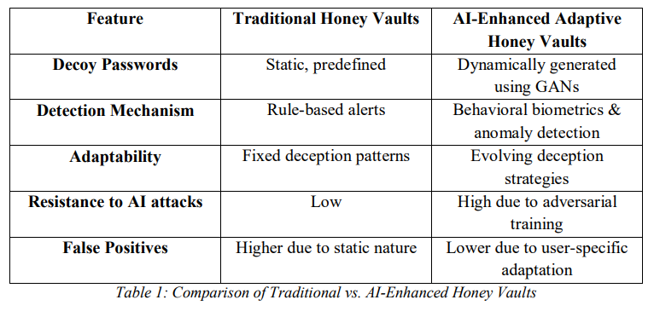
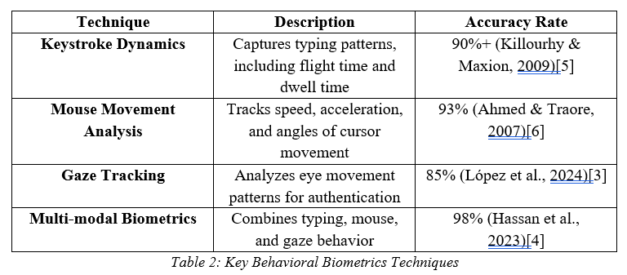
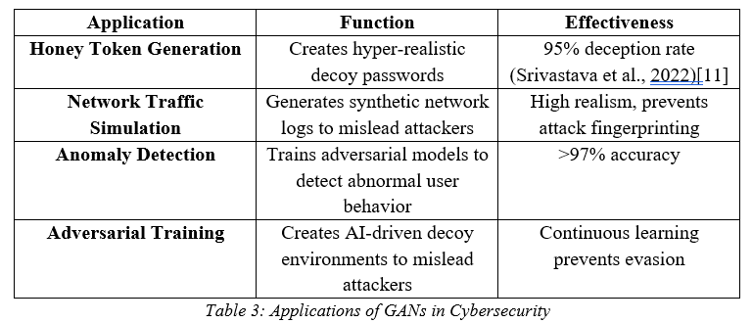
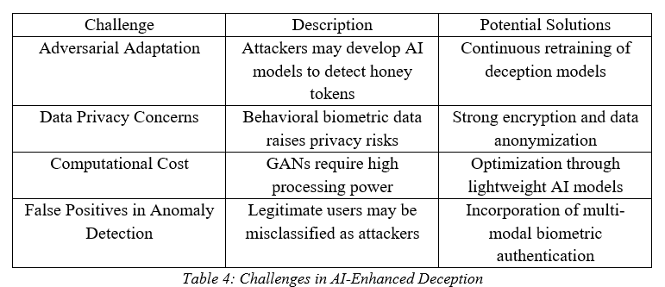

Slide 5
RESEARCH GAP
Challenges Identified:
Privacy Concerns: The collection of biometric data raises issues regarding data security and ethical considerations.
Adversarial Resistance: Ensuring generated decoy passwords remain indistinguishable under scrutiny by attackers.
Scalability: Difficulty in maintaining real-time processing capabilities as user base increases.
Key Research Gaps:
Limited real-world implementation of AI-driven honey vaults.
Lack of integration between behavioral biometrics and adaptive deception systems.
Minimal focus on scalability and performance optimization for multi-user environments.

Slide 6
PROBLEM FORMULATION
Inadequate Password-Based Authentication:
Traditional password systems are increasingly ineffective against sophisticated cyberattacks targeting user credentials.
Static Honey Vault Vulnerabilities:
Static honey vaults lack flexibility, making them prone to pattern analysis and brute-force decryption as attackers identify predictable decoy credentials.
Failure to Incorporate Behavioral Biometrics:
Most security models overlook the potential of behavioral biometrics, such as keystroke dynamics and mouse movements, which are essential for real-time and user-specific security measures.

Slide 7
RELEVANCE TO SDGs – SDG 9 Industry, Innovation, and Infrastructure
Focus on Resilient Infrastructure:
The AI-Augmented Adaptive Honey Vault system introduces cutting-edge cybersecurity measures, helping to secure digital infrastructure against increasingly sophisticated cyberattacks.
By leveraging AI, behavioral biometrics, and real-time anomaly detection, the system provides a dynamic approach to securing user credentials and authentication processes.
Fostering Innovation:
The project promotes innovation in cybersecurity, especially in the context of e-commerce and digital platforms, by developing adaptive deception techniques such as GAN-based honey tokens.
This innovation paves the way for future advancements in authentication methods, reducing reliance on traditional password-based systems that are prone to exploitation.
Support for Digital Economy:
By improving the security of digital platforms, the project contributes to building a more secure and resilient digital economy, encouraging businesses and users to trust online systems and services.
Strengthening Cybersecurity as a Critical Infrastructure:
In a world increasingly reliant on digital technologies, securing the infrastructure of digital services becomes essential. This project aligns with SDG 9 by fortifying infrastructure against cyber threats.

Slide 8
RELEVANCE TO SDGs – SDG 16 Peace, Justice, and Strong Institutions
Cybersecurity for Trustworthy Institutions:
The AI-driven honey vault system enhances trust in digital institutions by ensuring robust protection of user credentials and sensitive data.
It supports the creation of strong, trustworthy digital services by mitigating the risks posed by cyberattacks, fostering transparency and integrity in online systems.
Reducing Cybercrime:
The system provides proactive defense mechanisms to protect against cybercrime, including identity theft, credential stuffing, and unauthorized access to sensitive systems.
By reducing the incidence of breaches, it contributes to safer digital environments where users can engage in online activities with confidence.
Promoting Access to Justice:
By incorporating real-time anomaly detection and adaptive security mechanisms, the project ensures that users' rights to privacy and data protection are upheld.
It supports a fairer digital world where users are safeguarded against malicious actors, ensuring justice is served in online interactions.
Enhancing Law Enforcement Capabilities:
The project's innovations contribute to stronger institutions by providing tools that can be used by law enforcement and cybersecurity professionals to prevent and investigate cybercrimes, strengthening legal frameworks around digital security.

Slide 9
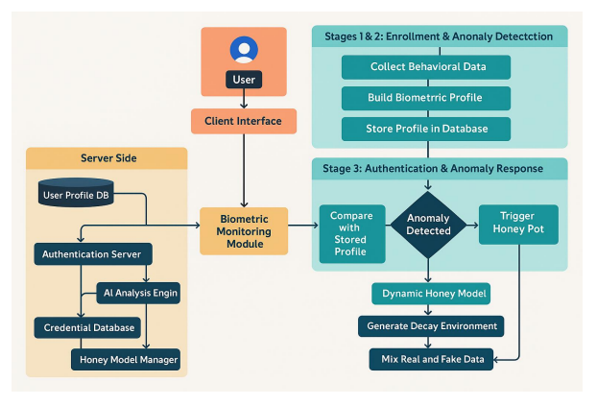
SYSTEM ARCHITECTURE

Slide 10
BEHAVIOURAL BIOMETRIC CAPTURE LAYER
Purpose: Continuously monitors and records user interaction patterns for authentication and anomaly detection.
Key Functions:
Keystroke Dynamics Analysis:
Captures typing speed, rhythm, key hold/dwell time, and inter-key intervals.
Tracks habitual errors (e.g., backspacing patterns).
Cursor/Mouse Behavior Profiling:
Records movement trajectories, click timing, and scroll behavior.
Detects deviations in acceleration or precision (e.g., bot-like vs. human movement).
Real-Time Data Streaming:
Encrypts and transmits raw behavioral data to the Anomaly Detection Engine.

Slide 11
ANOMALY DETECTION ENGINE
Purpose: Analyzes behavioral data to flag suspicious activity using machine learning.
Key Functions:
Behavioral Baseline Modeling:
Trains ML models (e.g., SVM) on historical user data to establish "normal" behavior.
Real-Time Deviation Scoring:
Computes risk scores based on deviations.
Context-Aware Thresholds:
Adjusts sensitivity based on factors like IP geolocation, time of day, or accessed resource.

Slide 12
GAN – BASED HONEY VAULT ENGINE
Purpose: Generates deceptive credentials to mislead attackers during detected breaches.
Key Functions:
Dynamic Decoy Generation:
Uses Generative Adversarial Networks (GANs) to create plausible fake passwords/OTPs matching the user’s style (e.g., "Summer2023!" → "Winter2024?").
Entrapment Triggers:
Deploys decoys only during active anomalies (e.g., credential stuffing attacks).
Forensic Tagging:
Embeds unique markers in decoys to trace attacker activity post-breach.

Slide 13
RESPONSE HANDLER
Purpose: Executes countermeasures and logs incidents for further action.
Key Functions:
Tiered Response Protocol:
Low Risk: Triggers silent MFA (e.g., unnoticeable biometric re-check).
High Risk: Invalidates sessions, locks accounts, or deploys decoys.
Alerting & Logging:
Integrates with SIEM (e.g., Splunk) for audit trails and SOC alerts.
User Recovery:
Auto-resets compromised credentials or initiates admin workflows.

Slide 14
ANALYTICAL AND THEORETICAL DESCRIPTIONS
Keystroke Dynamics:
Typing speed, rhythm, and dwell time are unique to individuals.
Analyzed using statistical models and machine learning techniques (e.g., LSTM for time-series data).
Mouse Movement Profiling:
Trajectory patterns and precision metrics differentiate between bots and humans.
Evaluated using unsupervised ML methods like Isolation Forests for anomaly detection.
Supervised Learning:
Used for detecting known attack patterns through classification models such as SVM.
Unsupervised Learning:
Isolation Forests and Mahalanobis Distance used for detecting zero-day anomalies.

Slide 15
ANALYTICAL AND THEORETICAL DESCRIPTIONS
Generative Adversarial Networks (GANs):
The generator creates decoy credentials similar to real passwords (e.g., "Password@123" → "Passw0rd!321").
The discriminator evaluates decoys for indistinguishability, ensuring attackers cannot differentiate real from fake.
Level - Based Responses:
Low Level: Silent MFA rechecks.
High Level: Session termination, decoy deployment, and alert generation.
Adaptive Thresholds:
Anomaly scoring adapts based on user behavior context (e.g., typing speed, flight time on keys, etc).

Slide 16
HARDWARE SPECIFICATIONS
Processor:
Minimum Intel Core i7 (8th Gen) or AMD Ryzen 7 to support real-time biometric data analysis and machine learning inference.
Memory:
Minimum 16GB RAM to handle large datasets, biometric data, and training of machine learning models.
Storage:
Minimum 512GB SSD for quick data access, model storage, and efficient logging of authentication attempts.
GPU (Optional):
NVIDIA RTX 3060 or higher for accelerating Generative Adversarial Networks (GAN) operations and other compute-intensive tasks.

Slide 17
SOFTWARE SPECIFICATIONS
Operating System:
Compatible with Windows 10, Linux (Ubuntu 20.04 or higher), or macOS.
Programming Languages:
Python 3.8+: For core development of machine learning models, data processing, and backend logic.
JavaScript: For creating a user-friendly front-end authentication interface.
Libraries and Frameworks:
Machine Learning:
TensorFlow, Scikit-Learn, and PyTorch for model development and evaluation.
Data Processing:
Pandas and NumPy for efficient manipulation and preprocessing of datasets.
Keystroke and Mouse Capture:
Pynput and OpenCV for collecting user behavior data such as keystrokes and mouse movements.
Web Framework:
Flask or Django for implementing the backend logic, APIs, and secure authentication workflows.
Database:
MongoDB or PostgreSQL for securely storing biometric profiles, honey tokens, and logs of authentication events.

Slide 18
Algorithms and Techniques Used
1. Keystroke Anomaly Detection
Features:
H.key: Hold time = release - press.
UD.key: Flight time = press(i) - press(i-1).
Model: Isolation Forest (unsupervised, robust to outliers).
Threshold: If more than 40% of the session is anomalous → fail authentication.
2. Honeytoken Generation (Decoys)
Mutation Logic:
Bidirectional substitutions (@, 4, 1, etc.).
Word reordering using separators (@, ., _, -).
Common password affixes (password, 123, !, etc.).
GAN-based Password Generation (optional but implemented):
Conditional GAN trained on features like length, digit/uppercase/special presence.
Output interpreted as one-hot character distributions.
3. Password Hashing
Salt: Random 16-byte value per password to prevent rainbow table attacks.
Pepper: Static hidden value stored server-side for added obscurity.
Hashing: PBKDF2-HMAC-SHA256 with 100,000 iterations for resistance to brute-force.

Slide 19
DESIGN PARAMETERS
Keystroke Dynamics:
Features: Typing speed, key hold/dwell time, inter-key intervals.
Mouse Movement Profiling:
Parameters: Cursor trajectory, click timing, scroll patterns.
Behavioral Modeling:
ML Algorithms: LSTM, Isolation Forest, One-Class SVM.
Deviation Scoring:
Techniques: Mahalanobis distance, threshold-based risk computation.

Slide 20
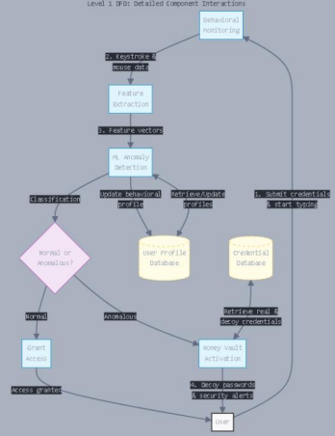
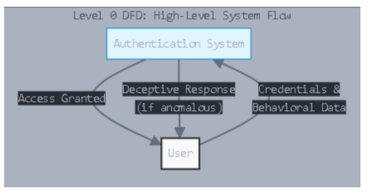
DESIGN PARAMETERS
Decoy Generation:
Techniques: GAN models to create realistic password decoys.
Attributes: Password length, structure, and complexity mimic user style.
Encryption:
End-to-end encryption for biometric data and authentication logs.

Slide 21
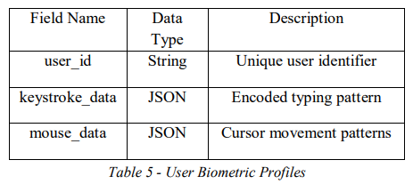
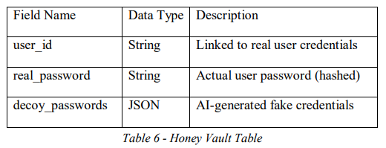
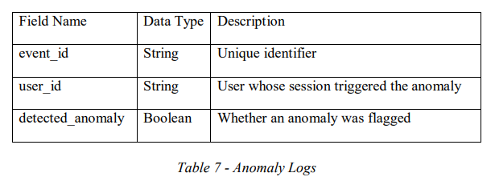
DATABASE DESIGN

Slide 22
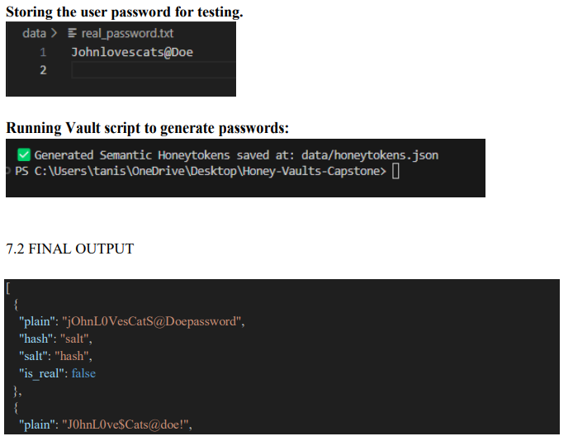
RESULTS ANALYSIS
Multiple passwords generated with hashing and fake status declared in bool within a vault to prolong intrusion process and resource expense for intruder.

Slide 23
RESULTS ANALYSIS
Input (Real Password):
A real user password (e.g., "ilovecatsmeow!") is stored securely and used as the base for generating honeytokens.
Realistic Mutation Engine:
A set of functions simulates how users typically modify their passwords by:
Introducing typos.
Applying leetspeak (e.g., replacing 'o' with '0', or 'a' with '@').
Flipping letter cases.
Appending common patterns (e.g., 123, !, 2024).
These mutations ensure the generated honeytokens resemble plausible human-chosen passwords instead of random strings.

Slide 24
RESULTS ANALYSIS
Secure Hashing & Storage:
Each password (real and decoy) is securely hashed using SHA-256 with a unique salt and a fixed pepper value.
This approach ensures strong protection against brute-force or rainbow table attacks.
The generated vault contains both the plaintext and hashed versions of each password for testing and evaluation.

Slide 25
RESULTS ANALYSIS
Output:
plain: The human-readable password (either real or a realistic decoy)
hash: A salted and peppered SHA-256 hash of the password
salt: A randomly generated salt (encoded in Base64) is_real: Boolean flag indicating if the password is the real one
When a hacker compromises the vault, they see all passwords as hashed values, and even if they try brute-forcing, they can't tell which one is genuine unless they know the user's exact input. Even slight variations of the real password are indistinguishable.

Slide 26
CONCLUSION
The AI-Augmented Adaptive Honey Vaults system introduces a paradigm shift in cybersecurity, particularly in defending against credential-based attacks. By seamlessly blending behavioral biometrics, machine learning, and AI-driven deception mechanisms, the project establishes a highly adaptive and intelligent defense framework that significantly enhances traditional authentication models.

Slide 27
INDIVIDUAL CONTRIBUTIONS
Sanskar: Keystroke Anomaly Detection (Behavioral Biometrics)
Responsibilities:
Designed and implemented the feature extraction for keystroke dynamics: Hold Time (H.key) and Flight Time (UD.key).
Created process_new_keystroke.py to normalize live input using the same scaler and feature space as the training data.
Built keystroke_anomaly_detection.py to train an Isolation Forest model on processed keystroke data.
Integrated keystroke_real_time_detection.py to analyze live keystroke sessions and flag anomalies during login.

Slide 28
INDIVIDUAL CONTRIBUTIONS
Ayush: Honeytoken Generation + GAN Integration
Responsibilities:
Developed the initial GAN architecture (train_conditional_gan.py) to generate semantically correct passwords based on features like digit count, uppercase use, etc.
Created mutation logic for honeytokens including:
Substitutions (e.g., a → @, 4 → A, 1 → i and vice versa).
Separator-based rearrangements (e.g., tanish@sanskar@ayush → Ayush@sanskar@tanish).
Prefixes/suffixes (e.g., secure, 123!, etc.).
Built vault_manager.py for generating:
vault.json: Client-facing salted+peppered password hashes.
truth_map.json: Server-side real/decoy map.
plaintext_passwords_for_demo.txt: For validation/demo.

Slide 29
INDIVIDUAL CONTRIBUTIONS
Tanish: Authentication System & Hash Management
Responsibilities:
Created the login.py script which integrates:
Live keystroke capture using pynput.
Password entry + verification with salted and peppered hashing.
Validation against public vault and hidden truth map.
Keystroke anomaly analysis in real-time.
Built hasher.py with secure PBKDF2-HMAC-SHA256 hashing using random salt and hidden pepper (loaded from pepper.secret).
Provided fail-safe logic for partial authentication and debugging.

Slide 30
IMPACT OF PROJECT ON SOCIETY AND ENVIRONMENT
Enhanced Cybersecurity:
Strengthens protection against credential theft, reducing financial and personal losses caused by cyberattacks.
Supports sectors like healthcare, finance, and e-commerce by safeguarding sensitive user data.
User-Centric Security:
Reduces the need for intrusive authentication steps by leveraging behavioral biometrics, enhancing user experience.
Mitigates the frustration of frequent account breaches through adaptive and dynamic security measures.
Environmental Impact:
Promotes efficient use of computational resources through advanced machine learning models optimized for energy consumption.
Encourages the use of scalable, cloud-based solutions, reducing the carbon footprint associated with large-scale physical server deployments.

Slide 31
REFERENCES
[1] Juels, A., & Rivest, R. L. (2013). "Honeywords: Making password-cracking detectable." Proceedings of the 2013 ACM SIGSAC Conference on Computer and Communications Security (CCS '13), pp. 145–160.
[2] Srivastava, A., Mittal, A., & Gupta, A. (2022). "Dynamic decoy passwords using generative adversarial networks." Proceedings of the 2022 International Conference on Cybersecurity and Resilience (ICCR 2022), pp. 67–74.
[3] López, P. B., Pérez, M. G., & Nespoli, P. (2024). "Cyber Deception: State of the art, Trends and Open challenges." arXiv:2409.07194.
[4] Hassan, M., & Moustafa, N. (2023). "Multi-modal biometrics for cyber defense: A review of AI-powered authentication." IEEE Transactions on Information Forensics & Security.
[5] Killourhy, S. Y., & Maxion, R. A. (2009). "Comparing anomaly-detection algorithms for keystroke dynamics." Proceedings of the 2009 IEEE/IFIP International Conference on Dependable Systems & Networks (DSN '09), pp. 125–134.

Slide 32
REFERENCES
[6] Ahmed, A., & Traore, I. (2007). "A new biometric technology based on mouse dynamics." IEEE Transactions on Dependable and Secure Computing, 4(3), 165–179.
[7] Liu, F., Ting, K. M., & Zhou, Z. (2008). "Isolation Forest." Proceedings of the 2008 IEEE International Conference on Data Mining (ICDM '08), pp. 413–422.
[8] Goodfellow, I., Pouget-Abadie, J., Mirza, M., et al. (2014). "Generative adversarial nets." Advances in Neural Information Processing Systems (NeurIPS 2014), pp. 2672–2680.
[9] Chamola, V., Sikdar, B., Sai, S., & Yashvardhan, U. (2024). "Generative AI for cyber security: Analyzing the potential of AI-driven deception models.“
[10] Amiri, Z., Heidari, A., & Navimipour, N. J. (2024). "Leveraging computational intelligence techniques for defensive deception: A review, recent advances, open problems, and future directions.“
[11] Srivastava, A., Mittal, A., & Gupta, A. (2022). "Dynamic decoy passwords using generative adversarial networks." ICCR 2022.

