Slide 1

STRING in Java
Presented By TANUJA SHARMA

Slide 2
What is String?
Generally, String is a sequence of characters. But in Java, string is an object that represents a sequence of characters.
The java.lang.String class is used to create a string object.
A string class is a user-defined template for creating and manipulating string objects.

Slide 3
Classes for String in Java
String Class (immutable)
StringBuffer Class (mutable)
StringBuilder Class (mutable)

Slide 4
How to create String Object?
(i)String Literal: Whenever a String Object is created as a literal, the object will be created in the String constant pool. This allows JVM to optimize the initialization of String literal.
Syntax: String str = "Geeks";

Slide 5
How to create String Object?
(ii)new Keyword: The string can also be declared using a new operator i.e. dynamically allocated. The object will be created in heap memory area. This string will not be added to String constant pool.
Syntax: String str = new String("Geeks");

Slide 6
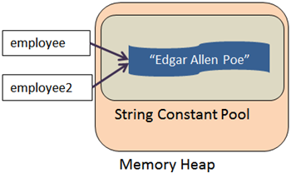
Note:
When we create a string Using literal. JVM checks “String Constant Pool”. If string already exists in the pools then it's reference returned otherwise new instance is created in pool.

Slide 7
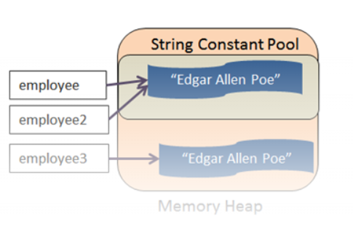
Note:
When we create a string Using new Keyword. Java will act a little differently. Instead of re-using the same literal again, it will create a new value in memory. In this case, it does not create it in the string constant pool, but in the memory heap.

Slide 8
Methods
Although strings created using the string class are immutable, There are several utility string methods that can be used to alter strings are,
split(): split strings at a specified point, such as white spaces.
toLowerCase(): make the string lowercase.
toUpperCase(): make the string uppercase.
length(): give the string length.
equals(): compares the two given strings based on the content of the string. If any character is not matched, it returns false. If all characters are matched, it returns true.

Slide 9
Note:
Since String is immutable in Java, whenever we do String manipulation like concatenation, substring, etc.
it generates a new String and discards the older String for garbage collection. These are heavy operations and generate a lot of garbage in heap.
So Java has provided StringBuffer and StringBuilder classes that should be used for String manipulation.
StringBuffer and StringBuilder are mutable objects in Java.

Slide 10
StringBuffer Class
StringBuffer is a peer class of String that provides much of the functionality of strings.
It's same as the String Class except it is mutable.
It's thread-safe & synchronized.
It’s thread safe because multiple threads cannot access it simultaneously.
It’s more secure.
It’s slower than StringBuilder.
Syntax: StringBuffer s = new StringBuffer("GeeksforGeeks");

Slide 11
StringBuilder Class
StringBuilder is used to create mutable string, same as StringBuffer except it is non-synchronized.
StringBuilder is not thread safe. It means two threads can call the methods of StringBuilder simultaneously.
StringBuilder is more efficient than StringBuffer.
StringBuffer is thread-safe and synchronized whereas StringBuilder is not. That’s why StringBuilder is faster than StringBuffer.
Syntax: StringBuilder str = new StringBuilder();

Slide 12
Concat() method:
String has conat() method, and String is immutable.
It adds a string to another string.
It will create the new object after concatenation done, since it is immutable.

Slide 13
append() method:
StringBuilder and StringBuffer has append method, and these two are mutable.
It appends a char or char sequence to a string.
It will not create a new object, since it is mutable one.

Slide 14
THANK YOU

