Slide 1
Data Driven Actuator Selection
APL-405 Term Project
Mentor: Saswath Ghosh

Slide 2
Work Division
Aryan - 2020CS50475
Paper Implementation - SVM
Atharv - 2020CS10328
Sparse Data Handling
Hetal - 2019CE10247
Neural Network Classifier - {Generative Model for sparse data; if time permits}
Tushar - 2020CS10400
Documentation
Yogya - 2020EE10570
One v All classifier using regression

Slide 3
Problem Statement
Sparse Data based Classification using SVM
Data: Actuators {labels} suitable for certain working loads and parameters {features}
Use a classifier to find the best class of Actuators to use in the given work environment
10 SVMs have been used for 1v1 classification in A tutorial on support vector regression by ALEX J. SMOLA and BERNHARD SCHOLKOPF

Slide 4
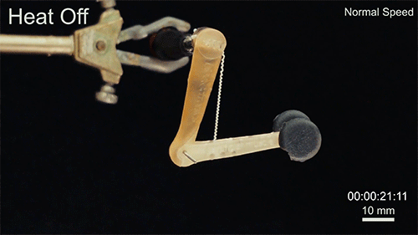
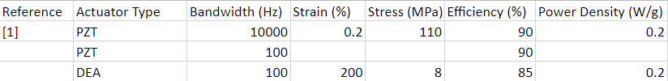
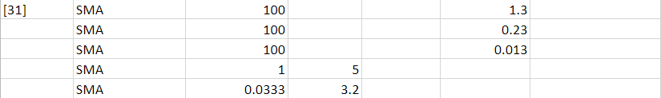
Sparse Data: Problem at hand
Actuators: PZT, DEA, IPMC (ionic polymer metal composites), SMA, SFA, SCP, and EAP (electroactive polymers other than DEAs and IPMCs).
Analogy
Artificial muscle Actuator : Robots
Biological Muscles : Animals

Slide 5
Sparse Data: Problem at hand
The performance of artificial muscles depends majorly on :
Strain
Stress
Bandwidth
Efficiency
Power Density

Slide 6

Sparse Data: Problem at hand
As no centralized database of multiple muscle actuator parameters currently exists, we have this data with a lot of missing points

Slide 7
Sparse Data: What can we do ?
Deletion method :
Removing rows with too many missing column values.
Removing columns with too many missing values : Some features may simply be low quality and have null rates which are too high to build models with them, and simply won’t affect our selection of actuators.
Other more complex solution can be to try to fill the missing data :
For each column, we can replace missing values with either a constant value or some column statistic on the available feature values (e.g. the mean or median).
Regression imputation. A more complex method of imputing data involves building a predictive model that can infer the values of missing data.

Slide 8

SVM classifier: Architecture
The bivariate model with the highest amount of data is the one with Stress and Strain as input.
Log normalisation
Finds a hyperplane with the maximum margin.
Classifies data to either side.
Recommended kernel - RBF

Slide 9
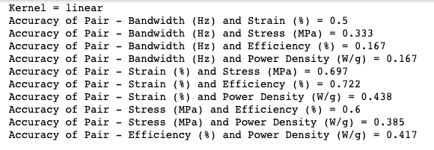
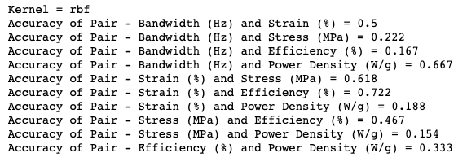
SVM classifier: Result

Slide 10
SVM classifier: Improvements
Confidence score used to remove ties, need to implement.
The confidence score is used to choose among several actuator muscle options for their needs while knowing the relative chances of success given their application constraints. It is also used to break ties when some classes get equal votes.
To calculate the final result, either the confidence score is used or the probabilistic estimation formulated by pairwise coupling. The research paper results showed that using confidence score gives a better accuracy.

Slide 11
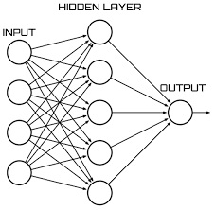
NN classifier: Architecture
Using 1 hidden layer neural network with 25 hidden nodes [Sequential].
Activation: Relu
Optimizer: Adam
Loss: Sparse Categorical Cross Entropy {for indexed labels [1,2,3,4..,9]}
Shape: [5, 25, 9]
Using: Tf.keras

Slide 12
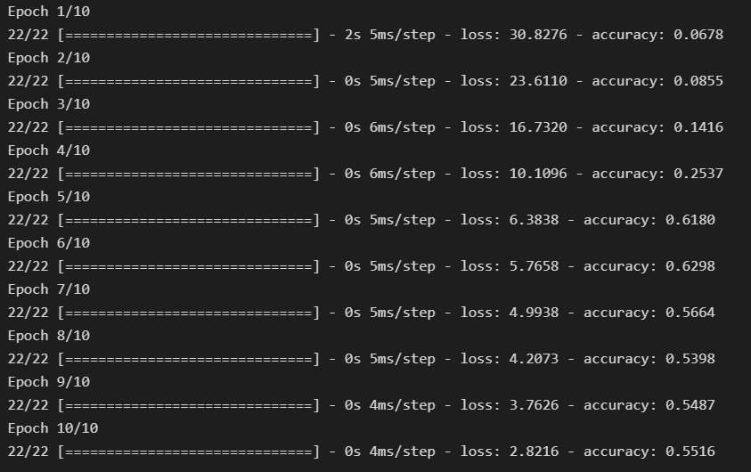
NN classifier: Result
Current: 57 % accuracy [for all classes data; NaN set to Zero]

Slide 13
NN classifier: Improvements
> Use Generative Adversarial Network for Data Generation
> Exhaustively compare different NN architectures.
> Implement 2-feature NN

Slide 14
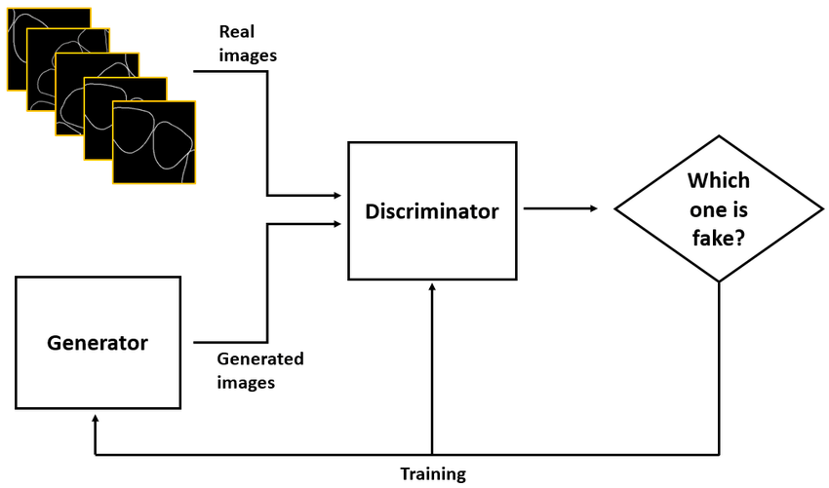
To do:
> Deal with sparse data set. Generative Model?
> Comparison between various NN Classifier Architectures, 1vAll and SVM.
> GANN for Images [to be modified for multivariate classification]

Slide 15
Questions

Slide 16
Thank You

