Slide 1
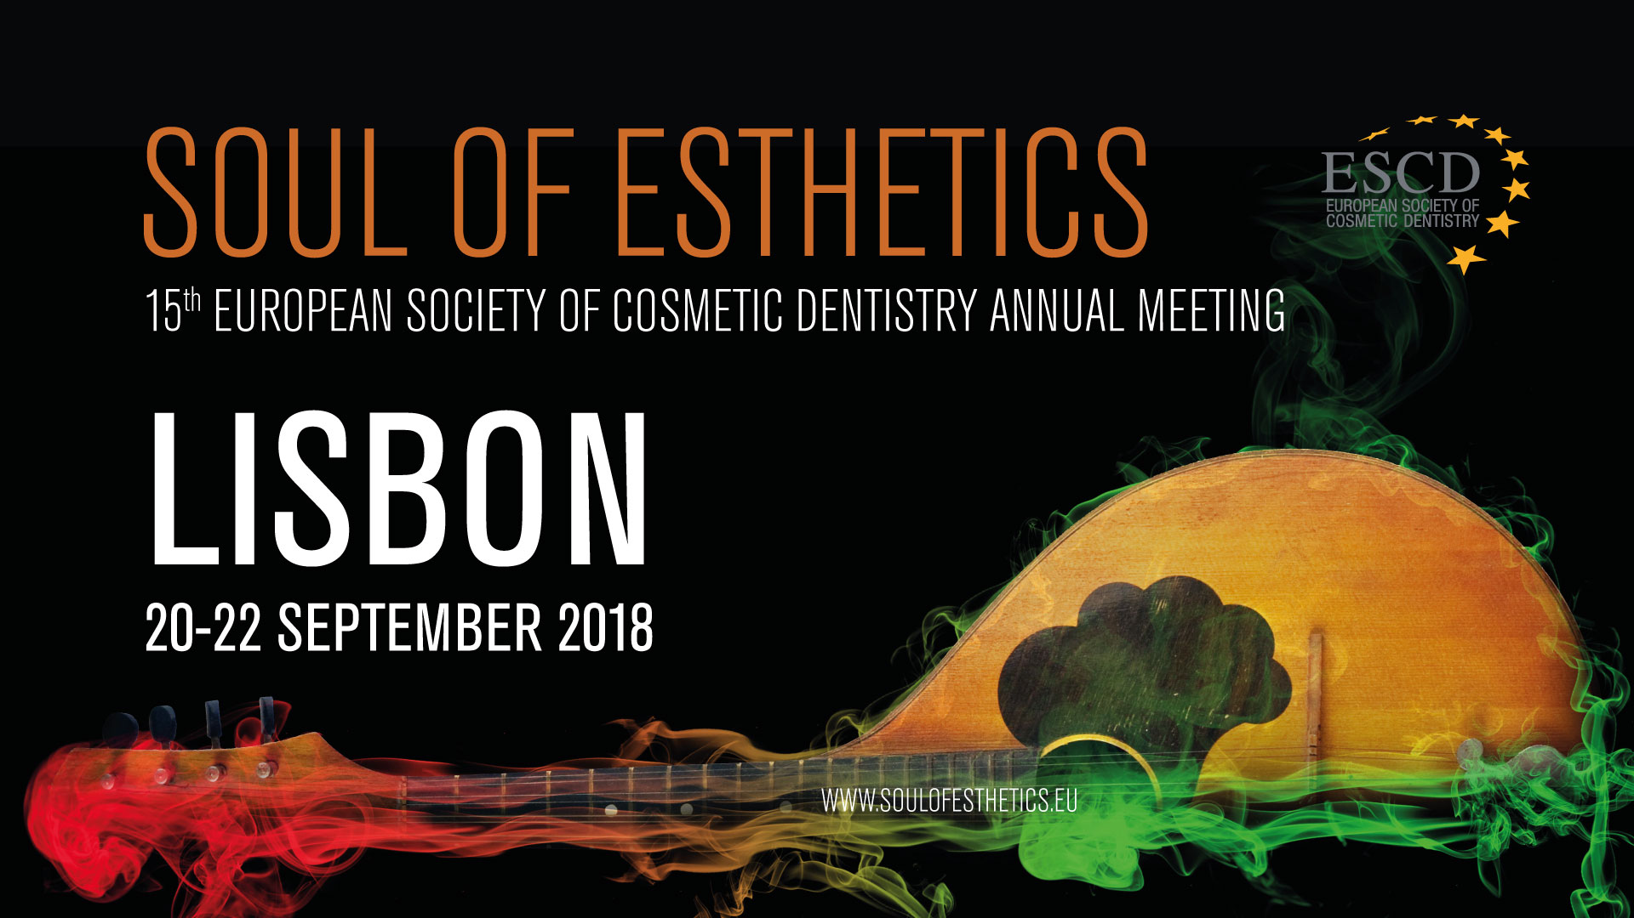

Slide 2
Thursday September 20st | Auditorium I Conferences | Auditorium II Conferences | Hall 2 Hands-on Session | Hall 3 Hands-on Session
14.00 | Official Congress Opening | Official Congress Opening
14.00-16.00 | Prof. Dr. Marius Steigmann Treatment Options for the aesthetic zone Session Chairpersons : Dr. Wolfgang Richter & Dr. Luca Dalloca | 14.00 - 15.00 Dr. Gaetano Paolone Translucency as the key factor in esthetic outcome in direct anterior and posterior restorations. Session Chairpersons : Dr. Seppo Lindroos & Dr. Daniel Baketic
 |  | 15.00 - 16.00 Prof. Dr. Rade Paravina New Color Matching Curriculum for Dental Professionals and Students – An Overview Session Chairpersons : Dr. Seppo Lindroos & Dr. Daniel Baketic
16.00-16.30 | Coffee break
16.30-17.30 | Dr. Pablo Santoro Posterior Resins – Present, Past and Future Session Chairpersons : Dr. Luca Dalloca & Dr. Karl Schwaninger | Dr. Raquel Zita The foundation of aesthetic in implant dentistry: from Red to White Session Chairpersons : Prof. Dr. Wolfgang Richter & Dr. Maria Csillag | ESCD Certification Session Chairpersons : Dr. Verena Nizic, Dr. Mauro Bazzoli, Dr. Igor Ristic, Dr. Attilio Muscio, Dr. Gregory Brambila & DT Przemek Seweryniak | Dr. Luca Tacchini The direct restorations in the posterior teeth: the secrets to inscrease the quality and reduce the times Session Chairpersons: Dr. Alexandr Kozhemiak
17.30 – 19.00 | Dr. Paulo Monteiro & Dr. Ines Barbosa Aesthetic composite resins: what we have, how to use it and what will the future bring to us Session Chairpersons : Dr. Luca Dalloca & Dr. Karl Schwaninger | 17.30 – 18.30 Dr. Joao Rua Let’s go vertical! Session Chairpersons : Prof. Dr. Wolfgang Richter & Dr. Maria Csillag
 |  | 18.30 - 19.00 Dr. Markus Troeltzsch TBA Session Chairpersons : Prof. Dr. Wolfgang Richter & Dr. Maria Csillag
21.00 | ESCD & FRIENDS @ Level Eight Sky Bar

Slide 3
Friday September 21ST | Auditorium I - Conferences | Auditorium II - Conferences | Hall 2- Hands-on Session | Hall 3- Hands-on Session | Hall 6 - Hands-on Session
09.00-10.00 | Dr. Gianfranco Politano & Dr. Marleen Peumans Indirect bonded partial restorations in the posterior region - new concepts Sessions Chairpersons : Dr. Selim Pamuk & Dr. Kleanthis Manolakis | Dr. Luca Tacchini Strategies for optimizing the workflow in Direct and Indirect Restorations Sessions Chairpersons : Dr. Antonio Olivo & Dr. Bogdan Culic | Dr. Rade Paravina New color matching curriculum for dental professionals and students Session Chairperson : Dr. Teresa Szupiany | Prof. Dr. André Saadoun Soft Tissue Management around Teeth and Implants Session Chairperson : Dr. Gregory Camaleonte
10.00 – 11.00 | Prof. Dr. Rafael Decurcio Cementation of Ceramic Veneers - The Science as the basis of Clinical Decisions Sessions Chairpersons : Dr. Selim Pamuk & Dr. Kleanthis Manolakis | Dr. Jorge Andrea Cardoso Full-arch immediate implants - facially driven planning and prosthetics Sessions Chairpersons : Dr. Antonio Olivo & Dr. Bogdan Culic
11.00-11.30 | Coffee break
11.30-13.00 | Dr. Eric Van Dooren & Dr. Nuno Sousa Dias Team approach in challenging aesthetic compromised cases Sessions Chairpersons : Dr. Selim Pamuk & Dr. Kleanthis Manolakis | Dr. Giuseppe Chiodera Direct posterior restorations from diagnosis to essential lines Sessions Chairpersons : Dr. Antonio Olivo & Dr. Bogdan Culic | Prof. Dr. Liu Feng From Digital guided immediate implant placement tp esthetic chairside restoration Session Chairperson : Dr. Teresa Szupiany | Prof. Dr. André Saadoun Soft Tissue Management around Teeth and Implants Session Chairperson : Dr. Gregory Camaleonte | ESCD Board Meeting
13.00-14.00 | Lunch
14.00 – 15.00 | Dr. Roberto Rossi Esthetic Crown Lengthening - the role of the periodontist in creating a beautiful smile Sessions Chairpersons : Dr. Mauro Bazzoli & Dr. Marco Nicastro | Prof. Dr. Louis Hardan Dental documentation and communication: a new easy way for everyone, every day Sessions Chairpersons : Dr. Verena Nizic & Dr. Igor Ristic | Dr. Paulo Monteiro Simple direct composite restorations in anterior teeth Session Chairperson : Dr. Kamila Azimova | Dr. Walter Renne How to create a pre-surgical provisional restoration from an implant plan Session Chairperson : Dr. Daniel Baketic | HO Dr. Giuseppe Chiodera Essential lines developed by Style Italiano, modern approach for creating aesthetic posterior restoration using 3M Bulk Fill materials Session Chairperson : Dr. Natasa Zepic
15.00 – 16.00 | Dr. Javier Tapia Emulation of teeth ageing with composite resin: challenges and feasibility Sessions Chairpersons : Dr. Mauro Bazzoli & Dr. Marco Nicastro | Dr. Juan Arias Aesthetics procedures in compromise implant situations: The aesthetic zone Sessions Chairpersons : Dr. Verena Nizic & Dr. Igor Ristic
16.00-16.30 | Coffee break
16.30-18.00 | Dr. Jordi Manauta Styleitaliano Tips and tricks. Sessions Chairpersons : Dr. Mauro Bazzoli & Dr. Marco Nicastro | 16.30 - 17.15 Dr. Diana Boangar Ortho-prosthetics interdisciplinarity; from planning to execution Sessions Chairpersons : Dr. Verena Nizic & Dr. Igor Ristic | Dr. Roberto Rossi The art of crown lengthening’ and feature the surgery in the Esthetic zone Session Chairperson : Dr. Kamila Azimova | Dr. Louis Hardan Documenting and communicating with mobile dental photography: all you need to know. Session Chairperson : Dr. Daniel Baketic | ESCD Chairperson Meeting
 |  | 17.15 - 18.00 Dr. Alecsandru Ionescu The Biological Guided Approach for predictable long term esthetic and functional results in implant patients Sessions Chairpersons : Dr. Verena Nizic & Dr. Igor Ristic
18.00-19.00 | Prof. Dr. Liu Feng To establish or to maintain? Strategies for pink esthetics in implants“ Sessions Chairpersons : Dr. Mauro Bazzoli & Dr. Marco Nicastro | Dr. Joao Barbosa Digital Biomimetics: "Nature Copy / Nature Paste" Sessions Chairpersons : Dr. Verena Nizic & Dr. Igor Ristic
21.00 | President Dinner @Pestana Palace Lisbon

Slide 4
Saturday September 22ND | Auditorium I - Conferences | Auditorium II - Conferences | Hall 2 - Hands-on Session | Hall 3 - Hands-on Session
09.00-11.00 | Dr. Mauro Fradeani The prosthetic revolution Session Chairpersons : Dr. Miguel Stanley & Dr. Constantin Varlan | 09.00 - 10.00 Dr. Joao Fonseca This computer has no Brain, use your own Session Chairpersons : Dr. Natasa Zepic & Dr. Sinisa Kovacevic
 |  | 10.00 - 11.00 Jon Gurrea Simplified oral adhesive rehabilitation Session Chairpersons : Dr. Natasa Zepic & Dr. Sinisa Kovacevic
11.00-11.30 | Coffee Break
11.30-13.00 | Dr. Eva Berroeta Erosive patients – how to treat them from the beginning to the end Session Chairpersons : Dr. Miguel Stanley & Dr. Constantin Varlan | 11.30 - 12.15 Dr. Cosmin Dima Sinus lifting – everything from the detailed anatomy to very complex clinical cases Session Chairpersons : Dr. Natasa Zepic & Dr. Sinisa Kovacevic |  | ESCD General Assembly
 |  | 12.15 - 13.00 Prof. Dr. Andre Saadoun Partial extraction therapy and immediate / delayed implant Session Chairpersons : Dr. Natasa Zepic & Dr. Sinisa Kovacevic
13.00 14.00 | Lunch Break
14.00–15.00 | Dr. Miguel Stanley The Digital Smile Make over Session Chairpersons : Dr. Igor Ristic & Dr. Joao Pimenta | Dr. Dan Herschbach My digital reality – how technology changes the way we practice Session Chairpersons : DT Alessandro Arnone & Dr. Gregory Brambilla | Dr. Javier Tapia Guadix Live Demo Essentia: the smart simplification of direct composite restorations Session Chairperson: Dr. Alexandr Kozhemiak | ESCD Member Pearls
15.00–16.00 | Dr. Maciej Zarow The restoration of root canal treated anterior teeth – ABC for the clinical practice Session Chairpersons : Dr. Igor Ristic & Dr. Joao Pimenta | Dr. Walter Renne Pre-surgical provisional prosthetics in the esthetic zone Session Chairpersons : DT Alessandro Arnone & Dr. Gregory Brambilla
16.00 – 16.30 | Coffee Break
16.30-18.00 | Prof. Dr. Nitzan Bichacho Dr. Mirela Feraru Managing the perio-restorative interface of different abutment types in the smile zone – Concepts and strategies. Session Chairpersons : Dr. Igor Ristic & Dr. Joao Pimenta | 16.30 – 17.30 DT Sascha Hein “eLAB®” - A new dawn in shade matching! Session Chairpersons : DT Alessandro Arnone & Dr. Gregory Brambilla | 16.30 - 18.30 3M Modern Cementation techniques choosing an appropiate cement for indirect dental restorations, from self-etching cements to adhesive cementation Session Chairperson: Dr. Alexandr Kozhemiak
 |  | 17.30 – 18.00 DT Pedro Brito TBA Session Chairpersons : DT Alessandro Arnone & Dr. Gregory Brambilla
18.00–19.00 |  | DT Giuseppe Romeo Technical Diagnostic and Esthetical Approach Session Chairpersons : DT Alessandro Arnone & Dr. Gregory Brambilla
19.00 | Congress Closing Ceremony

