Slide 1

MODE
Hour ++
MODE
Hour --
Hour Data
MSPM0
Minute ++
ESP8266
Minute --
Minute Data
Second Data
Second ++
Second --
MQTT Broker
to
TM4C

Slide 2

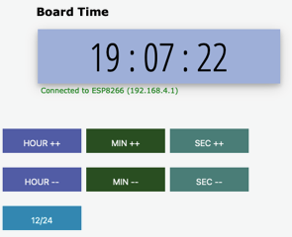

ESP8266
WSS
MSPM0
P2P
Sensors
Actuators
Smart Object

Slide 3
Router
MAIN
CONTROL
LOOP
UART0
SysTick
DRIVER
USB
Debug
Port
Timer
HW
WIFI
CONTROL
LCD
ROUTINES
ESP8266
WiFi
UART1
FIFO
LCD
DISPLAY
P2P

Slide 4
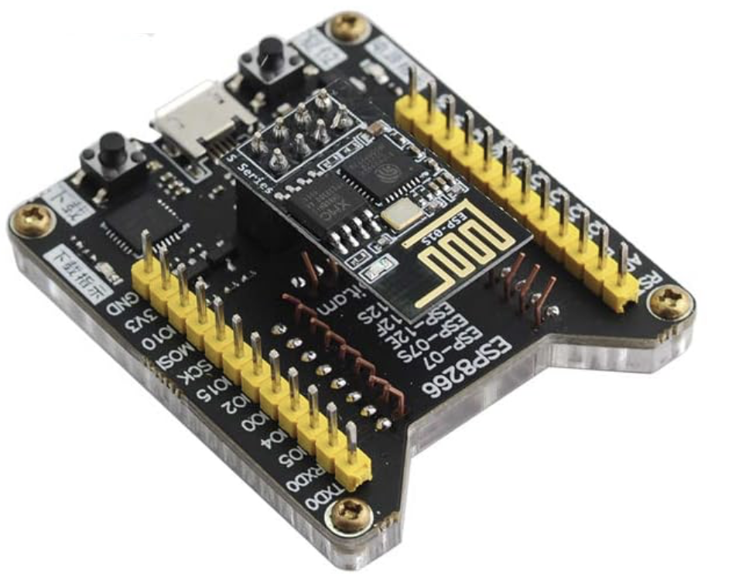

Slide 5
MSPMO
ESP8266
WS Server
HTML/WS
Client
Request Connect
Connection Granted
Update Display on Screen
Send CSV packet: MODE, Hour, Minutes, Seconds
1 Second
Send CSV packet: MODE, Hour, Minutes, Seconds
Update Display on Screen
Send CSV packet: MODE, Hour, Minutes, Seconds
1 Second
Update Display on Screen
Send CSV packet: MODE, Hour, Minutes, Seconds
1 Second
Update Display on Screen
Send Command: Minute+
Update Time Values
Asynchronous
Keystrokes
Send CSV packet: MODE, Hour, Minutes, Seconds
Send Command: Second+
Update Time Values
Send CSV packet: MODE, Hour, Minutes, Seconds
Asynchronous
Keystrokes
Send Command: Second-
Send Command: Second-
Update Time Values

