Slide 1

Power BI Admin Report (Rest API)
This document outlines the process of creating an admin report for Power BI using the Rest API. This report will extract key information from your Power BI service account and store it in a CSV file.
Information we can extract:-
How many workspaces available in Power Bi service?
How many datasets are available in Power BI service workspace?
How many report are present in Power BI service workspace?
How many times dataset refreshed in Power BI service workspace?
by Tanaji Sulagave

Slide 2
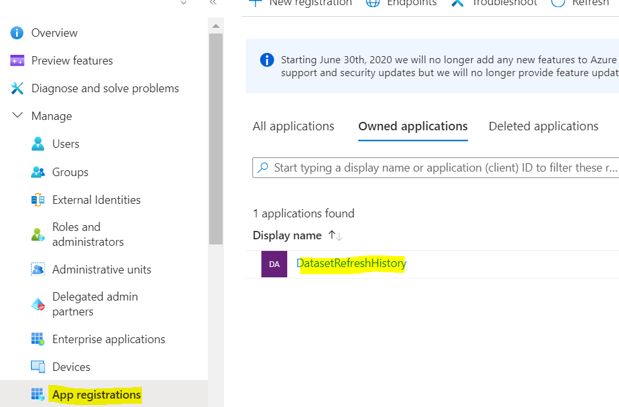
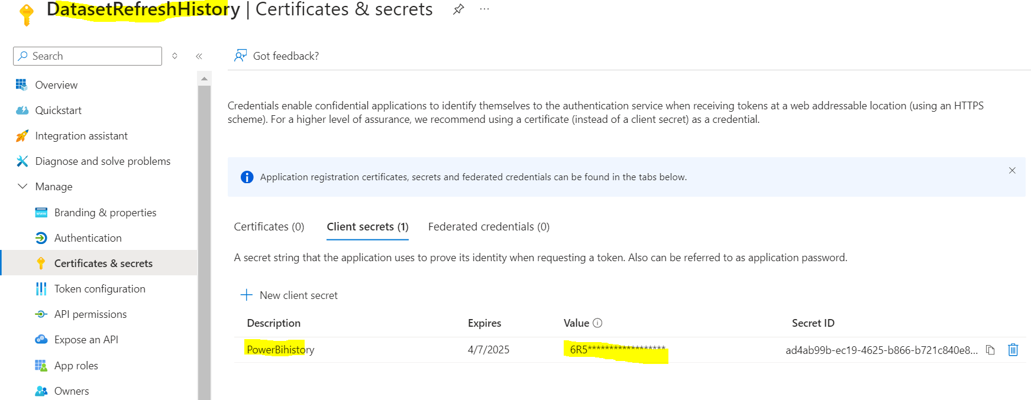
Creating a Service Principle
The first step is to create a service principle (app registration) in the Azure portal. This service principle will act as the identity for accessing your Power BI service account.
Steps we need to follow on Azure portal
1
App Registration
Create an app registration in the Azure portal, giving it a descriptive name like "DatasetRefreshHistory".
2
Secret Key
Generate a secret key for the app. This key is only visible once during registration, so make sure to record it securely.

Slide 3
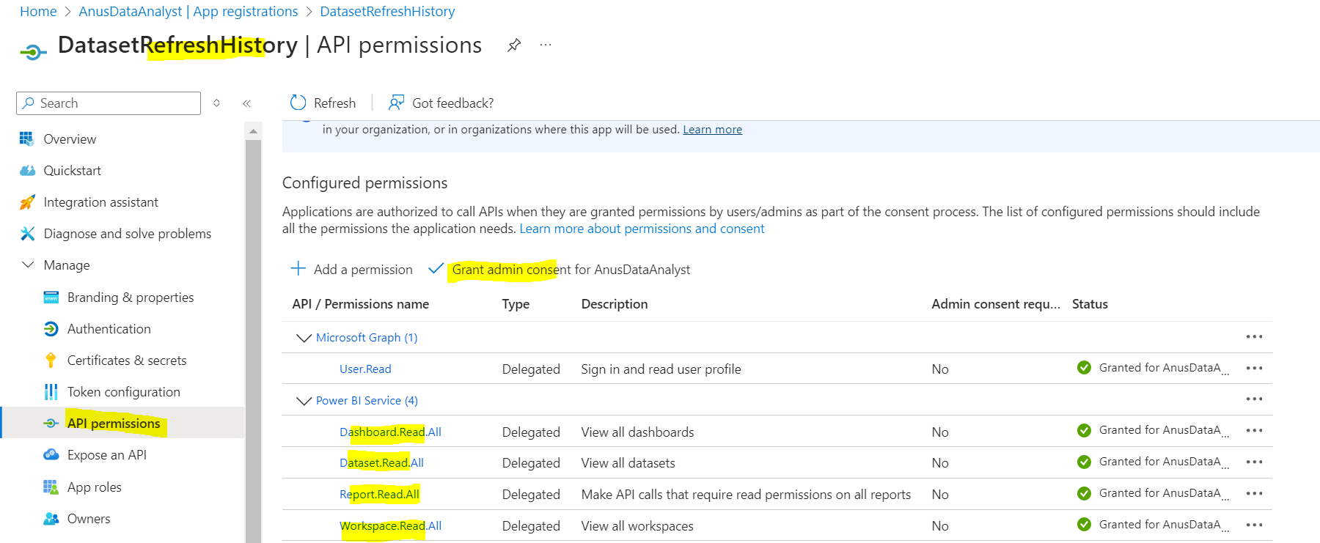
3
API Permissions
Grant the app necessary permissions to access Power BI data. This includes permissions like Dashboard.Read.All, Dataset.Read.All, Report.Read.All, and Workspace.Read.All.
Now we have Tenantid, AppId and secret key which required to login in power bi service account into powershell cmd.

Slide 4
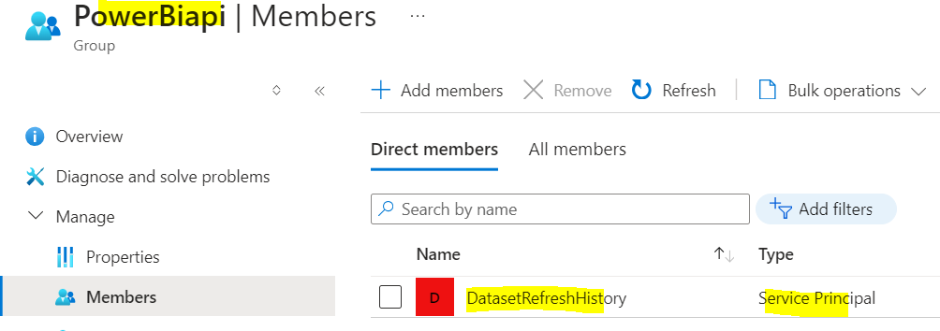
Security Group Creation on Azure portal
Once you have created the service principle and granted it permissions, We need to add this service principle in security group as a member.
Steps we need to follow on Azure portal
1
Security Group
Create Security group in Azure Entra ID and add that member as
service principle as shown in snap.
2
Add Service Principle
Add the service principle you created (e.g., DatasetRefreshHistory) as a member of the "PowerBiapi" security group.

Slide 5
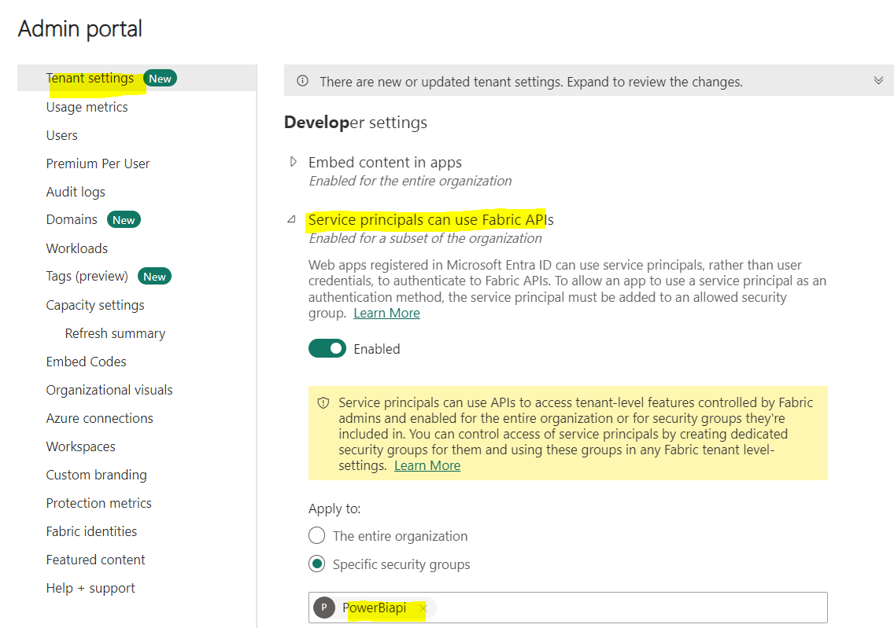
Power BI Service Account Access (Admin Portal)
Once you have created the service principle and granted it permissions, you need to configure your Power BI service account to allow access.
1
Enable Service Principle under Power BI
service Admin section
Navigate to the Admin Portal in your Power BI service account and enable “”Service Principal can use Fabric APIs" under Developer Settings.
Enable toggle button and specific security groups option and, we need to add security group in this textbox (example:- PowerBiapi )

Slide 6
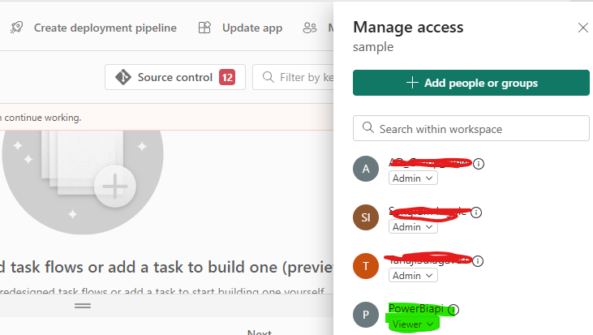
Power BI Workspace Access
To access the specific workspace where you want to extract information, you need to grant the "PowerBiapi" security group access.
1
Manage Access
Open the workspace you want to access and go to the "Manage Access" section.
2
Add Security Group
Add the "PowerBiapi" security group to the workspace's access roles, ensuring it has the necessary permissions to read data.

Slide 7
Extracting Workspace Information
The script begins by connecting to your Power BI service account using the service principal credentials. It then retrieves information about workspaces, datasets, reports, and refresh history.
Workspaces
Datasets
Reports
The script retrieves information about all workspaces in your Power BI service account, including their ID, name, type, state, read-only status, orphaned status, and capacity ID.
For each workspace, the script retrieves information about datasets, including their ID, name, author, refreshable status, and whether an on-premises gateway is required.
The script retrieves information about reports within each workspace, including their ID, name, web URL, and associated dataset ID.

Slide 8
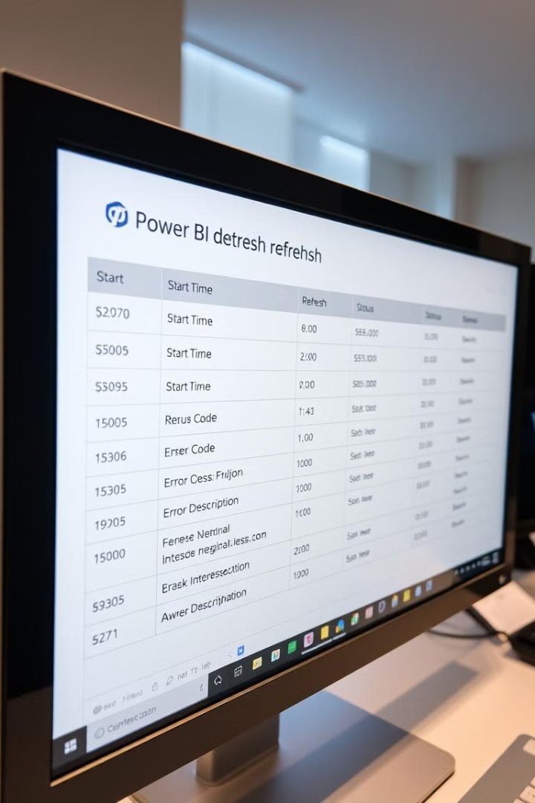
Refresh History
The script retrieves refresh history for each dataset, providing details about each refresh event.
startTime | endTime | refreshType | status | errorCode | Error Description

Slide 9

Exporting Data
The script exports the extracted information into CSV files, organized by category. These files can be used for further analysis and reporting.
1
Workspaces
The script exports workspace information to a CSV file named "workspaces.csv".
2
Datasets
The script exports dataset information to a CSV file named "datasets.csv".
3
Reports
The script exports report information to a CSV file named "reports.csv".
4
Refresh History
The script exports refresh history information to a CSV file named "refresh.csv".

Slide 10
PowerShell Script
The following PowerShell script will extract and save the desired Power BI service details into a specific folder. Make sure to install the necessary modules before running the script.
1
Install module and login
Power BI service account
Extract data for Power BI
workspace in Csv format
2
#Install-Module -Name MicrosoftPowerBIMgmt
#Install-Module -Name MicrosoftPowerBIMgmt.Workspaces
$Tenantid = "**************************"
$AppId = "******************************"
$secret = "****************************" # secrete key value
$Password = ConvertTo-SecureString $secret -Force -AsPlainText
$Creds = New-Object Management.Automation.PSCredential ($AppId, $Password)
Connect-PowerBIServiceAccount -ServicePrincipal -Tenant $Tenantid -Credential $Creds
$headers = Get-PowerBIAccessToken
$logbase = "E:\Powershell_PBI\"
Write-Host "******* Exporting Workspaces *****"
$Workspaces = Get-PowerBIWorkspace
# export workspaces
$logpath = $logbase + "workspaces.csv"
$Workspaces | select Id, Name, Type, State, IsReadOnly, IsOrphaned, CapacityId | Export-Csv -Path $logpath –NoTypeInformation

Slide 11
Extract data for Power BI
Datasets details in Csv format
Extract data for Power BI
Reports details in Csv format
3
4
#################################
# Reports #
#################################
# same as dashboards and datasets - loop over each workspace and list the reports in it.
Write-Host "******* Exporting Reports *****"
$logpath = $logbase + "reports.csv"
$Reports =
ForEach ($workspace in $Workspaces)
{
Write-Host "Writing reports...on workspace: " $workspace.Name
ForEach ($report in (Get-PowerBIReport -WorkspaceId $workspace.Id))
{
[pscustomobject]@{
WorkspaceID = $workspace.Id
WorkspaceName = $workspace.Name
ReportID = $report.Id
ReportName = $report.Name
ReportURL = $report.WebUrl
ReportDatasetID = $report.DatasetId
}
}
}
$Reports | Export-Csv -Path $logpath -NoTypeInformation
#################################
# Datasets #
#################################
Write-Host "******* Exporting Datasets ******"
$logpath = $logbase + "datasets.csv"
$Datasets =
ForEach ($workspace in $Workspaces)
{
ForEach ($dataset in (Get-PowerBIDataset -WorkspaceId $workspace.Id))
{
[pscustomobject]@{
WorkspaceID = $workspace.Id
WorkspaceName = $workspace.Name
DatasetID = $dataset.Id
DatasetName = $dataset.Name
DatasetAuthor = $dataset.ConfiguredBy
IsRefreshable = $dataset.IsRefreshable
IsOnPremGatewayRequired = $dataset.IsOnPremGatewayRequired
}
}
}
$Datasets | Export-Csv -Path $logpath -NoTypeInformation

Slide 12
5
Extract data for Power BI Dataset refresh history details in Csv format
#################################
# Dataset Refresh history #
#################################
# Loop over all datasets to get the associated datasources
# Scott ToDo - add try/catch blocks. Some datasources blow up with error "ConvertFrom-Json : Cannot bind argument to parameter 'InputObject' because it is null."
# I believe this is because it is an invalid data source - for example reading text file that doesn't exist, etc.
Write-Host "******* Exporting Refresh *****"
$logpath = $logbase + "refresh.csv"
$Refresh =
ForEach ($dataset in $Datasets)
{
$url = "groups/" + $dataset.WorkspaceID + "/datasets/" + $dataset.DatasetID + "/refreshes"
$Ref = (ConvertFrom-Json (Invoke-PowerBIRestMethod -Url $url -Method Get)).value
ForEach($refresh in $Ref)
{
$errorDetails = $refresh.serviceExceptionJson | ConvertFrom-Json -ErrorAction SilentlyContinue
[pscustomobject]@{
WorkspaceID = $dataset.WorkspaceID
WorkspaceName = $dataset.WorkspaceName
DatasetID = $dataset.DatasetID
DatasetName = $dataset.DatasetName
startTime = $refresh.startTime
endTime = $refresh.endTime
refreshType = $refresh.refreshType
status = $refresh.status
errorCode = $errorDetails.errorCode
errorDescription = $errorDetails.errorDescription
#DataSourceConnection = $datasource.connectionDetails
#DataSourceGatewayID = $datasource.gatewayId
}
}
}
$Refresh | Export-Csv -Path $logpath -NoTypeInformation
Write-Host "Script complete:" (Get-Date).ToString('MM/dd/yyyy hh:mm:ss tt')

