Slide 1
JavaScript
Or Ecmascript, Jscript, JS, Etc...

Slide 2
The Browser Wars
A History of the way you look at the web

Slide 3
The Internet
Pretty cool
Designed by the US DoD in the 1960s to share military research
Coopted by universities to share research data
Eventually used to share cat videos and dank memes

Slide 4
The Internet
Pretty cool
Designed by the US DoD in the 1960s to share military research
Coopted by universities to share research data
Eventually used to share cat videos and dank memes
But the Internet is not the Web

Slide 5
WorldWideWeb (or Nexus)
Developed by Tim Berners-Lee in 1990 at CERN
Better way of sharing interconnected research articles using hyperlinks
Built specifically for the NextStep OS, and originally was both a web editor and viewer.
On porting to other devices, this capability was quickly lost

Slide 6
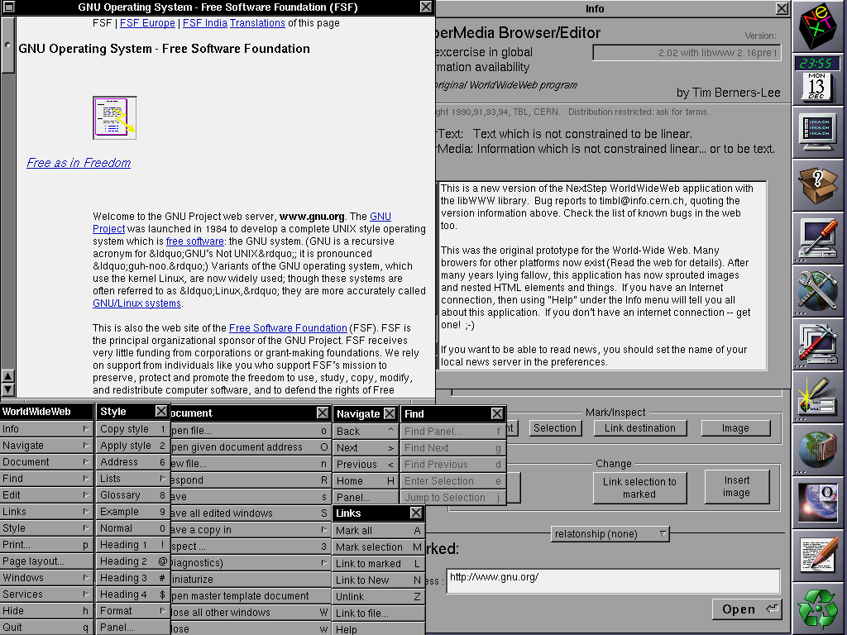

Slide 7
Mosaic
Developed in 1993 by Marc Andreesson for the National Center for Supercomputing Applications
WWW only supported NextStep, what about Xorg?
Bundled HTTP with FTP and USENET
Also cross platform!
The first real browser.

Slide 8
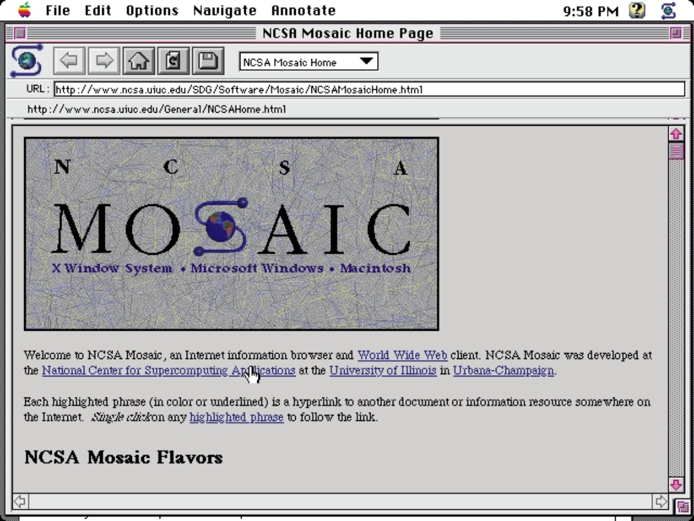

Slide 9
The Browser Wars Begin
Marc Andreesson left the NCSA and made a commercial version of Mosaic
The NCSA’s parent body, the University of Illinois, were not happy with the use of Mosaic’s name.
So Marc Andreesson decided to rename it Mozilla.
This became Netscape Navigator.
At around the same time, Microsoft decides it needs a browser, and develops Internet Explorer
To out-compete it’s competition, Netscape creates a language based on a hybrid of Java and Scheme, called “JavaScript”, IE steals this and calls it “JScript” to avoid Sun asking for royalties.
Due to the popularity of this technology, IE and NN dominate the market.

Slide 10
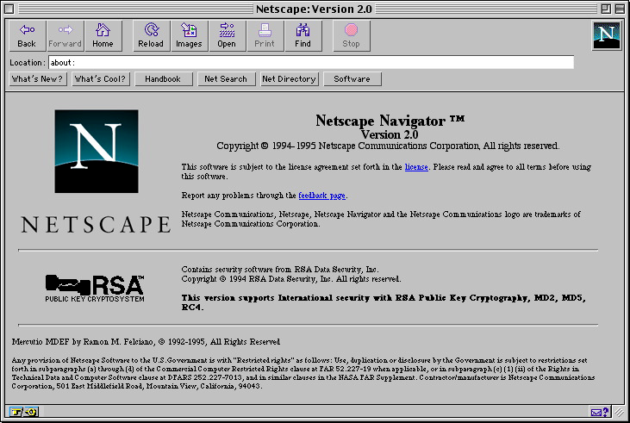
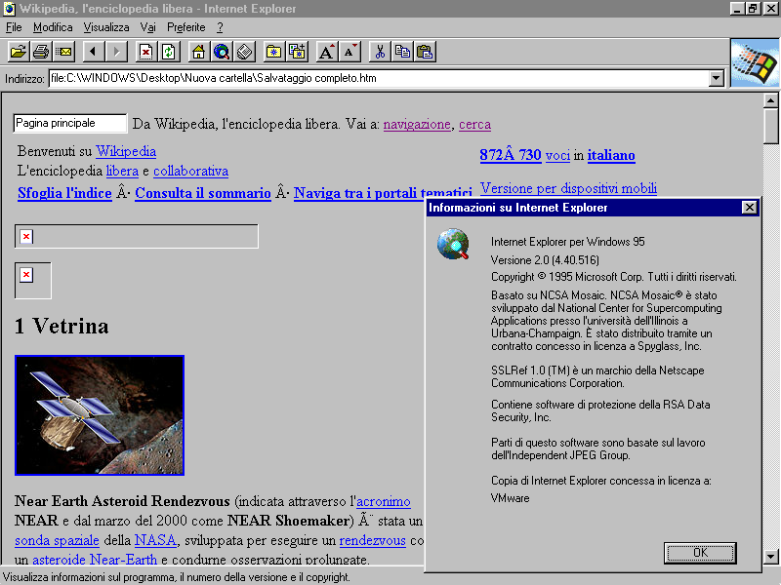

Slide 11
IE5 and the death of Netscape
1998, the darkest year of Microsoft’s existence, and the darkest days of the net as a whole.
Microsoft installs IE by default on all new installs of Win98, their brand new OS.
Microsoft also deploys changes to JScript that eclipse Netscape’s JavaScript capability, and integrate this functionality into the OS itself.
Now replacing IE will break windows.
Netscape never recovers, goes bankrupt, spins out the Mozilla Foundation as a NFP, and is then acquired by AOL.
Microsoft is very nearly split in two due to a massive antitrust lawsuit, the results of which have ramifications for tech to this day.

Slide 12
Browser Wars II : Electric Boogaloo
For around 5 years, JScript was completely stagnant due to Microsoft’s complacency at the top.
Then, in 2004, Mozilla Firefox arrives, and completely changes the game.
Due to it’s open source nature, new JavaScript frameworks are developed.
This successfully out competes IE at it’s own game, and very soon nobody is using IE anymore.
This leads to the entrance of new competitors Opera and Safari, which quickly destroy IE’s strategy by agreeing to Mozilla’s offer to create a joint framework for how the web should work.

Slide 13
A New Contender Emerges
Then, Google Chrome appears.
Google achieves market dominance with quick update schedules and rapid feature development, as well as making the browser itself radically extensible via a new dialect of JavaScript.
Google then moves to extinguish it’s competition much in the same way Microsoft did by enforcing which libraries must be supported natively by the browser unilaterally.
So now we’re right back to the start again with one browser dominating the world.

Slide 14
ECMAScript
And its many dialects

Slide 15
Whatmascript?
ECMA International, the standards body that runs the standard for ECMAscript!
People like to believe JavaScript is a dialect of ECMAScript, which is true…. But JavaScript predates ECMAScript…. So ECMAScript is a superset of JavaScript
Encompasses JavaScript, JScript, ActionScript, Node.js….
There are a lot of sublanguages.
But when talking about JavaScript qualities, ECMAScript is the correct name.

Slide 16
ECMAScript: Features
Weakly typed language
Interpreted (in the browser)
Inherently object oriented, everything is an object
Dependant on the Document Object by default
Has exception handling (sometimes)
Is inherently polymorphic (like Scheme)
No implementation of ECMAScript works exactly like it.

Slide 17
ECMAScript: Datatypes
There are 3:
Objects
Strings
Non-Strings
Every implementation plays fast and loose with this concept. Generally there are:
Objects
Strings
Arrays (which may or may not be specialised strings)
Numbers
Characters

Slide 18
ECMAScript: Polymorphism
As ECMAScript was based initially on Scheme, part of the concept that carried over was the ability to change the program on demand.
This is because the script is inherently part of the document, and edits the document.
So the script can easily edit itself.
Can dynamically execute strings as ECMAScript using the “eval” keyword.
Initially used fairly sparingly, AJAX completely changed that.

Slide 19
ECMAScript: Objects
ECMAScript uses Parasitic Object Orientation.

Slide 20
ECMAScript: Objects
ECMAScript uses Parasitic Object Orientation.
PARASITIC

Slide 21
ECMAScript: Objects
ECMAScript uses Parasitic Object Orientation.
PARASITIC
OBJECT

Slide 22
ECMAScript: Objects
ECMAScript uses Parasitic Object Orientation.
PARASITIC
OBJECT
ORIENTATION

Slide 23
ECMAScript: Objects
Objects are completely dynamic
Are actually function scopes that have been detached and now float about.
Can have features added to and subtracted from dynamically
Can do this per object
OBJECTS DON’T HAVE TO HAVE THE SAME STUFF IN THEM!

Slide 24
ECMAScript: Inheritance
ECMAScript uses Prototyping for Classes.
There is no class, there are prototype functions.
Instead of being a banana object, you are a clone of the first banana.
Inheritance is therefore parasitic.
Objects are dynamically reformed to become similar to the other object they are “inheriting” from.
This is the worst form of OO enablement.

Slide 25
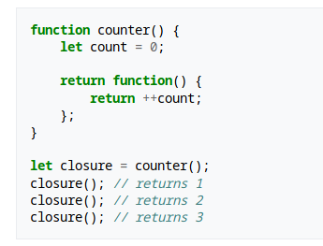
ECMAScript: Structure
ECMAScript uses a pseudodynamic chain based on Lexical Scope.
This combines concepts of both the static chain and the dynamic chain.
So long as a thing maintains reference to a thing, it will always exist. Even if that reference is not clear.
Example:

Slide 26
ECMAScript: Structure
Does contain some control structures, for example:
Do loops
While loops
If statements
Switch statements
Contains three kinds of declaratives:
Var, for dynamic scoping
Let, for block scoping
Const, for block scoping that should remain constant.

Slide 27
Why So Scopey?
ECMAScript is actually a functional language.

Slide 28


Slide 29
Why So Scopey?
ECMAScript is actually a functional language.
Functions are first class entities, variables are sort of an afterthought, they’re supposed to be references to the Document Object.
This means that basically all JavaScript code is a violation of the original ECMAScript concept.
This also explains the weird scope problems, it’s not intended to be used in the way it is.
Should be written in more of a Scheme like way, with heavy reliance on Lambdas and recursion.

Slide 30
Scope Creep to the power of ∞
AJAX was developed during the original release of Firefox.
Allows JavaScript to self modify with the assistance of web servers.
Entire applications can now be single web pages.
But… AJAX is not part of the EMACScript spec? What is it?
It is (usually) a library, a creative use of self-modifying and self-executing code.

Slide 31
Libraries into Infinity
Lovecraftscript

Slide 32
Libraries
Are generally good.
Allow extensibility to the language
Still follow the general undercurrent of the language
Someone who had not seen the library before could figure out (roughly) what was going on.

Slide 33
JavaScript Libraries
JavaScript can modify itself.
So, libraries can redefine the language itself.
This means that depending on the libraries you have loaded, you may or may not be able to actually do what you think you can do.
This can go even further into allowing JavaScript to self compile into other forms of JavaScript.
The simplest use of this is to use JavaScript to interpret other languages.

Slide 34
Transpilers
As a result of the hugely variable nature of JavaScript due to both browser implementation and library functionality, it’s actually popular now to write in a completely different language, and then transpile it to JavaScript.
This is hugely problematic (automatic coders were tried once! Not great!) as programmers start to lose touch with what is actually going on in code.
Results in effectively unmaintainable code with strange heisenbugs and essentially black box systems.
These systems still send their source code to those wanting to use them!
Inverts the preservation of information principle!
Massive security problem!

Slide 35
Google and the End of Good Programming.
Microsoft is one of the worst abusers of the EMACScript specification.
However, Google is worse.
Has unilaterally decided which libraries are implemented in V8, the Google Chrome web engine.
This fundamentally changes how JavaScript works, as others need to implement it in their native engines or the browser won’t be “as snappy”.
Implements disturbing extensions to JavaScript such as hardware execution (when it’s designed primarily for a document).
Imagine running LaTeX on your GPU. Not exactly good.

Slide 36
And the worst bit?
This is the language most people learn first.
A language of terrible irregularities, quirks, unstable implementations, fundamentally broken scoping, that is used incorrectly, and outside it’s scope.
People think they can code. People think they understand programming. They go on to implement their own vague understanding of what is going on in new programs.
Then you have to comprehend and fix it.
This is even worse than PL1. It’s a metastatic programming cancer.
And yet, this is the future for the time being.

Slide 37
To Recap
JavaScript/Jscript/ECMAScript
Functional? OO? Procedural? Language?
Contains both Javalike and Schemelike concepts
Is highly extensible to a fault.
Works basically everywhere
Violates…. Basically every programming principle.
Is still the most popular language, and is the first language most people encounter.

Slide 38
Did I mention it didn’t follow it’s own rules?
Javascript doesn’t make intuitive sense due to it’s many issues.
Let’s watch a video!

