Slide 1
NLP for Neuroscience and Biobehavioral
Health Applications

Slide 2
Our Goals / Structure
Evaluating corpora
What data and meta-data will I need for inference?
Sources of bias in corpora
Importing/reading data
Gutenberg, Text files, Metadata
Character encoding,
Wrangling/cleaning data
Tidy format (split, unlist)
Text cleaning (regex, stopwords, lemmatization)

Slide 3
Goals / Structure for the Class
4. Measurement / description / insights
Corpus analytics
keyword frequency
Appending norms to each word (database joins)
Summarizing and visualizing trends

Slide 4
Reminders!
Use best practices for your filenames and file organization
Reilly_NLPCheatsheet
Store utilities in a utilities folder, data in a data folder
Add <br> for breaks in markdown
Mark your headers and TOC levels in markdown
Organize your cheatsheets logically
Check color contrast in your css
Check links/URLS in homework and documents
How to share HTML files from Github
Recommend install Giithub Desktpp

Slide 5
Reminders!
Distribute data as *.rda from public github or OSF repositories
Helps with collaboration
Don’t store your text files in *.xlsx format
Csv is ok, txt is ok

Slide 6
Reminders!
Don’t confuse/conflate speech and language
Speech is an oral communication modality linked to articulation and motor control (e.g., voice, prosody)
Get into the habit(s) of:
Annotating your code!
Being intentional about your file structure and naming conventions
cloud drive not local drive
Using open software and open science principles
Writing tutorials, supplying code snippets
Creating R project files for each text mining project

Slide 7
HW 4
Cheat sheet code snips (N=5)
Unabomber
Generate a hypothesis about a lexical variable
Join Unabomber to a large psycholinguistic database
Clean the text using your cleaning genie
Create a visualization of the data specific to your hypothesis

Slide 8
Terminology
Tidy text format
Each variable is a column, Each observation is a row
Tokens, types, observations
‘Observation’ underspecified term in NLP
document, sentence, phrase, word
Token: a unique/discrete unit of interest
Tokenization is parsing (splitting) a document or corpus
Type: all tokens in a given set
TTR (type token ratio): What does this tell us?
unique words divided by total number of words
E.g., Alzheimer’s Disease biomarker low TTR
MATTR (moving average TTR): Snapshots iteratively
windows over a language sample

Slide 9
More Terminology
N-grams
N-elements within a continuous language sample
Unigrams, bigrams
Google n-gram viewer
Word vs. corpus frequency
Typically normalized to X-per-million, log transformed
Word frequency in almost any corpus follows a Zipf-distribution
E.g., ‘the’ is about 7% of the words in any corpus

Slide 10
More Terminology
Tagging
Tokens are tagged
POS (part-of-speech) tagging: Grammatical roles, etc.
Structured vs. unstructured text samples
Structured: parsed, headers (e.g., HTML documents)
Unstructured: no headers, markup, etc.
Corpus (pl. corpora)
Large structured sample of text
General corpus (multiple genres)
Corpus of Contemporary American English (CoCA)

Slide 11
More Terminology
Morpheme: smallest units of language that convey meaning
Free/Bound
Affixation (prefix, suffix)
Inflectional: change grammar, tense, plural (e.g., -s, -ing)
Derivational: (e.g., joy → enjoyment)
Lemma
root or dictionary form of a word, often uninflected
Morphological derivatives
Inflect the root and you have many possible derivatives of a word it
These derivatives are counted as entirely separate entries in frequency analyses. You might not want that.

Slide 12
Lemmatization and Stemming
Lemmatization
Converts are morphological derivatives of a word to their root form
E.g., runs, running, ran all lemmatized to run
Stemming
A primitive form of lemmatization where you cut off suffixes and prefixes probabilistically leaving naked roots forms
E..g., leaving → leave
Why lemmatize?
Improve term aggregation
Grouping, counting, categorizing by keywords
More accurate picture of lexical variability

Slide 13
Corpora and where to find them
More corpora
Specialized corpora
Conspiracy Theories, Rare Diseases
Diachronic Corpora (historical linguistics)
Language samples across time
Link to a fascinating example of changing word embeddings by age
Finding corpora
Concepts and Cognition Lab Database Page
Hugging Face
Project Gutenberg
English Corpora Dot Org

Slide 14
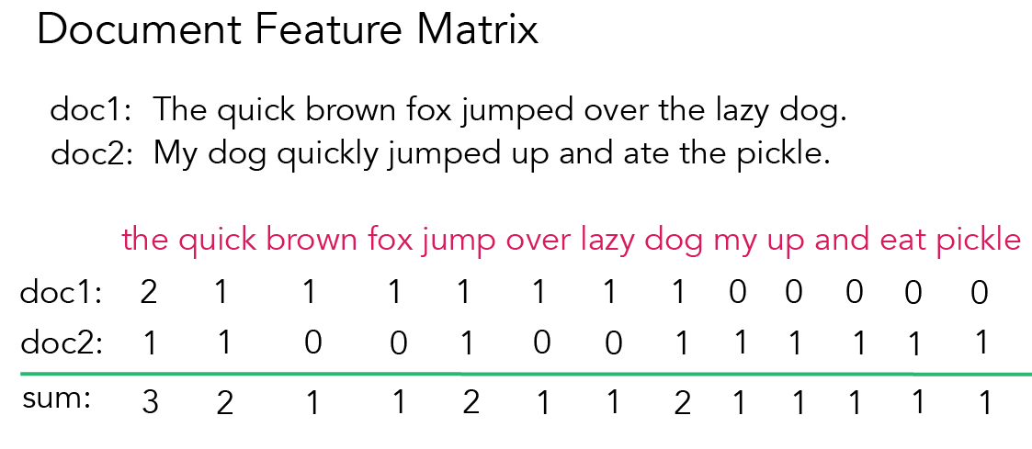
Document Term Matrix (DTM) or Feature Matrix (DFM)
Let’s consider two language samples
To transform this sample into a DTM involves tokenizing and counting each unique token…

Slide 15
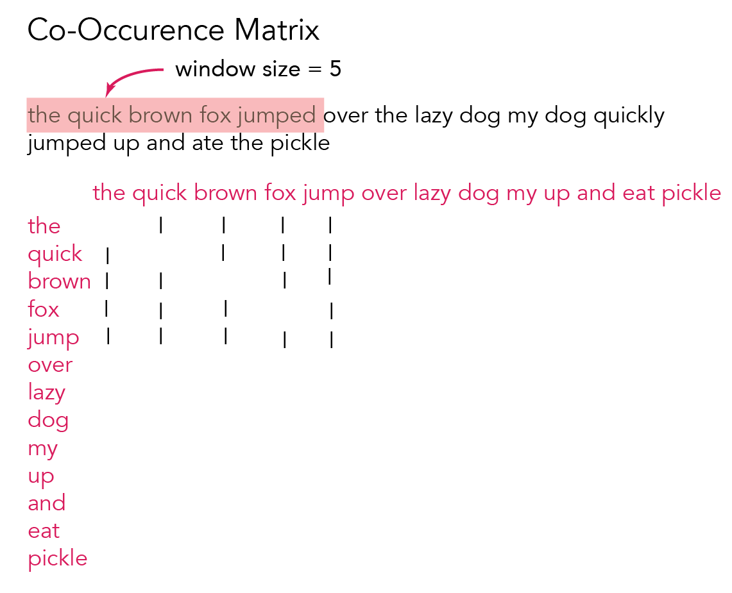
Co-Occurrence Matrix
Matrices with many empty observations are mathematically considered sparse.
e.g.. p(astronaut|kangaroo)

Slide 16
Stopwords
In many NLP analyses, we omit stopwords
Semantically empty but highly frequent and will overwhelm content words in most count analyses
Open class words (content words)
Nouns, verbs, adjectives, adverbs
Closed class words (function words)
Pronouns, prepositions, conjunctions, determiners
Stopwords
We created a custom list using POS tagging.
In R we pattern match a target text using regular expressions to search and replace stopwords with nothing….

Slide 17
Functions
There’s no way to avoid writing functions in NLP
Format:
myfunc <- function(mystring) {
x <- mystring
x <- x %>% gsub("[[:punct:]]”, “”)
return(x)
}
Create a few functions you might find useful
e.g., sub out a stopword from a text sample

Slide 18
Regular Expressions (regex)
YouTube Tutorial
Link to stringr introduction and cheatsheet
1950s Stephen Kleene
Algebraic notation for modeling nervous system behavior
Adopted by computer science for string matching
Literal characters (e.g., search ‘e’ in ’pets are fun’)
[\^$.|?*+()
Must ‘escape’ with \ to search a special character
Character sets
g[eo]t will retrieve ‘get’ or ‘got’ one time only!

Slide 19
More Regex
Ranges (hyphen)
[0-9] matches a single digit from 0 to 9
Anchors (match positions in string)
^ start of a string
$ end of a string
\b word boundary
Alternation (or)
cat|dog
Repetition
* match a character 0 or more times

Slide 20
CORPUS ANALYICS

Slide 21
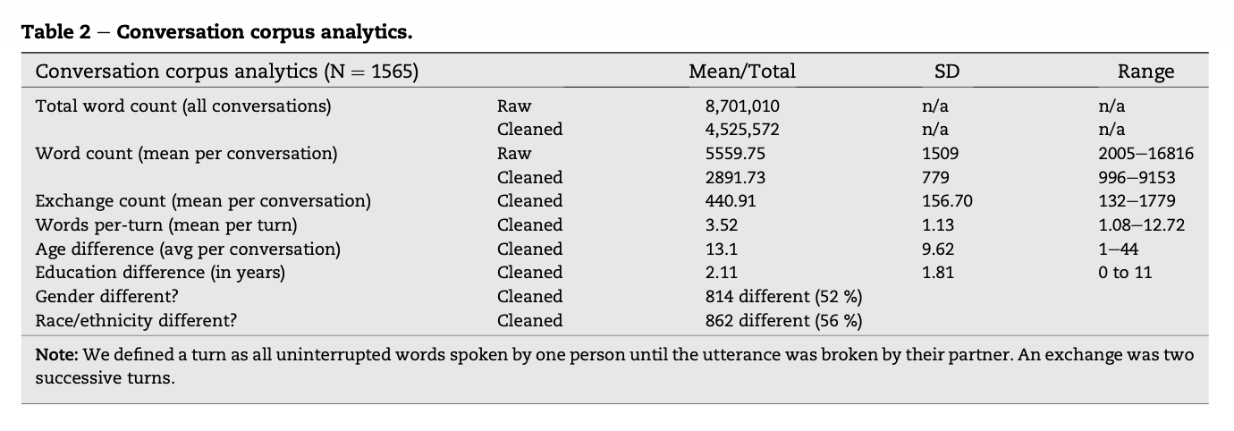
Corpus Analytics
Descriptive statistics but for words
Complexity (length, etc.)
Diversity (sample attributes)
Describe corpus before/after cleaning
Word count, sentence count

Slide 22
Quanteda Does Some for You
<link to R package documentation for Quanteda>

Slide 23
DATABASE JOINS

